Slide 1
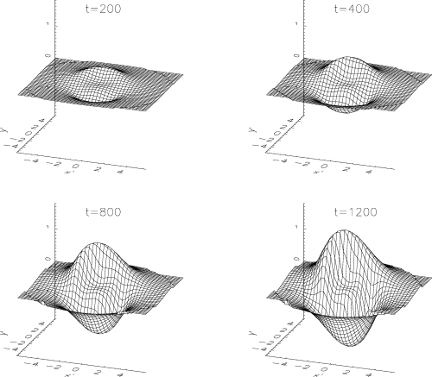
Figure 1 Snapshots of the shape of a massless accretion disc warped by a stellar ring of radius R = 2 inclined at ...
Notes:
Figure 1 Snapshots of the shape of a massless accretion disc warped by a stellar ring of radius R = 2 inclined at angle β=π/4 with respect to the disc. The snapshots are for four different times, as indicated at the top of each panel. The time unit is 1/ΩK(R = 1) = 1400 r3/2pcM8 yr. At times larger than those used in the figure, the disc becomes warped so much that, looking from its initially non-warped plane, the plane equation z′(x′, y′) becomes a multiple-valued function for some (x′, y′). In reality, non-linear effects will limit the growth of the warp.
Unless provided in the caption above, the following copyright applies to the content of this slide: © 2005 RAS

Slide 2
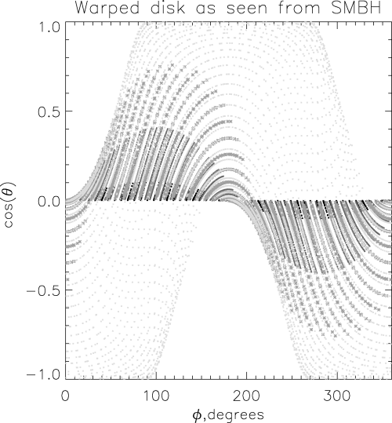
Figure 2 The accretion disc surface as seen from the SMBH location for four different times: t = 100, 400, 800 and ...
Notes:
Figure 2 The accretion disc surface as seen from the SMBH location for four different times: t = 100, 400, 800 and 3200 for the black, dark grey, grey crosses and light grey dots, respectively. (The disc is represented as a sequence of tilted rings that can be clearly seen in the figure as a sine-wave sequence of symbols.) Note that at the largest time most of the available solid angle is obscured by the strongly warped disc.
Unless provided in the caption above, the following copyright applies to the content of this slide: © 2005 RAS

