Slide 1
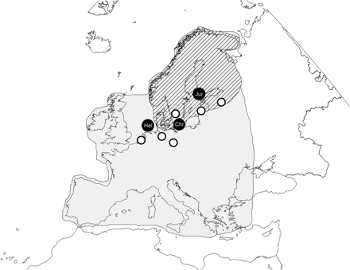
Fig. 1 Map of Europe presenting the three ringing stations (black circles, Hel: Heligoland; Chr: Christiansø; and ...
Notes:
Fig. 1 Map of Europe presenting the three ringing stations (black circles, Hel: Heligoland; Chr: Christiansø; and Jur: Jurmo) and locations of the eight weather stations from where temperature data was taking (circles). Gray area roughly indicates the area included in the NDVI measurement (se text for details) and the broad breeding range of the species included in the study are also indicated (striped area; Rabøl and Rahbek 2002; Bønløkke et al. 2006).
Unless provided in the caption above, the following copyright applies to the content of this slide: © The Author 2010. Published by Oxford University Press on behalf of the Society for Integrative and Comparative Biology. All rights reserved. For permissions please email: journals.permissions@oxfordjournals.org.

Slide 2
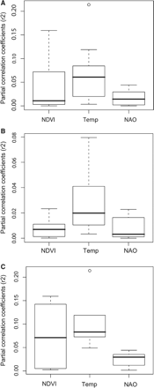
Fig. 2 Comparing the unique variation explained by spring NDVI, spring temperature, and winter NAO (see text for ...
Notes:
Fig. 2 Comparing the unique variation explained by spring NDVI, spring temperature, and winter NAO (see text for details) for all species (A), short-distance migrants (B), and long-distance migrants (C), respectively. Figures are box plots of the squared standard partial correlation coefficients (). Note the different scales to facilitate comparisons within groups.
Unless provided in the caption above, the following copyright applies to the content of this slide: © The Author 2010. Published by Oxford University Press on behalf of the Society for Integrative and Comparative Biology. All rights reserved. For permissions please email: journals.permissions@oxfordjournals.org.

Slide 3
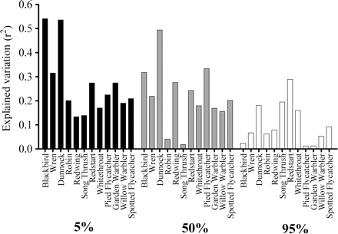
Fig. 3 Degree of explained variation (r²) in passage day for 12 migratory songbirds when including spring ...
Notes:
Fig. 3 Degree of explained variation (r2) in passage day for 12 migratory songbirds when including spring NDVI, spring temperature, and winter NAO in general linear regression models for three phases of migration (first 5, 50, and 95% of the total number of trapped individuals).
Unless provided in the caption above, the following copyright applies to the content of this slide: © The Author 2010. Published by Oxford University Press on behalf of the Society for Integrative and Comparative Biology. All rights reserved. For permissions please email: journals.permissions@oxfordjournals.org.

Slide 4
Fig. 5 Mean effect of spring NDVI, spring temperature and winter NAO on the arrival day in short- and long-distance ...
Notes:
Fig. 5 Mean effect of spring NDVI, spring temperature and winter NAO on the arrival day in short- and long-distance migrants (dark and light bars, respectively) for the 5% migration phase (see text for details). Error bars indicate standard error.
Unless provided in the caption above, the following copyright applies to the content of this slide: © The Author 2010. Published by Oxford University Press on behalf of the Society for Integrative and Comparative Biology. All rights reserved. For permissions please email: journals.permissions@oxfordjournals.org.

Slide 5
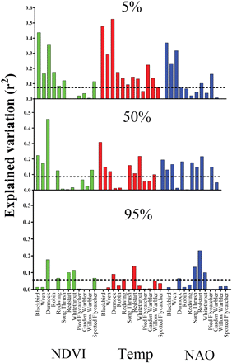
Fig. 4 Degree of variation explained (r²) in passage day for 12 migratory songbirds when doing specific ...
Notes:
Fig. 4 Degree of variation explained (r2) in passage day for 12 migratory songbirds when doing specific general linear regression models for spring NDVI (green bars), spring temperature (red bars), and winter NAO (blue bars) for three phases of migration (first 5, 50, and 95% of the total number of trapped individuals). The dotted line indicates level of significance.
Unless provided in the caption above, the following copyright applies to the content of this slide: © The Author 2010. Published by Oxford University Press on behalf of the Society for Integrative and Comparative Biology. All rights reserved. For permissions please email: journals.permissions@oxfordjournals.org.

