Slide 1
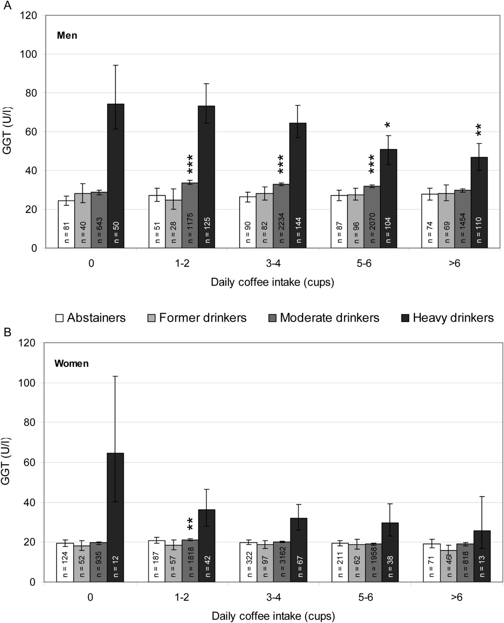
Fig. 1. GGT activities (geometric means ± 95% confidence intervals) in men (A) and women (B), as classified into ...
Notes:
Fig. 1. GGT activities (geometric means ± 95% confidence intervals) in men (A) and women (B), as classified into groups according to alcohol consumption and daily coffee intake. *Group significantly different from the corresponding group of individuals reporting no coffee consumption: *P < 0.05, **P < 0.01, ***P < 0.001. Age, BMI and smoking were used as covariates in all analyses.
Unless provided in the caption above, the following copyright applies to the content of this slide: © The Author 2013. Medical Council on Alcohol and Oxford University Press. All rights reserved

