Slide 1
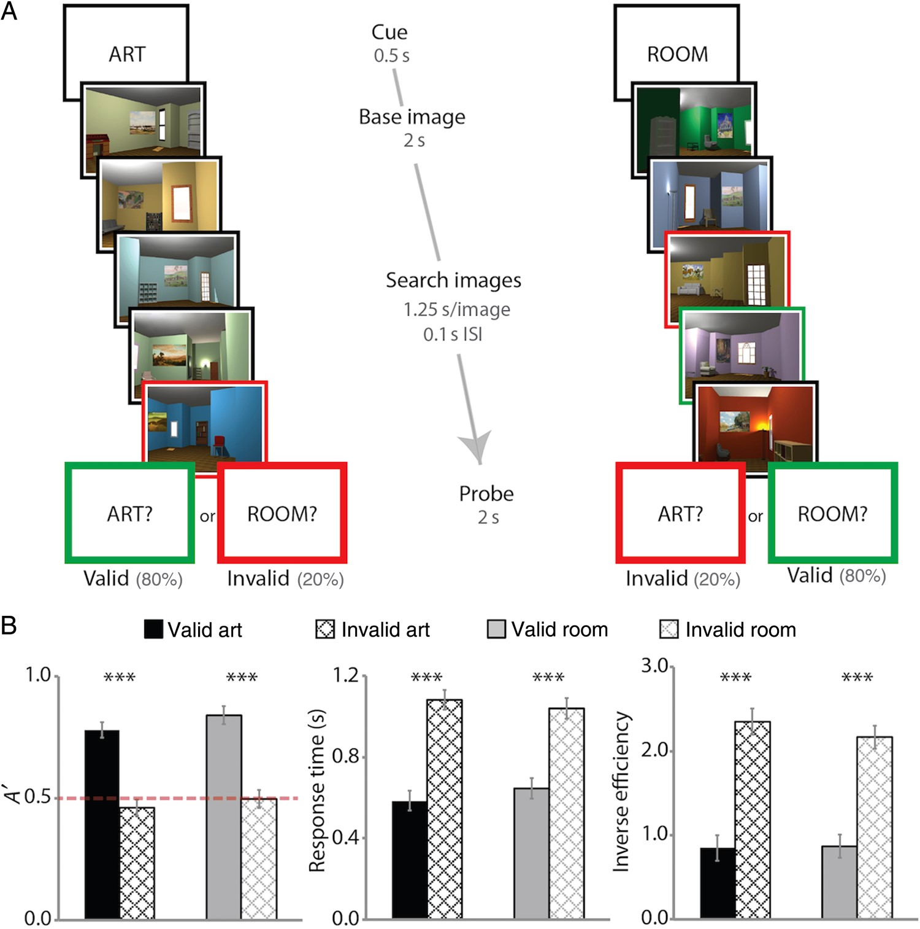
Figure 1. Behavioral task. Two sample trials are depicted (see text for details about task instructions). For ...
Notes:
Figure 1. Behavioral task. Two sample trials are depicted (see text for details about task instructions). For visualization, cued matches are outlined in green and uncued matches in red. (A) Example of an art-state trial, with cued match absent and uncued match present, and a room-state trial, with cued match present and uncued match present. (B) Sensitivity, RT, and inverse efficiency in making present/absent judgment as a function of attentional state and probe type. Error bars depict ±1 SEM of the within-subject valid versus invalid difference. Dashed line indicates chance performance. ***P < 0.001.
Unless provided in the caption above, the following copyright applies to the content of this slide: © The Author 2015. Published by Oxford University Press. All rights reserved. For Permissions, please e-mail: journals.permissions@oup.com

Slide 2
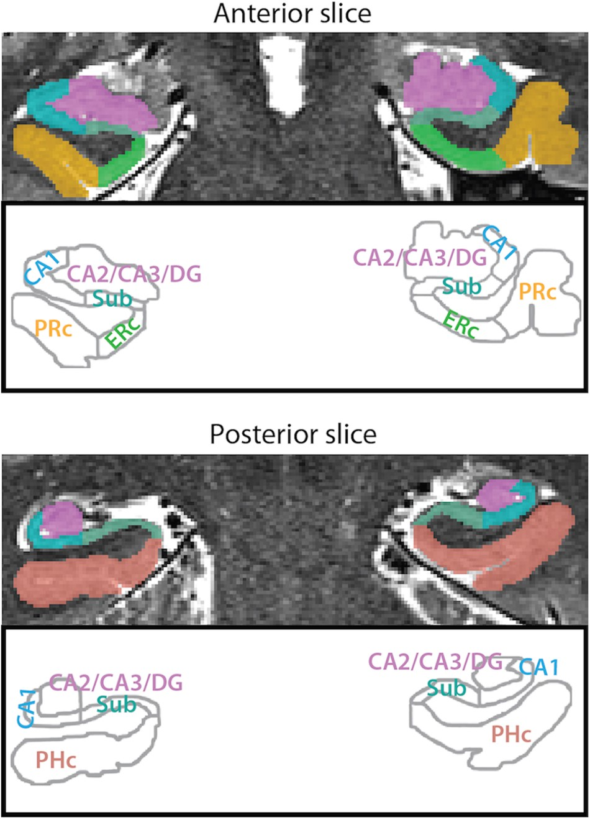
Figure 2. MTL ROIs. Example segmentation from one participant is depicted for an anterior and a posterior slice. ROIs ...
Notes:
Figure 2. MTL ROIs. Example segmentation from one participant is depicted for an anterior and a posterior slice. ROIs consisted of 3 hippocampal subfields (subiculum [Sub], CA1, and CA2/CA3/DG) and 3 MTL cortical regions (PRc, ERc, and PHc). For segmentation guide, see Supplementary Methods.
Unless provided in the caption above, the following copyright applies to the content of this slide: © The Author 2015. Published by Oxford University Press. All rights reserved. For Permissions, please e-mail: journals.permissions@oup.com

Slide 3
Figure 3. Attentional modulation of univariate activity. BOLD activity evoked in the art and room states was extracted ...
Notes:
Figure 3. Attentional modulation of univariate activity. BOLD activity evoked in the art and room states was extracted from all voxels in each ROI and averaged. Baseline corresponds to unmodeled periods of passive viewing of a blank screen. In MTL cortex, PHc and ERc were more active in the room state and PRc was more active in the art state. In the hippocampus, CA1 and CA2/CA3/DG were also more active in the art state (or deactivated in the room state). Error bars depict ±1 SEM of the within- subject art versus room state difference. *P < 0.05, **P < 0.01, ***P < 0.001.
Unless provided in the caption above, the following copyright applies to the content of this slide: © The Author 2015. Published by Oxford University Press. All rights reserved. For Permissions, please e-mail: journals.permissions@oup.com

Slide 4
Figure 4. State-dependent pattern similarity. BOLD activity evoked in the art and room states was extracted from all ...
Notes:
Figure 4. State-dependent pattern similarity. BOLD activity evoked in the art and room states was extracted from all voxels in each ROI and correlated across trials of the same versus different states. In MTL cortex, all regions showed greater pattern similarity for same versus different states. In the hippocampus, all subfields showed greater pattern similarity for same versus different states. Results are shown as Pearson correlations, but statistical tests were performed only after applying the Fisher transformation. Error bars depict ±1 SEM of the within-subject same versus different state difference. ***P < 0.001.
Unless provided in the caption above, the following copyright applies to the content of this slide: © The Author 2015. Published by Oxford University Press. All rights reserved. For Permissions, please e-mail: journals.permissions@oup.com

Slide 5
Figure 5. Comparison of pattern similarity between states. BOLD activity was extracted from all voxels in each ROI and ...
Notes:
Figure 5. Comparison of pattern similarity between states. BOLD activity was extracted from all voxels in each ROI and separately correlated across trials of the art and room states, respectively. In MTL cortex, PHc and ERc showed greater pattern similarity for room versus art states, and PRc showed no difference. In the hippocampus, all subfields showed greater pattern similarity for room versus art states. Results are shown as Pearson correlations, but statistical tests were performed only after applying the Fisher transformation. Error bars depict ±1 SEM of the within-subject art- versus room-state difference. **P < 0.01, ***P < 0.001.
Unless provided in the caption above, the following copyright applies to the content of this slide: © The Author 2015. Published by Oxford University Press. All rights reserved. For Permissions, please e-mail: journals.permissions@oup.com

Slide 6
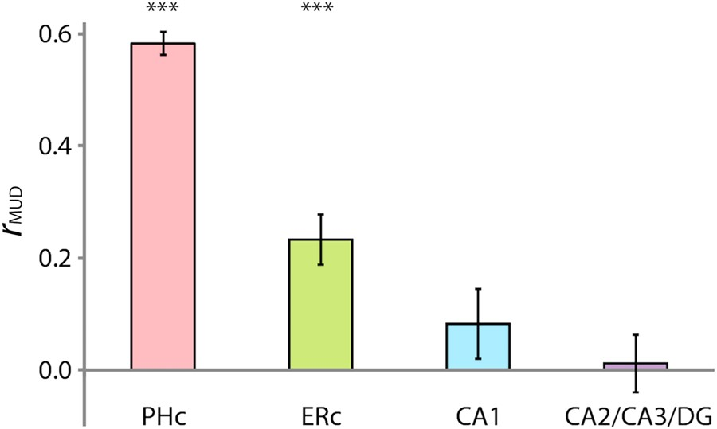
Figure 6. Multivariate-univariate dependence (MUD) analysis. The contribution of each voxel to pattern similarity was ...
Notes:
Figure 6. Multivariate-univariate dependence (MUD) analysis. The contribution of each voxel to pattern similarity was estimated by normalizing BOLD activity over voxels within an ROI for each trial and computing pairwise products across trials. Average products from room trials were then correlated with average activity in room trials over voxels to estimate MUD. In MTL cortex, PHc and ERc showed a positive relationship between activity and pattern similarity. In the hippocampus, CA1 and CA2/CA3/dentate gyrus (DG) showed no relationship. Error bars depict ±1 SEM across participants. Results are shown as Pearson correlations, but statistical tests were performed only after applying the Fisher transformation. ***P < 0.001.
Unless provided in the caption above, the following copyright applies to the content of this slide: © The Author 2015. Published by Oxford University Press. All rights reserved. For Permissions, please e-mail: journals.permissions@oup.com

Slide 7
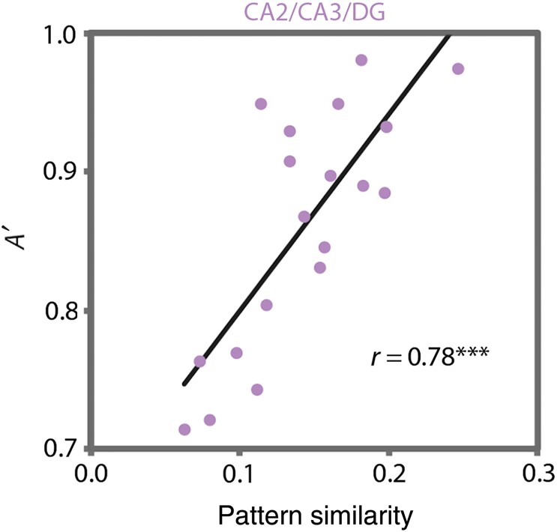
Figure 7. Brain–behavior relationships. Individual differences in room-state pattern similarity in CA2/CA3/DG were ...
Notes:
Figure 7. Brain–behavior relationships. Individual differences in room-state pattern similarity in CA2/CA3/DG were strongly correlated with individual differences in behavioral performance (A′) on the room task. This effect was specific to this region, to the room task, and to the pattern similarity measure. ***P < 0.001.
Unless provided in the caption above, the following copyright applies to the content of this slide: © The Author 2015. Published by Oxford University Press. All rights reserved. For Permissions, please e-mail: journals.permissions@oup.com

