Slide 1
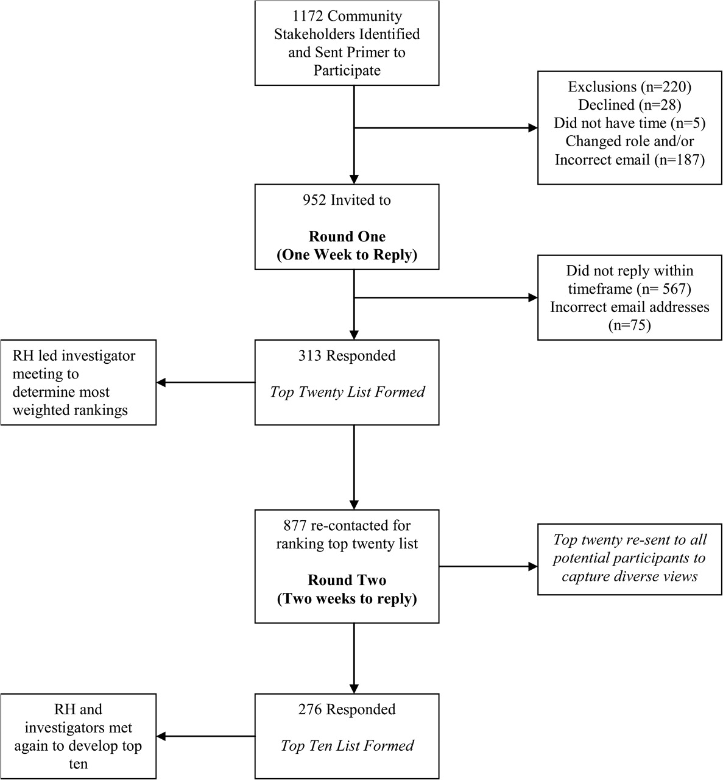
FIGURE 1 Illustration of modified Delphi process
Notes:
FIGURE 1 Illustration of modified Delphi process
Unless provided in the caption above, the following copyright applies to the content of this slide: © 2010 The AuthorsThis is an Open Access article distributed under the terms of the Creative Commons Attribution Non-Commercial License (http://creativecommons.org/licenses?by-nc/2.5), which permits unrestricted non-commercial use distribution, and reproduction in any medium, provided the original work is properly cited.

Slide 2
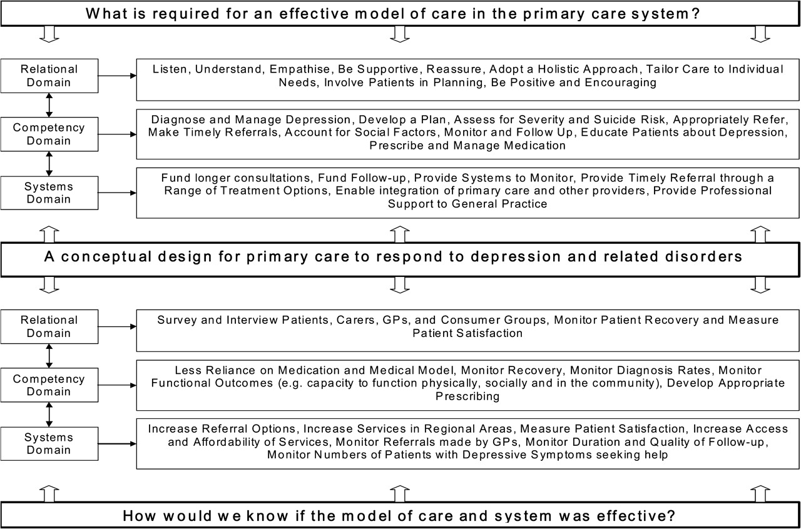
FIGURE 2 A conceptual design for a primary care response to depression
Notes:
FIGURE 2 A conceptual design for a primary care response to depression
Unless provided in the caption above, the following copyright applies to the content of this slide: © 2010 The AuthorsThis is an Open Access article distributed under the terms of the Creative Commons Attribution Non-Commercial License (http://creativecommons.org/licenses?by-nc/2.5), which permits unrestricted non-commercial use distribution, and reproduction in any medium, provided the original work is properly cited.

