Slide 1
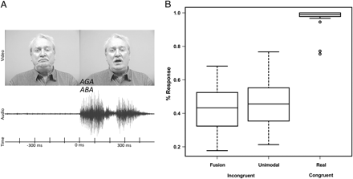
Figure 1. Trial and timing overview with relative responses. (A) Example trial with 2 video frames from a video used in ...
Notes:
Figure 1. Trial and timing overview with relative responses. (A) Example trial with 2 video frames from a video used in this experiment (top row), the audio trace of the syllable “aba” presented simultaneously to the video (middle row). Mouth movement and audio onset occur at time 0 ms. The interval prior to this is referred to as “prestimulus.” (B) Box plot with responses relative to the total number of trials per category. On average, matching trials were correctly identified in 96.19% of cases. A “fusion” percept was reported in 41.61% of mismatching trials, whereas a “unimodal” percept was reported 48.02% of the time.
Unless provided in the caption above, the following copyright applies to the content of this slide: © The Author 2011. Published by Oxford University Press. All rights reserved. For permissions, please e-mail: journals.permissions@oup.com

Slide 2
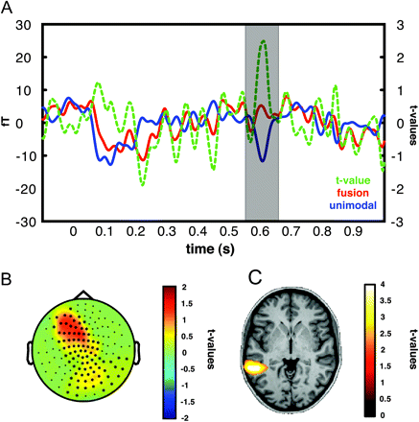
Figure 2. Summarized results of the time-course analysis. (A) Event-related field trace of the positive sensor cluster ...
Notes:
Figure 2. Summarized results of the time-course analysis. (A) Event-related field trace of the positive sensor cluster for the “fusion” (red) and “unimodal” (blue) trials as well as the t values for the comparison between the 2 conditions (green). (B) Topography (t values, fusion vs. unimodal trials) of the positive sensor cluster (masked for statistical significance) found in the statistical analysis between 550 and 650 ms after sound onset. (C) Source projection (t values, fusion vs. unimodal trials) of the effect found in the event-related field analysis based on the LCMV analysis masked for statistical significance.
Unless provided in the caption above, the following copyright applies to the content of this slide: © The Author 2011. Published by Oxford University Press. All rights reserved. For permissions, please e-mail: journals.permissions@oup.com

Slide 3
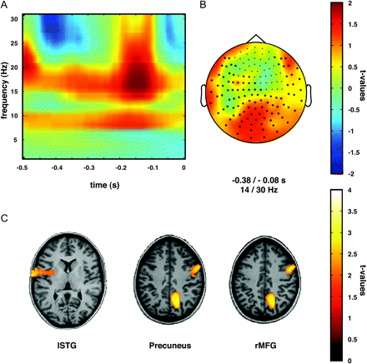
Figure 3. Summarized results of the prestimulus time–frequency analysis. (A) Time–frequency representation of the ...
Notes:
Figure 3. Summarized results of the prestimulus time–frequency analysis. (A) Time–frequency representation of the prestimulus interval at sensor level for the comparison between “fusion” and “unimodal” trials. Time 0 ms indicates the onset of mouth movement and audio stream. (B) Topography (14–30 Hz, −380 to −80 ms) of the positive beta-band cluster found in the prestimulus interval at sensor level for the comparison between fusion and unimodal trials. (C) DICS source projection of the beta-band effect found at sensor level. lSTG (left), precuneus (middle), and right middle frontal gyrus (right) were identified as possible generators of the beta-band effect. Displayed are t values of the comparison between trials with a “fusion” percept versus a “unimodal” percept masked for statistical significance.
Unless provided in the caption above, the following copyright applies to the content of this slide: © The Author 2011. Published by Oxford University Press. All rights reserved. For permissions, please e-mail: journals.permissions@oup.com

Slide 4
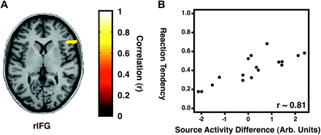
Figure 4. Summary of the correlation between the individual tendency towards a “fusion” percept (0 equals no fusion ...
Notes:
Figure 4. Summary of the correlation between the individual tendency towards a “fusion” percept (0 equals no fusion percept in any trial, 1 equals fusion percept in all trials) and the individual voxelwise power difference values for the comparison between fusion and “unimodal” trials. rIFG (A) displayed a high positive correlation (B) between the individual reaction tendency and the fusion versus unimodal power difference (r ∼ 0.81). Displayed are correlation indices r masked for statistical significance. High values on the reaction tendency indicate a high tendency toward a fusion percept.
Unless provided in the caption above, the following copyright applies to the content of this slide: © The Author 2011. Published by Oxford University Press. All rights reserved. For permissions, please e-mail: journals.permissions@oup.com

Slide 5
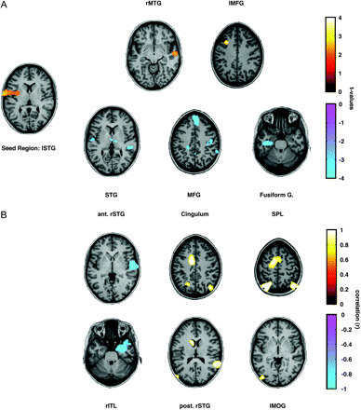
Figure 5. Phase synchrony between the seed region in lSTG (far left) and the whole-brain volume as well as correlation ...
Notes:
Figure 5. Phase synchrony between the seed region in lSTG (far left) and the whole-brain volume as well as correlation with the tendency toward a “fusion” percept. (A) Displayed are t values of the comparison between trials with a fusion percept versus a “unimodal” percept masked for statistical significance. Right middle temporal gyrus (top left) and left middle frontal gyrus (top right) were found to be functionally coupled to the lSTG. Bilateral STG (bottom left), medial frontal gyrus (bottom middle), and left fusiform gyrus (bottom right) were found to be functionally decoupled from the lSTG. (B) Correlation between the tendency toward a fusion percept and the voxelwise difference values for the comparison between fusion and unimodal trials for the phase synchrony with the lSTG. Displayed are correlation indices r masked for statistical significance. Anterior right STG (top left) and right inferior temporal gyrus (bottom left) displayed high negative correlations. Bilateral superior parietal lobule (top right), cingulum (top middle), posterior right STG (bottom middle), and left middle occipital gyrus (bottom right) displayed high positive correlations.
Unless provided in the caption above, the following copyright applies to the content of this slide: © The Author 2011. Published by Oxford University Press. All rights reserved. For permissions, please e-mail: journals.permissions@oup.com

Slide 6
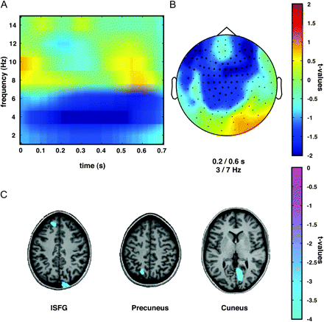
Figure 6. Summarized results of the poststimulus time–frequency analysis. (A) Time–frequency representation of the ...
Notes:
Figure 6. Summarized results of the poststimulus time–frequency analysis. (A) Time–frequency representation of the poststimulus interval at sensor level for the comparison between “fusion” and “unimodal” trials. Time 0 ms indicates the onset of mouth movement and audio stream. (B) Topography (3–7 Hz, 200–600 ms) of the negative theta-band cluster found in the poststimulus interval at sensor level for the comparison between fusion and unimodal trials. (C) DICS source projection of the theta-band effect found at sensor level. Left superior frontal gyrus (left), precuneus (middle), and cuneus (right) were identified as possible generators of the theta-band effect. Displayed are t values of the comparison between trials with a fusion percept versus a unimodal percept masked for statistical significance.
Unless provided in the caption above, the following copyright applies to the content of this slide: © The Author 2011. Published by Oxford University Press. All rights reserved. For permissions, please e-mail: journals.permissions@oup.com

Slide 7
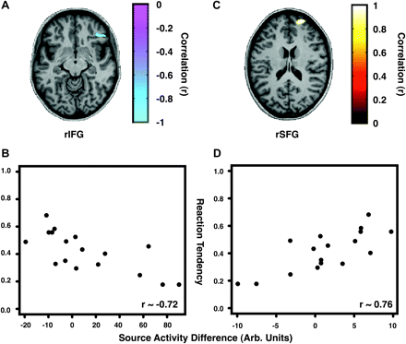
Figure 7. Summary of the correlation between the individual tendency toward a “fusion” percept (0 equals no fusion ...
Notes:
Figure 7. Summary of the correlation between the individual tendency toward a “fusion” percept (0 equals no fusion percept in any trial, 1 equals fusion percept in all trials) and the individual voxelwise power difference values for the comparison between “fusion” and “unimodal” trials. rIFG (A and B) displayed a high negative correlation (r ∼ −0.72) between the individual reaction tendency and the fusion versus unimodal power difference. Right superior frontal gyrus (C and D) displayed a high positive correlation (r ∼ 0.76) between the individual reaction tendency and the fusion versus unimodal power difference. Displayed are correlation indices r masked for statistical significance. High values on the reaction tendency indicate a high tendency toward a fusion percept.
Unless provided in the caption above, the following copyright applies to the content of this slide: © The Author 2011. Published by Oxford University Press. All rights reserved. For permissions, please e-mail: journals.permissions@oup.com

