Slide 1
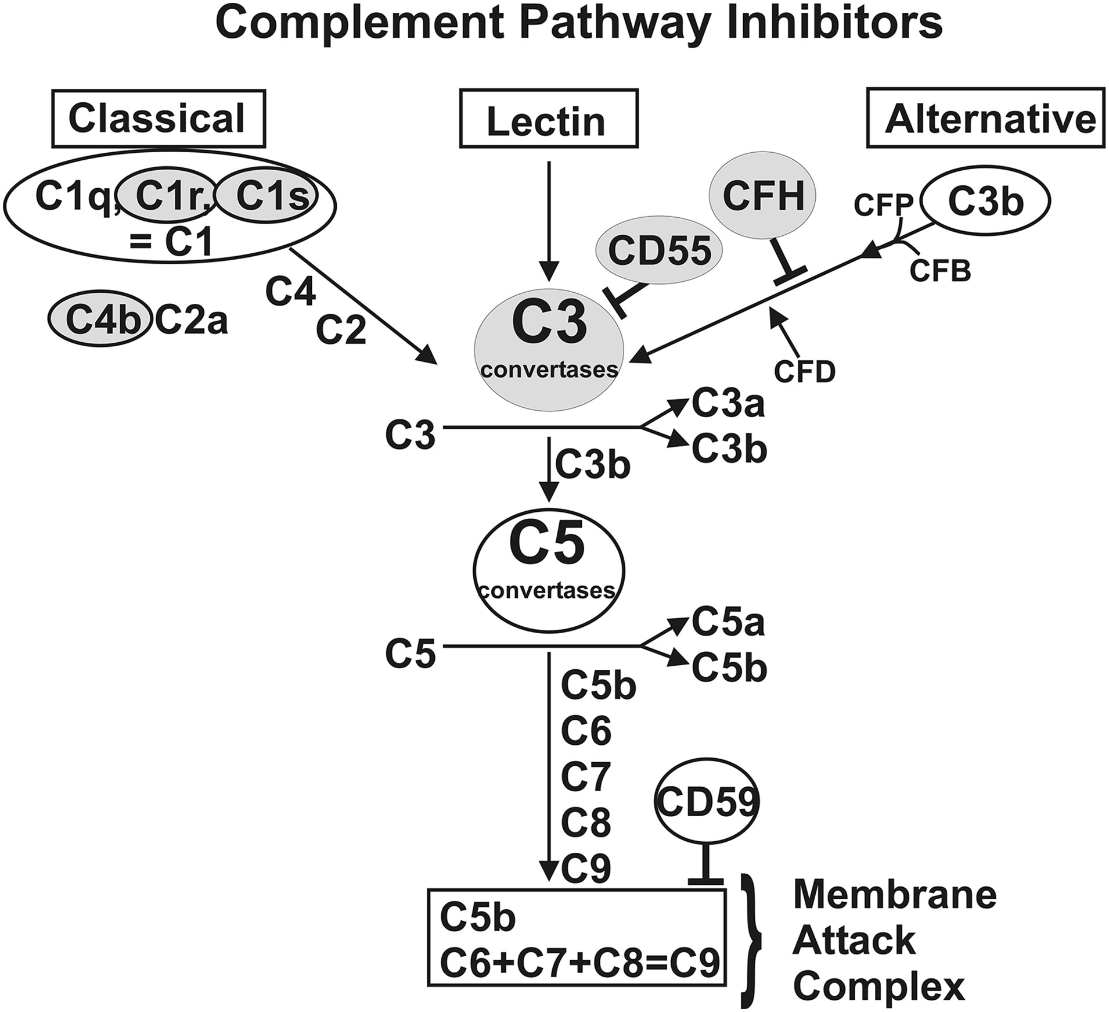
Figure 1. Schematic of the three branches of the complement pathway showing sites where CFH, C3, CD55, C1s, C1r and C4b ...
Notes:
Figure 1. Schematic of the three branches of the complement pathway showing sites where CFH, C3, CD55, C1s, C1r and C4b are located. The CFH is an inhibitor of the alternative complement pathway. CD55 is a critical inhibitor of the C3 convertase step. C1s and C1r are major subunits of C1 component and C4b is a component of C4. The C1s, C1r and C4b are components of the classical complement pathway.
Unless provided in the caption above, the following copyright applies to the content of this slide: © The Author 2014. Published by Oxford University Press. All rights reserved. For Permissions, please email: journals.permissions@oup.com

Slide 2
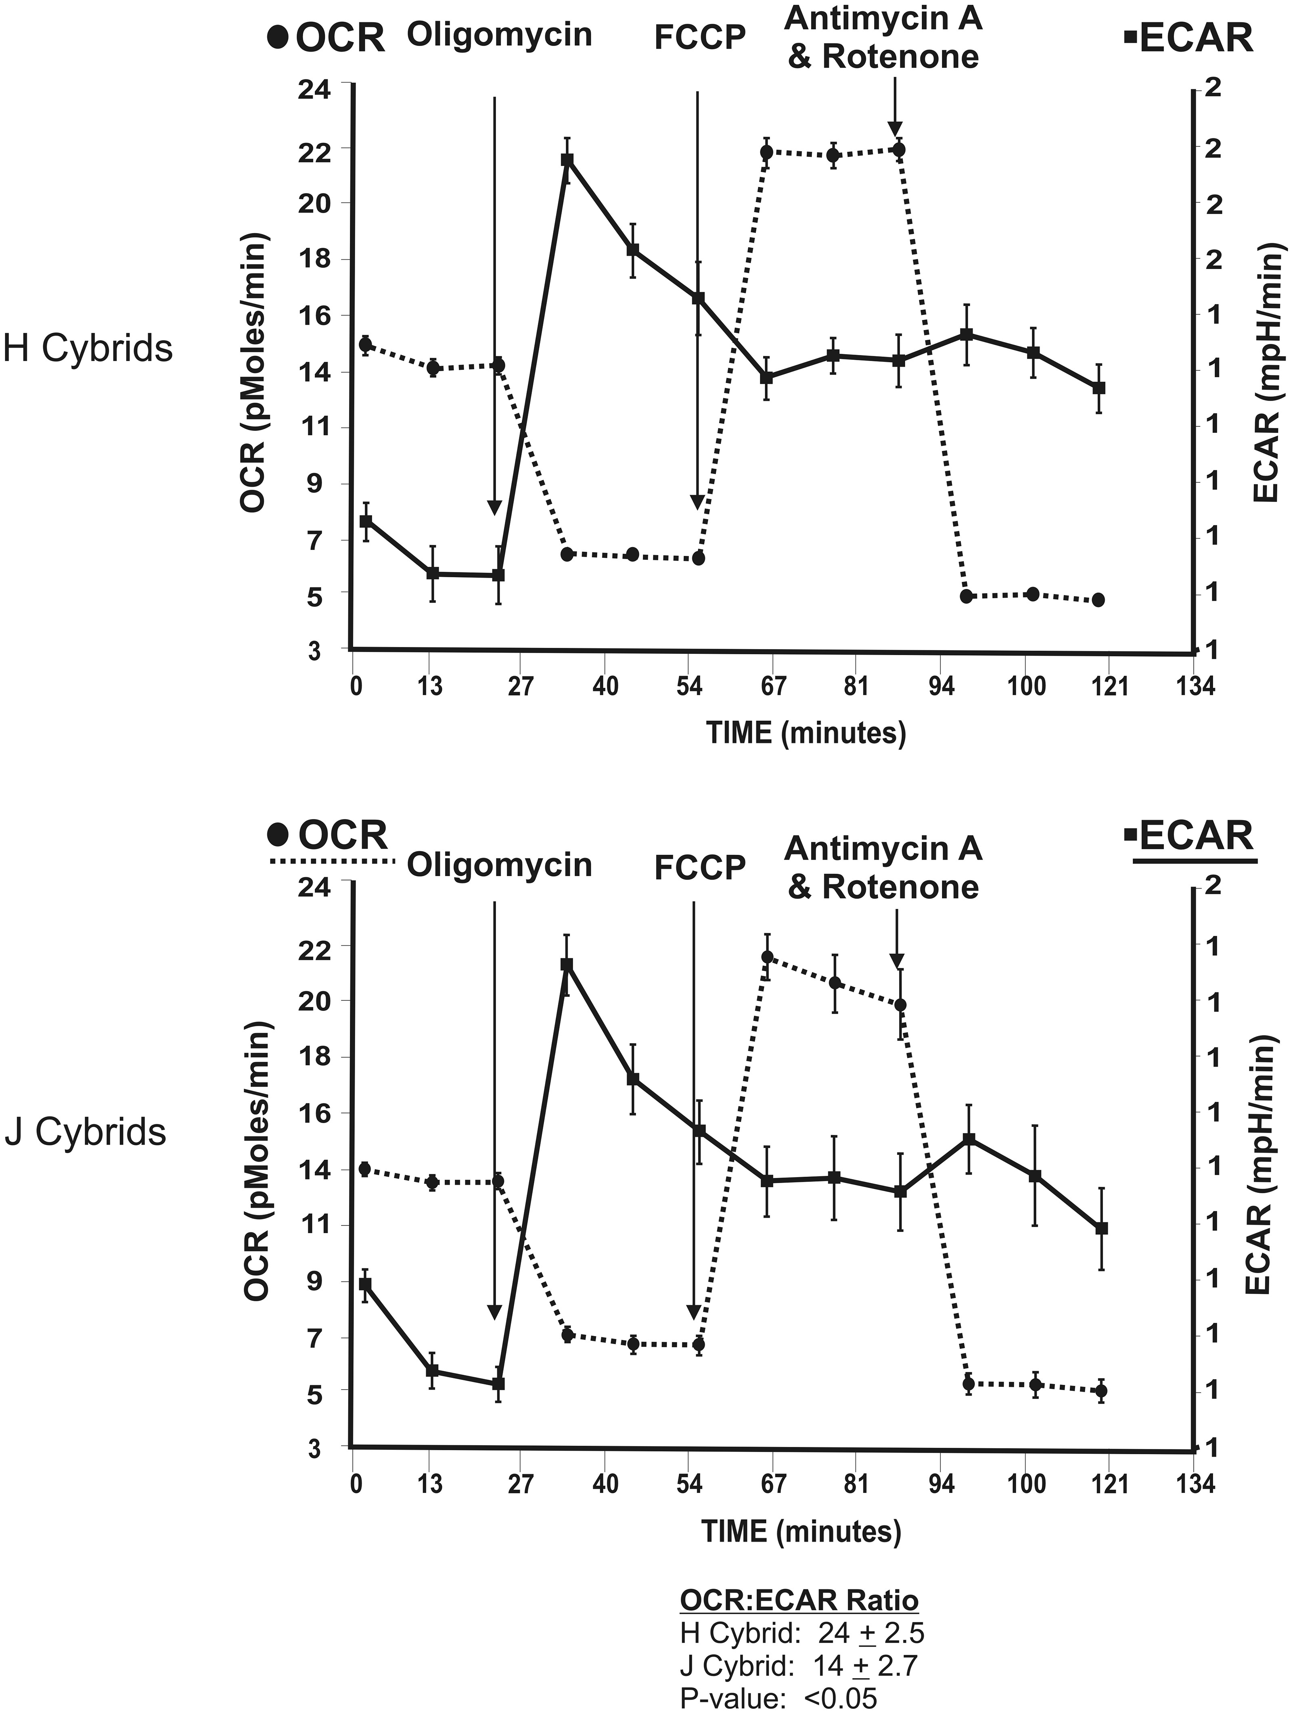
Figure 2. The OCR and ECAR values were measured after sequential treatments with Oligomycin (1 µm), FCCP (1 µm) and ...
Notes:
Figure 2. The OCR and ECAR values were measured after sequential treatments with Oligomycin (1 µm), FCCP (1 µm) and Antimycin A plus Rotenone (1 µm) for the H cybrids (n = 3) and J cybrids (n = 3). The values represent the means ± SEM which were obtained by analyzing four wells per cybrid sample and repeating the experiment twice. Note that the H cybrids versus J cybrids showed similar overall patterns in their responses to the inhibitors and uncoupling agents. However, the OCR:ECAR ratios were significantly different from each other (24 ± 2.5 versus 14 ± 2.7, P < 0.05). OCR, oxygen consumption rate; ECAR, extracellular acidification rate; FCCP, carbonyl cyanide 4-trifluoromethoxy-phenylhydrazone.
Unless provided in the caption above, the following copyright applies to the content of this slide: © The Author 2014. Published by Oxford University Press. All rights reserved. For Permissions, please email: journals.permissions@oup.com

Slide 3
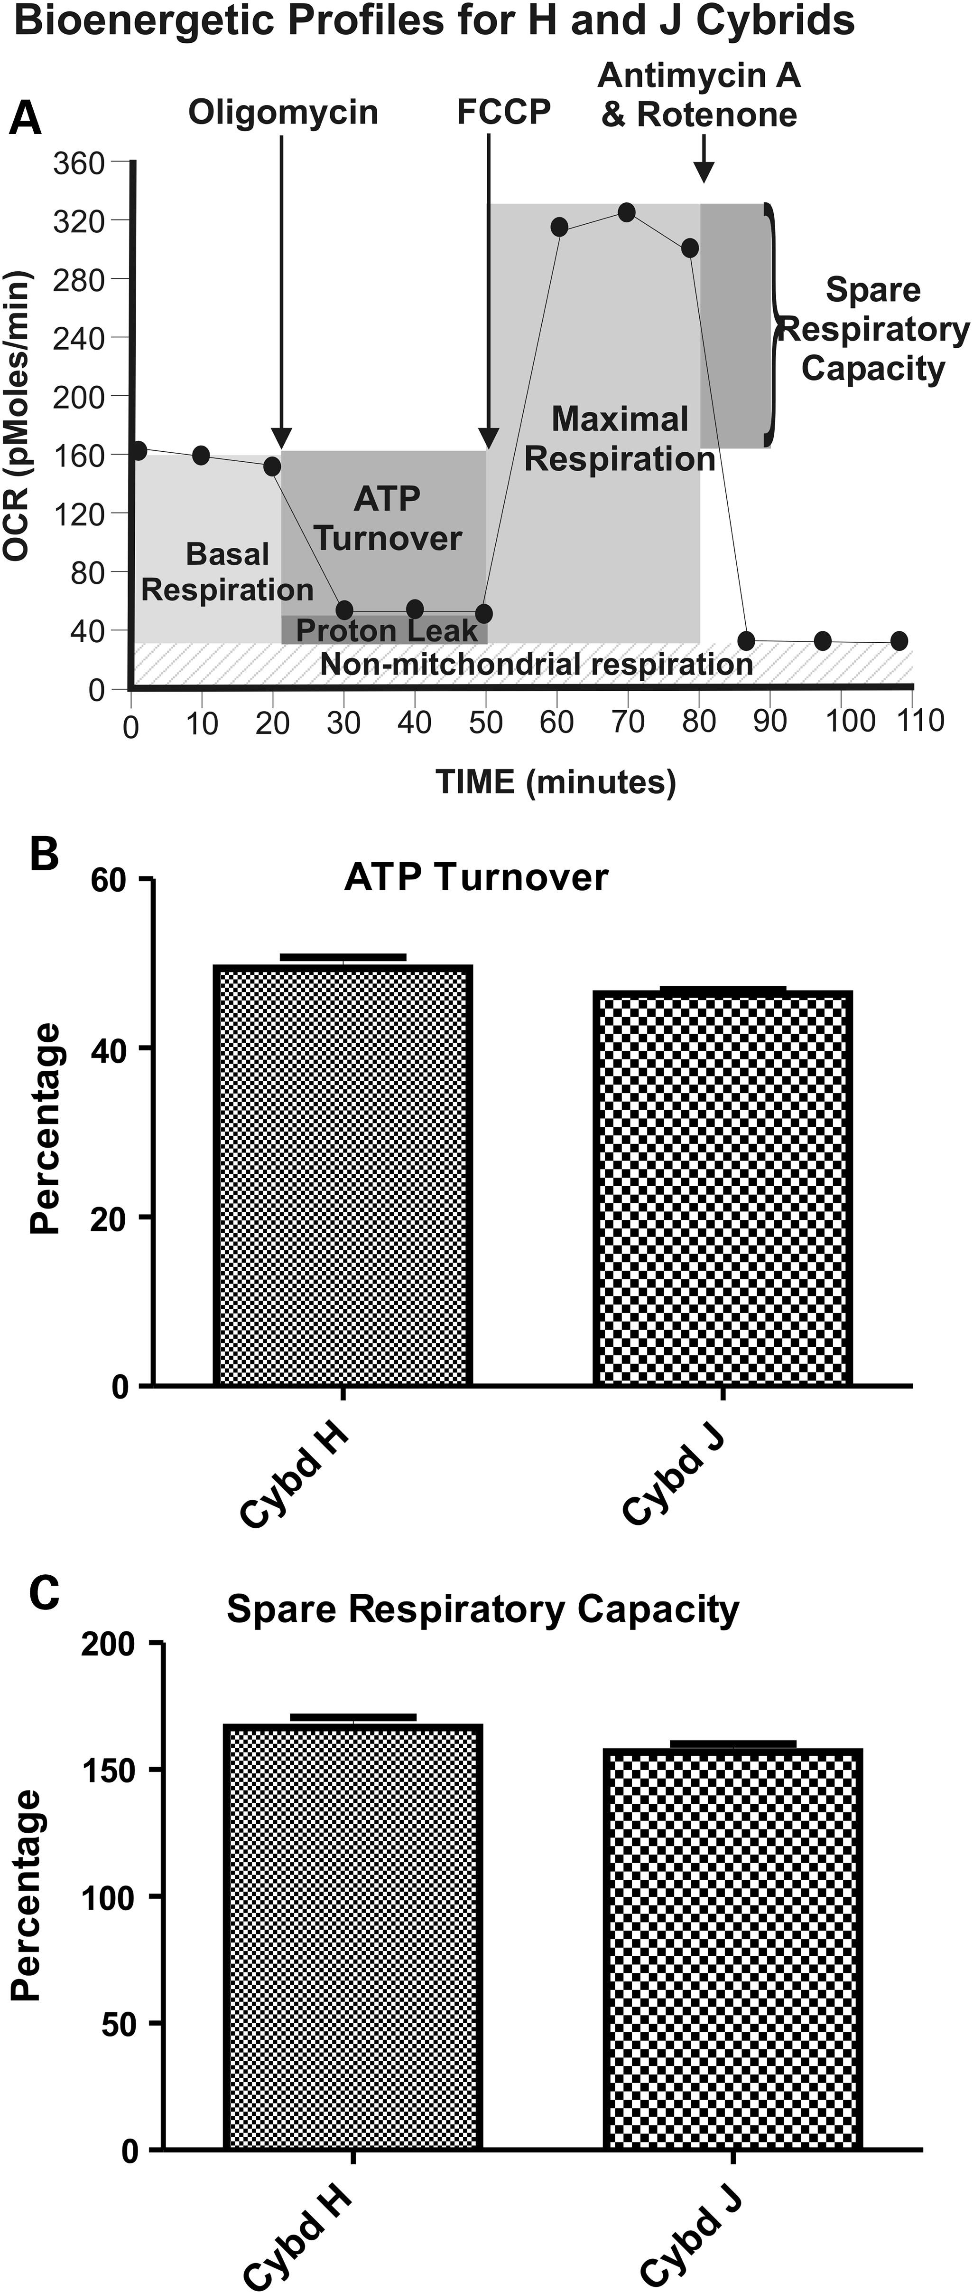
Figure 3. (A) A representative profile measured by the Seahorse XF24 flux analyzer showing OCR and ECAR patterns after ...
Notes:
Figure 3. (A) A representative profile measured by the Seahorse XF24 flux analyzer showing OCR and ECAR patterns after sequential treatment with oligomycin (1 µm), FCCP (1 µm) and Antimycin A plus Rotenone (1 µm), showing the regions that define the basal aerobic respiration, ATP turnover and spare respiratory capacity. (B) The H and J cybrids showed similar responses in ATP turnover after Oligomycin treatment. (C) The H and J cybrids showed similar responses in the spare respiratory capacity measured after FCCP treatment. These data are presented as a % response from the basal readings, with non-mt respiration subtracted out and the basal respiratory rate is normalized to 100%. Cybd, cybrid.
Unless provided in the caption above, the following copyright applies to the content of this slide: © The Author 2014. Published by Oxford University Press. All rights reserved. For Permissions, please email: journals.permissions@oup.com

Slide 4
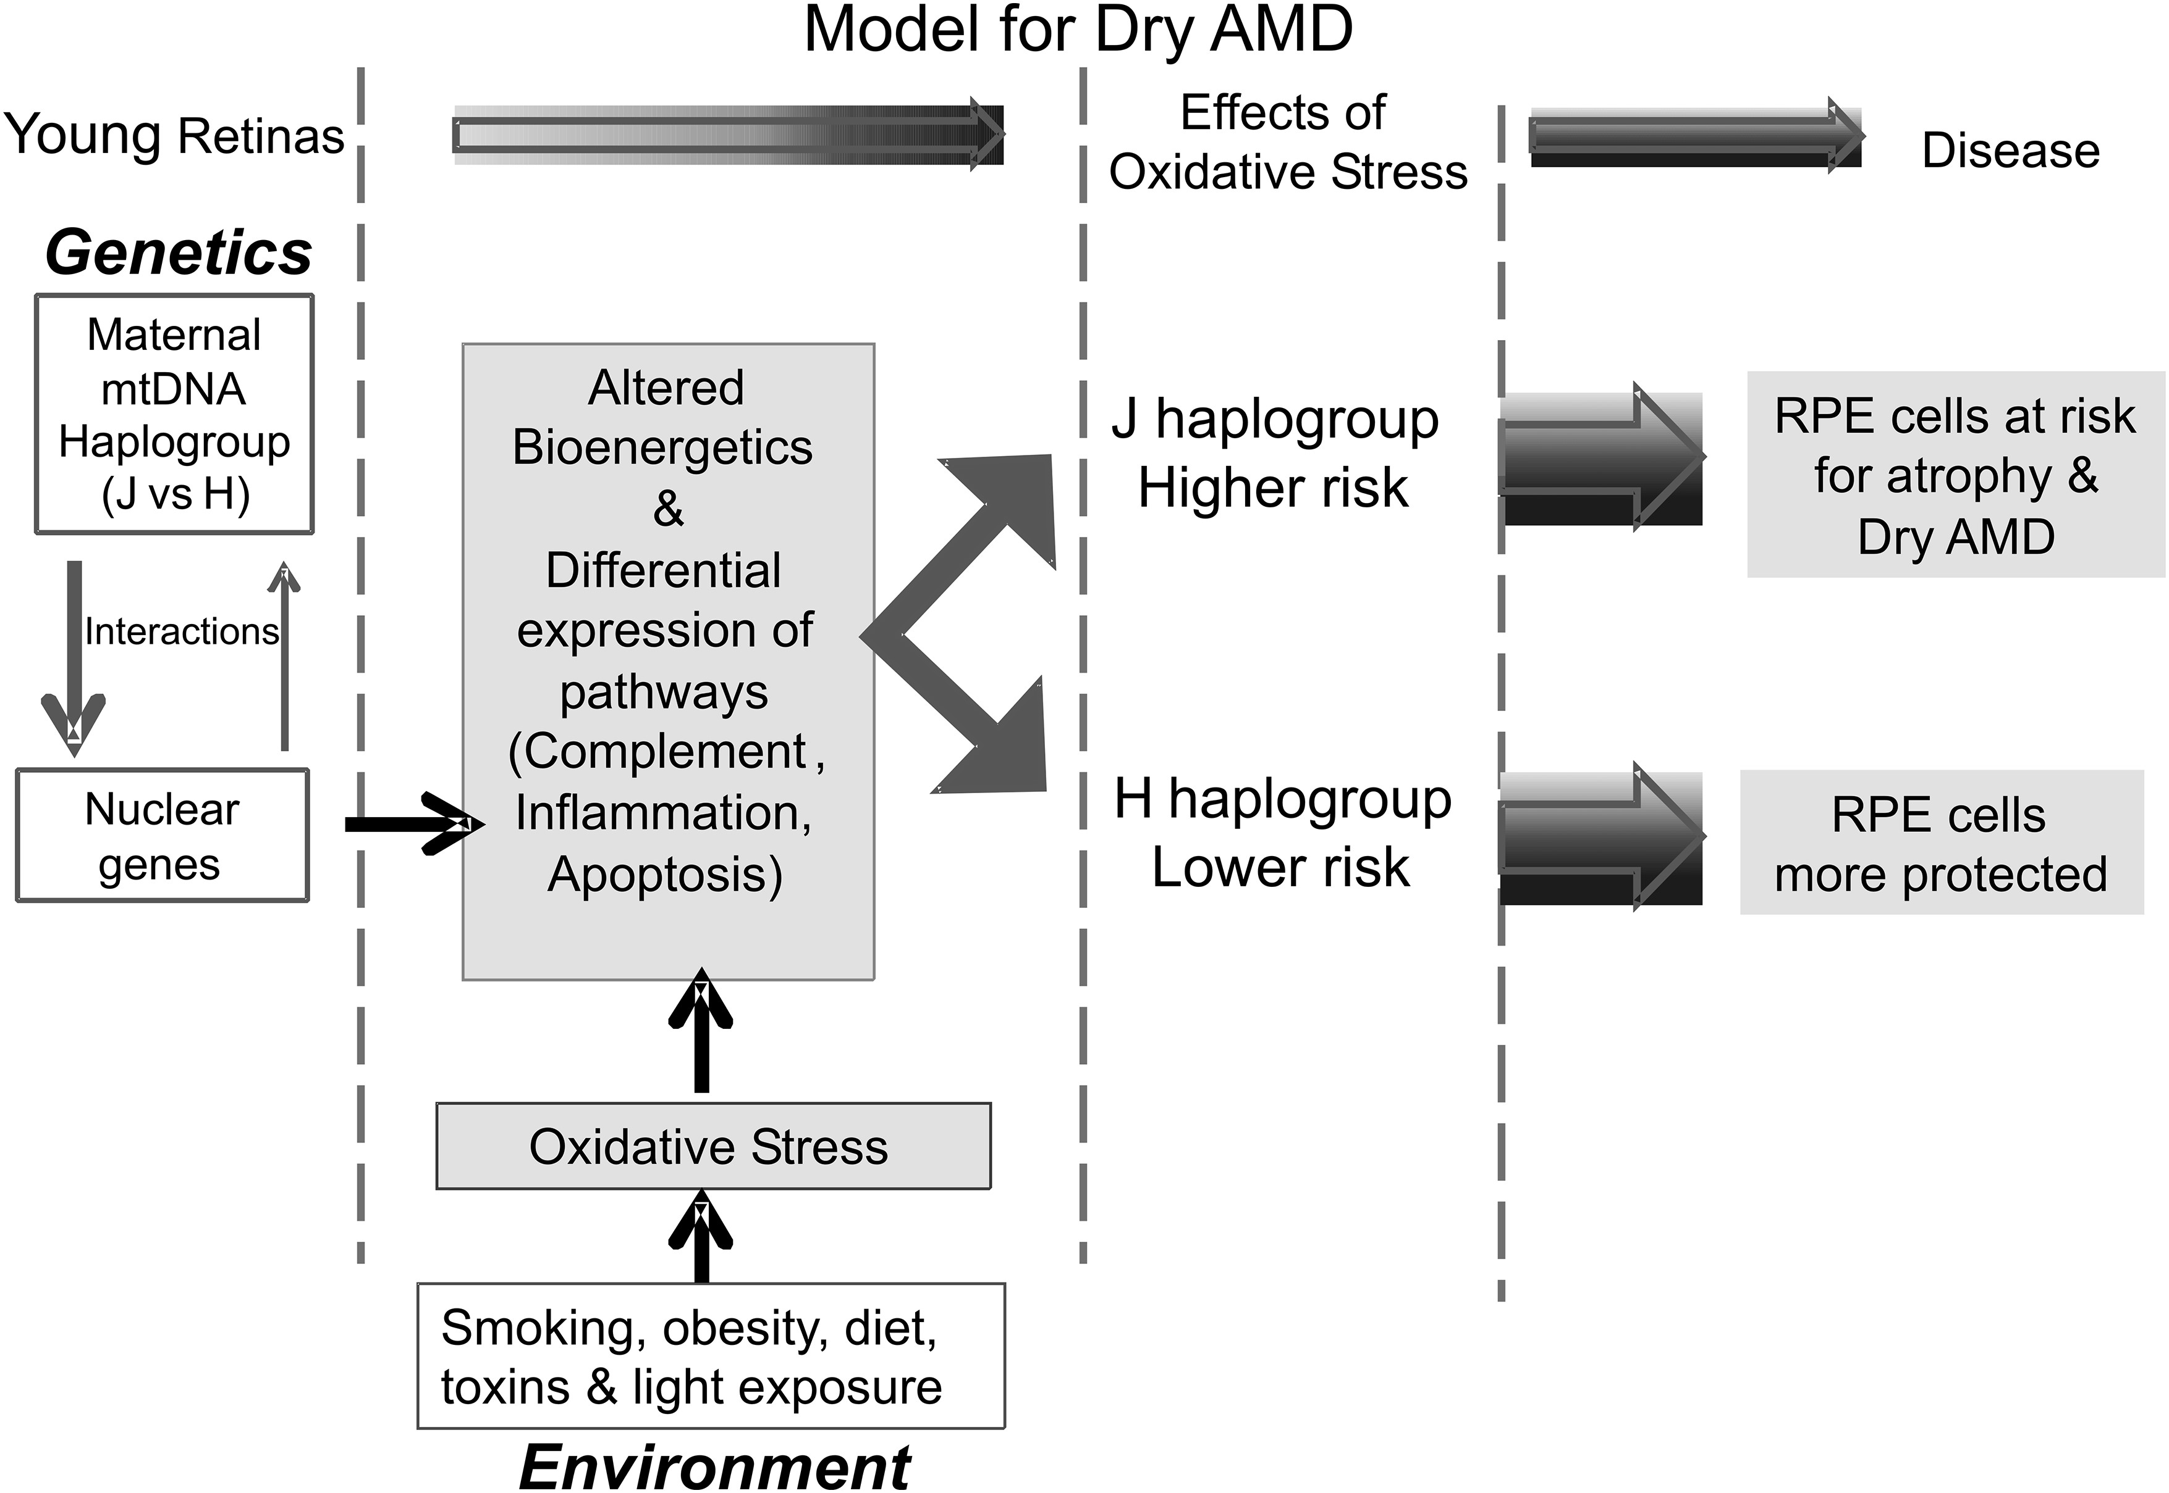
Figure 4. Schematic of new paradigm for mt–nuclear interactions. We propose that individuals have maternally inherited ...
Notes:
Figure 4. Schematic of new paradigm for mt–nuclear interactions. We propose that individuals have maternally inherited mtDNA haplogroups (e.g. H versus J), which acts as a ‘modifier’ for the nuclear genome via constant interactions. The haplogroup pattern mediates a ‘baseline’ of bioenergetics (e.g. energy production, ATP turnover) and nDNA expression levels for specific cellular pathways (e.g. complement, inflammation and apoptosis). As the cells are exposed to different environmental oxidative-stress factors (e.g. smoking, obesity, light exposures), the H haplogroup cells might respond differently than the J haplogroups cells because of the baseline expression levels of major pathways (e.g. complement, inflammation, apoptosis). This in turn may influence which cells undergo mitochondria dysfunction and cell death and which cells are protected and have longevity.
Unless provided in the caption above, the following copyright applies to the content of this slide: © The Author 2014. Published by Oxford University Press. All rights reserved. For Permissions, please email: journals.permissions@oup.com

