Slide 1
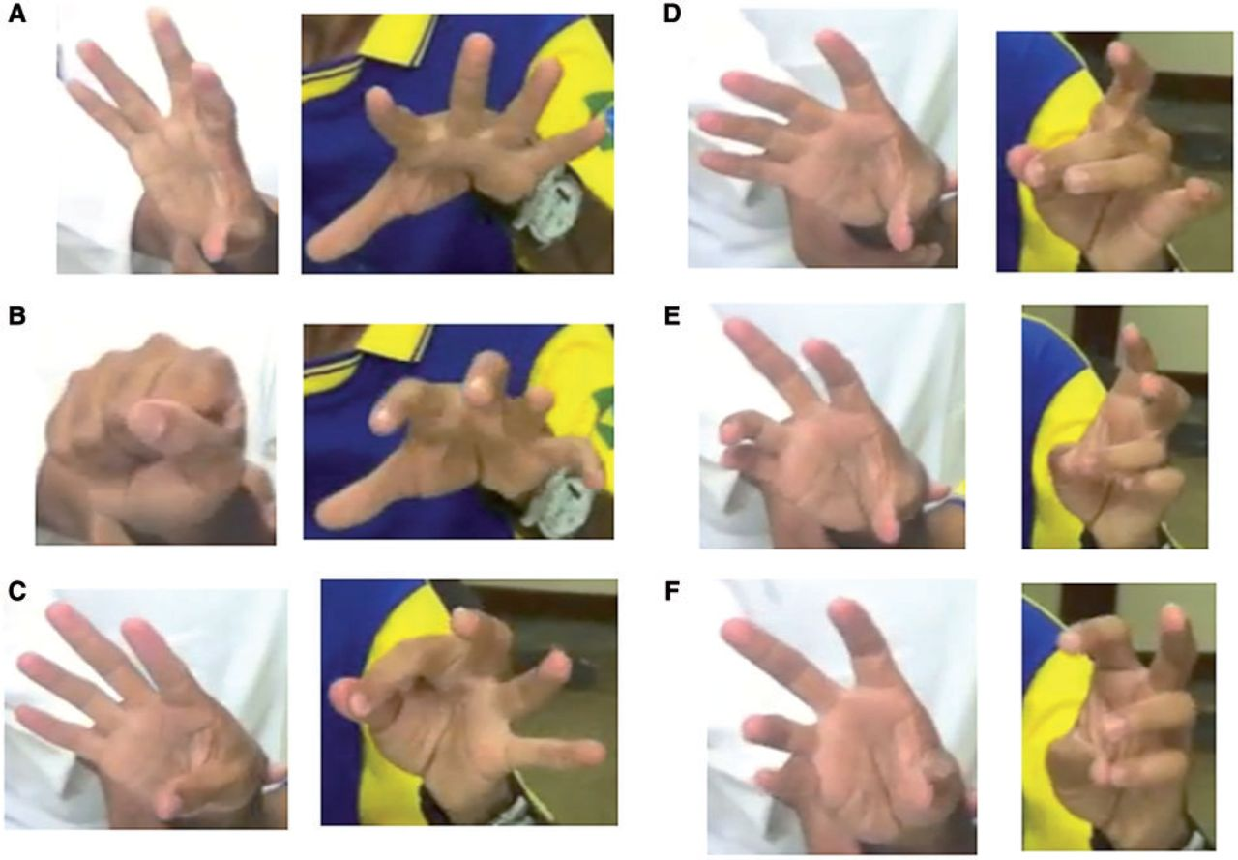
Figure 1 Synkinetic contralateral movements (mirror movements) with distal motor task of the upper limb: (A and B) ...
Notes:
Figure 1 Synkinetic contralateral movements (mirror movements) with distal motor task of the upper limb: (A and B) voluntary hand grip of the right hand, (C–F) intentional alternating finger tapping of the left hand, using from second to fifth hand digits.
Unless provided in the caption above, the following copyright applies to the content of this slide: © The Author (2014). Published by Oxford University Press on behalf of the Guarantors of Brain. All rights reserved. For Permissions, please email: journals.permissions@oup.com

Slide 2
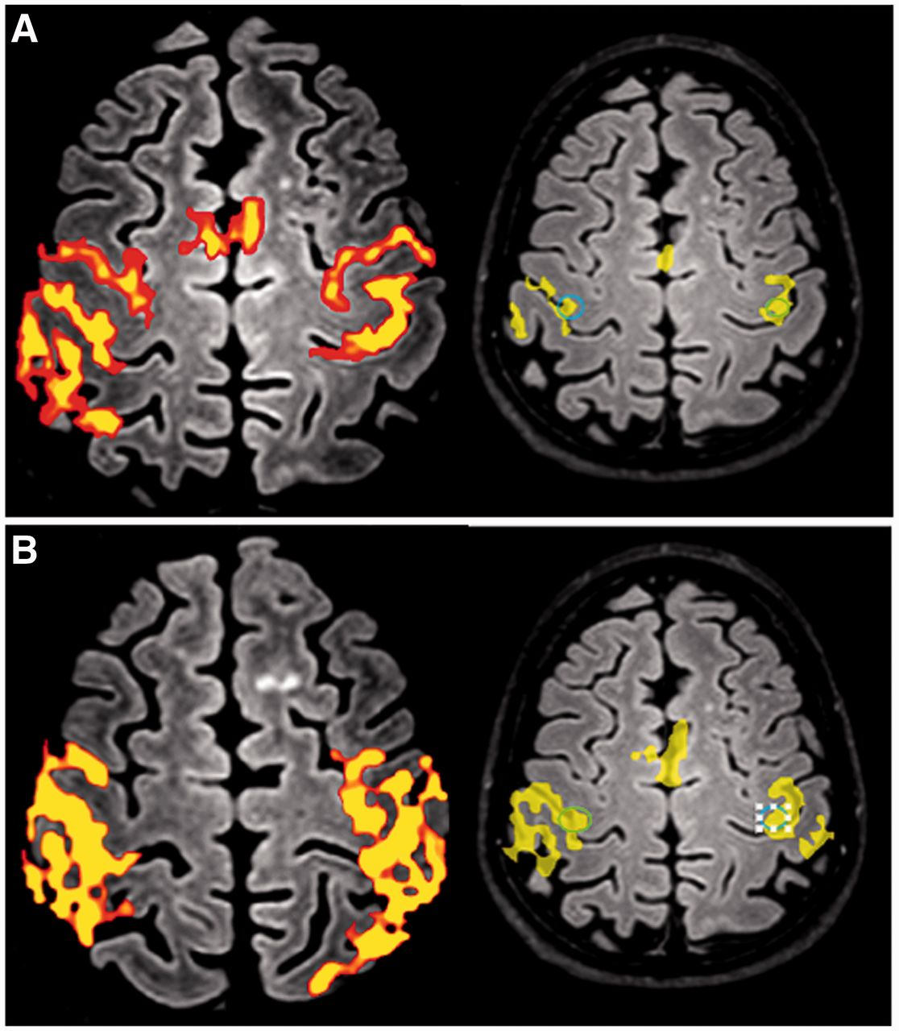
Figure 2 Bilateral functional MRI blood oxygen level-dependent response over precentral, post central gyrus and ...
Notes:
Figure 2 Bilateral functional MRI blood oxygen level-dependent response over precentral, post central gyrus and supplementary motor area during unimanual task. The patient was asked to perform a finger tapping task with either (A) the right hand or (B) the left hand.
Unless provided in the caption above, the following copyright applies to the content of this slide: © The Author (2014). Published by Oxford University Press on behalf of the Guarantors of Brain. All rights reserved. For Permissions, please email: journals.permissions@oup.com

Slide 3
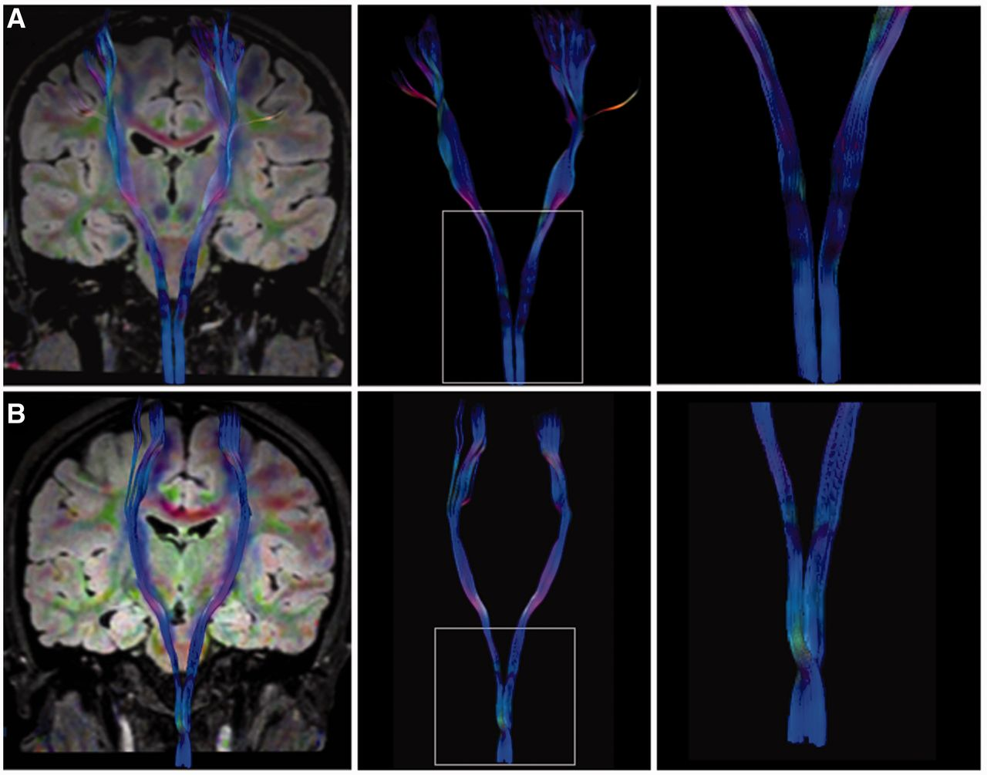
Figure 3 3.0 T MRI DTI tractography, (A) missing decussation of pyramids, with strictly unilateral non-crossing ...
Notes:
Figure 3 3.0 T MRI DTI tractography, (A) missing decussation of pyramids, with strictly unilateral non-crossing corticospinal tracts, and (B) a control subject, with normal crossing corticospinal tracts.
Unless provided in the caption above, the following copyright applies to the content of this slide: © The Author (2014). Published by Oxford University Press on behalf of the Guarantors of Brain. All rights reserved. For Permissions, please email: journals.permissions@oup.com

Slide 4
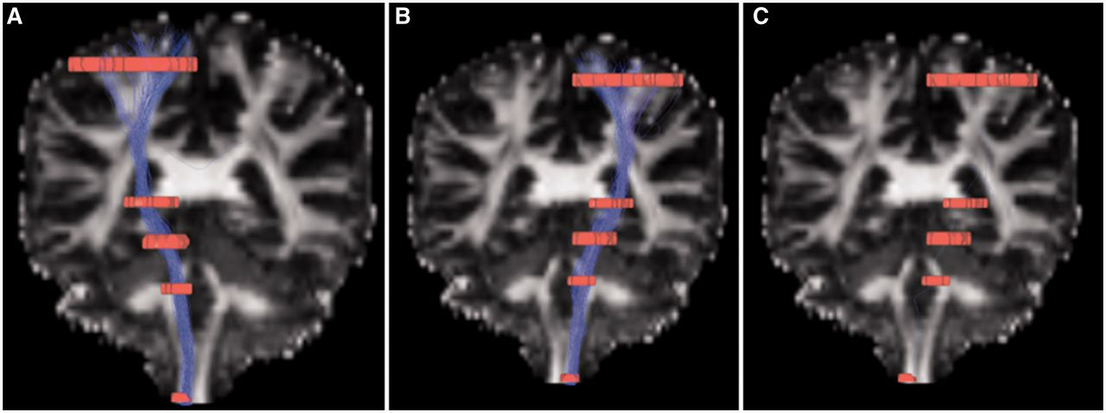
Figure 4 HARDI/Q-ball fibre tracking through orientation distribution function estimation of the corticospinal ...
Notes:
Figure 4 HARDI/Q-ball fibre tracking through orientation distribution function estimation of the corticospinal projection of the patient with congenital mirror movements. Strictly non-crossed corticospinal tract is shown in (A and B). A crossed corticospinal fibre bundle is not found when the region of interest is segmented to the contralateral lateral funiculus in (C).
Unless provided in the caption above, the following copyright applies to the content of this slide: © The Author (2014). Published by Oxford University Press on behalf of the Guarantors of Brain. All rights reserved. For Permissions, please email: journals.permissions@oup.com

