Slide 1
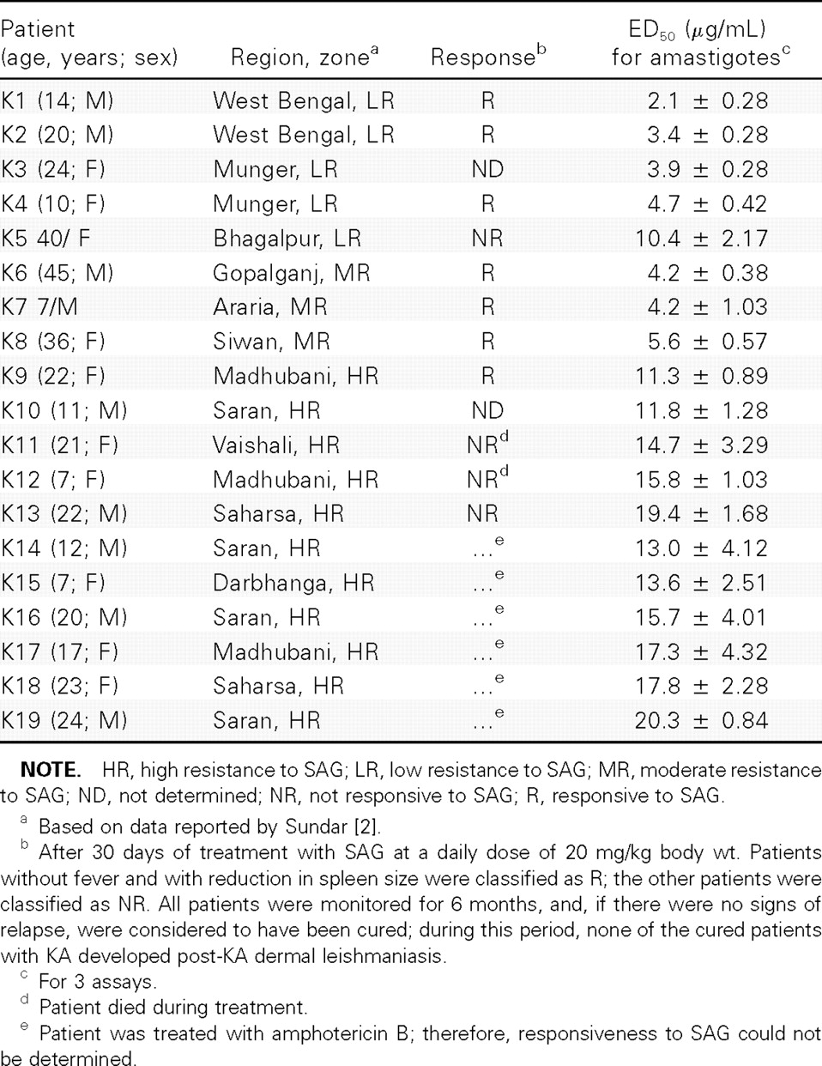
Table 1 Clinical profile of patients with kala azar (KA) who are from different zones of endemicity, and in vitro ...
Notes:
Table 1 Clinical profile of patients with kala azar (KA) who are from different zones of endemicity, and in vitro susceptibility of intracellular amastigotes to sodium antimony gluconate (SAG)
Unless provided in the caption above, the following copyright applies to the content of this slide: © 2006 by the Infectious Diseases Society of America

Slide 2
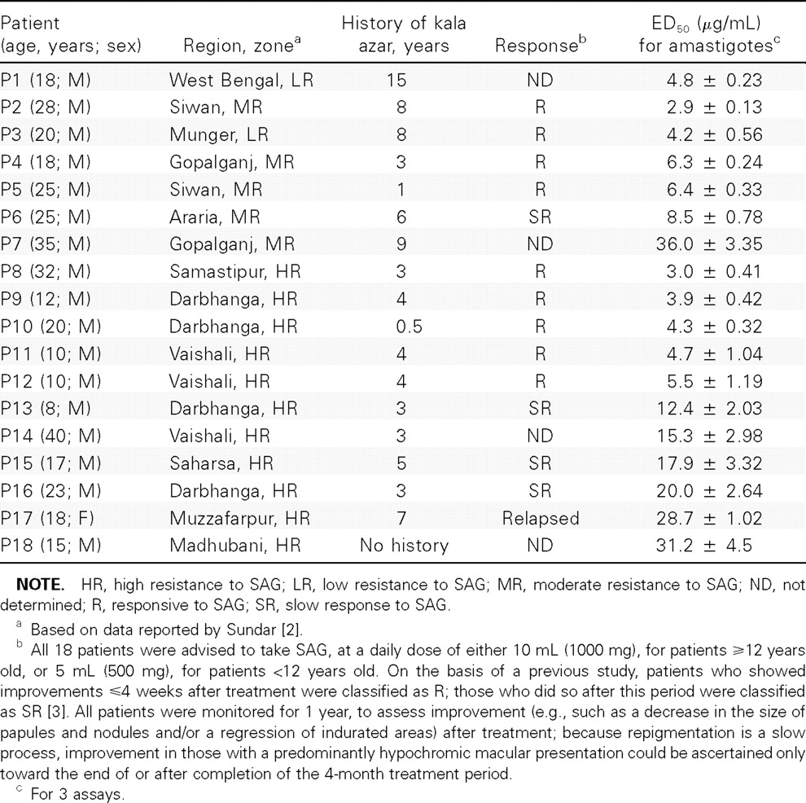
Table 2 Clinical profile of patients with post–kala azar dermal leishmaniasis (PKDL) who are from different zones of ...
Notes:
Table 2 Clinical profile of patients with post–kala azar dermal leishmaniasis (PKDL) who are from different zones of endemicity, and in vitro susceptibility of intracellular amastigotes to sodium antimony gluconate (SAG)
Unless provided in the caption above, the following copyright applies to the content of this slide: © 2006 by the Infectious Diseases Society of America

