Slide 1
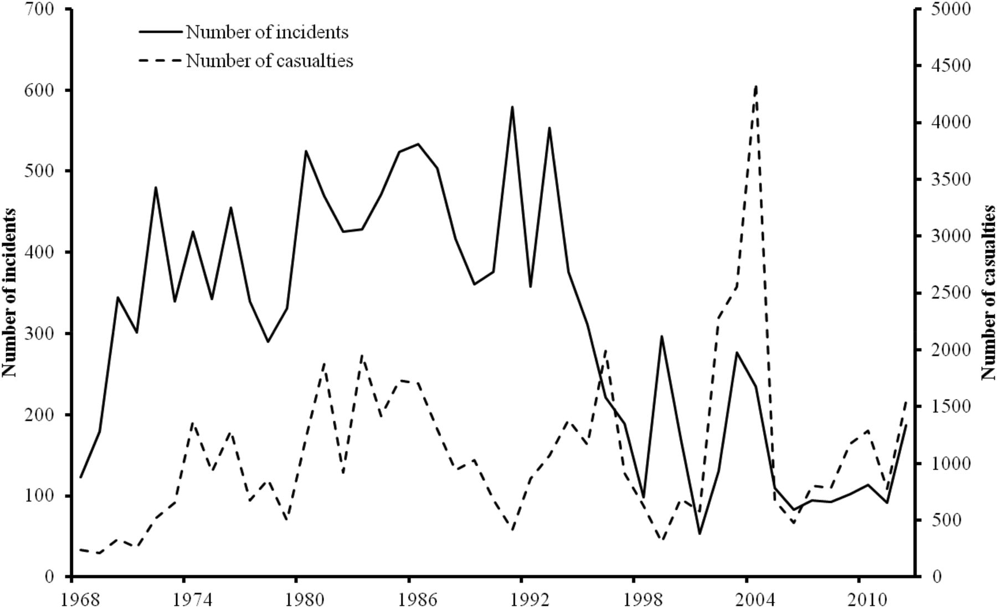
Fig. 1. ITERATE transnational terrorist incidents and total casualties per year, 1968–2012
Notes:
Fig. 1. ITERATE transnational terrorist incidents and total casualties per year, 1968–2012
Unless provided in the caption above, the following copyright applies to the content of this slide: © Oxford University Press 2014This is an Open Access article distributed under the terms of the Creative Commons Attribution-NonCommercial-NoDerivs licence (http://creativecommons.org/licenses/by-nc-nd/4.0/), which permits non-commercial reproduction and distribution of the work, in any medium, provided the original work is not altered or transformed in any way, and that the work properly cited. For commercial re-use, please contact journals.permissions@oup.com

Slide 2
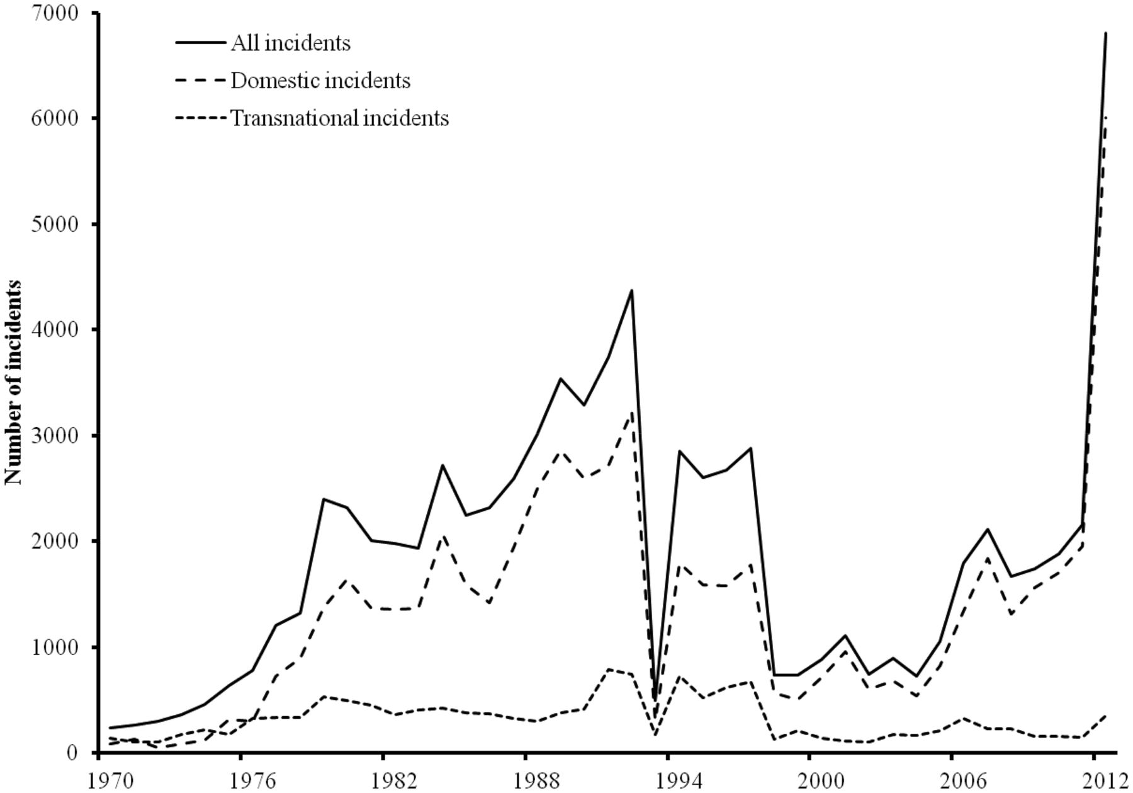
Fig. 2. GTD terrorist incidents per year, 1970–2012
Notes:
Fig. 2. GTD terrorist incidents per year, 1970–2012
Unless provided in the caption above, the following copyright applies to the content of this slide: © Oxford University Press 2014This is an Open Access article distributed under the terms of the Creative Commons Attribution-NonCommercial-NoDerivs licence (http://creativecommons.org/licenses/by-nc-nd/4.0/), which permits non-commercial reproduction and distribution of the work, in any medium, provided the original work is not altered or transformed in any way, and that the work properly cited. For commercial re-use, please contact journals.permissions@oup.com

Slide 3
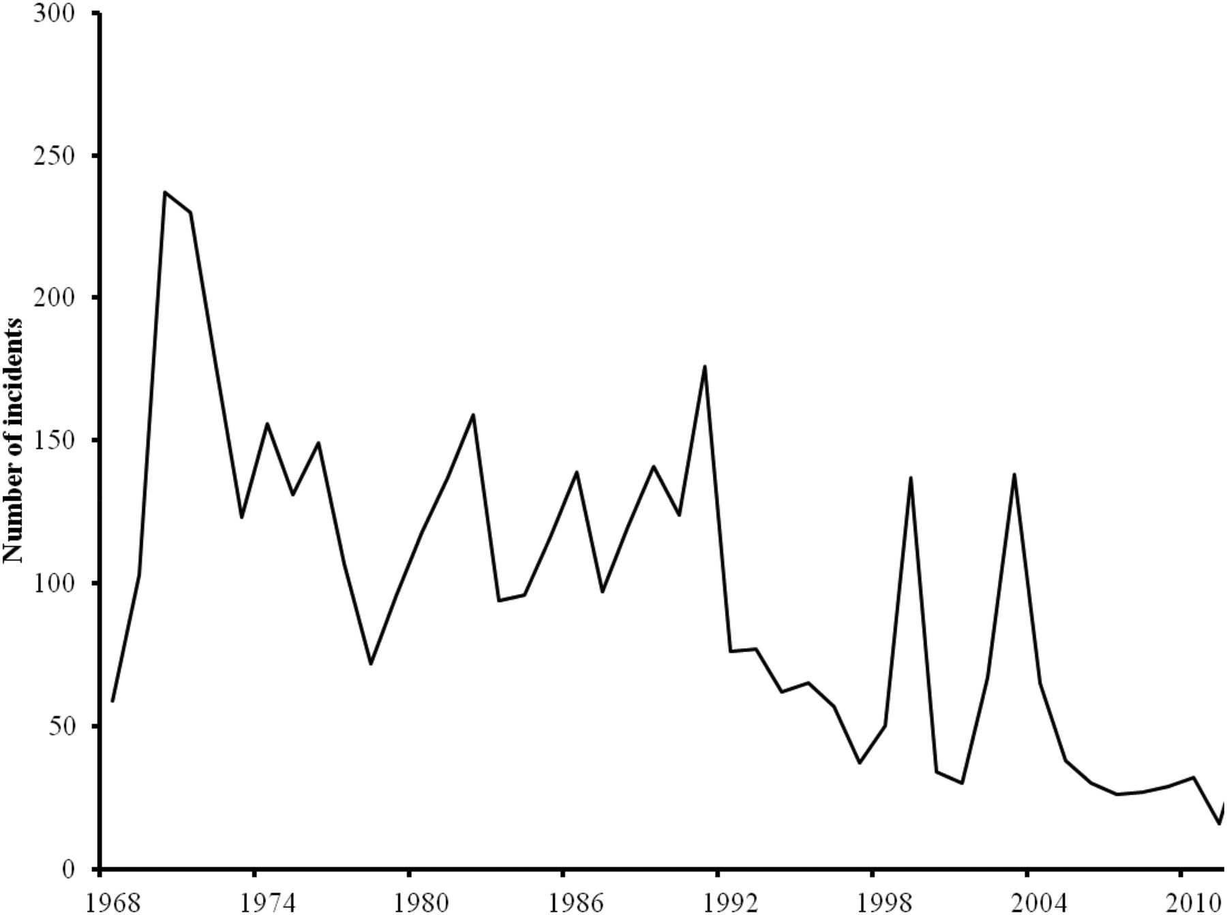
Fig. 3. ITERATE attacks against US interests per year, 1968–2012
Notes:
Fig. 3. ITERATE attacks against US interests per year, 1968–2012
Unless provided in the caption above, the following copyright applies to the content of this slide: © Oxford University Press 2014This is an Open Access article distributed under the terms of the Creative Commons Attribution-NonCommercial-NoDerivs licence (http://creativecommons.org/licenses/by-nc-nd/4.0/), which permits non-commercial reproduction and distribution of the work, in any medium, provided the original work is not altered or transformed in any way, and that the work properly cited. For commercial re-use, please contact journals.permissions@oup.com

Slide 4
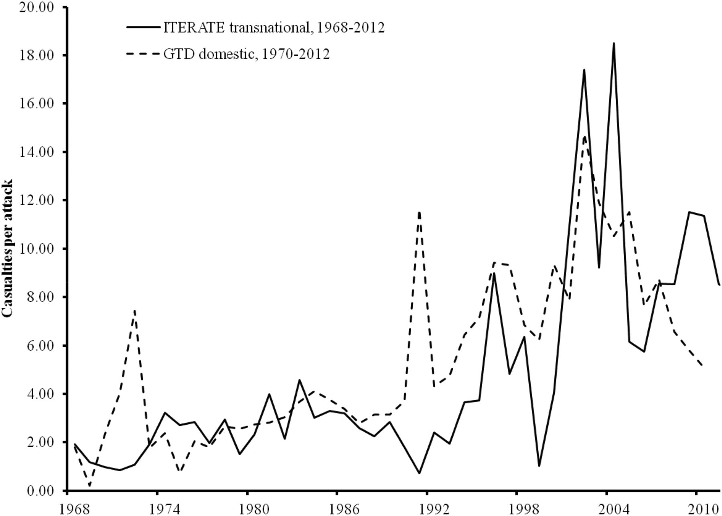
Fig. 4. Annual number of casualties per attack
Notes:
Fig. 4. Annual number of casualties per attack
Unless provided in the caption above, the following copyright applies to the content of this slide: © Oxford University Press 2014This is an Open Access article distributed under the terms of the Creative Commons Attribution-NonCommercial-NoDerivs licence (http://creativecommons.org/licenses/by-nc-nd/4.0/), which permits non-commercial reproduction and distribution of the work, in any medium, provided the original work is not altered or transformed in any way, and that the work properly cited. For commercial re-use, please contact journals.permissions@oup.com

