Slide 1
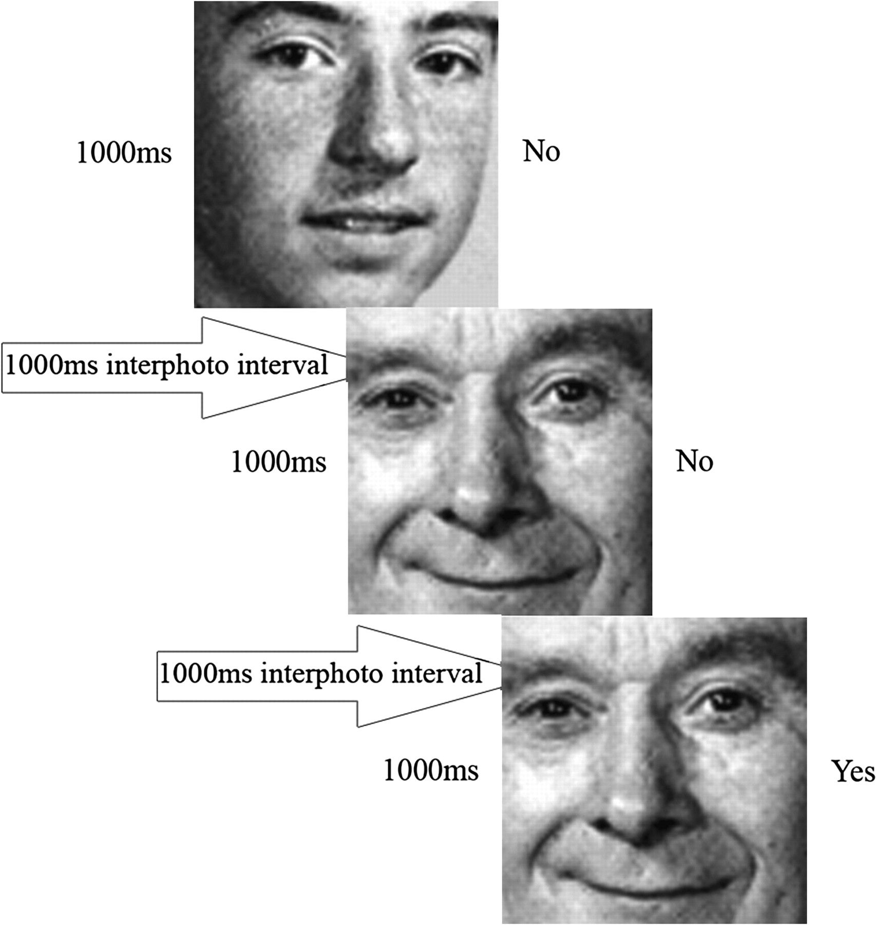
Figure 1. Schematic representation of the 1-back condition. Each stimulus face was presented for 1000 ms then followed ...
Notes:
Figure 1. Schematic representation of the 1-back condition. Each stimulus face was presented for 1000 ms then followed by a blank display for 1000 ms. Participants were asked to judge if each face was the same as the one that appeared one face ago.
Unless provided in the caption above, the following copyright applies to the content of this slide: © The Author 2007. Published by Oxford University Press. All rights reserved. For permissions, please e-mail: journals.permissions@oxfordjournals.org

Slide 2
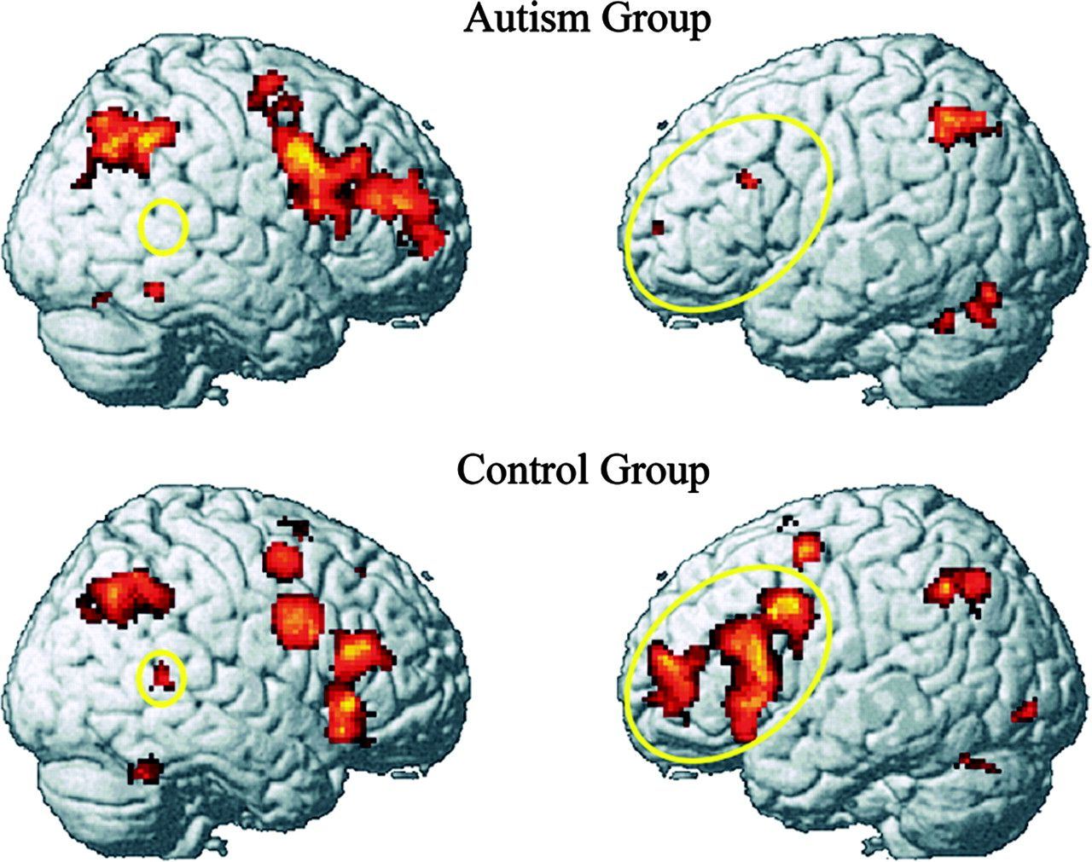
Figure 2. Reduced activation in left IFG and right superior/middle temporal gyri in autism (yellow ellipses) during the ...
Notes:
Figure 2. Reduced activation in left IFG and right superior/middle temporal gyri in autism (yellow ellipses) during the n-back task with faces (contrast with Fixation baseline). The data are collapsed across the three working memory conditions.
Unless provided in the caption above, the following copyright applies to the content of this slide: © The Author 2007. Published by Oxford University Press. All rights reserved. For permissions, please e-mail: journals.permissions@oxfordjournals.org

Slide 3
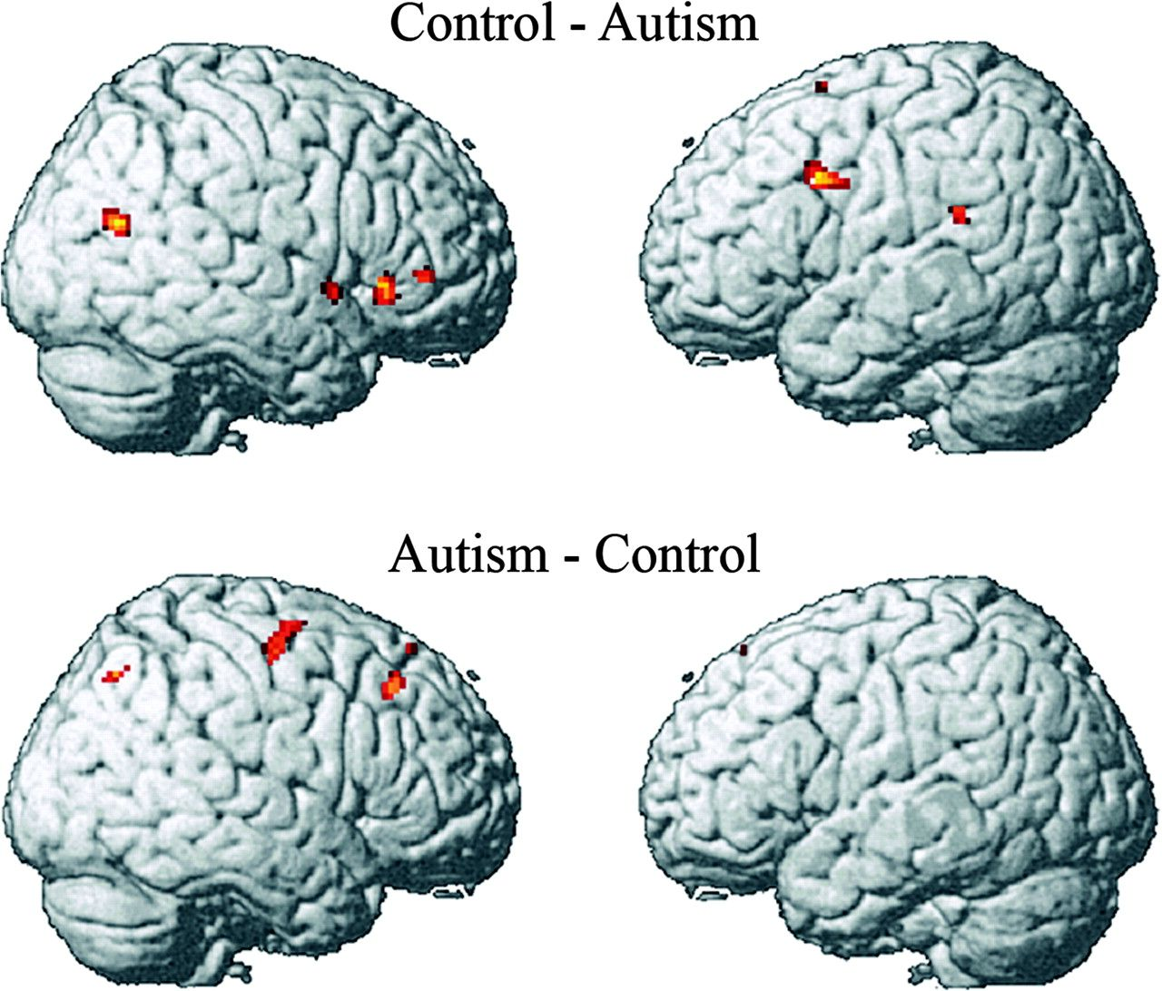
Figure 3. Group contrast showing areas where the control group showed more activation than the autism (top) and autism ...
Notes:
Figure 3. Group contrast showing areas where the control group showed more activation than the autism (top) and autism group exhibited more activation than the control (bottom). The data were collapsed across 3 working memory load conditions.
Unless provided in the caption above, the following copyright applies to the content of this slide: © The Author 2007. Published by Oxford University Press. All rights reserved. For permissions, please e-mail: journals.permissions@oxfordjournals.org

Slide 4
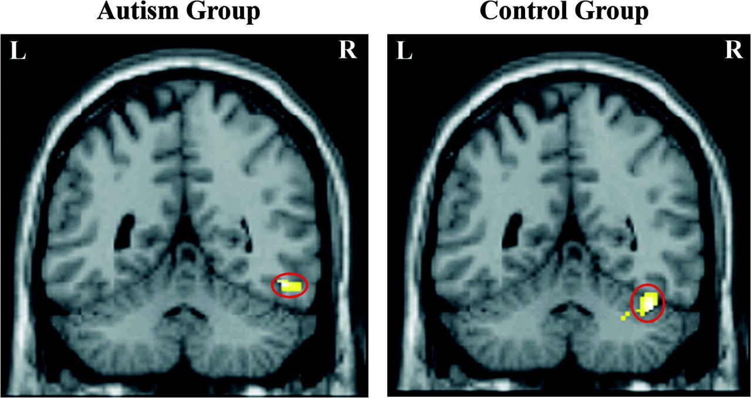
Figure 4. Right fusiform gyrus activation in autism and control groups.
Notes:
Figure 4. Right fusiform gyrus activation in autism and control groups.
Unless provided in the caption above, the following copyright applies to the content of this slide: © The Author 2007. Published by Oxford University Press. All rights reserved. For permissions, please e-mail: journals.permissions@oxfordjournals.org

Slide 5
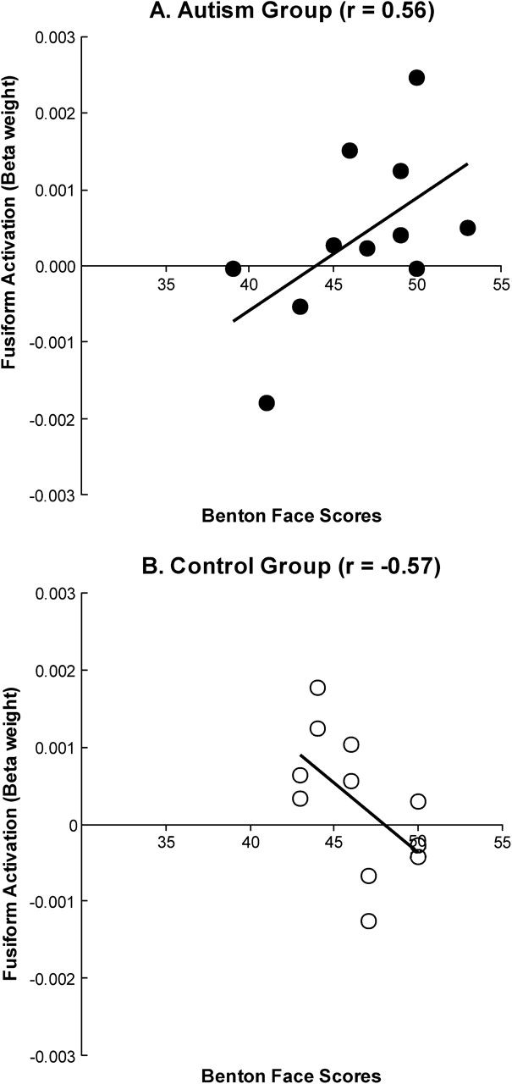
Figure 5. Correlation between Benton Face Recognition test scores and right fusiform activation in (A) autism and (B) ...
Notes:
Figure 5. Correlation between Benton Face Recognition test scores and right fusiform activation in (A) autism and (B) control groups.
Unless provided in the caption above, the following copyright applies to the content of this slide: © The Author 2007. Published by Oxford University Press. All rights reserved. For permissions, please e-mail: journals.permissions@oxfordjournals.org

Slide 6
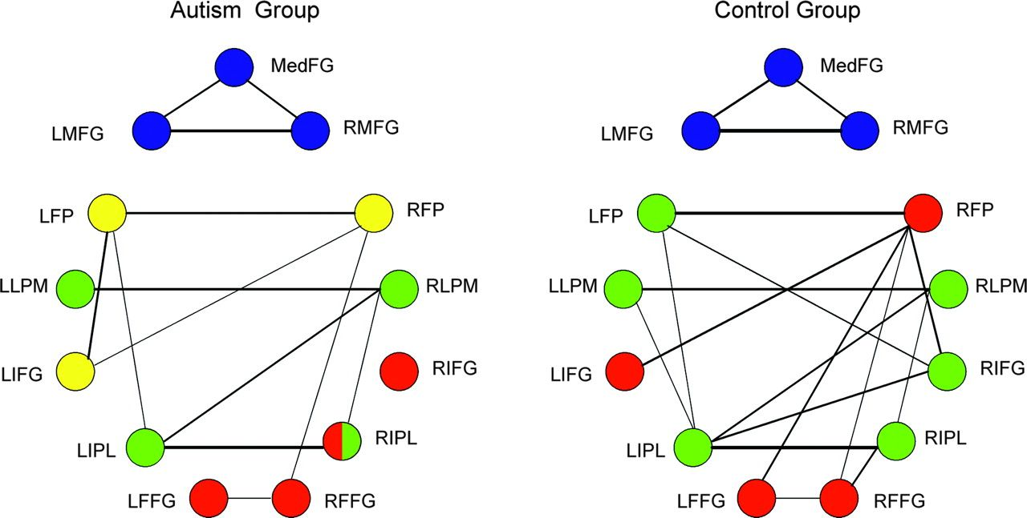
Figure 6. A graphical depiction of the combined results of the factor analyses and functional connectivity, showing ...
Notes:
Figure 6. A graphical depiction of the combined results of the factor analyses and functional connectivity, showing that the autism group had a smaller number of functional connections among their brain regions than the control group. Node colors correspond to factors (blue: frontal factor; green: frontal–parietal; red: fusiform; yellow: an additional frontal factor in the autism group). The internode link thicknesses depict functional connectivity strength, with only those connectivities above some fixed threshold being depicted. FFG = fusiform gyrus.
Unless provided in the caption above, the following copyright applies to the content of this slide: © The Author 2007. Published by Oxford University Press. All rights reserved. For permissions, please e-mail: journals.permissions@oxfordjournals.org

