Slide 1
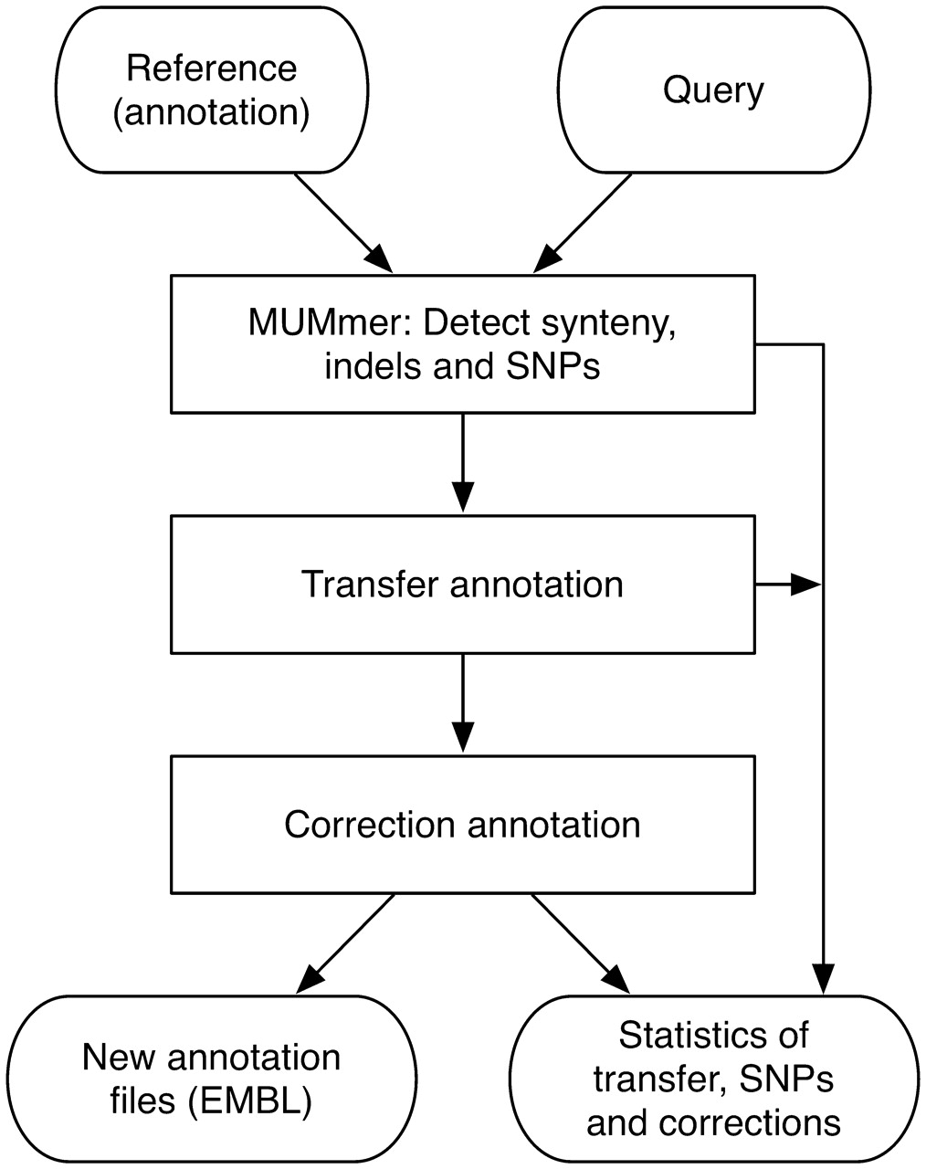
Figure 1. Workflow of RATT.
Notes:
Figure 1. Workflow of RATT.
Unless provided in the caption above, the following copyright applies to the content of this slide: © The Author(s) 2011. Published by Oxford University Press.This is an Open Access article distributed under the terms of the Creative Commons Attribution Non-Commercial License (http://creativecommons.org/licenses/by-nc/2.5), which permits unrestricted non-commercial use, distribution, and reproduction in any medium, provided the original work is properly cited.

Slide 2
Figure 2. Transfer of annotation from the M. tuberculosis strain H37Rv onto the strain F11 sequence, over a deletion. ...
Notes:
Figure 2. Transfer of annotation from the M. tuberculosis strain H37Rv onto the strain F11 sequence, over a deletion. The genomes of H37Rv (upper) and F11 (lower) are shown using the Artemis Comparison Tool (ACT). The source H37Rv annotation (light blue) is directly mapped onto F11 by RATT (green) except for those features corresponding to a region that is unique to the source strain that cannot be transferred and are written to a separate output file (brown).
Unless provided in the caption above, the following copyright applies to the content of this slide: © The Author(s) 2011. Published by Oxford University Press.This is an Open Access article distributed under the terms of the Creative Commons Attribution Non-Commercial License (http://creativecommons.org/licenses/by-nc/2.5), which permits unrestricted non-commercial use, distribution, and reproduction in any medium, provided the original work is properly cited.

Slide 3
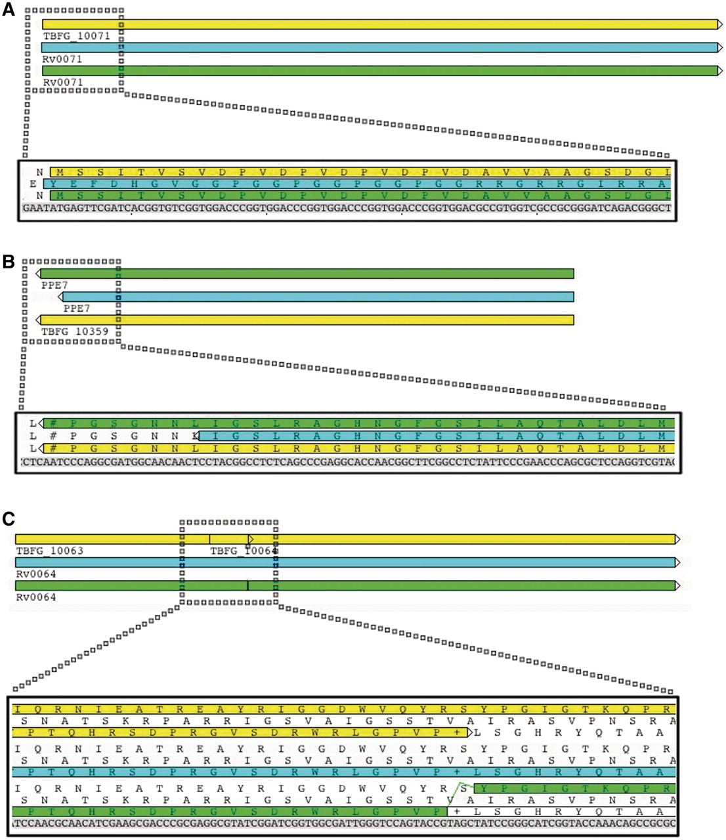
Figure 3. RATT corrections of transferred annotations. Annotation from H37Rv were transferred onto the F11 sequence ...
Notes:
Figure 3. RATT corrections of transferred annotations. Annotation from H37Rv were transferred onto the F11 sequence (pale blue), corrected (green) and then compared with the existing strain F11 annotation in EMBL (yellow). (A and B) The correction of start and stop codons, respectively. In a more complex mapping situation (C), where all three reading frames are shown for clarity, RATT maps a large single coding sequence (CDS) from H37Rv to a locus within F11 that includes several in-frame stop codons. By inserting a frameshift (i.e. to indicate a pseudogene) the conceptual translation is preserved. This contrasts with two overlapping genes predicted as part of the F11 genome project.
Unless provided in the caption above, the following copyright applies to the content of this slide: © The Author(s) 2011. Published by Oxford University Press.This is an Open Access article distributed under the terms of the Creative Commons Attribution Non-Commercial License (http://creativecommons.org/licenses/by-nc/2.5), which permits unrestricted non-commercial use, distribution, and reproduction in any medium, provided the original work is properly cited.

