Slide 1
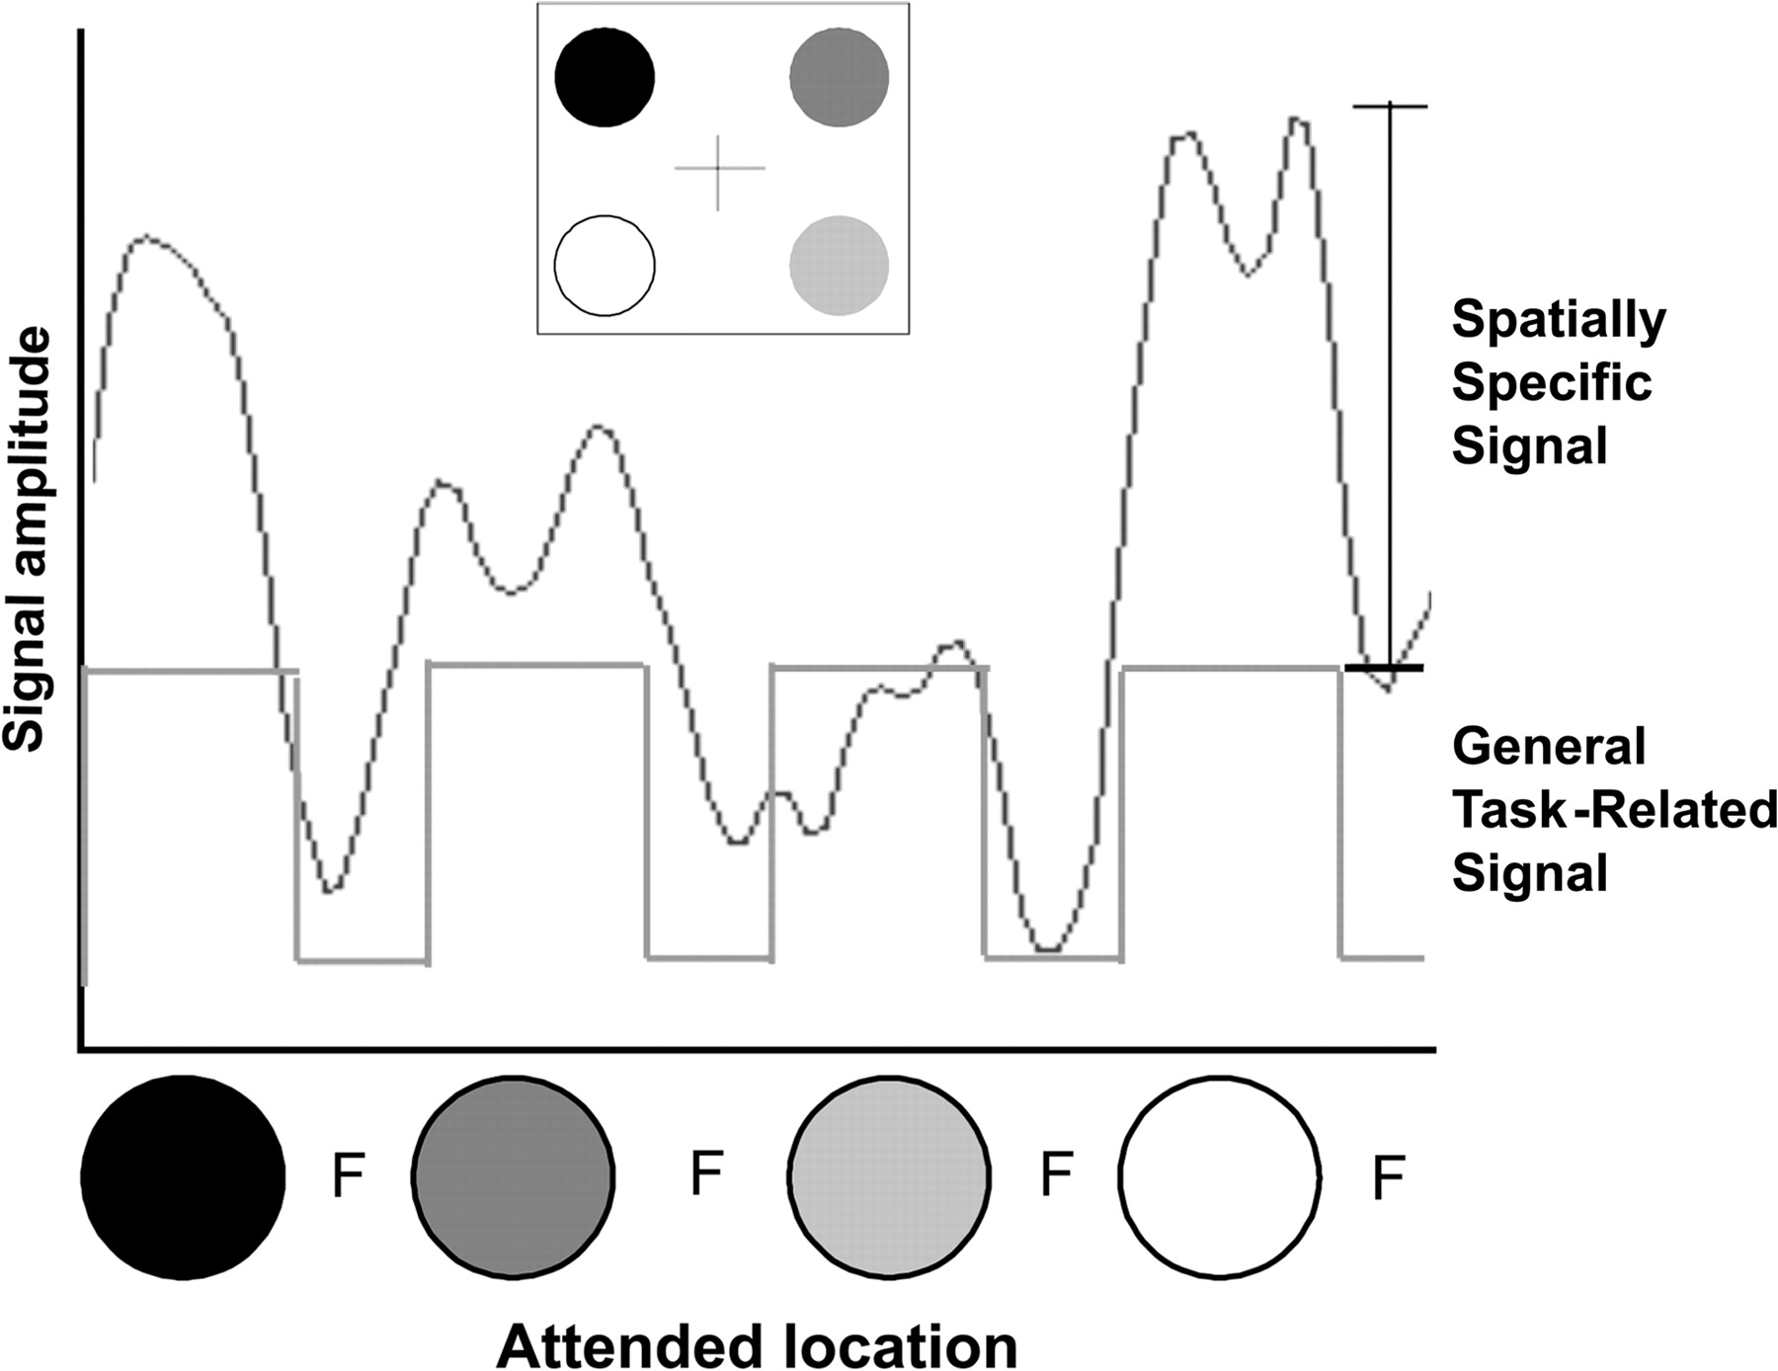
Figure 3. Representative time series from right parietal cortex. An average time series across 9 voxels taken from the ...
Notes:
Figure 3. Representative time series from right parietal cortex. An average time series across 9 voxels taken from the right parietal cortex of 1 subject. Two components to the BOLD signal are present: 1) a general task-related signal and 2) a spatially specific signal. Inset on top of figure demonstrates gray scale code for attended locations. Blocks of fixation are marked on the x axis as “F.”
Unless provided in the caption above, the following copyright applies to the content of this slide: © 2007 The AuthorsThis is an Open Access article distributed under the terms of the Creative Commons Attribution Non-Commercial License (http://creativecommons.org/licenses/by-nc/2.0/uk/) which permits unrestricted non-commercial use, distribution, and reproduction in any medium, provided the original work is properly cited.

Slide 2
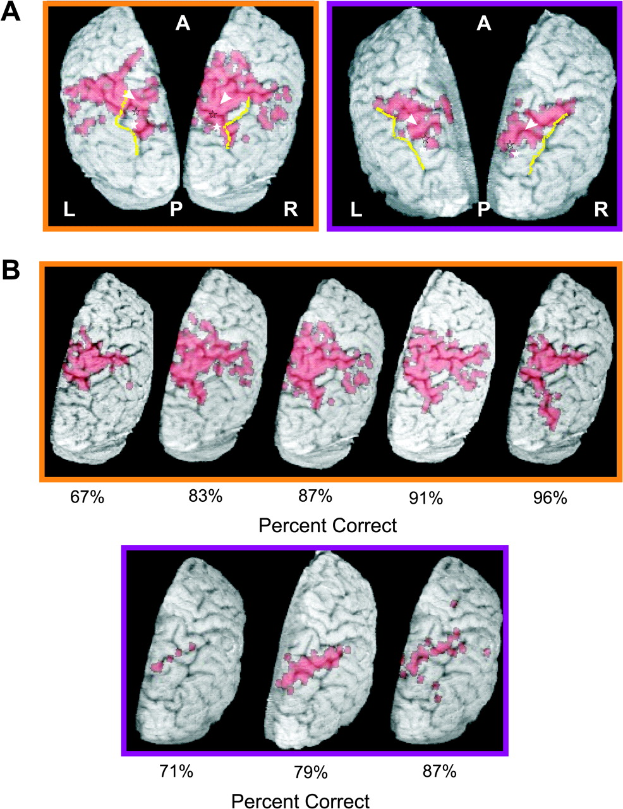
Figure 2. Parietal activation patterns. Representative patterns of bilateral parietal ROI activation in 2 subjects are ...
Notes:
Figure 2. Parietal activation patterns. Representative patterns of bilateral parietal ROI activation in 2 subjects are shown in (A) (L, left; R, right; A, anterior; P, posterior). The maps represent the magnitude of the BOLD signal in the ROIs. The IPS is drawn in yellow to orient the reader. Centers-of-mass from previously reported literature are marked with symbols (IPS1—filled stars and IPS2—unfilled stars (Silver et al. 2005); putative human lateral intraparietal sulcus—arrowheads [Sereno et al. 2001]). (B) Right parietal activation at various performance levels for 2 subjects (matching subject data indicated by the respective orange and purple boxes surrounding the images) across different levels of performance. The performance level, indicated below each image, represents accuracy of target assessment for all target locations. Disk densities for the subject banded in orange from left to right were 32, 24, 24, 24, and16 and for the subject banded in purple 32, 24, and 16.
Unless provided in the caption above, the following copyright applies to the content of this slide: © 2007 The AuthorsThis is an Open Access article distributed under the terms of the Creative Commons Attribution Non-Commercial License (http://creativecommons.org/licenses/by-nc/2.0/uk/) which permits unrestricted non-commercial use, distribution, and reproduction in any medium, provided the original work is properly cited.

Slide 3
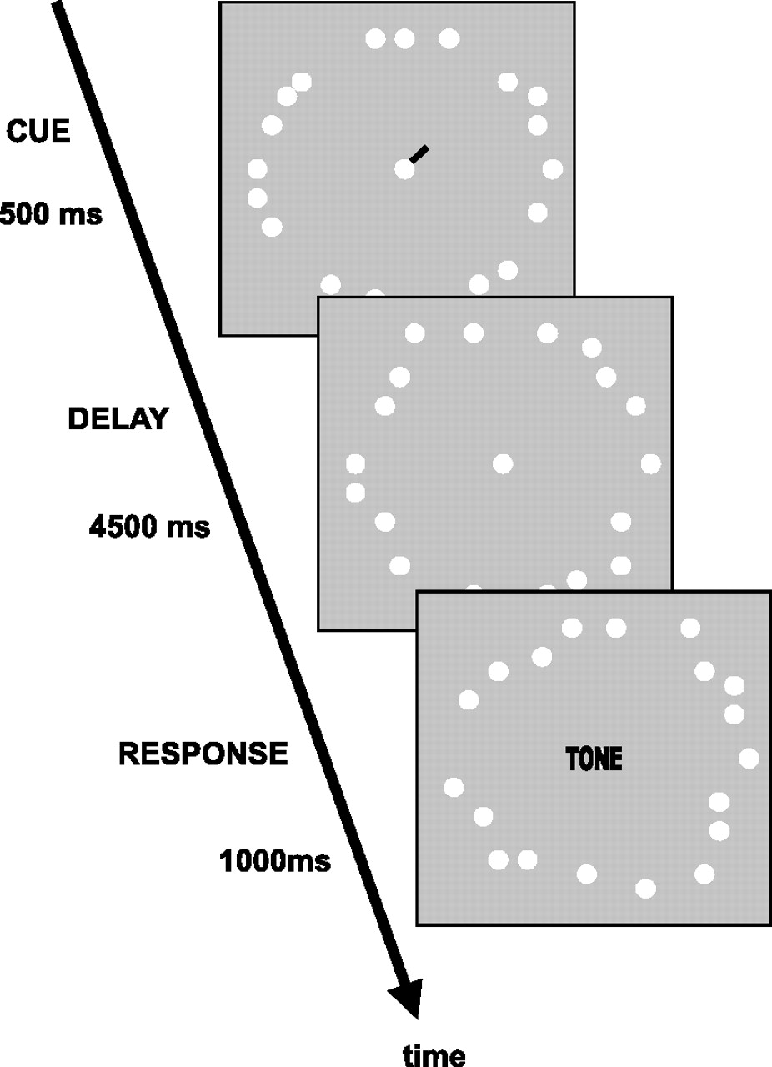
Figure 1. Trial time course. Each trial consisted of 3 epochs. Subjects were cued to the start of a new trial by the ...
Notes:
Figure 1. Trial time course. Each trial consisted of 3 epochs. Subjects were cued to the start of a new trial by the presence of a green line extending from the fixation point for 500 ms and pointing to the cued target disk. Subjects were instructed to immediately attend covertly to the target disk upon presentation of the cue. The subsequent delay lasted 4500 ms. Disks continued to both flicker and jitter throughout the delay. Subjects were instructed to determine if the target disk was present or absent at the time of a 500-ms tone played through headphones. Subjects had to respond within 1000 ms from the start of the tone.
Unless provided in the caption above, the following copyright applies to the content of this slide: © 2007 The AuthorsThis is an Open Access article distributed under the terms of the Creative Commons Attribution Non-Commercial License (http://creativecommons.org/licenses/by-nc/2.0/uk/) which permits unrestricted non-commercial use, distribution, and reproduction in any medium, provided the original work is properly cited.

Slide 4
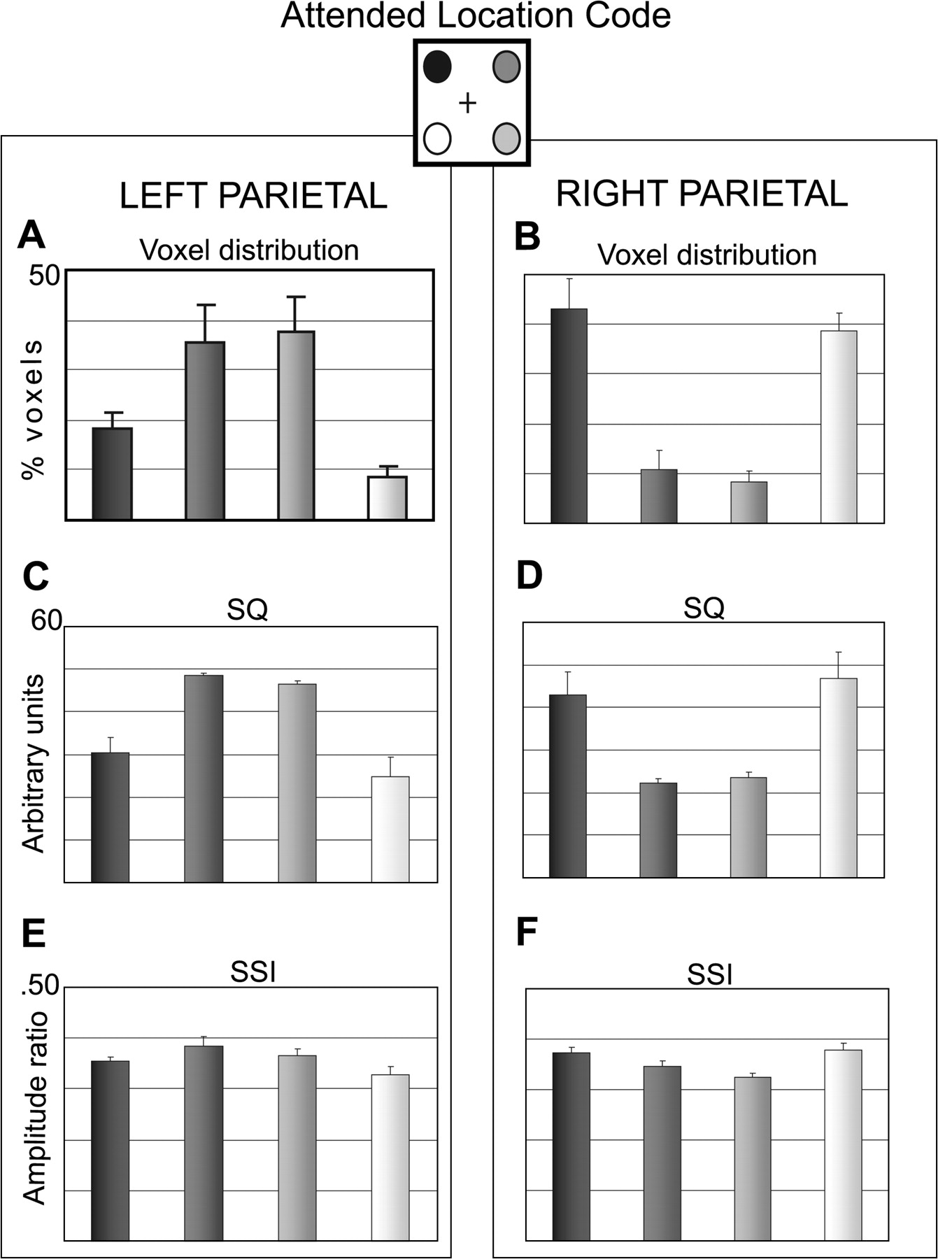
Figure 4. Quantitative analysis of attention maps for left and right parietal ROIs. The inset illustrates the gray ...
Notes:
Figure 4. Quantitative analysis of attention maps for left and right parietal ROIs. The inset illustrates the gray scale coding for the 4 attended locations as in Figure 3 (A, B) Voxel distribution across attended locations as a percent of the total number of voxels showing a significant task-related response. (C, D) Normalized SQ values for voxels representing each attended target location. The SQ data are represented in arbitrary units, which prevent direct comparison of SQ across hemispheres, but do illustrate the SQ in voxels active during attention to the 4 different target locations within a hemisphere. (E, F) Normalized spatial specificity measures for parietal cortex. (All data [n = 9] are represented as means + standard error of the mean.)
Unless provided in the caption above, the following copyright applies to the content of this slide: © 2007 The AuthorsThis is an Open Access article distributed under the terms of the Creative Commons Attribution Non-Commercial License (http://creativecommons.org/licenses/by-nc/2.0/uk/) which permits unrestricted non-commercial use, distribution, and reproduction in any medium, provided the original work is properly cited.

Slide 5
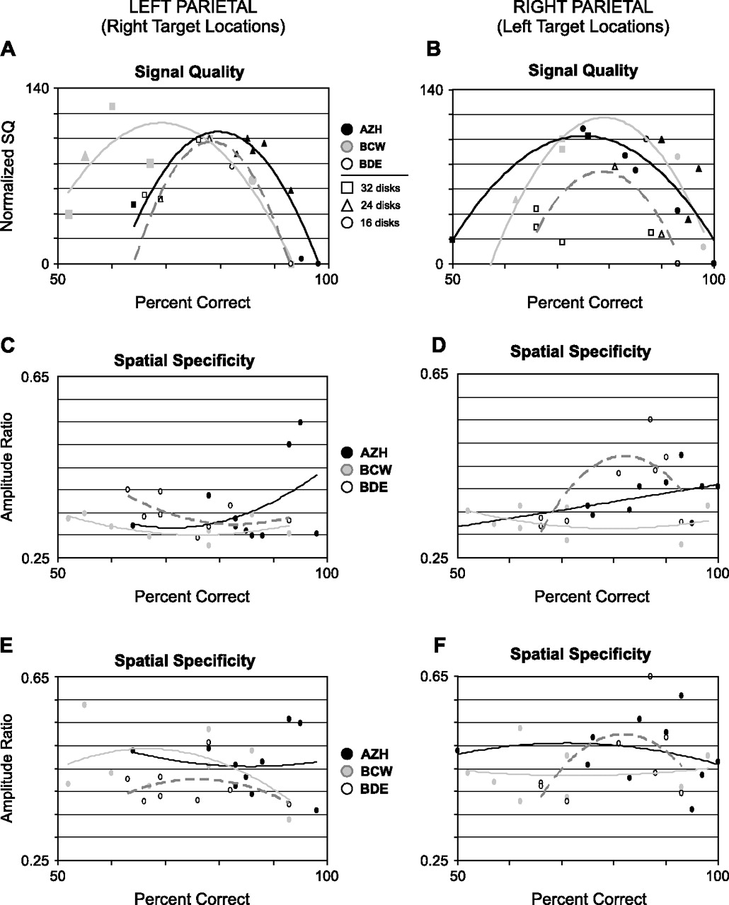
Figure 5. SQ varies with performance nonmonotonically. Performance (x axis) versus SQ (A, B) and spatial specificity ...
Notes:
Figure 5. SQ varies with performance nonmonotonically. Performance (x axis) versus SQ (A, B) and spatial specificity for same voxels (C, D) or for “best specificity” voxels (E, F) for each hemisphere (left column = left hemisphere and right column = right hemisphere). Accuracy of target status assessment (performance, x axis) was calculated separately for each attended target location, 2 in each hemisphere. (A, B) SQ values represent the median of the top 10% of SQ values for those voxels preferring a given target location. Because absolute SQ varied across subjects and hemispheres, SQs for each hemisphere of each subject were rescaled. Continuous curves show best-fit second-order polynomial for each subject (coded by gray color). Data point shapes encode corresponding stimulus disk density as indicated in the central legend. Note that different SQ values can be associated with the same disk density and vice versa. In (A), data points at 93% and 78% correct for BCW and BDE overlap. (C, D) Median spatial specificity indices versus performance from the same voxels as used in the analysis for (A, B). (E, F) To eliminate any possible bias in voxel selection, the median of the top 10% of spatial specificity indices were used regardless of the associated SQ value for that voxel. In this way, the “best” spatial specificity indices were used for this plot in an attempt to maximize any relationship present between these 2 parameters. Note lack of systematic relationship between amplitude ratio and performance in (C–F).
Unless provided in the caption above, the following copyright applies to the content of this slide: © 2007 The AuthorsThis is an Open Access article distributed under the terms of the Creative Commons Attribution Non-Commercial License (http://creativecommons.org/licenses/by-nc/2.0/uk/) which permits unrestricted non-commercial use, distribution, and reproduction in any medium, provided the original work is properly cited.

Slide 6
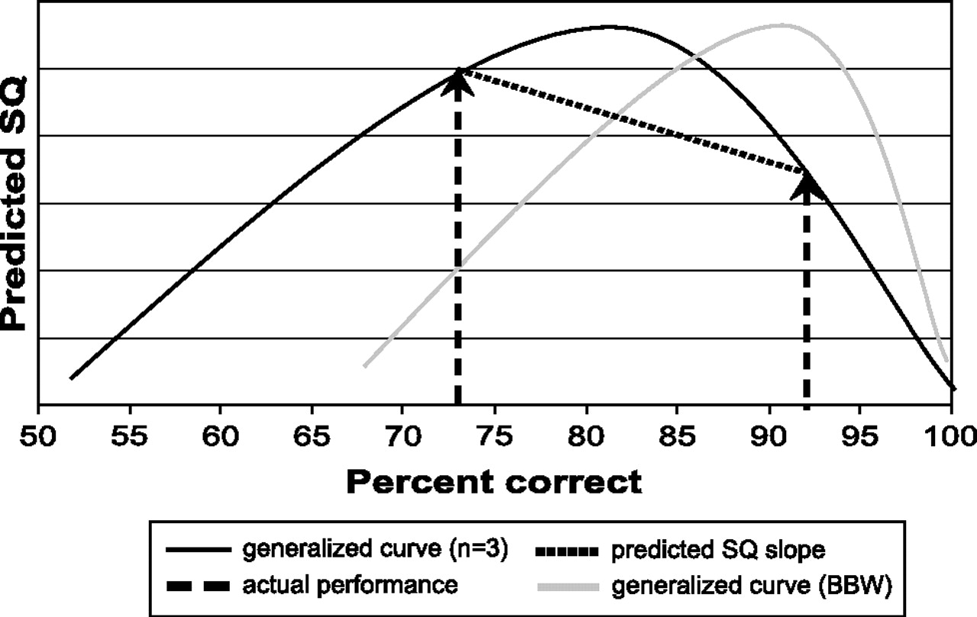
Figure 6. Generalized SQ curve. Estimated SQ (black line) based on subject accuracy (x axis). Predictions regarding the ...
Notes:
Figure 6. Generalized SQ curve. Estimated SQ (black line) based on subject accuracy (x axis). Predictions regarding the relationship between SQ in each of 2 cases for a single target location within subject were made based on the slope (dotted line) of the line connecting the 2 performance values (dashed line). The generalized curve was slid to the right of the graph (gray line) to best fit one subject's data.
Unless provided in the caption above, the following copyright applies to the content of this slide: © 2007 The AuthorsThis is an Open Access article distributed under the terms of the Creative Commons Attribution Non-Commercial License (http://creativecommons.org/licenses/by-nc/2.0/uk/) which permits unrestricted non-commercial use, distribution, and reproduction in any medium, provided the original work is properly cited.

Slide 7
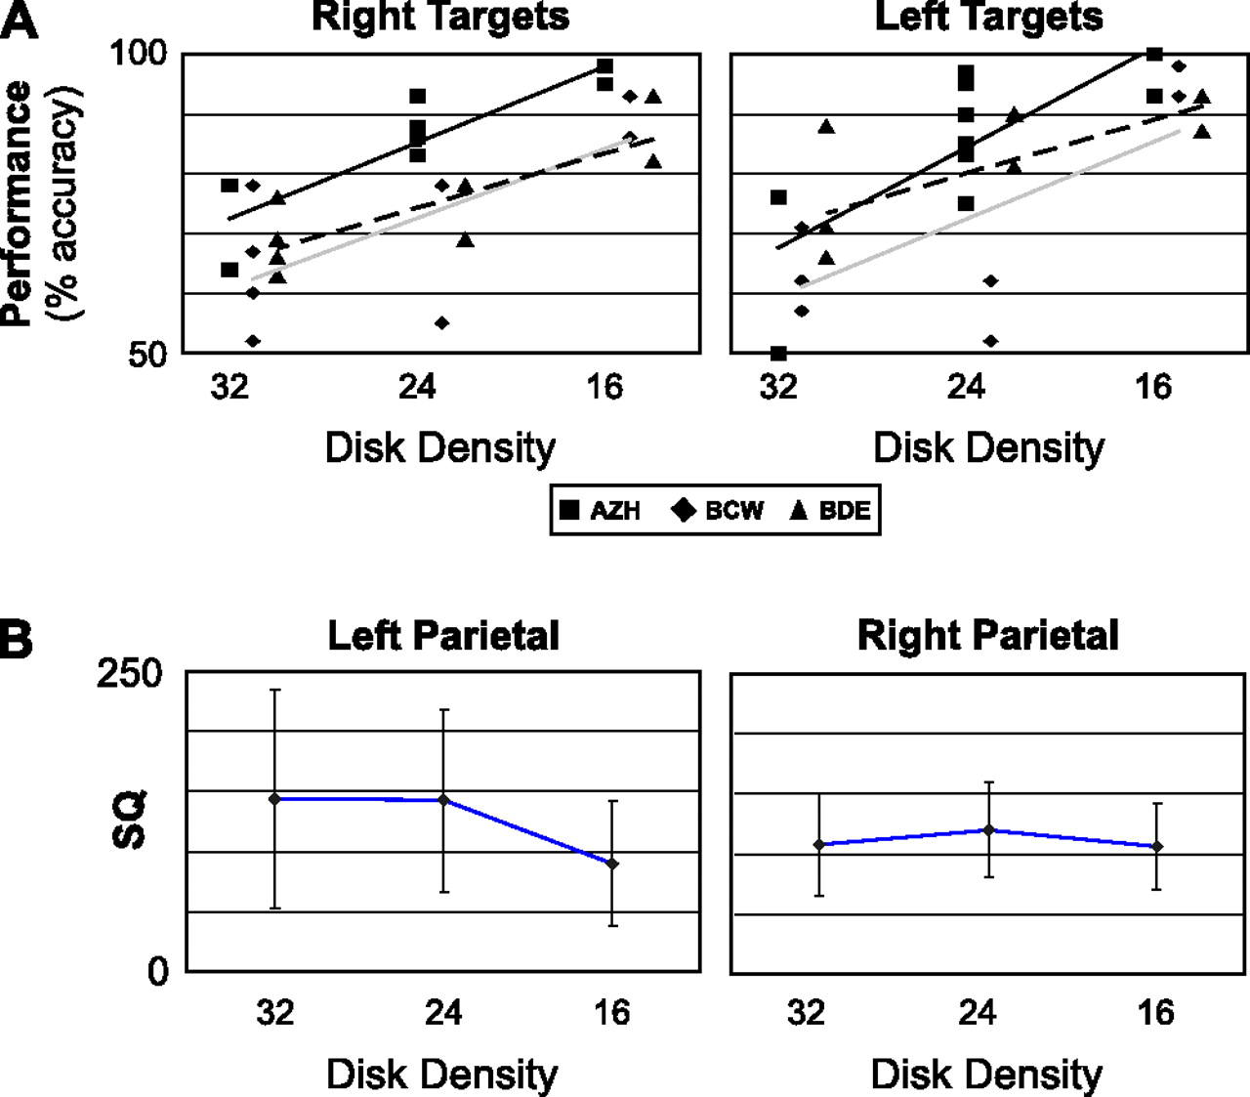
Figure 7. The effects of disk density on performance and SQ. (A) Performance versus disk density for same subjects ...
Notes:
Figure 7. The effects of disk density on performance and SQ. (A) Performance versus disk density for same subjects whose data are shown in Figure 5. Performance scores are plotted for all 4 target locations separately. Note the considerable overlap of task accuracy between disk densities within subjects. Linear trend lines are presented for each of the 3 subjects (black line, AZH; gray line, BCW; dashed line, BDW). (B) SQ versus disk density for 4 subjects who completed the task at all 3 disk densities. The median SQ of the top 10% of the target-specific voxels from the contralateral hemisphere associated with each disk density was averaged within subject. (Graphs illustrate the means + standard error of the mean). The average SQs were then compared across disk densities and between subjects using a dependent measures randomization test for scores (1296 possible permutations, P = 0.05). In left parietal cortex, SQ was only significantly different at the 16 disk density when compared with the other 2 conditions (16 disks = 90.12 ± 51.91, 24 disks = 142.76 ± 76.49, 32 disks = 144.95 ± 91.35). In the right hemisphere, no SQ value was significantly different (16 disks = 106.27 ± 36.10, 24 disks = 119.87 ± 40.49, 32 disks = 107.86 ± 42.09).
Unless provided in the caption above, the following copyright applies to the content of this slide: © 2007 The AuthorsThis is an Open Access article distributed under the terms of the Creative Commons Attribution Non-Commercial License (http://creativecommons.org/licenses/by-nc/2.0/uk/) which permits unrestricted non-commercial use, distribution, and reproduction in any medium, provided the original work is properly cited.

