Slide 1
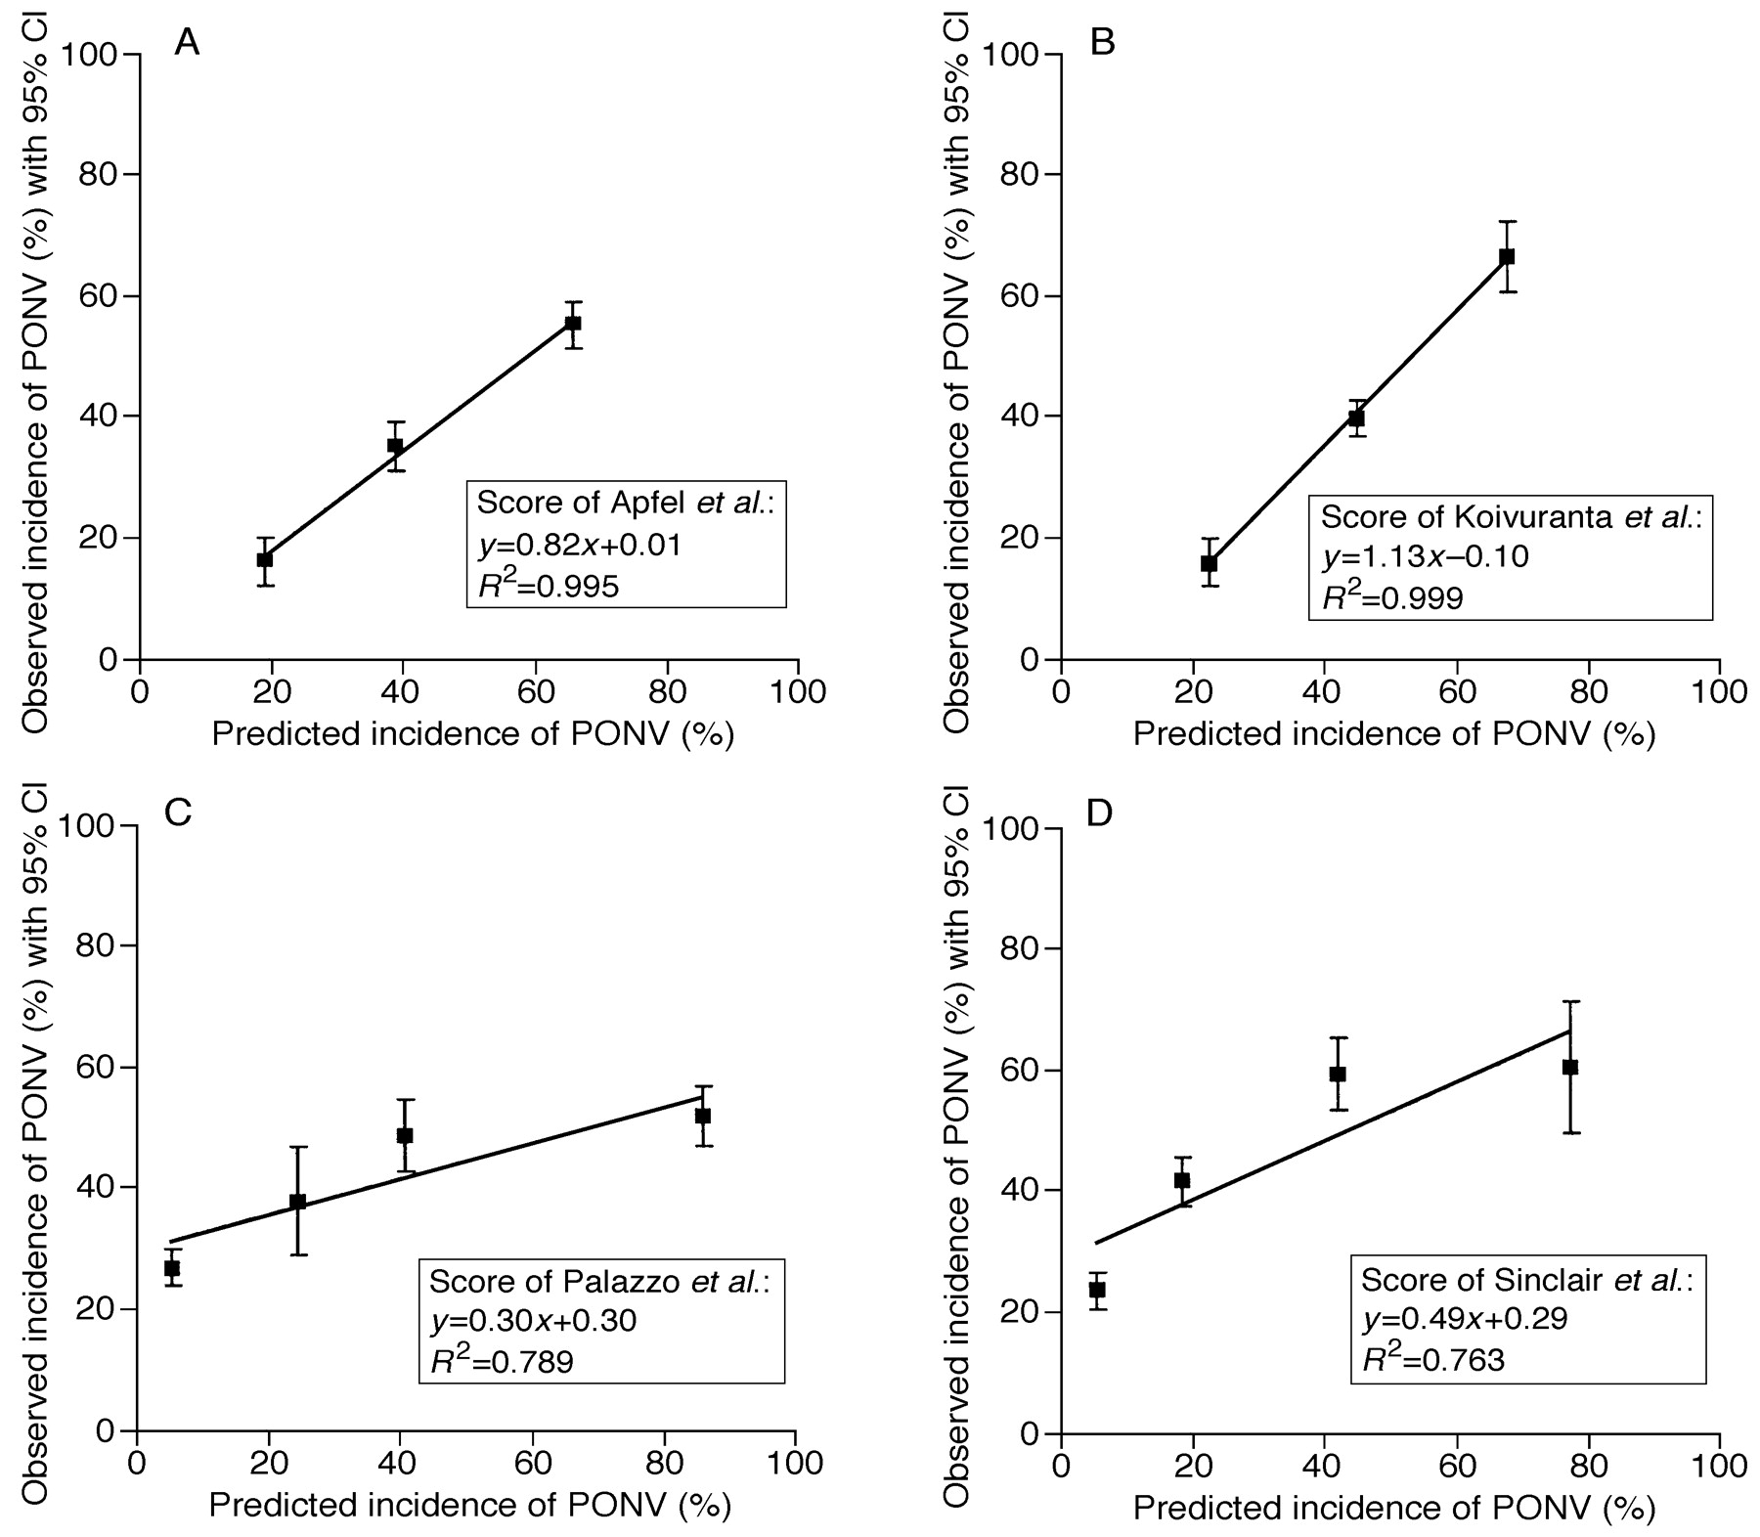
Fig 1 Calibration curves, i.e. correlations between predicted (x) and actual (y) incidences, for the scores ...
Notes:
Fig 1 Calibration curves, i.e. correlations between predicted (x) and actual (y) incidences, for the scores adapted to the risk classes suggested by White and Watcha to allow direct comparisons.10 11 (a) Score of Apfel et al.2 (b) Score of Koivurantaet al.14 (c) Score of Palazzo et al.12 (d) Score of Sinclair et al.17 The calibration curves are weighted according to the number of patients per group.
Unless provided in the caption above, the following copyright applies to the content of this slide:

