Slide 1
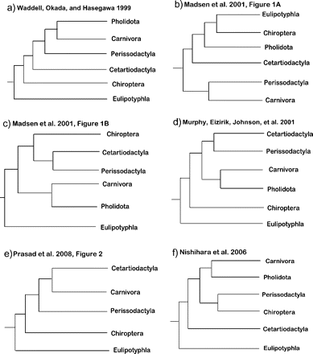
FIGURE 1. Alternative hypotheses for the interorder relationships of major Laurasiatherian lineages based on molecular ...
Notes:
FIGURE 1. Alternative hypotheses for the interorder relationships of major Laurasiatherian lineages based on molecular sequences data (a–e) and retroposon analysis (f). Clade support values and the size of the data sets used are available in Table 1.
Unless provided in the caption above, the following copyright applies to the content of this slide: © The Author(s) 2011. Published by Oxford University Press, on behalf of the Society of Systematic Biologists.This is an Open Access article distributed under the terms of the Creative Commons Attribution Non-Commercial License (http://creativecommons.org/licenses/by-nc/3.0), which permits unrestricted non-commercial use, distribution, and reproduction in any medium, provided the original work is properly cited.

Slide 2
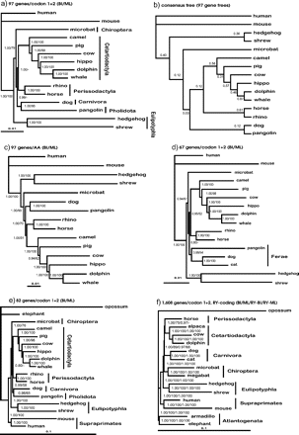
FIGURE 2. Phylogenetic trees reconstructed using BI and ML methods based on two different data sets. Integers ...
Notes:
FIGURE 2. Phylogenetic trees reconstructed using BI and ML methods based on two different data sets. Integers associated with branches are BP support values from ML analyses, whereas values of 1 or less are Bayesian PPs. Dash denotes BP support values that are <50%. Codon 1+2 and RY coding refer to the concatenated sequences combined with the first and second codon positions and combined with RY recoding, respectively. A consensus tree based on a majority rule of 97 BI trees from the 97-gene data set is shown in (b). Numbers associated with each branch represent the proportion of universally distributed input trees that contain that particular split.
Unless provided in the caption above, the following copyright applies to the content of this slide: © The Author(s) 2011. Published by Oxford University Press, on behalf of the Society of Systematic Biologists.This is an Open Access article distributed under the terms of the Creative Commons Attribution Non-Commercial License (http://creativecommons.org/licenses/by-nc/3.0), which permits unrestricted non-commercial use, distribution, and reproduction in any medium, provided the original work is properly cited.

