Slide 1
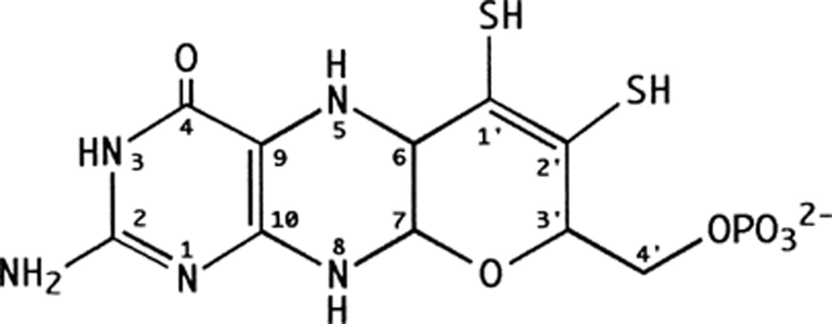
Figure 1 Structure of the organic component of the molybdenum cofactor (Mo-co) in the tricyclic form as observed in ...
Notes:
Figure 1 Structure of the organic component of the molybdenum cofactor (Mo-co) in the tricyclic form as observed in all crystal structures of enzymes containing this cofactor. The atom-numbering scheme used in the text is indicated.
Unless provided in the caption above, the following copyright applies to the content of this slide: © 1999 Federation of European Microbiological Societies.

Slide 2
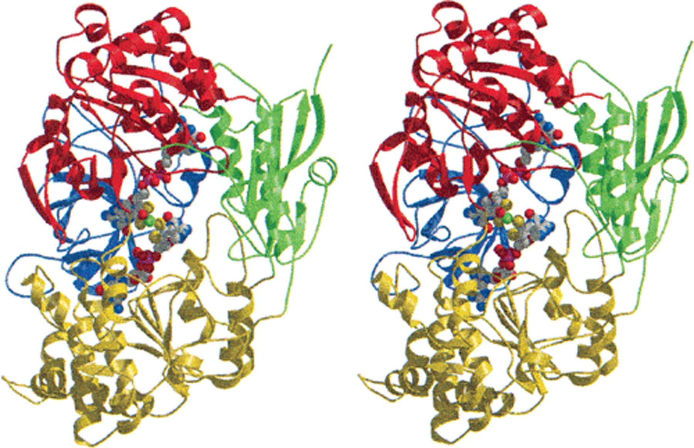
Figure 2 Overall structure of R. sphaeroides DMSO reductase. Schematic ribbons stereo drawing viewed into the active ...
Notes:
Figure 2 Overall structure of R. sphaeroides DMSO reductase. Schematic ribbons stereo drawing viewed into the active site funnel with domain I in green, domain II in yellow, domain III in red and domain IV in blue. The cofactor is shown in a space filling representation. Atoms are color-coded with molybdenum in green, sulfur in yellow, oxygen in red, nitrogen in blue and carbon in grey. Fig. 2 and Figs. 4–6, have been prepared using MOLSCRIPT [22] and RASTER3D [23,24].
Unless provided in the caption above, the following copyright applies to the content of this slide: © 1999 Federation of European Microbiological Societies.

Slide 3
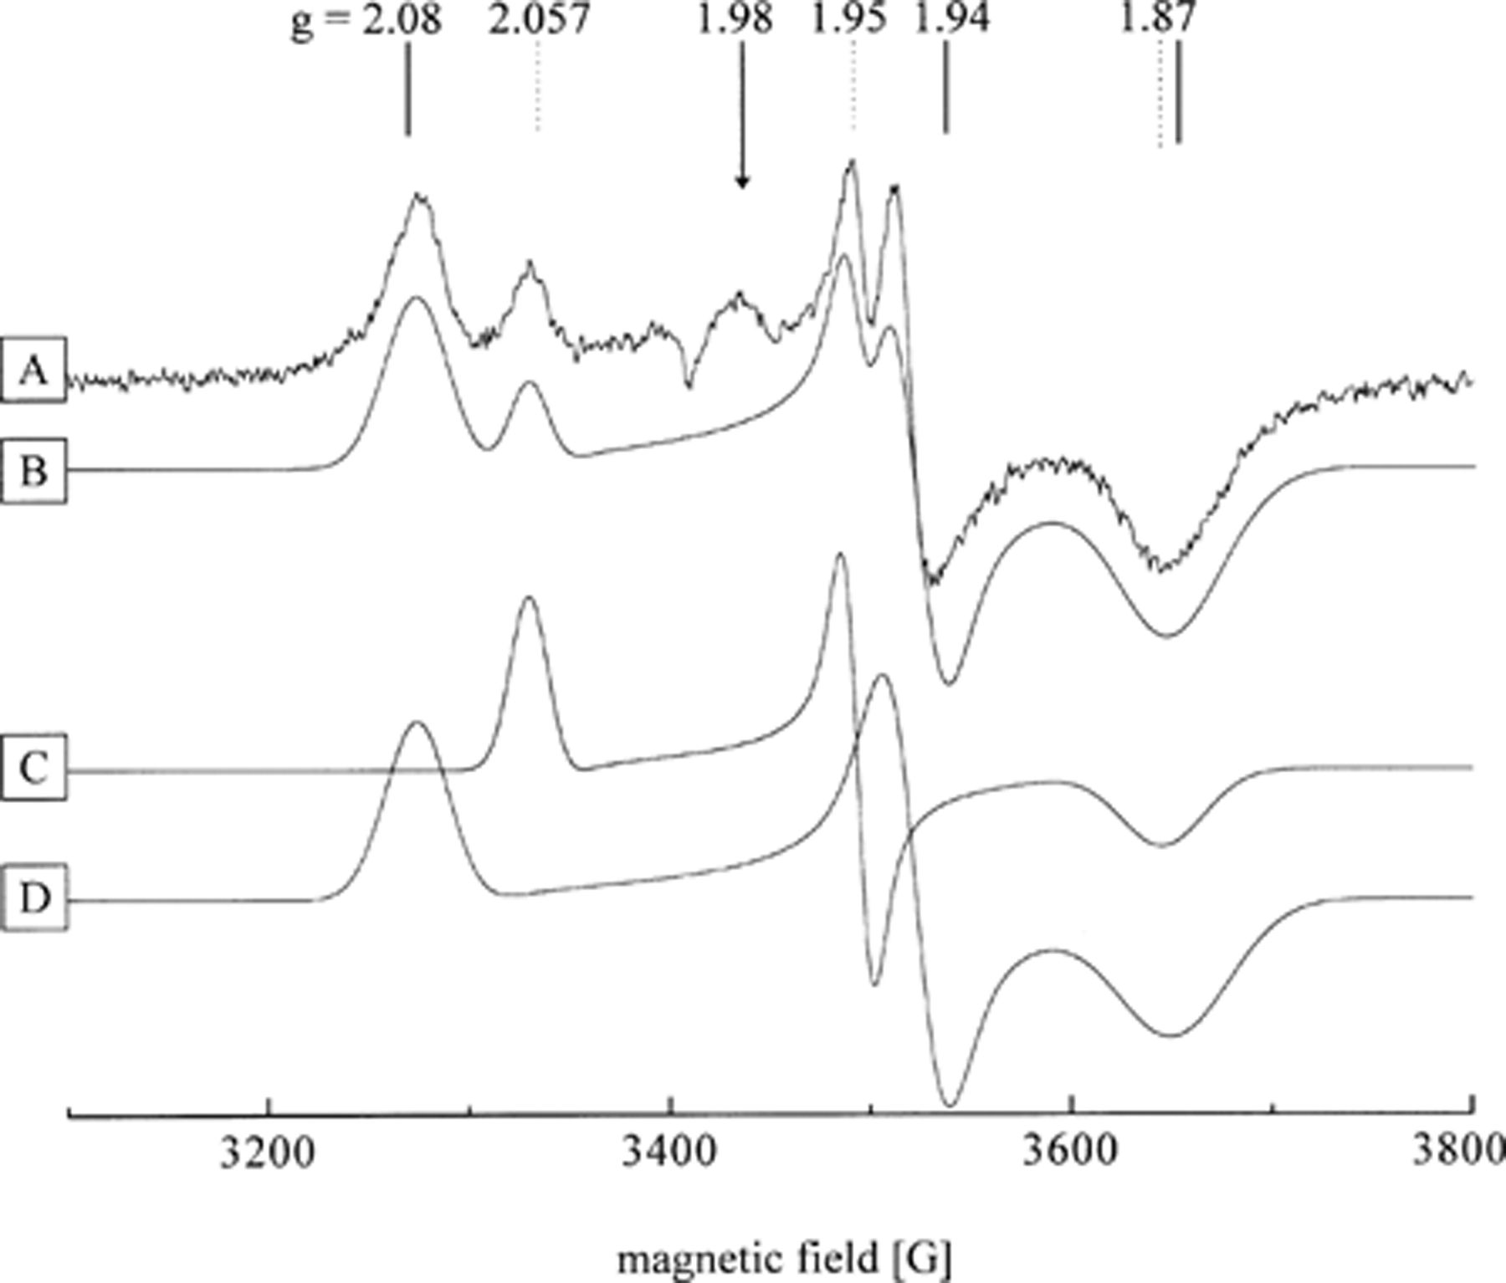
Figure 3 EPR spectra (X-band, 14 K, 0.6 mW microwave power) of transhydroxylase from P. acidigallici reduced with ...
Notes:
Figure 3 EPR spectra (X-band, 14 K, 0.6 mW microwave power) of transhydroxylase from P. acidigallici reduced with sodium dithionite. (A) Enzyme as isolated, 4.3 mg/ml in 40 mM TEA buffer, 300 mM NaCl, pH 7.3, after addition of 3.5 equivalents sodium dithionite, under anoxic conditions. (B) Combined simulations, with signals C and D, weight 2:3. (C) Simulated spectrum, with gx=1.874, gy=1.953, gz=2.057. (D) Simulated spectrum, with gx=1.869, gy=1.940, gz=2.080.
Unless provided in the caption above, the following copyright applies to the content of this slide: © 1999 Federation of European Microbiological Societies.

Slide 4
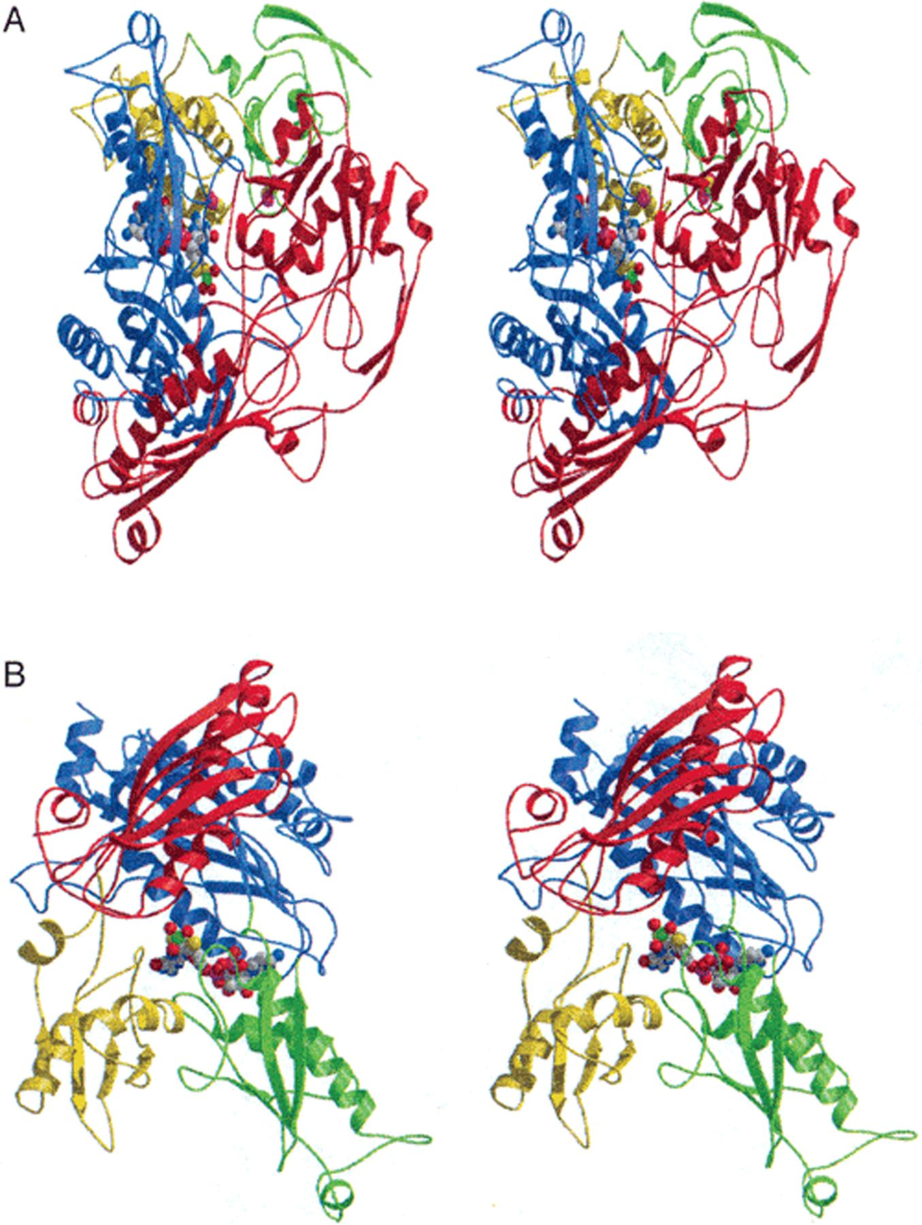
Figure 4 (A) Schematic ribbons stereo representation of a monomer of aldehyde oxidoreductase from D. gigas viewed into ...
Notes:
Figure 4 (A) Schematic ribbons stereo representation of a monomer of aldehyde oxidoreductase from D. gigas viewed into the active site with the [2Fe–2S] cluster containing domains in green and yellow, and the Mo1 and Mo2 domains in red and blue, respectively. The cofactors are shown in a space filling representation with the Fe-atoms in purple. (B) Alternative classification of residues 311–907 according to the SCOP database. The four repeating subdomains are shown in yellow, red, green and blue. The yellow and red as well as the green and blue subdomains form one lobe and the two lobes are related by an approximate two-fold axis of symmetry.
Unless provided in the caption above, the following copyright applies to the content of this slide: © 1999 Federation of European Microbiological Societies.

Slide 5
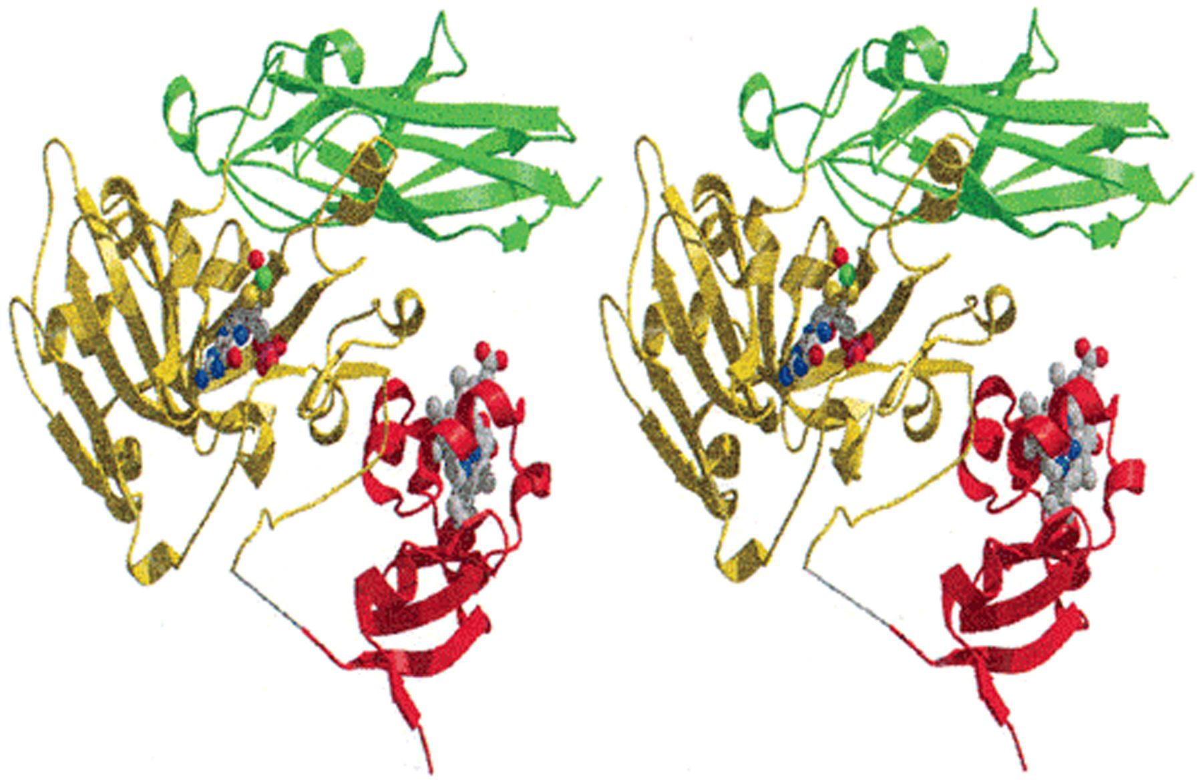
Figure 5 Crystal structure of sulfite oxidase. Ribbons representation of the polypeptide fold of the monomer with ...
Notes:
Figure 5 Crystal structure of sulfite oxidase. Ribbons representation of the polypeptide fold of the monomer with domains I, II and III in red, yellow and green, respectively. The cofactors are shown in a space filling representation.
Unless provided in the caption above, the following copyright applies to the content of this slide: © 1999 Federation of European Microbiological Societies.

Slide 6
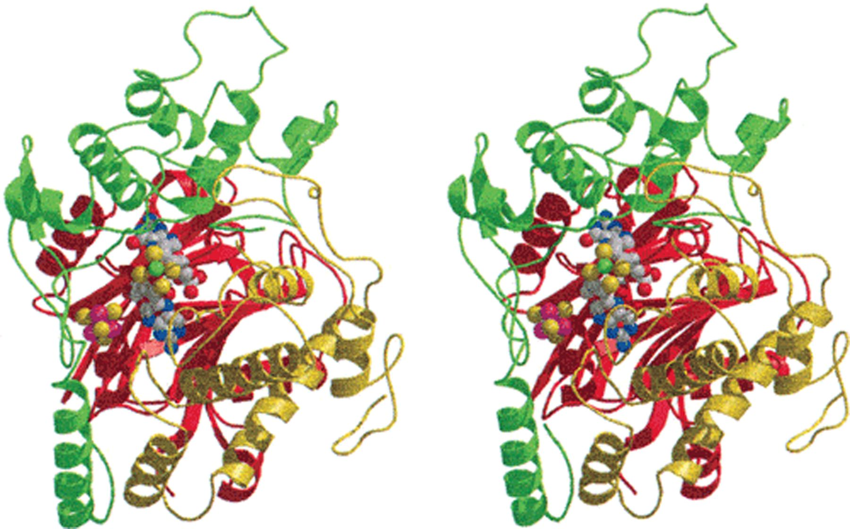
Figure 6 Structure of aldehyde ferredoxin oxidoreductase. Stereoview of α-ribbons representation of an AOR monomer ...
Notes:
Figure 6 Structure of aldehyde ferredoxin oxidoreductase. Stereoview of α-ribbons representation of an AOR monomer viewed into the active site with domains I, II and III in red, green and yellow, respectively. The cofactors are shown in ball-and-stick representation.
Unless provided in the caption above, the following copyright applies to the content of this slide: © 1999 Federation of European Microbiological Societies.

