Slide 1
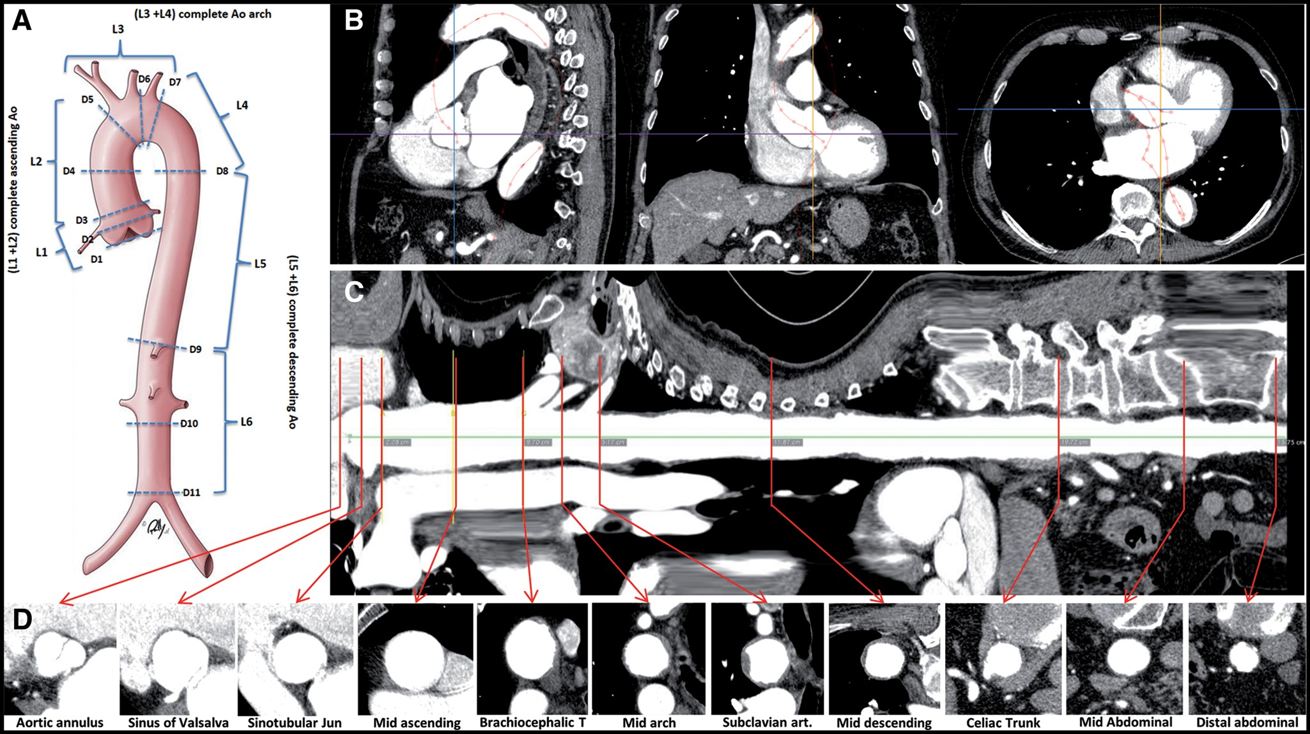
Figure 1: (A) Aortic landmarks. (B) Sagittal, frontal and transversal reconstruction of the CTA. (C) Curved multiplanar ...
Notes:
Figure 1: (A) Aortic landmarks. (B) Sagittal, frontal and transversal reconstruction of the CTA. (C) Curved multiplanar reformat of the entire aorta. (D) True short axis views at the landmarks. (D1) aortic valve annulus (AV). (D2) sinus of Valsalva (halfway between D1 and D3). (D3) sinotubular junction (STJ). (D4) mid-ascending aorta (halfway between D3 and D5). (D5) orifice of the brachiocephalic trunk (BCT). (D6) mid-aortic arch (halfway between D5 and D7). (D7) distal aortic arch (directly downstream the left subclavian artery). (D8) descending aorta (at the height of the pulmonary artery bifurcation). (D9) thoraco-abdominal (at the orifice of the celiac trunk). (D10) mid-abdominal (halfway between D9 and D11). (D11) distal abdominal (directly proximal the aortic bifurcation).
Unless provided in the caption above, the following copyright applies to the content of this slide: © The Author 2017. Published by Oxford University Press on behalf of the European Association for Cardio-Thoracic Surgery. All rights reserved.

Slide 2
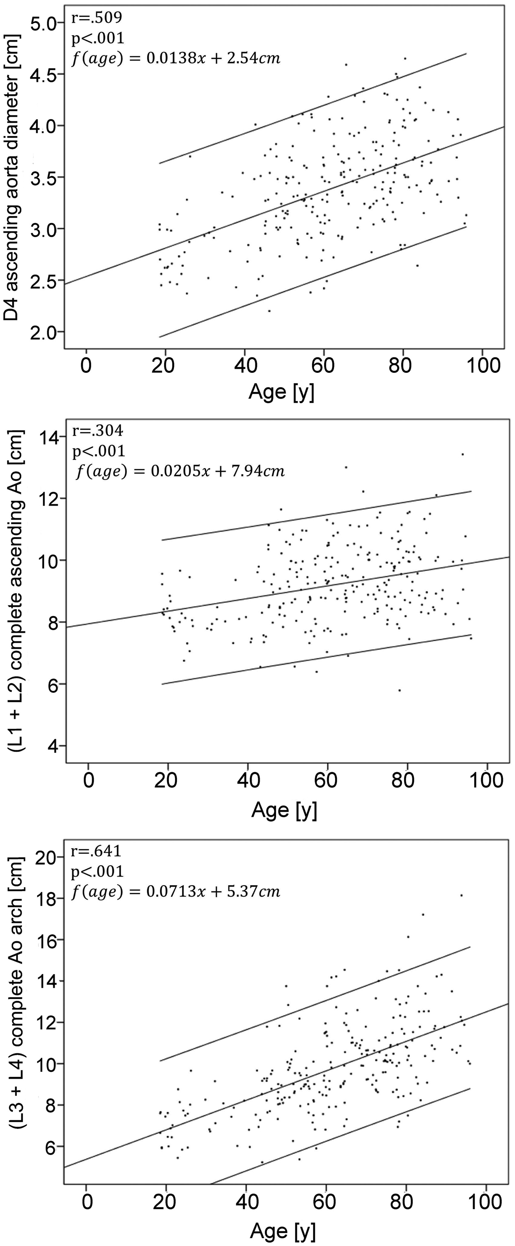
Figure 2: Scatter plots of age and the selected aortic dimensions; linear regression and 95% confidence intervals.
Notes:
Figure 2: Scatter plots of age and the selected aortic dimensions; linear regression and 95% confidence intervals.
Unless provided in the caption above, the following copyright applies to the content of this slide: © The Author 2017. Published by Oxford University Press on behalf of the European Association for Cardio-Thoracic Surgery. All rights reserved.

Slide 3
Figure 3: Aortic diameters at the landmarks in the preTAD, TAD and control groups.
Notes:
Figure 3: Aortic diameters at the landmarks in the preTAD, TAD and control groups.
Unless provided in the caption above, the following copyright applies to the content of this slide: © The Author 2017. Published by Oxford University Press on behalf of the European Association for Cardio-Thoracic Surgery. All rights reserved.

Slide 4
Figure 4: Aortic segment lengths in the preTAD, TAD and control groups.
Notes:
Figure 4: Aortic segment lengths in the preTAD, TAD and control groups.
Unless provided in the caption above, the following copyright applies to the content of this slide: © The Author 2017. Published by Oxford University Press on behalf of the European Association for Cardio-Thoracic Surgery. All rights reserved.

Slide 5
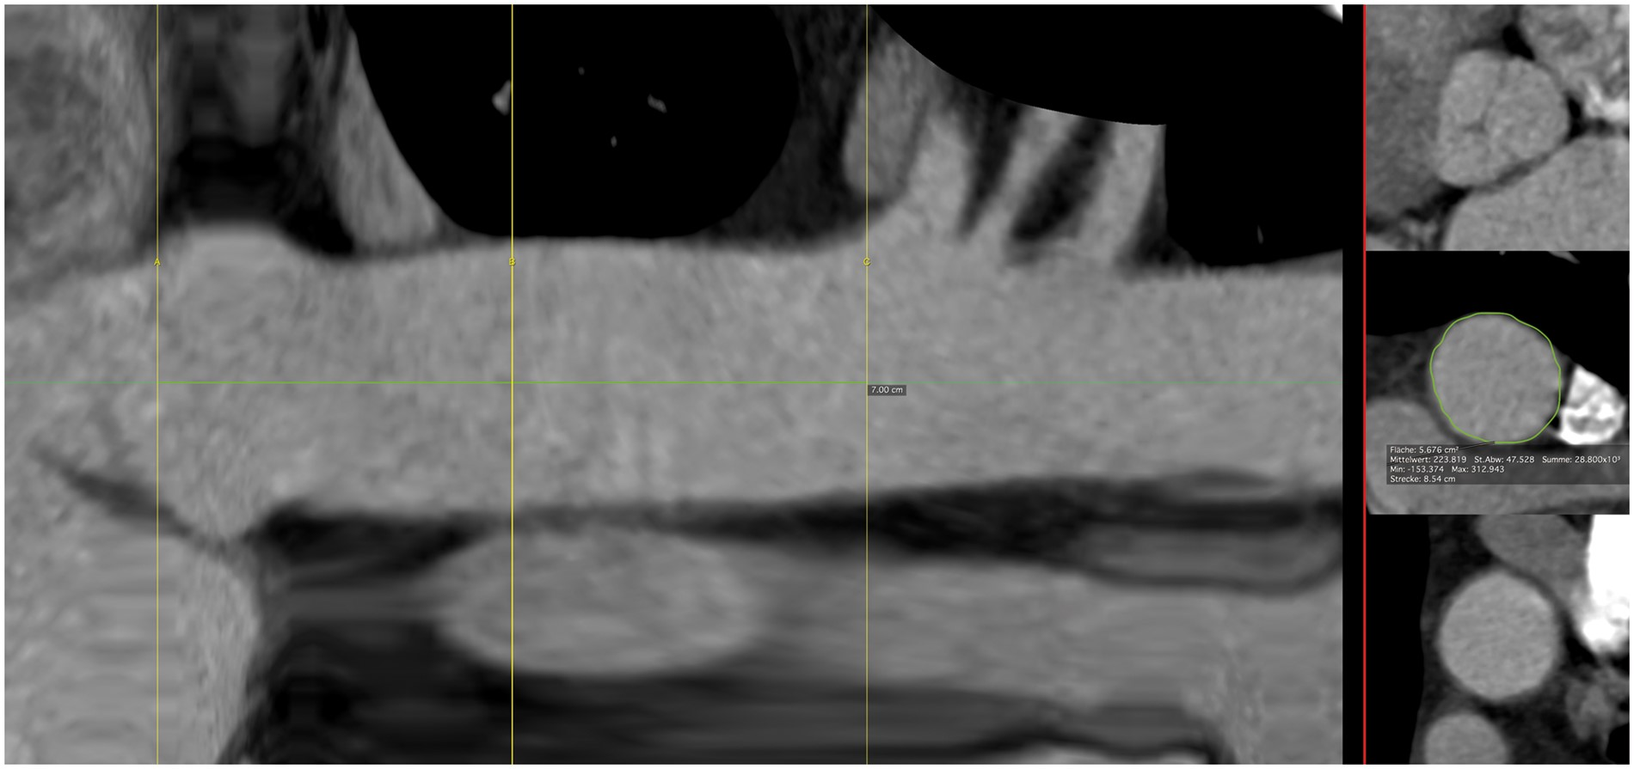
Figure 5: Practical measurements required for the TAIPAN score. Parameters of the TAIPAN ...
Notes:
Figure 5: Practical measurements required for the TAIPAN score. Parameters of the TAIPAN score ParametersmmPointsDiameter of Ao ascendens<45045–541≥552Length of Ao ascendens (3D-central line; AV to BCT)<1200≥1201AV: aortic valve annulus; BCT: brachiocephalic trunk; TAIPAN: Tübingen Aortic Pathoanatomy. Prophylactic ascending aorta replacement at ≥ 2 points.
Unless provided in the caption above, the following copyright applies to the content of this slide: © The Author 2017. Published by Oxford University Press on behalf of the European Association for Cardio-Thoracic Surgery. All rights reserved.

