Slide 1
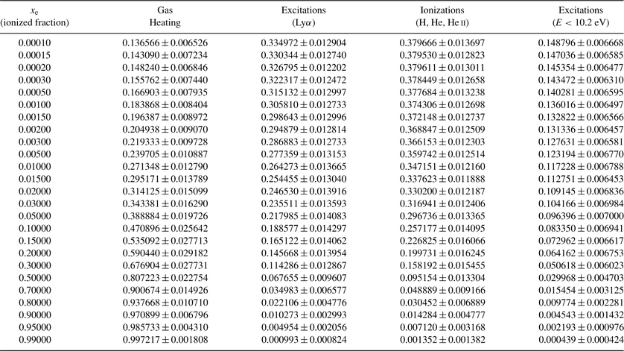
Table 1 Fraction of the energy E_{in} of a 10 keV primary electron that is deposited into heat, ionizations, ...
Notes:
Table 1 Fraction of the energy Ein of a 10 keV primary electron that is deposited into heat, ionizations, Lyα line radiation and photons with energy E < 10.2 eV after two-photon decay from the hydrogen 2s level. For every value of the ionized fraction, 1000 realizations were performed.
Unless provided in the caption above, the following copyright applies to the content of this slide: © The Authors. Journal compilation © 2008 RAS

