Slide 1
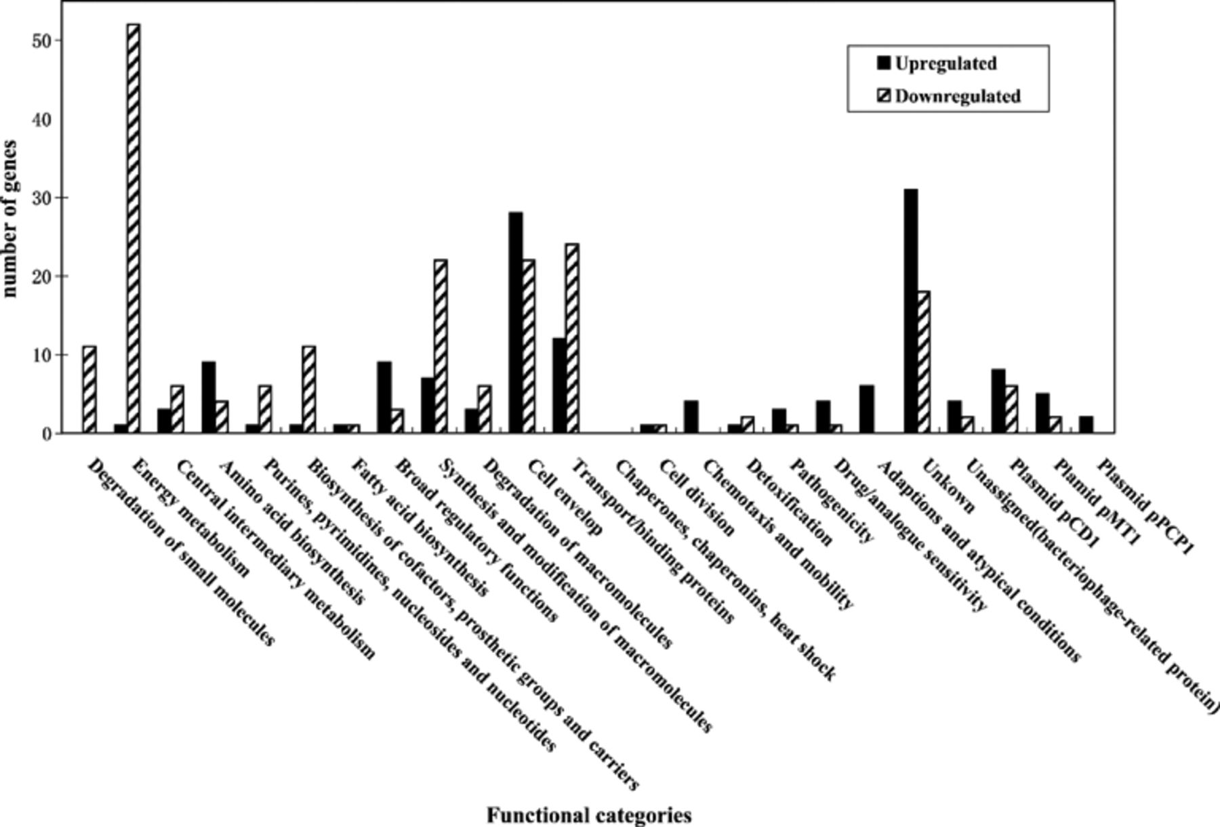
1 Differentially regulated genes grouped by functional classification according to Y. pestis CO92 genome ...
Notes:
1 Differentially regulated genes grouped by functional classification according to Y. pestis CO92 genome annotation. The differentially regulated genes on the chromosome were divided into 21 functional categories, and those on the three plasmids were listed additionally. The number of genes up-regulated and down-regulated for each functional group was represented.
Unless provided in the caption above, the following copyright applies to the content of this slide: © 2005 Federation of European Microbiological Societies

