Slide 1
Fig. 1. A summary alignment of SIV/HIV gp120 proteins produced by constock.pl. Posterior probabilities of alignment ...
Notes:
Fig. 1. A summary alignment of SIV/HIV gp120 proteins produced by constock.pl. Posterior probabilities of alignment columns are shown on the ‘PP’ line (most significant decimal digit) and by ANSI terminal color (white-on-cyan is most reliable, blue-on-black is least). Hypervariable (hV) region 5 [Leonard et al. (1990)] corresponds with a low-confidence region.
Unless provided in the caption above, the following copyright applies to the content of this slide: © The Author 2012. Published by Oxford University Press. All rights reserved. For Permissions, please email: journals.permissions@oup.com

Slide 2
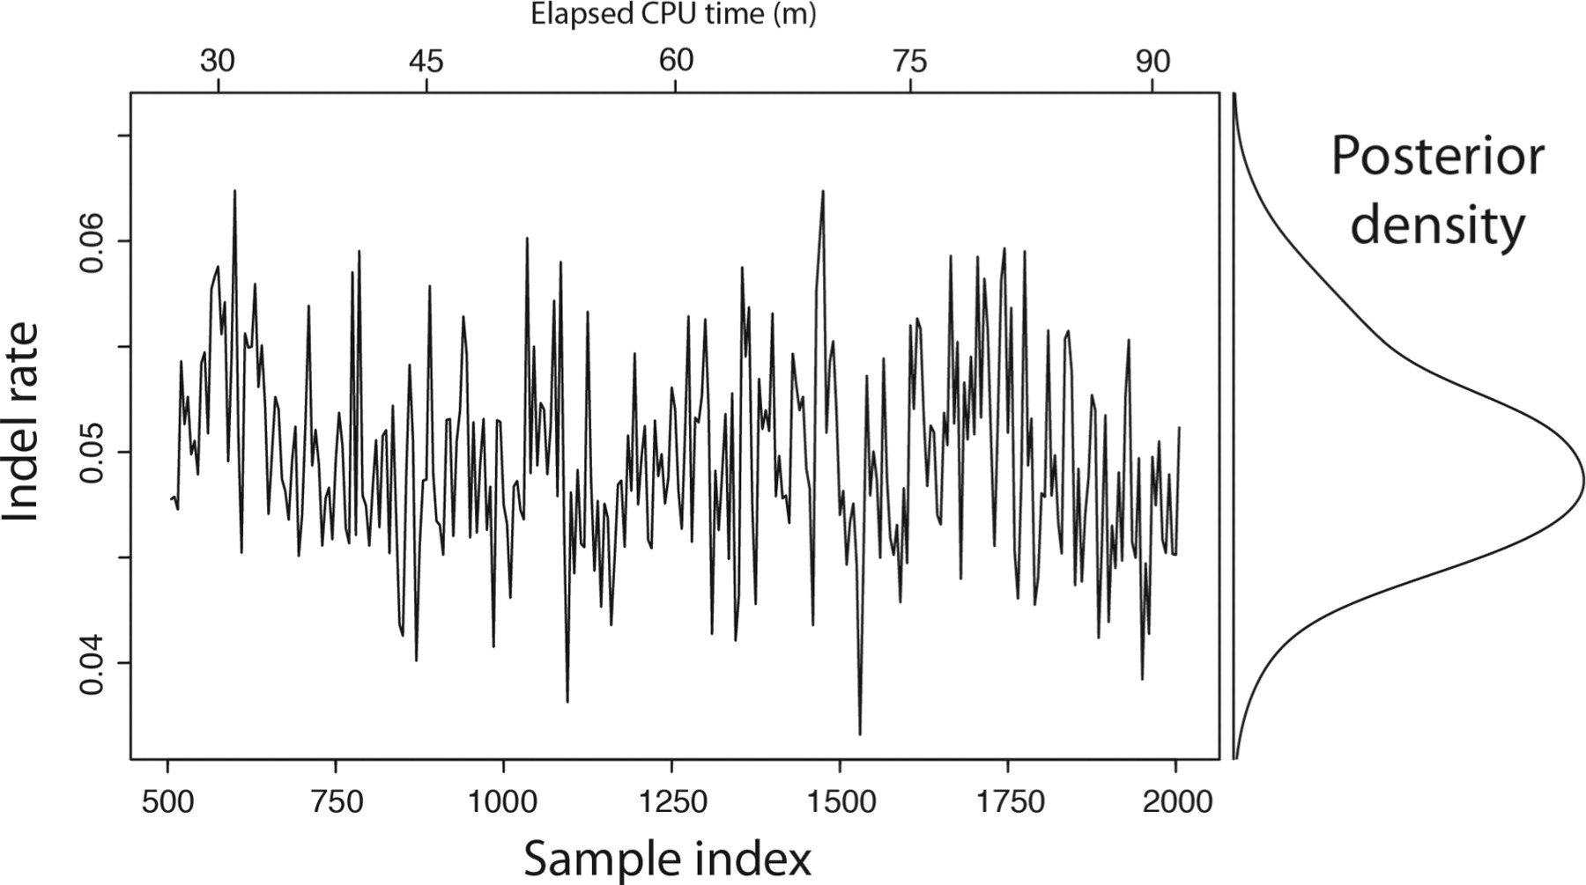
Fig. 2. The indel rate of the SIV/HIV gp120 protein has most of its probability mass concentrated between 0.04 and ...
Notes:
Fig. 2. The indel rate of the SIV/HIV gp120 protein has most of its probability mass concentrated between 0.04 and 0.06 indels per substitution. handalign was run for 90 min on a 3.4 GHz CPU, generating 2000 samples (500 discarded as burn-in). Every fifth sample is plotted; the entire trace was used to estimate the density.
Unless provided in the caption above, the following copyright applies to the content of this slide: © The Author 2012. Published by Oxford University Press. All rights reserved. For Permissions, please email: journals.permissions@oup.com

