Slide 1
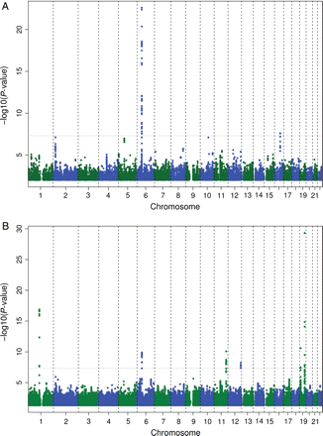
Figure 1 Association of log-transformed lipoprotein-associated phospholipase A2 mass (A) and lipoprotein-associated ...
Notes:
Figure 1 Association of log-transformed lipoprotein-associated phospholipase A2 mass (A) and lipoprotein-associated phospholipase A2 activity (B) concentrations and 2 661 766 single nucleotide polymorphisms displayed per chromosome and region. The dashed line indicates the significance threshold of P < 5 × 10−8.
Unless provided in the caption above, the following copyright applies to the content of this slide: Published on behalf of the European Society of Cardiology. All rights reserved. © The Author 2011. For permissions please email: journals.permissions@oup.com

Slide 2
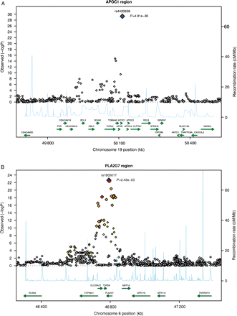
Figure 2 Regional plots for top single nucleotide polymorphisms rs4420638 (A), rs1805017 (B), rs964184 (C), rs7756935 ...
Notes:
Figure 2 Regional plots for top single nucleotide polymorphisms rs4420638 (A), rs1805017 (B), rs964184 (C), rs7756935 (D), rs10846744 (E), and rs247616 (F). LD: red: r2 (with primary SNP) >0.8; orange: r2 between 0.5 and 0.8; yellow: r2 between 0.2 and 0.5; white: r2 < 0.2.
Unless provided in the caption above, the following copyright applies to the content of this slide: Published on behalf of the European Society of Cardiology. All rights reserved. © The Author 2011. For permissions please email: journals.permissions@oup.com

Slide 3
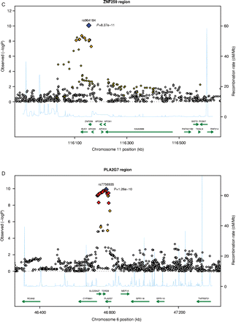
Figure 2 Continued.
Notes:
Figure 2 Continued.
Unless provided in the caption above, the following copyright applies to the content of this slide: Published on behalf of the European Society of Cardiology. All rights reserved. © The Author 2011. For permissions please email: journals.permissions@oup.com

Slide 4
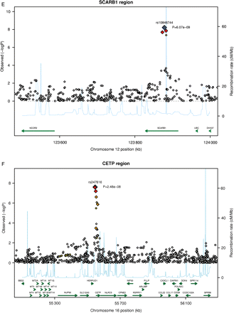
Figure 2 Continued.
Notes:
Figure 2 Continued.
Unless provided in the caption above, the following copyright applies to the content of this slide: Published on behalf of the European Society of Cardiology. All rights reserved. © The Author 2011. For permissions please email: journals.permissions@oup.com

Slide 5
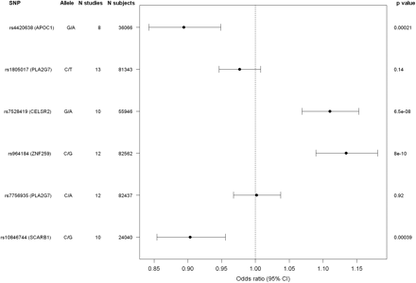
Figure 3 Association of the top single nucleotide polymorphisms in six loci with prevalent CHD/CAD in the CARDIoGRAM ...
Notes:
Figure 3 Association of the top single nucleotide polymorphisms in six loci with prevalent CHD/CAD in the CARDIoGRAM consortium.
Unless provided in the caption above, the following copyright applies to the content of this slide: Published on behalf of the European Society of Cardiology. All rights reserved. © The Author 2011. For permissions please email: journals.permissions@oup.com

