Slide 1
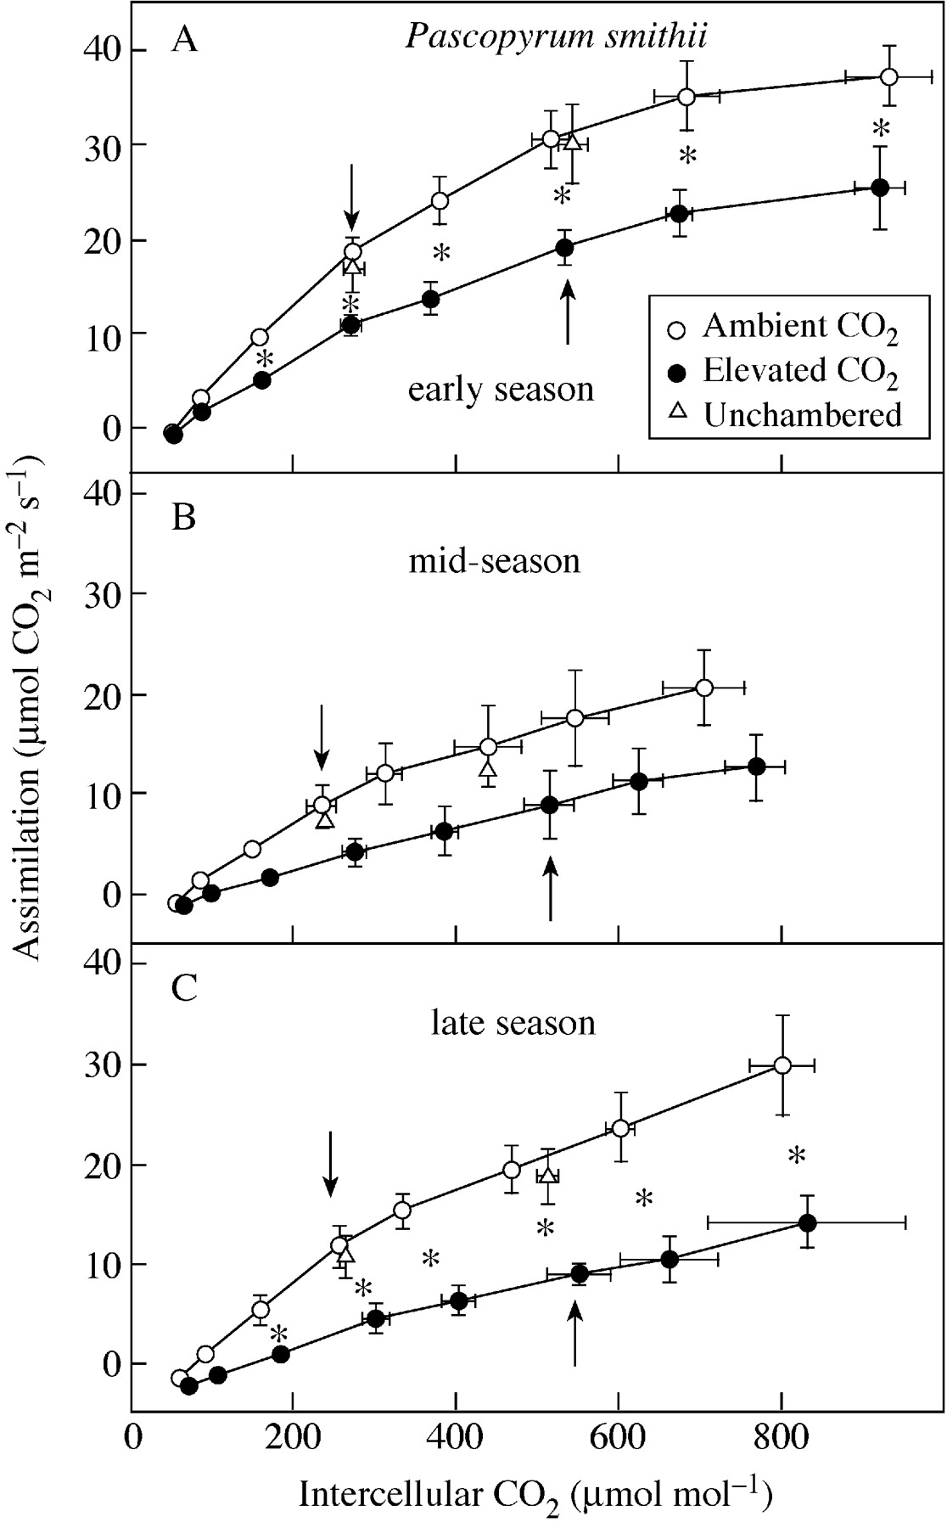
Fig. 2. Assimilation vs. intercellular CO₂ concentration of Pascopyrum smithii grown in open‐top ...
Notes:
Fig. 2. Assimilation vs. intercellular CO2 concentration of Pascopyrum smithii grown in open‐top chambers with ambient (360 µmol mol–1) and elevated (720 µmol mol–1) CO2, and in plots without chambers on the Colorado shortgrass steppe over the course of the 1999 growing season. Data are means of three replications ± s.e. An asterisk indicates a significant effect of CO2 treatment at P < 0·05. Arrows indicate data at the treatment [CO2].
Unless provided in the caption above, the following copyright applies to the content of this slide:

Slide 2
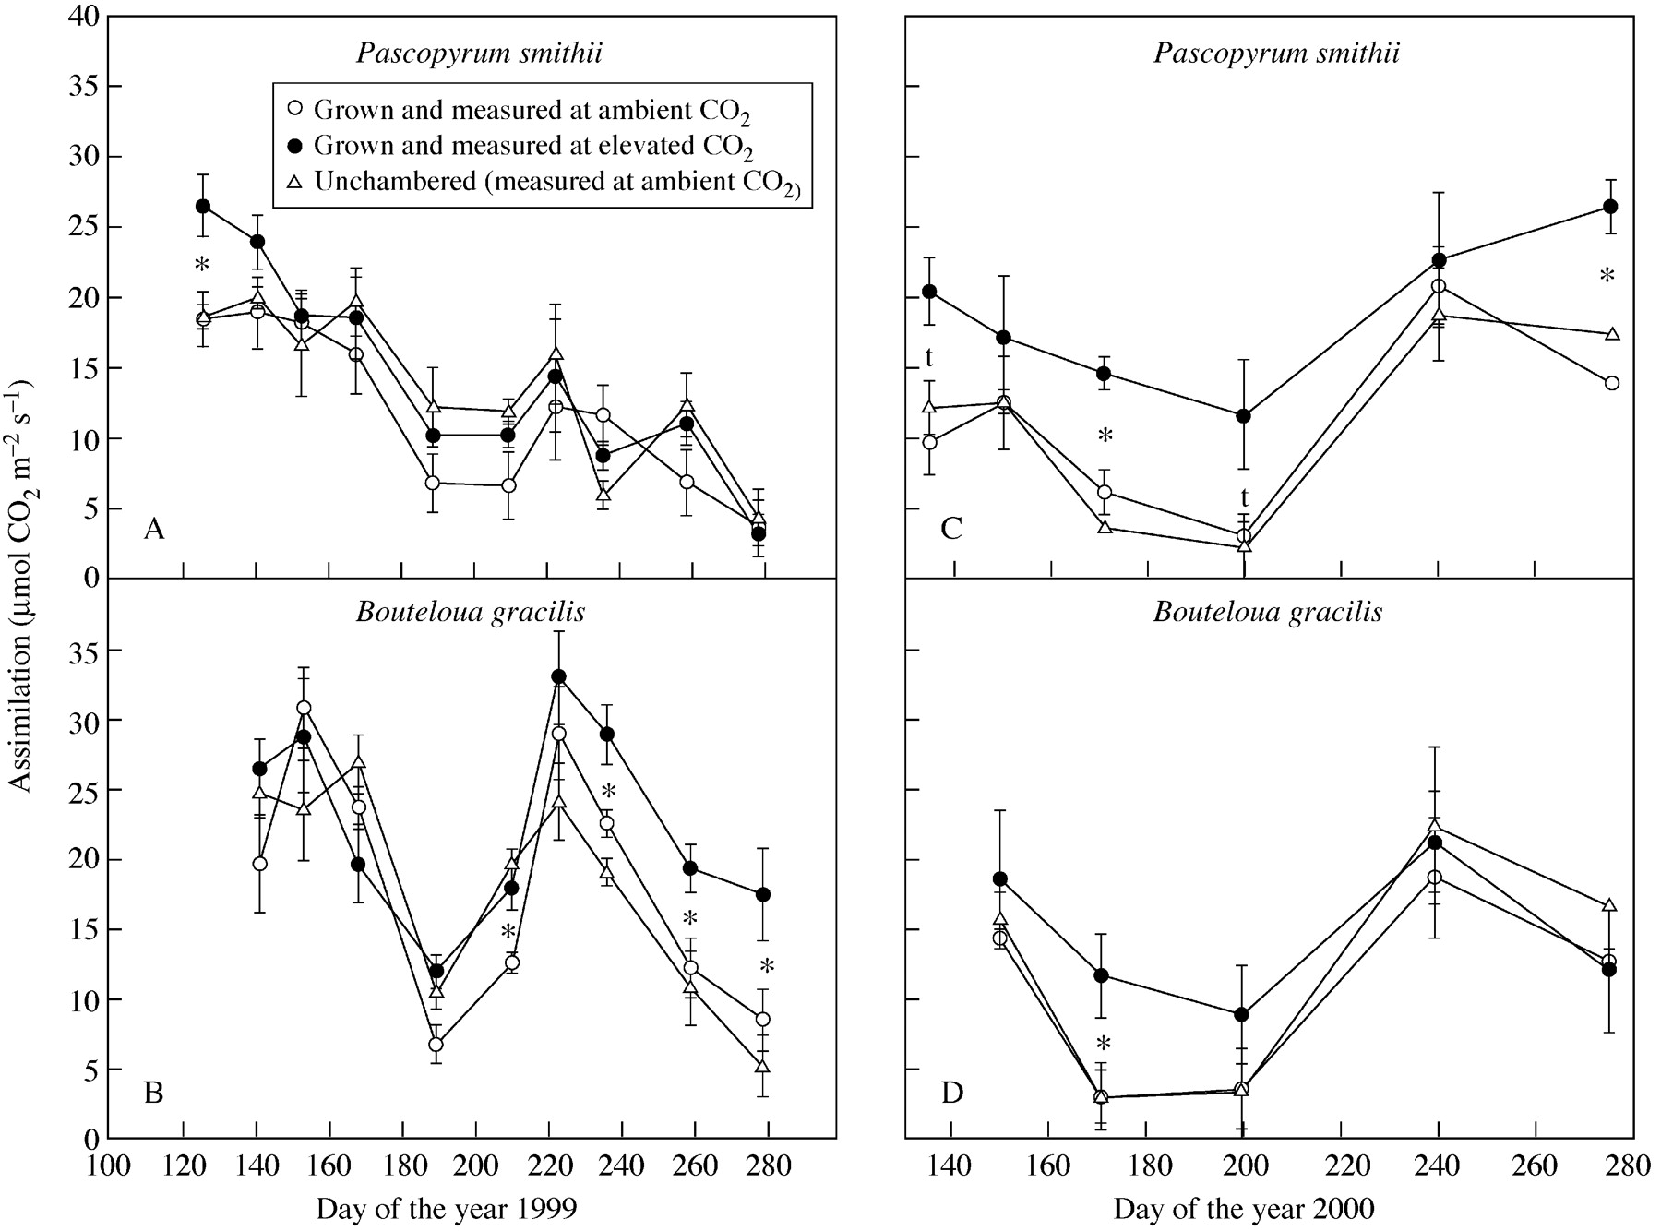
Fig. 3. Assimilation of Pascopyrum smithii and Boutleoua gracilis grown in open‐top chambers with ambient ...
Notes:
Fig. 3. Assimilation of Pascopyrum smithii and Boutleoua gracilis grown in open‐top chambers with ambient (360 µmol mol–1) and elevated (720 µmol mol–1) CO2, and in plots without chambers on the Colorado shortgrass steppe during the growing seasons of 1999 and 2000. Measurements were made at the chamber CO2 concentrations. Data are means of three replications ± s.e. An asterisk indicates an effect of CO2 treatment significant at P < 0·05; t, P < 0·10.
Unless provided in the caption above, the following copyright applies to the content of this slide:

Slide 3
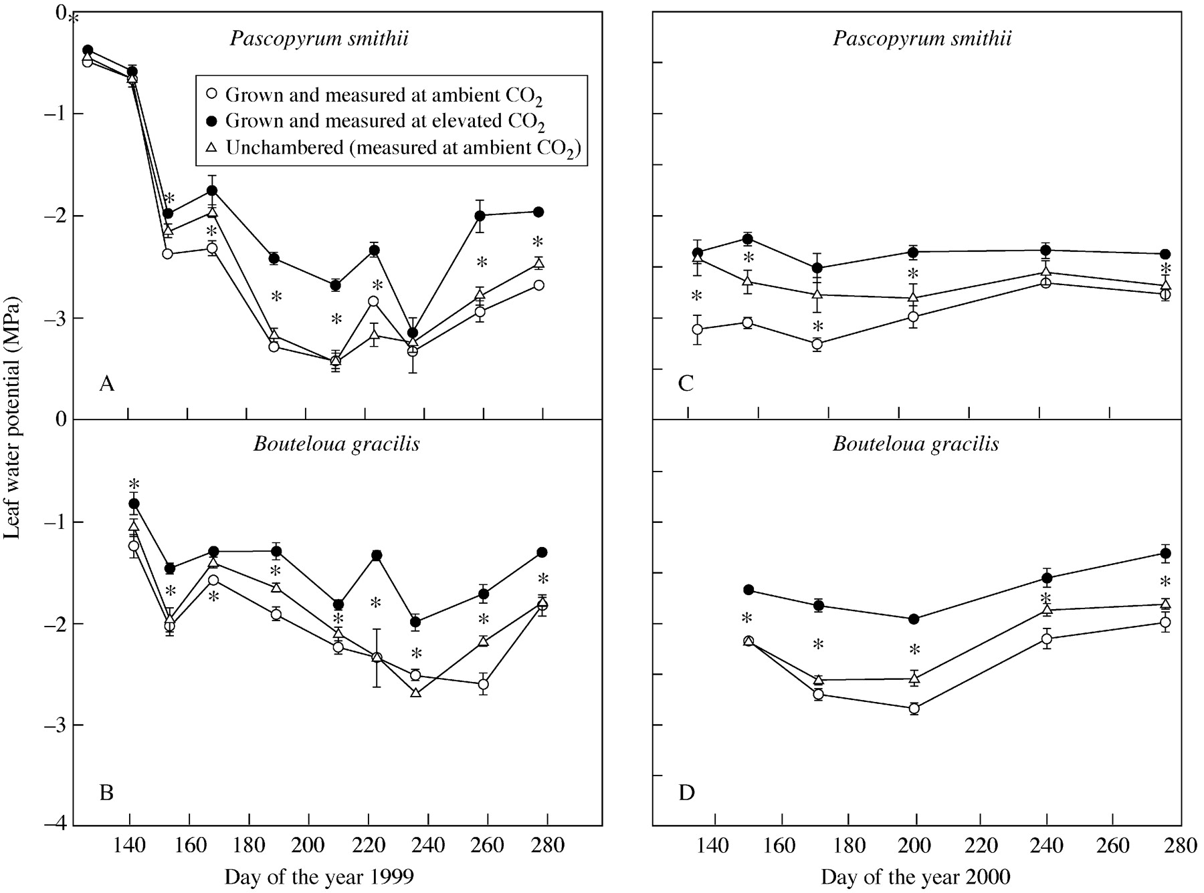
Fig. 4. Leaf water potential of Pascopyrum smithii and Boutleoua gracilis grown in open‐top chambers with ...
Notes:
Fig. 4. Leaf water potential of Pascopyrum smithii and Boutleoua gracilis grown in open‐top chambers with ambient (360 µmol mol–1) and elevated (720 µmol mol–1) CO2, and in plots without chambers on the Colorado shortgrass steppe during the growing seasons of 1999 and 2000. Data are means of three replications ± s.e. An asterisk indicates a significant effect of CO2 treatment at P < 0·05.
Unless provided in the caption above, the following copyright applies to the content of this slide:

Slide 4
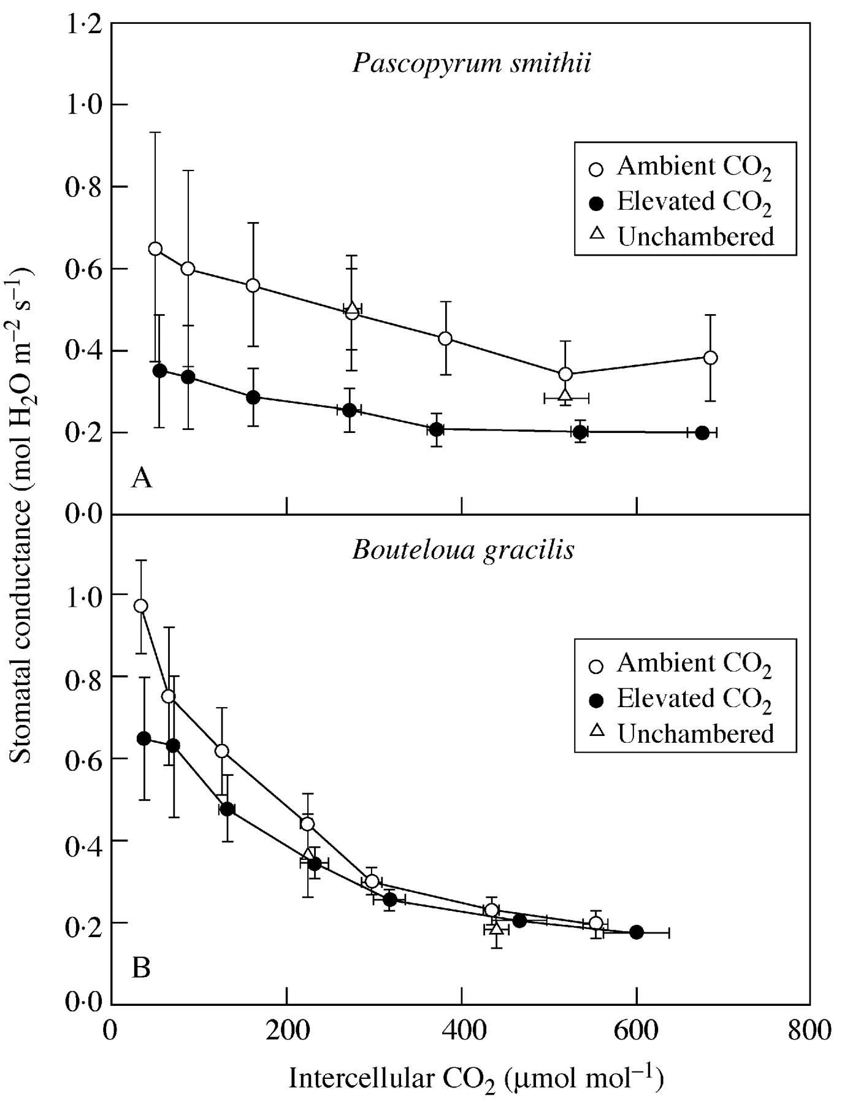
Fig. 5. Stomatal conductance vs. intercellular CO₂ of Pascopyrum smithii and Boutleoua gracilis ...
Notes:
Fig. 5. Stomatal conductance vs. intercellular CO2 of Pascopyrum smithii and Boutleoua gracilis grown in open‐top chambers with ambient (360 µmol mol–1) and elevated (720 µmol mol–1) CO2 and in plots without chambers on the Colorado shortgrass steppe. Measurements made during May 1999. Data are means of three replications ± s.e. The CO2 treatment effect was not significant.
Unless provided in the caption above, the following copyright applies to the content of this slide:

Slide 5
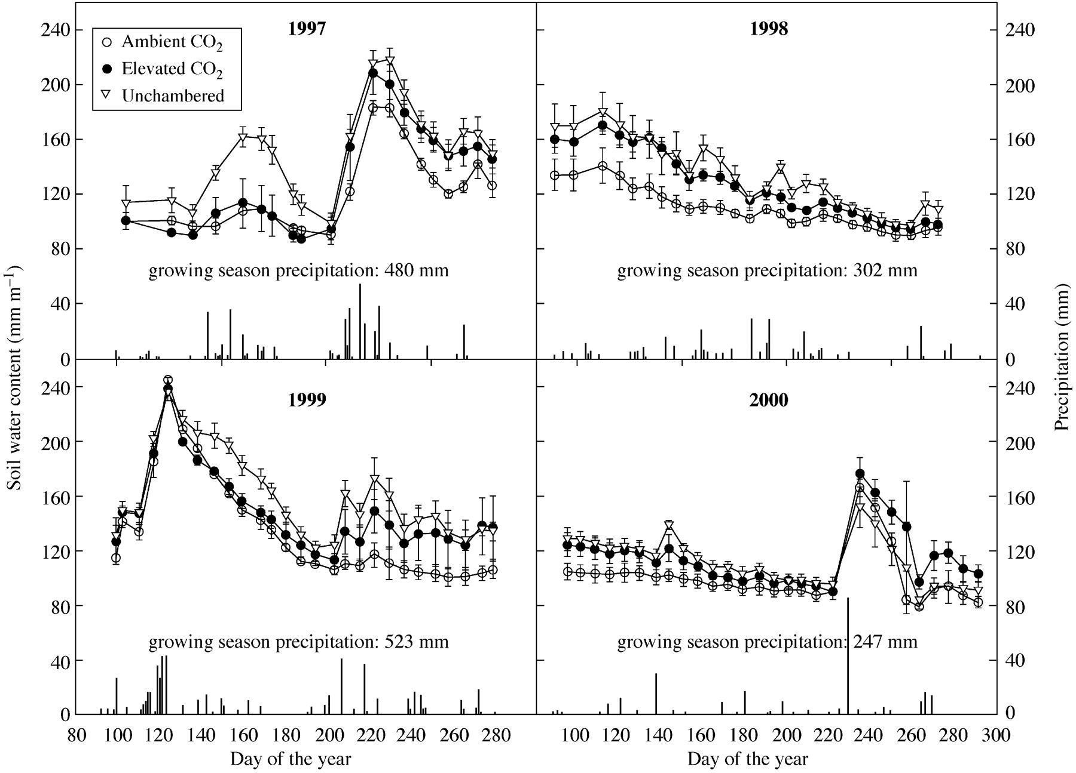
Fig. 1. Soil moisture (to 1 m) and growing season precipitation for 4 years in open‐top chambers with ambient ...
Notes:
Fig. 1. Soil moisture (to 1 m) and growing season precipitation for 4 years in open‐top chambers with ambient (360 µmol mol–1) and elevated (720 µmol mol–1) CO2 and in plots without chambers on the Colorado shortgrass steppe. Data are means of three replications ± s.e.
Unless provided in the caption above, the following copyright applies to the content of this slide:

Slide 6
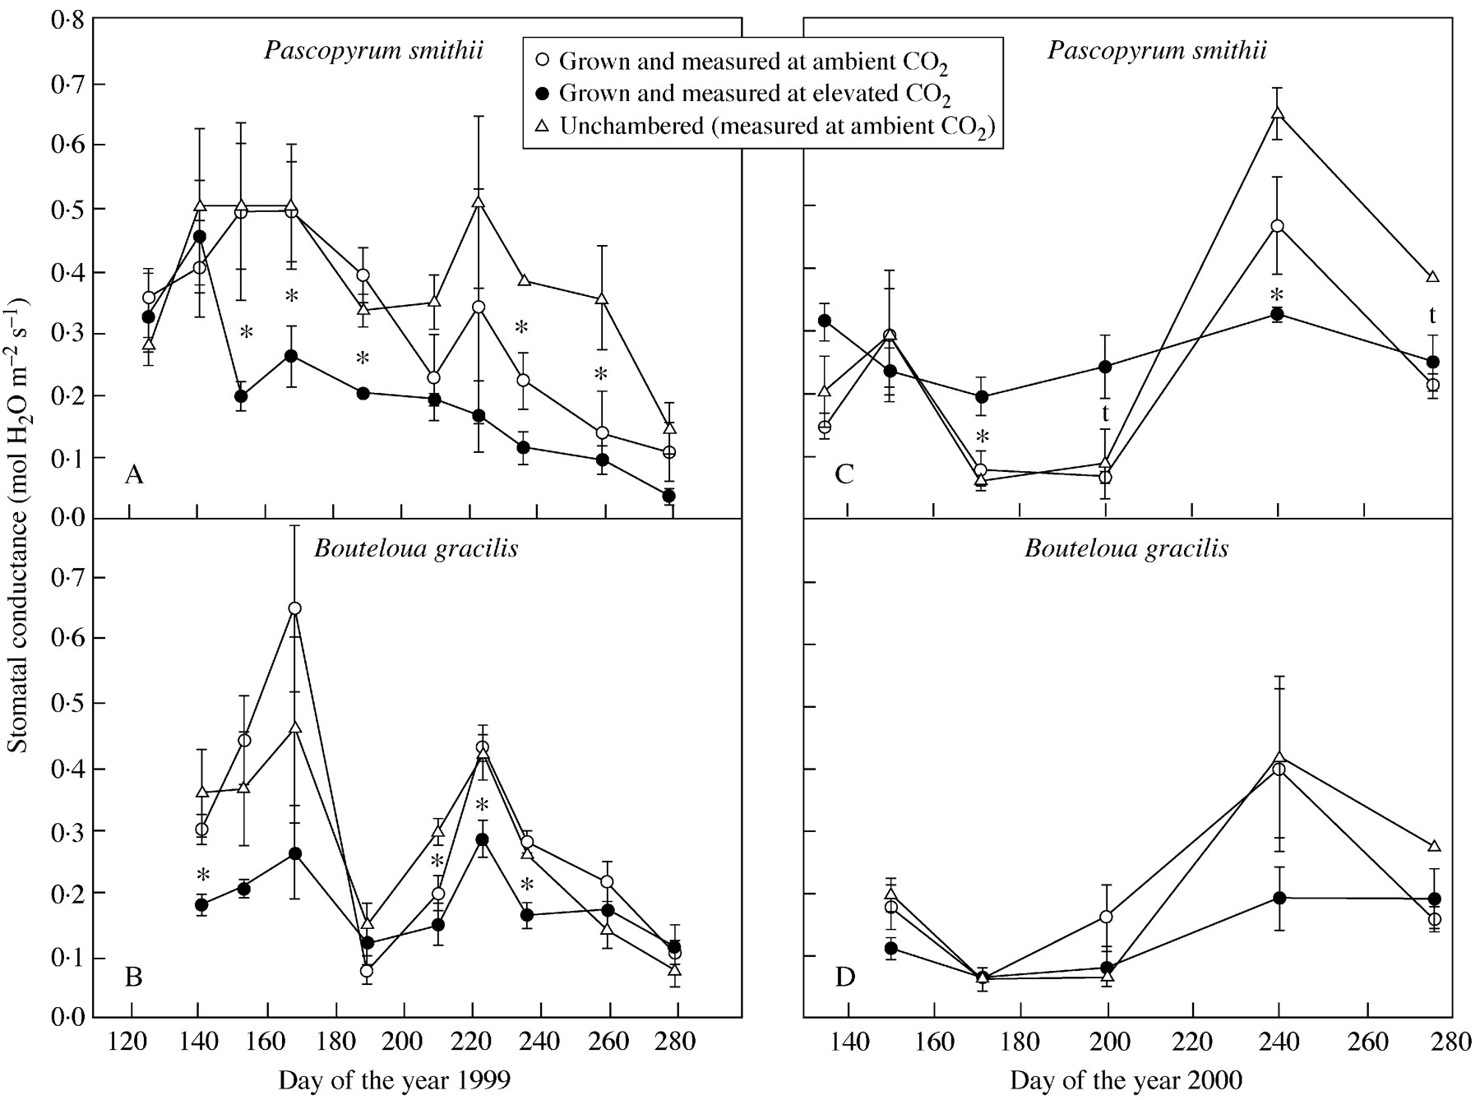
Fig. 6. Stomatal conductance of Pascopyrum smithii and Boutleoua gracilis grown in open‐top chambers with ...
Notes:
Fig. 6. Stomatal conductance of Pascopyrum smithii and Boutleoua gracilis grown in open‐top chambers with ambient (360 µmol mol–1) and elevated (720 µmol mol–1) CO2, and in plots without chambers on the Colorado shortgrass steppe during the growing seasons of 1999 and 2000. Measurements were made at the chamber CO2 concentrations. Data are means of three replications ± s.e. An asterisk indicates an effect of CO2 treatment significant at P < 0·05; t, P < 0·10.
Unless provided in the caption above, the following copyright applies to the content of this slide:

Slide 7
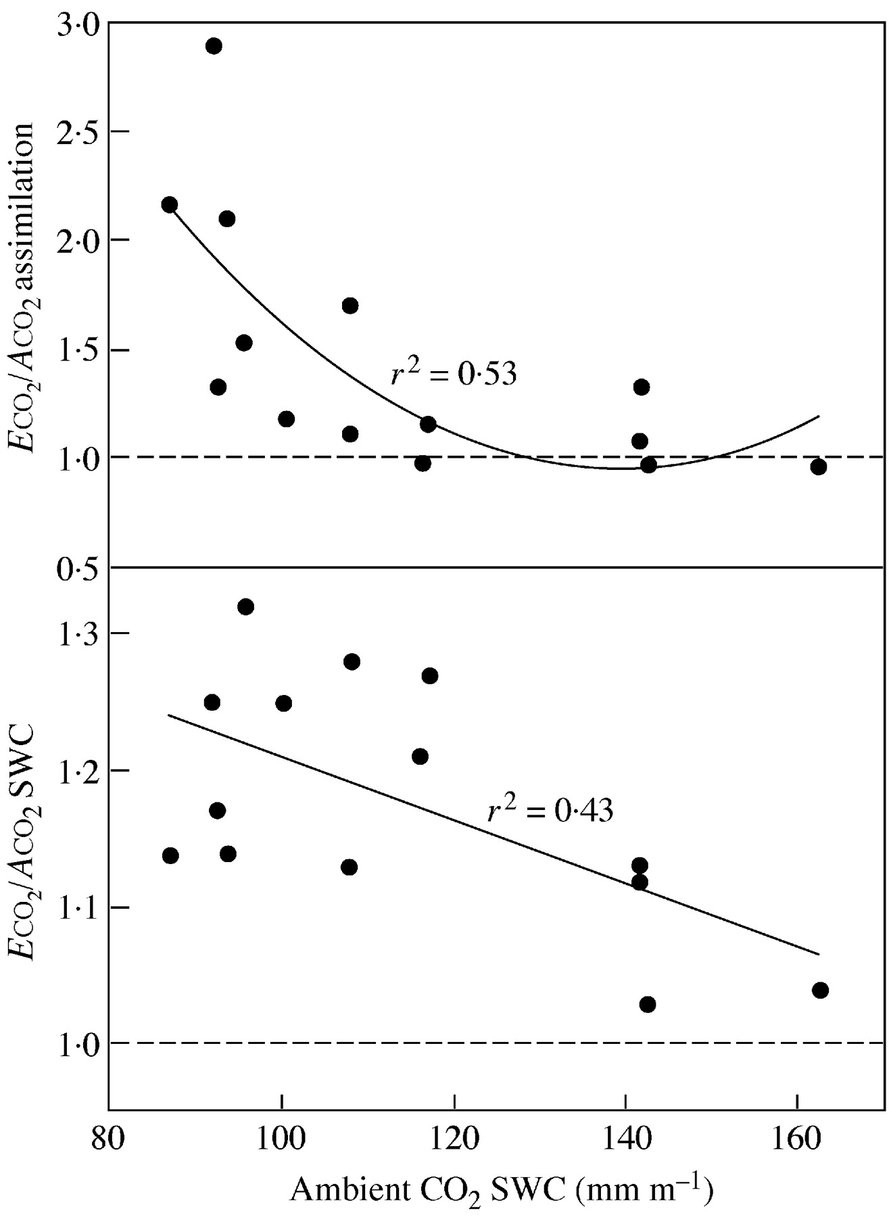
Fig. 7. 1999 and 2000 assimilation (A) and soil water content (SWC) data in elevated (E: 720 µmol ...
Notes:
Fig. 7. 1999 and 2000 assimilation (A) and soil water content (SWC) data in elevated (E: 720 µmol mol–1) relative to ambient (A: 360 µmol mol–1) CO2 chambers, plotted against the ambient CO2 SWC. Lines are a linear regression for SWC and a second order polynomial for assimilation. Both correlations are significant (P < 0·05).
Unless provided in the caption above, the following copyright applies to the content of this slide:

