Slide 1
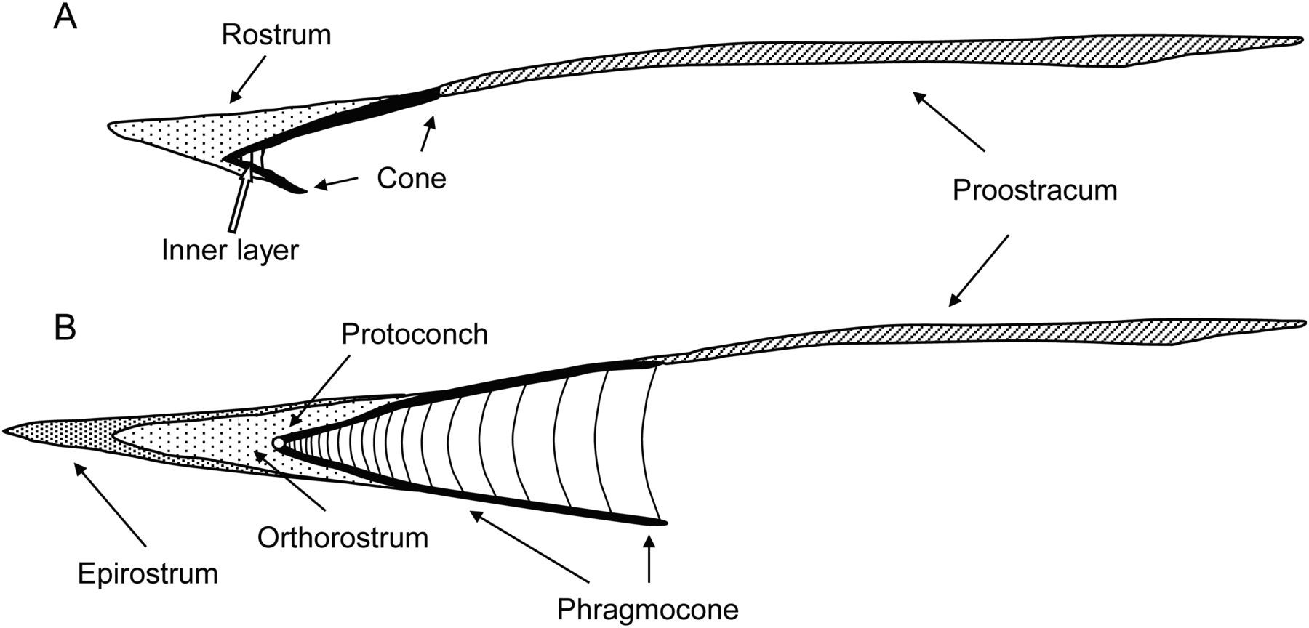
Figure 1. Schematic structure and terminology of the inner shell in coleoid cephalopods. Lateral view of the frontal ...
Notes:
Figure 1. Schematic structure and terminology of the inner shell in coleoid cephalopods. Lateral view of the frontal section, posterior part facing left. A. Gladius of the rostrum-bearing Recent Onykia (Onychoteuthidae). B. Inner shell of the Jurassic belemnite Megateuthis. Relationship of shell parts is discussed in the text and by Naef (1921–23), Bizikov (2008) and Arkhipkin et al. (2012).
Unless provided in the caption above, the following copyright applies to the content of this slide: © The Author 2015. Published by Oxford University Press on behalf of The Malacological Society of London, all rights reserved

Slide 2
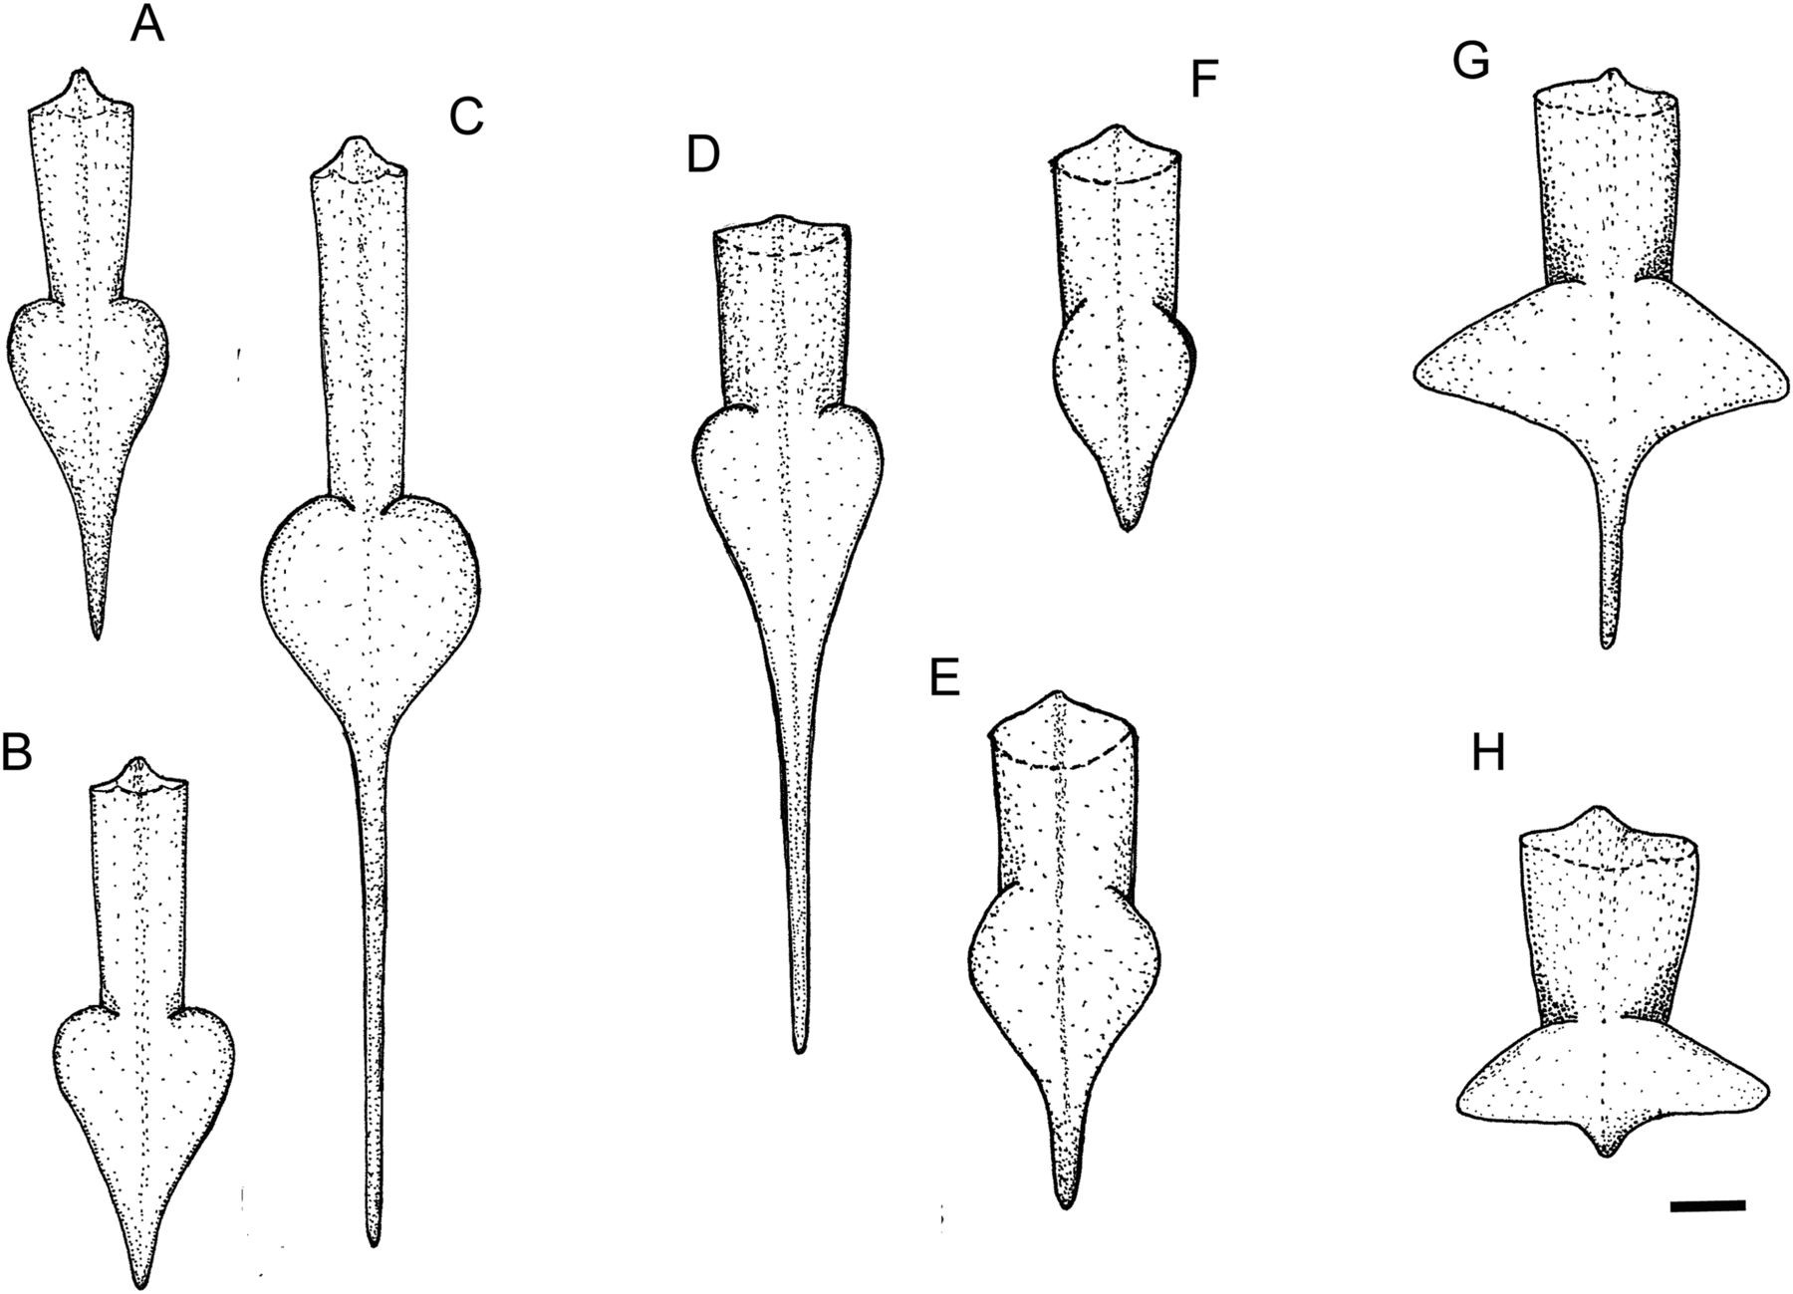
Figure 2. Body shape in tailed squid. A–C.Alloteuthis africana.A. Maturing male. B. Mature female. C. Mature male. ...
Notes:
Figure 2. Body shape in tailed squid. A–C.Alloteuthis africana.A. Maturing male. B. Mature female. C. Mature male. D–F.A. subulata.D. Mature large male. E. Mature small male. F. Mature female. G, H.Lycoteuthis springeri.G. Mature male. H. Mature female. Scale bar = 1 cm.
Unless provided in the caption above, the following copyright applies to the content of this slide: © The Author 2015. Published by Oxford University Press on behalf of The Malacological Society of London, all rights reserved

Slide 3
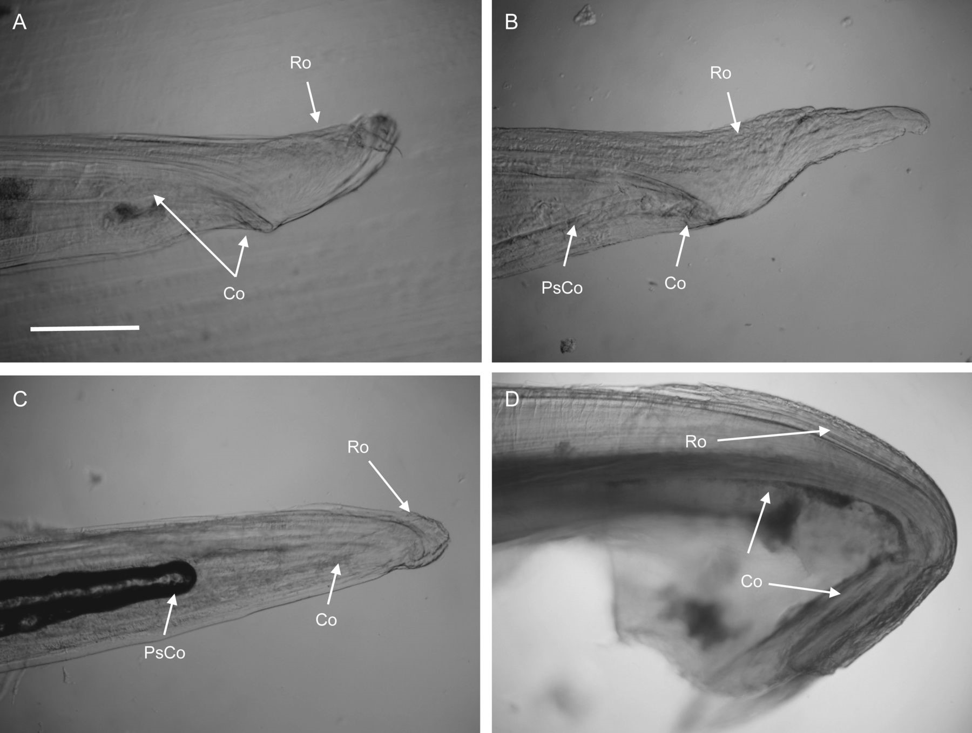
Figure 3. Microstructure of posterior part of gladius in recent squid. A.Alloteuthis africana, mature female. B.A. ...
Notes:
Figure 3. Microstructure of posterior part of gladius in recent squid. A.Alloteuthis africana, mature female. B.A. subulata, mature female in which pseudocone has started to develop. C.A. subulata, mature male with fully developed pseudocone (with some air trapped inside). D. Lycoteuthis springeri, mature female. Abbreviations: Ro, rostrum; Co, cone; PsCo, pseudocone. Scale bar = 0.5 mm.
Unless provided in the caption above, the following copyright applies to the content of this slide: © The Author 2015. Published by Oxford University Press on behalf of The Malacological Society of London, all rights reserved

Slide 4
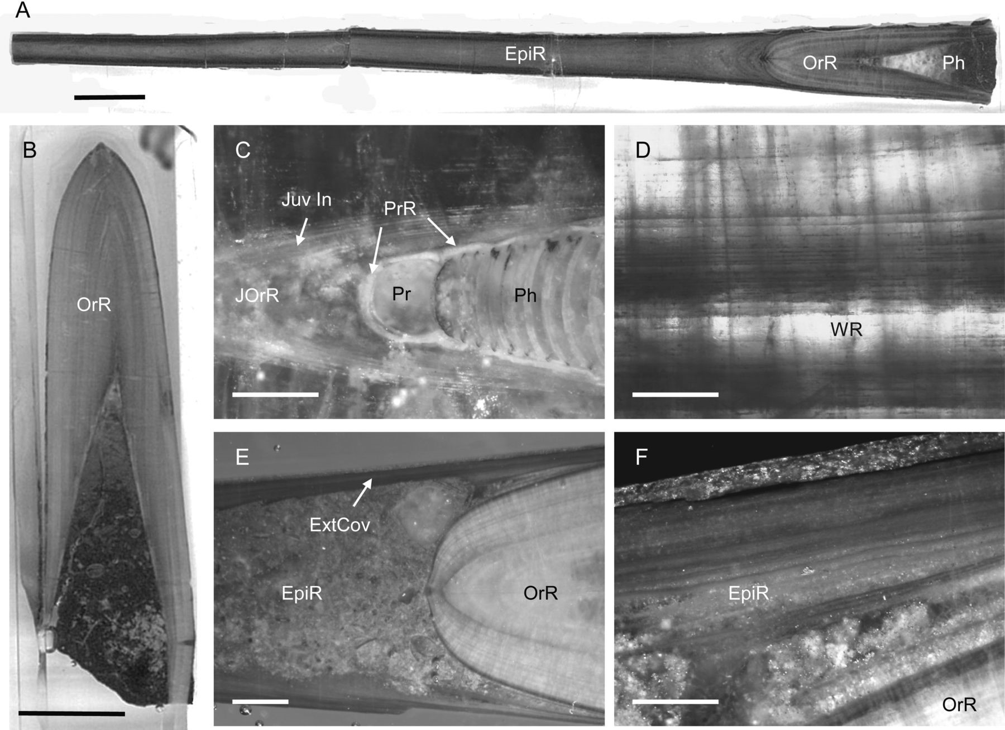
Figure 4. Dactyloteuthis semistriata. A. General view of the adult rostrum with phragmocone, orthorostrum and ...
Notes:
Figure 4. Dactyloteuthis semistriata. A. General view of the adult rostrum with phragmocone, orthorostrum and epirostrum broken at the end. B. General view of the subadult guard with fully developed orthorostrum. C. Juvenile region of rostrum with protoconch, primordial rostrum, juvenile part of orthorostrum and septa of phragmocone. D. Growth microincrements in middle part of orthorostrum. E. Transition between orthorostrum and epirostrum, with epirostrum cavity filled with sediment or cement. F. Microstructure of transition between orthorostrum and epirostrum, with growth microincrements visible in peripheral part of epirostrum. Abbreviations: Ph, phragmocone; OrR, orthorostrum; EpiR, epirostrum; Pr, protoconch; PrR, primordial rostrum; JOrR, juvenile part of orthorostrum; Juv In, juvenile growth increments; ExtCov, external covering of epirostrum. Scale bars: A, B = 1 cm; E = 2 mm; C, D, F = 0.5 mm.
Unless provided in the caption above, the following copyright applies to the content of this slide: © The Author 2015. Published by Oxford University Press on behalf of The Malacological Society of London, all rights reserved

Slide 5
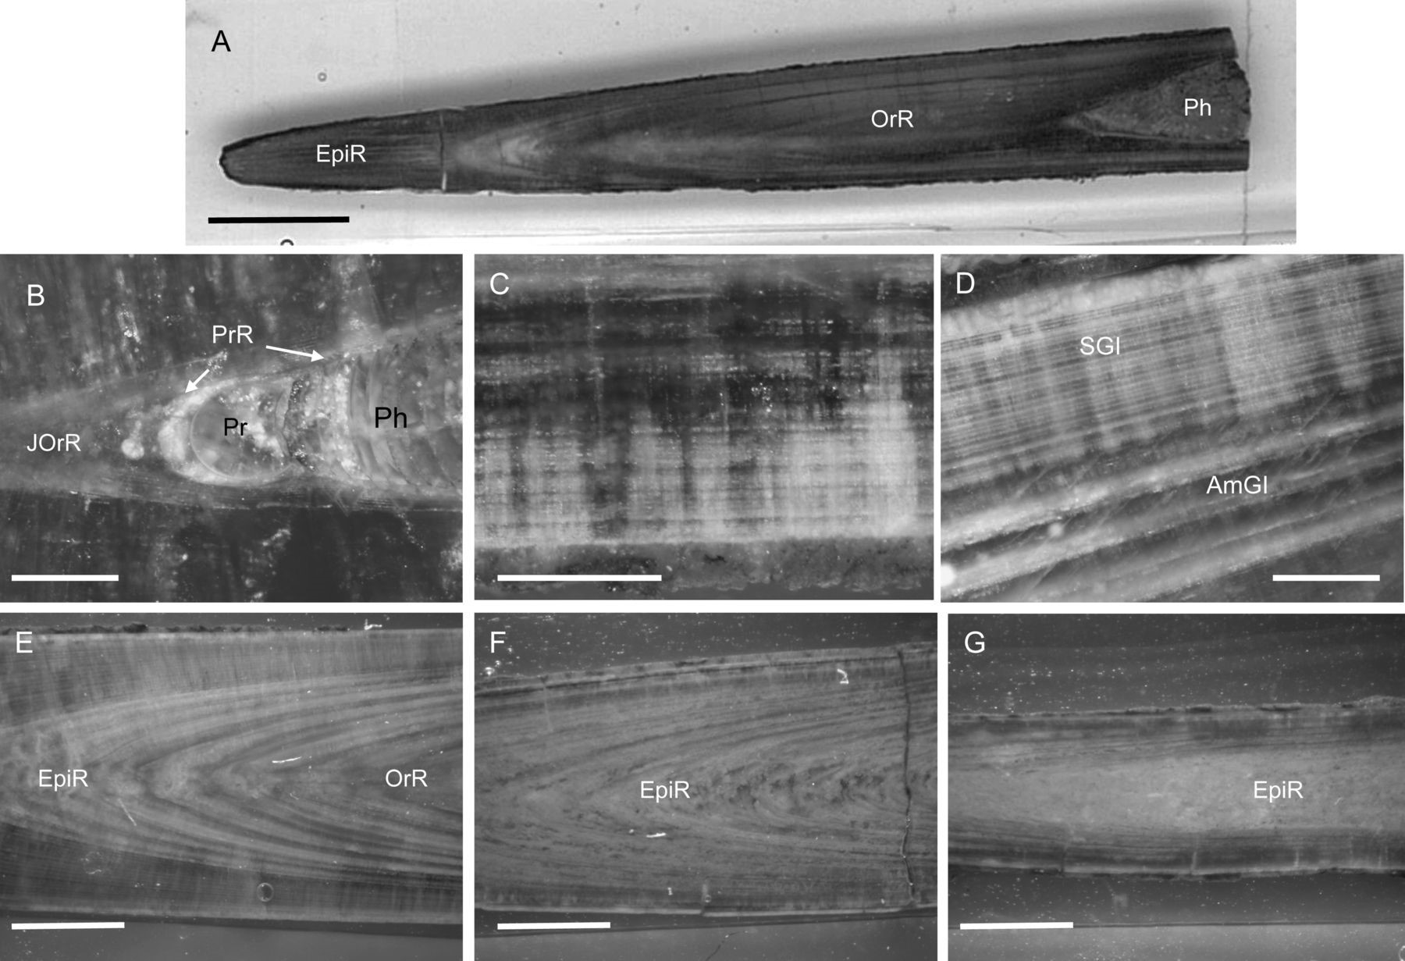
Figure 5. Acrocoelites riegrafi. A. General view of adult rostrum with phragmocone cavity, orthorostrum and epirostrum ...
Notes:
Figure 5. Acrocoelites riegrafi. A. General view of adult rostrum with phragmocone cavity, orthorostrum and epirostrum broken at the end. B. Juvenile region of rostrum with protoconch, primordial rostrum, juvenile part of orthorostrum and septa of phragmocone. C. Growth microincrements in middle part of orthorostrum. D. Transition between orthorostrum with solid growth increments and epirostrum with amorphous growth increments. E. Transition between orthorostrum and epirostrum. F. Middle part of epirostrum. G. Apical part of epirostrum with amorphous structure in the middle. Abbreviations: SGI, solid growth increments in orthorostrum; AmGI, amorphous growth increments in epirostrum; the rest is the same as in Figure 4. Scale bars: A = 1 cm; B–D = 0.5 mm; E–G = 2 mm.
Unless provided in the caption above, the following copyright applies to the content of this slide: © The Author 2015. Published by Oxford University Press on behalf of The Malacological Society of London, all rights reserved

Slide 6
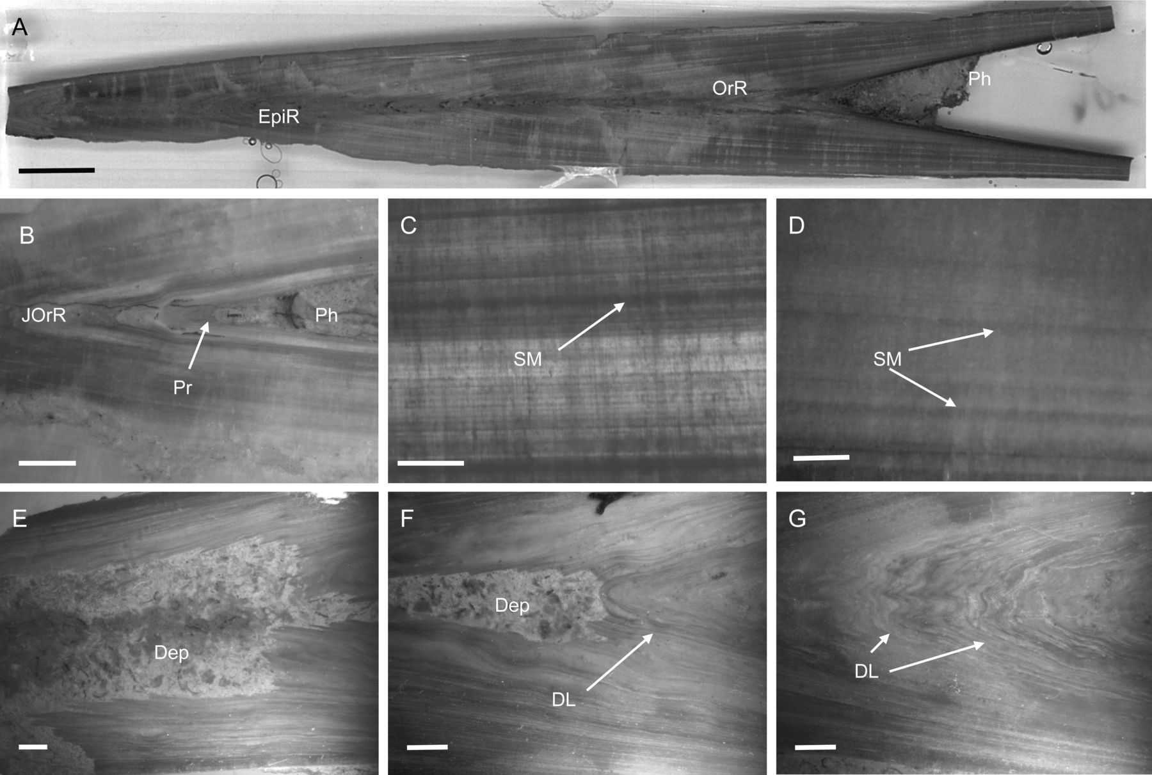
Figure 6. Megateuthis species A.M. elliptica. General view of adult rostrum with phragmocone, orthorostrum and ...
Notes:
Figure 6. Megateuthis species A.M. elliptica. General view of adult rostrum with phragmocone, orthorostrum and epirostrum broken at the end. B.M. suevica. Juvenile region of rostrum with protoconch, juvenile part of orthorostrum and phragmocone. C. Growth microincrements in middle part of orthorostrum with stress marks. D. Growth microincrements in peripheral part of orthorostrum with stress marks. E. Apical part of epirostrum with deposits filling middle part. F. Middle part of epirostrum with preserved but deformed growth layers and cavity partly filled with deposits. G. Middle part of epirostrum with deformed layers in middle part. Abbreviations: SM, stress marks; Dep, deposit filling; DL, deformed growth layers; the rest is the same as in Figure 4. Scale bars: A = 1 cm; B, E–G = 2 mm; C, D = 0.5 mm.
Unless provided in the caption above, the following copyright applies to the content of this slide: © The Author 2015. Published by Oxford University Press on behalf of The Malacological Society of London, all rights reserved

Slide 7
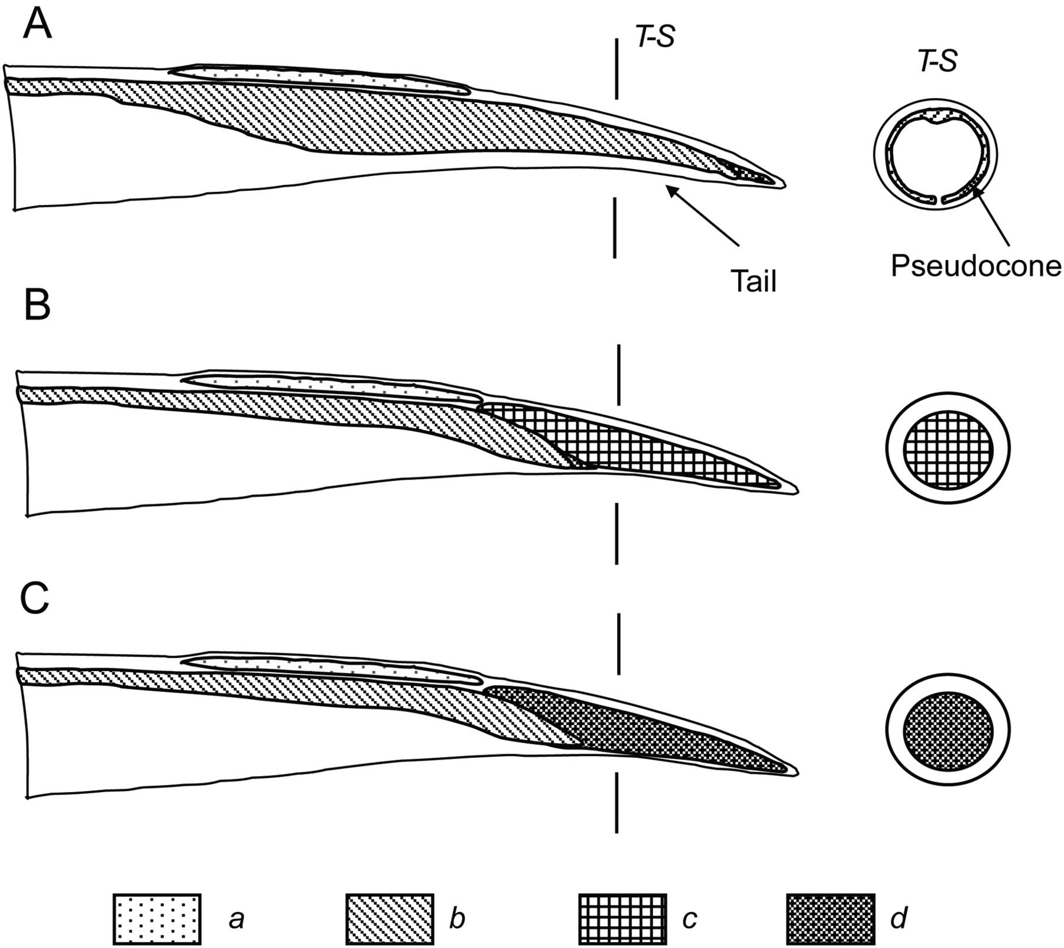
Figure 7. Schematic structure of posterior part of body with developed tail in coleoid cephalopods. Left, lateral view ...
Notes:
Figure 7. Schematic structure of posterior part of body with developed tail in coleoid cephalopods. Left, lateral view of frontal body section. Right, transverse cross-section (T-S) of tail. A.Alloteuthis type with gladius pseudocone supporting tail from inside. B.Lycoteuthis springeri type with apical vacuolated cartilage (derivative of fin cartilage) supporting tail from inside. Note that rostrum is very small. C.Onykia type with elongated rostrum supporting tail from inside. Similar tail development is characteristic of Jurassic belemnites. Abbreviations: a, fin; b, gladius cone and proostracum; c, apical vacuolated cartilage; d, rostrum.
Unless provided in the caption above, the following copyright applies to the content of this slide: © The Author 2015. Published by Oxford University Press on behalf of The Malacological Society of London, all rights reserved

Slide 8
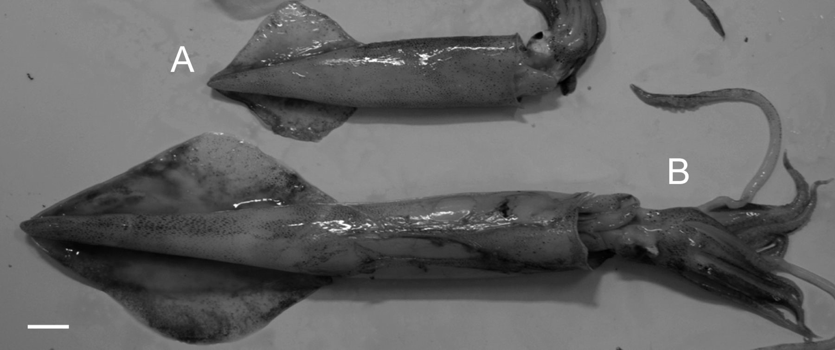
Figure 8. Differences in body shape in males of Doryteuthis gahi. A. Normal-sized mature male. B. Large mature male ...
Notes:
Figure 8. Differences in body shape in males of Doryteuthis gahi. A. Normal-sized mature male. B. Large mature male with streamlined body. Scale bar = 2 cm.
Unless provided in the caption above, the following copyright applies to the content of this slide: © The Author 2015. Published by Oxford University Press on behalf of The Malacological Society of London, all rights reserved

