Slide 1
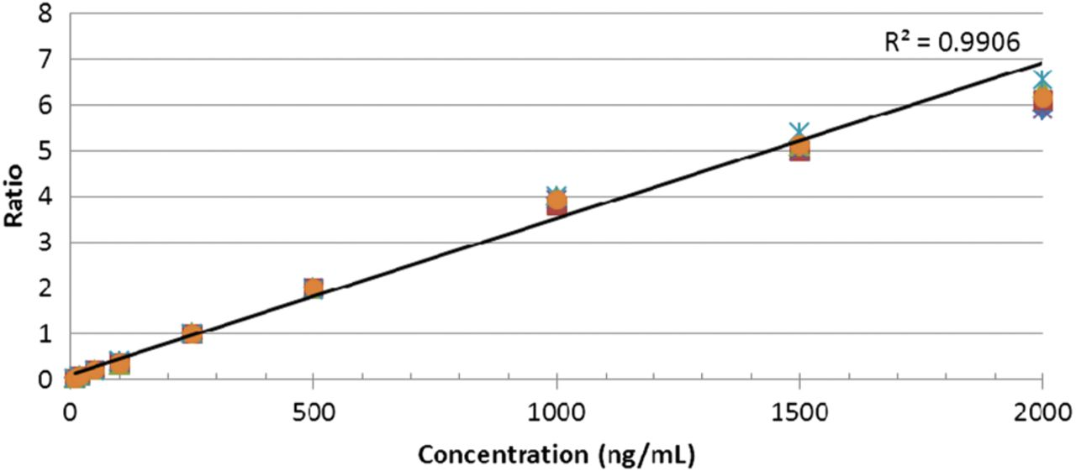
Figure A1. Combined calibration curve demonstrating loss of linearity above 1000 ng/mL
Notes:
Figure A1. Combined calibration curve demonstrating loss of linearity above 1000 ng/mL
Unless provided in the caption above, the following copyright applies to the content of this slide: © The Author [2013]. Published by Oxford University Press. All rights reserved. For Permissions, please email: journals.permissions@oup.com

Slide 2
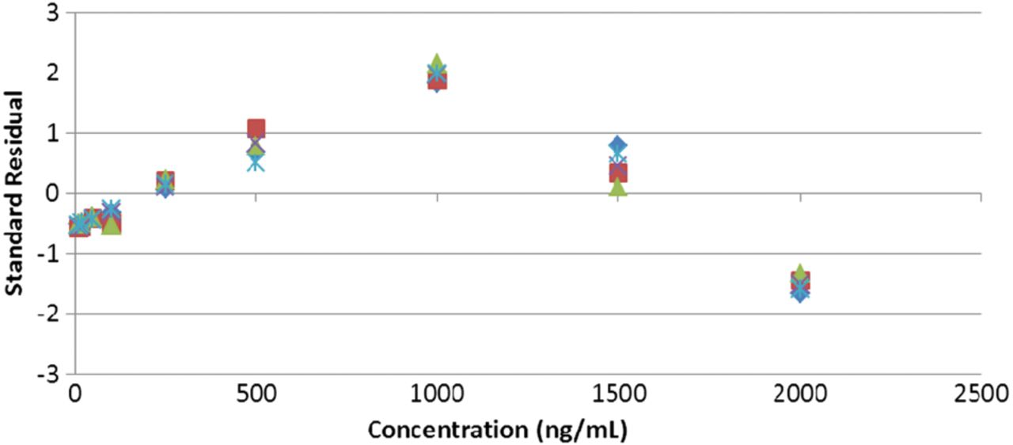
Figure A2. Standard residual plot of calibration curve data with an inverted U-shaped distribution
Notes:
Figure A2. Standard residual plot of calibration curve data with an inverted U-shaped distribution
Unless provided in the caption above, the following copyright applies to the content of this slide: © The Author [2013]. Published by Oxford University Press. All rights reserved. For Permissions, please email: journals.permissions@oup.com

Slide 3
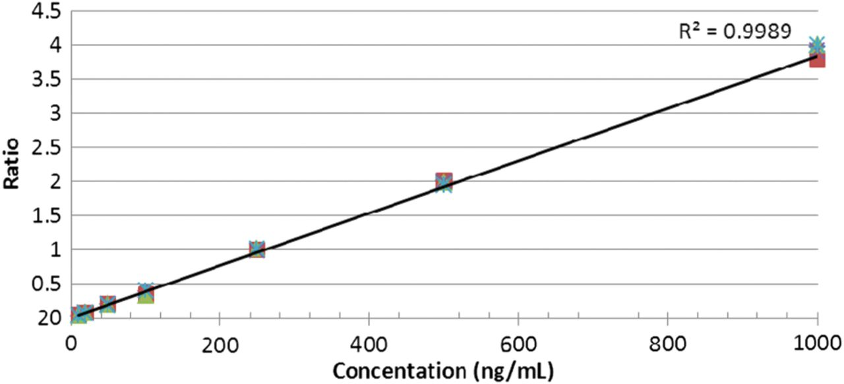
Figure A3. Revised calibration curve
Notes:
Figure A3. Revised calibration curve
Unless provided in the caption above, the following copyright applies to the content of this slide: © The Author [2013]. Published by Oxford University Press. All rights reserved. For Permissions, please email: journals.permissions@oup.com

Slide 4
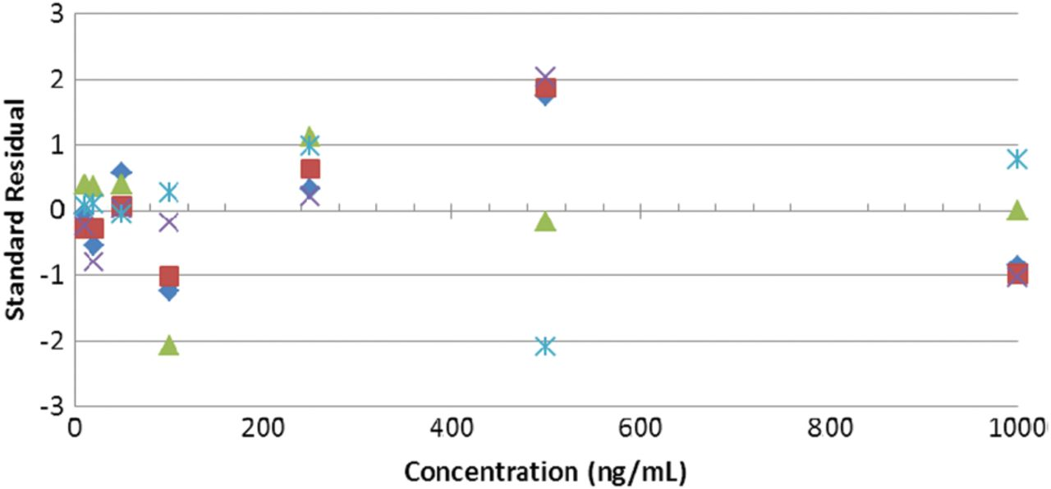
Figure A4. Residual plot of calibration curved data with a random distribution
Notes:
Figure A4. Residual plot of calibration curved data with a random distribution
Unless provided in the caption above, the following copyright applies to the content of this slide: © The Author [2013]. Published by Oxford University Press. All rights reserved. For Permissions, please email: journals.permissions@oup.com

Slide 5
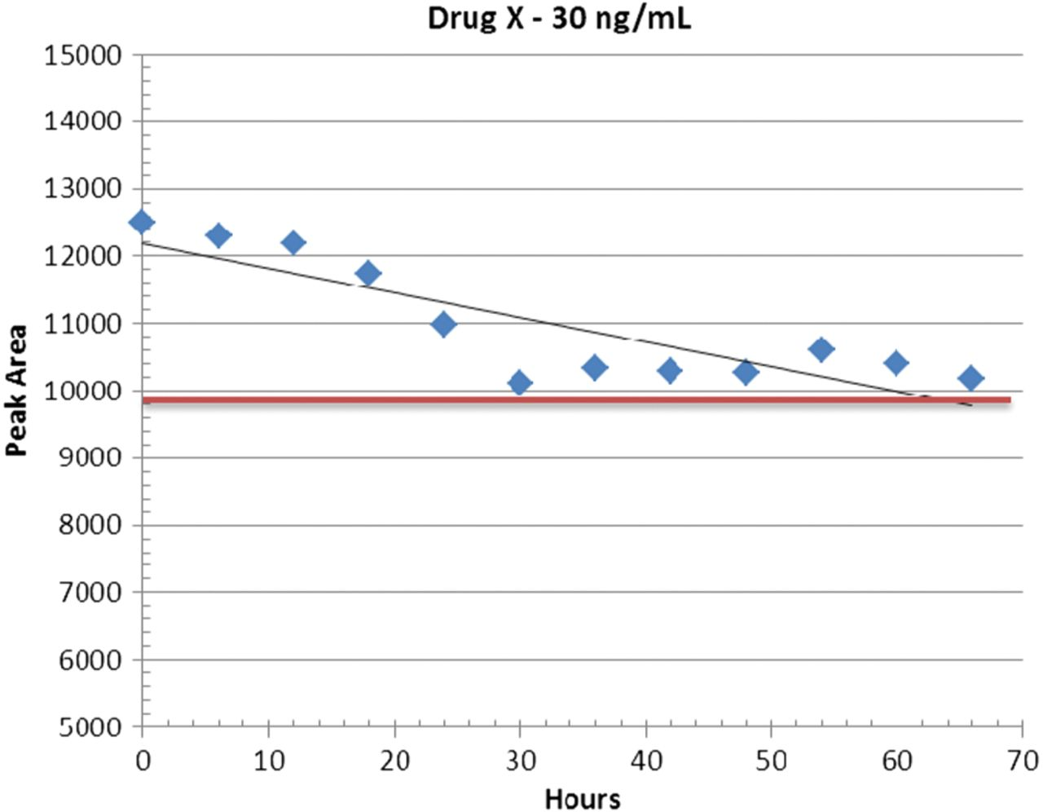
Figure A5. Change in Drug X peak area over 66 hours
Notes:
Figure A5. Change in Drug X peak area over 66 hours
Unless provided in the caption above, the following copyright applies to the content of this slide: © The Author [2013]. Published by Oxford University Press. All rights reserved. For Permissions, please email: journals.permissions@oup.com

