Slide 1
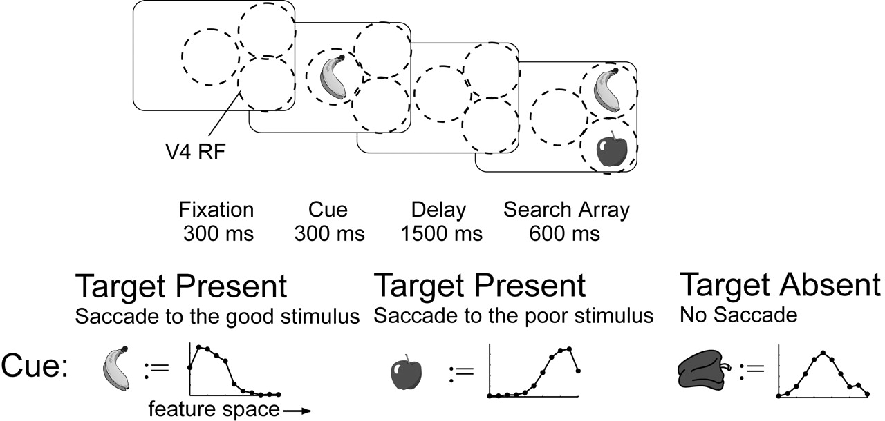
Figure 1. Simulation of the experiment of Chelazzi et al. (1998). We use the same temporal order of events as in the ...
Notes:
Figure 1. Simulation of the experiment of Chelazzi et al. (1998). We use the same temporal order of events as in the real experiment. The simulated objects (banana, apple, pepper) are represented by a noisy population input in a one-dimensional feature space, here illustrated by a snapshot at the bottom of the figure. We do not use images as input. RFs without an object just have noise as input. Each object is encoded within a separate RF, illustrated by the dashed circle, of V4 cells in two simulated dimensions (only one is shown). All V4 cells are within the RF of the IT cell population. First a cue is presented to the model for 300 ms. After a delay of 1500 ms, one, two, three or five stimuli are shown. The model has to indicate the detection of the target by selecting its location for an intended eye movement. By varying the cue, we can define different search conditions: target present and target absent.
Unless provided in the caption above, the following copyright applies to the content of this slide: Cerebral Cortex V 15 N 4 © Oxford University Press 2004; all rights reserved

Slide 2
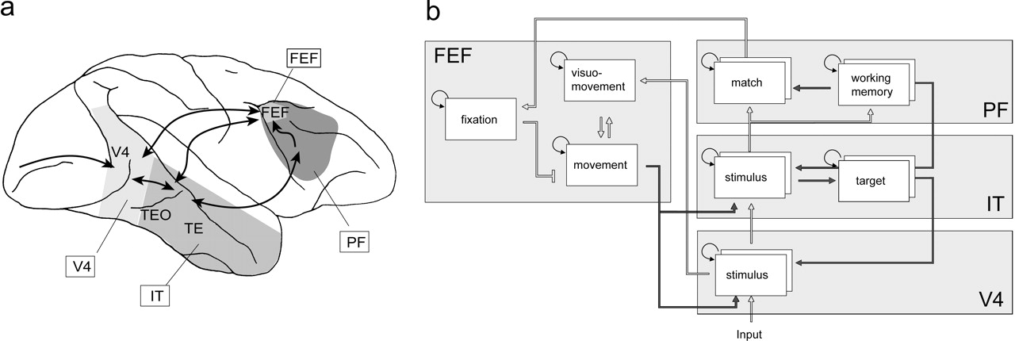
Figure 2. (a) Outline of the minimal set of interacting brain areas. Our model areas are restricted to elementary but ...
Notes:
Figure 2. (a) Outline of the minimal set of interacting brain areas. Our model areas are restricted to elementary but typical processes and do not replicate all features in these areas. The arrows indicate known anatomical connections between the areas, which are relevant to the model. The area that sends feedforward input into the model is not explicitly modeled. The labels in the boxes denote the implemented areas. (b) Sketch of the simulated model areas. Each box represents a population of cells. The formation of those populations is a temporal dynamic process. Bottom-up (driving) connections are indicated by a bright arrow and top-down (modulating) connections are shown as a dark arrow. The two boxes in V4 and other areas indicate that we simulate two dimensions (e.g. ‘color’ and ‘form’) in parallel. The FEF is pooled across dimensions.
Unless provided in the caption above, the following copyright applies to the content of this slide: Cerebral Cortex V 15 N 4 © Oxford University Press 2004; all rights reserved

Slide 3
Figure 3. Illustration of how top-down directed expectation in a higher area modulates feedforward processing in a ...
Notes:
Figure 3. Illustration of how top-down directed expectation in a higher area modulates feedforward processing in a lower area. (a) The expectation \batchmode \documentclass[fleqn,10pt,legalpaper]{article} \usepackage{amssymb} \usepackage{amsfonts} \usepackage{amsmath} \pagestyle{empty} \begin{document} \({\hat{r}}\) \end{document} acts on the input r↑ and increases the gain as depicted by the arrow through the circle. The y-axis encodes the firing rate of cells and the x-axis the feature space, e.g. orientation, color or location. For simplicity, the feature space of the involved areas is identical. To give an example, the expectation could originate from a population of cells in IT and modulate the conspicuity in V4. (b) Population activity without a significant top-down influence. In this case the content is simply processed in a bottom-up manner. (c) Population activity after top-down expectation multiplicatively increases the gain of the cells and therefore emphasizes a specific pattern (or location). Due to competitive interactions the population response for the non-supported stimuli decreases, resulting in a dynamic attention effect.
Unless provided in the caption above, the following copyright applies to the content of this slide: Cerebral Cortex V 15 N 4 © Oxford University Press 2004; all rights reserved

Slide 4
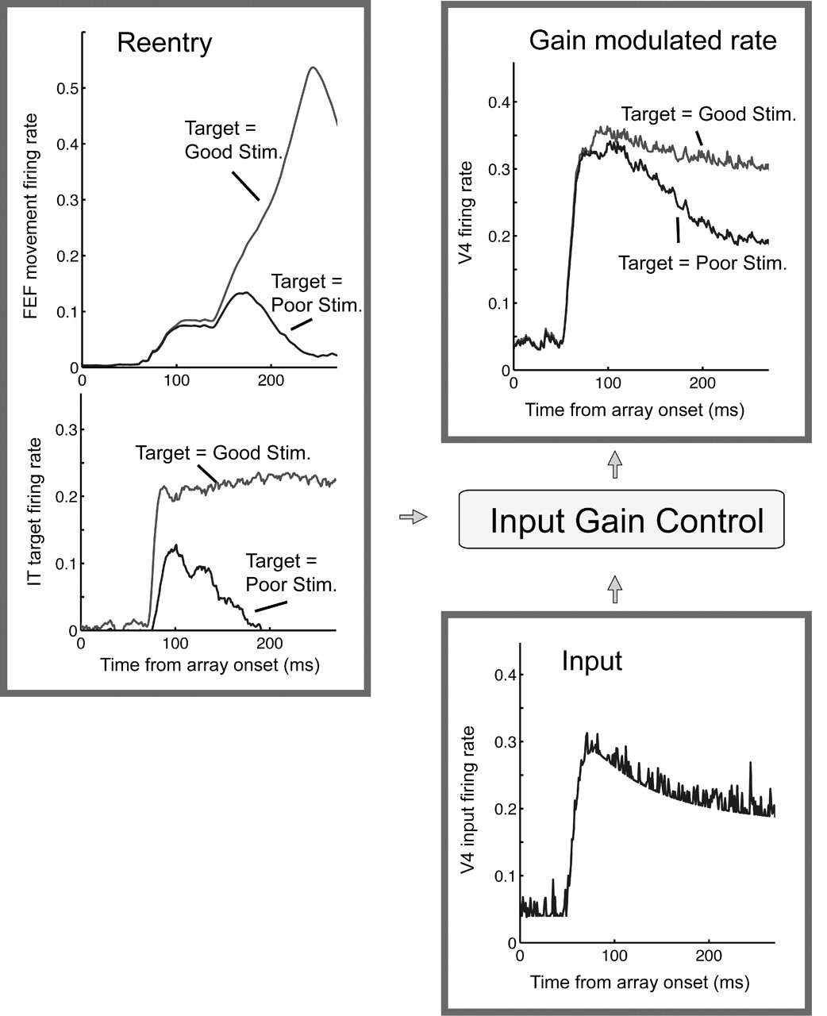
Figure 4. The temporal dynamics of gain control. We observe the influence of reentry onto the firing rate of a V4 cell ...
Notes:
Figure 4. The temporal dynamics of gain control. We observe the influence of reentry onto the firing rate of a V4 cell in two different conditions (depending on whether the target is the good or poor stimulus), given the input is identical. A V4 cell receives a reentry signal from movement cells and IT. Both reentry signals enhance the gain and add up in their effect. Due to the different top-down signal in PF working memory in either condition, the reentry signal from IT differs for the two conditions. This difference leads to a different gain and thus to a different activity in V4. After 150 ms the reentry signals from the movement cell start to differ. Thus, the gain of the cell in the saccade to the good stimulus case is much higher than in the saccade to the poor stimulus condition. Due to competitive interactions among the V4 cells, the activity in the saccade to the poor stimulus case gets suppressed as well.
Unless provided in the caption above, the following copyright applies to the content of this slide: Cerebral Cortex V 15 N 4 © Oxford University Press 2004; all rights reserved

Slide 5
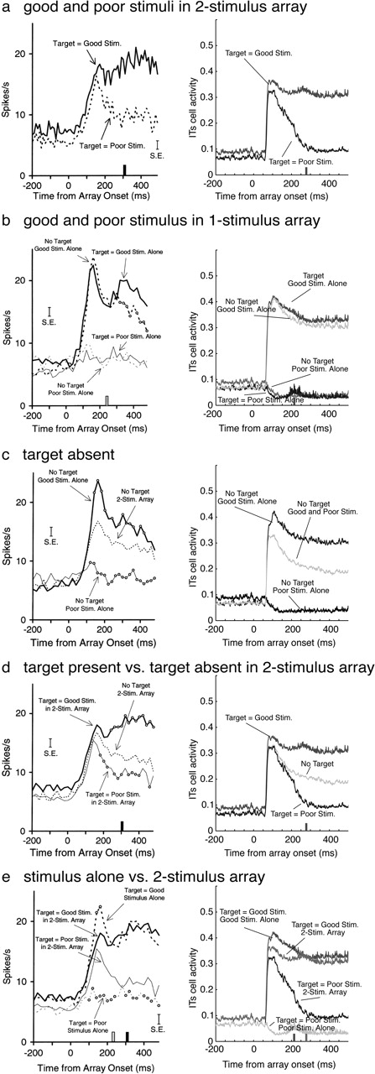
Figure 5. Activity of model IT neurons aligned to the onset of the search array. The activity of the cell with the ...
Notes:
Figure 5. Activity of model IT neurons aligned to the onset of the search array. The activity of the cell with the optimal response to the good stimulus is shown. The time of an eye movement is indicated by a bar on the time axis. Activity after the eye movement cannot be reliably compared to real data, since we do not model an actual foveation. (a–e) Physiological data (left) and simulation data (right). The physiological data is reprinted from ‘Responses of neurons in inferior temporal cortex during memory-guided visual search’ by Chelazzi L, Duncan, J, Miller EK, Desimone R (1998), J Neurophysiol 80:2918–2940. Copyright 1998 by the American Physiological Society. Reprinted with permission.
Unless provided in the caption above, the following copyright applies to the content of this slide: Cerebral Cortex V 15 N 4 © Oxford University Press 2004; all rights reserved

Slide 6
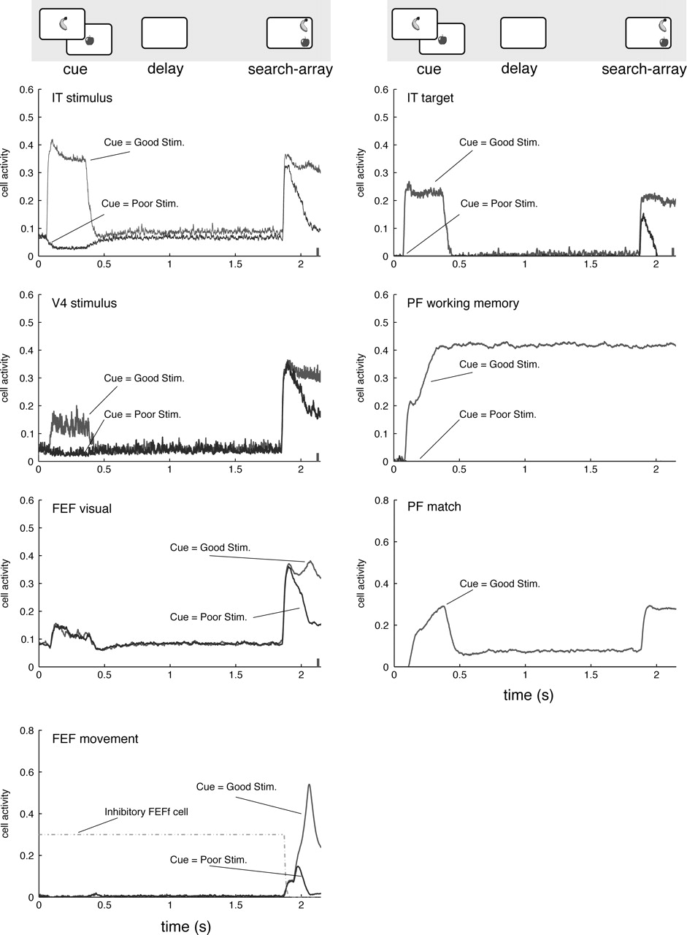
Figure 6. Overview of the simulated areas aligned on cue. The good stimulus of the observed cell is the ‘banana’. The ...
Notes:
Figure 6. Overview of the simulated areas aligned on cue. The good stimulus of the observed cell is the ‘banana’. The cue defines if the good or the poor stimulus is the target. Thus, the differences after cue presentation occur only due to the definition of which stimulus is the target. If the good stimulus is presented as the cue, the saccade goes to the banana, as indicated by the high movement activity. If the poor stimulus is the cue, the saccade is directed to the apple and, thus, movement activity at the location of the banana is low. The figures show the activity of the best matching cell for the good stimulus in a two-stimulus array over time. We observe attention in the system solely on the basis of interacting areas. Different attentional effects add up and their origin lies in feeback gain control as well as competition.
Unless provided in the caption above, the following copyright applies to the content of this slide: Cerebral Cortex V 15 N 4 © Oxford University Press 2004; all rights reserved

Slide 7
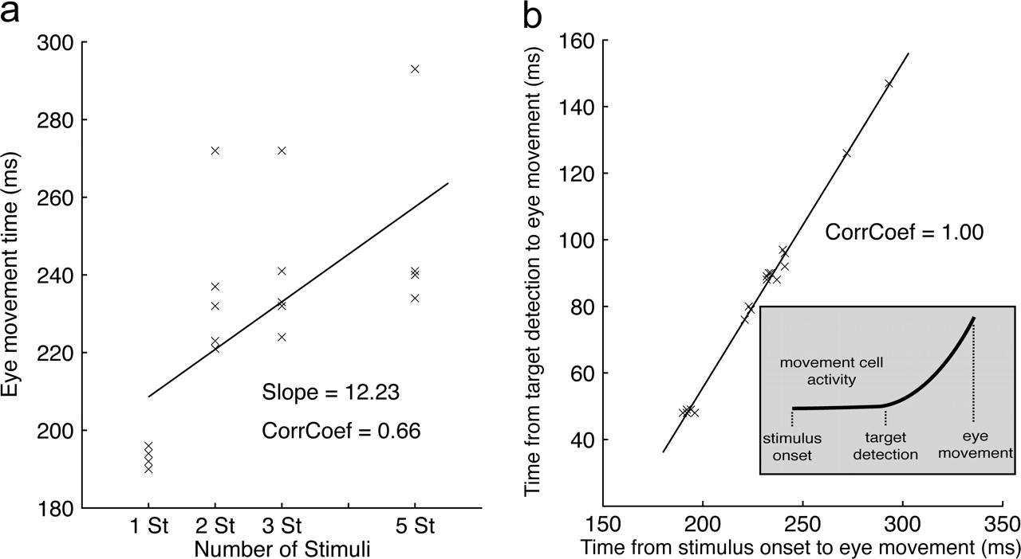
Figure 7. Latency of eye movements depending on the set size. (a) Linear fit of the measured latencies. If two or more ...
Notes:
Figure 7. Latency of eye movements depending on the set size. (a) Linear fit of the measured latencies. If two or more stimuli appear, the model predicts a delay in eye movement selection although the search is parallel. (b) Linear fit between the time for saccade selection and time for location discrimination. The time for location discrimination is the time from the target presence detection in the PF match cells to the time of saccade selection. Since the time for ‘target-present’ detection in PF match cells is almost constant, the different latencies occur during target discrimination and selection in FEF cells and not in the bottom-up wave into PF match cells. Thus, the interactions in the FEF are responsible for the delay in eye movement selection.
Unless provided in the caption above, the following copyright applies to the content of this slide: Cerebral Cortex V 15 N 4 © Oxford University Press 2004; all rights reserved

Slide 8
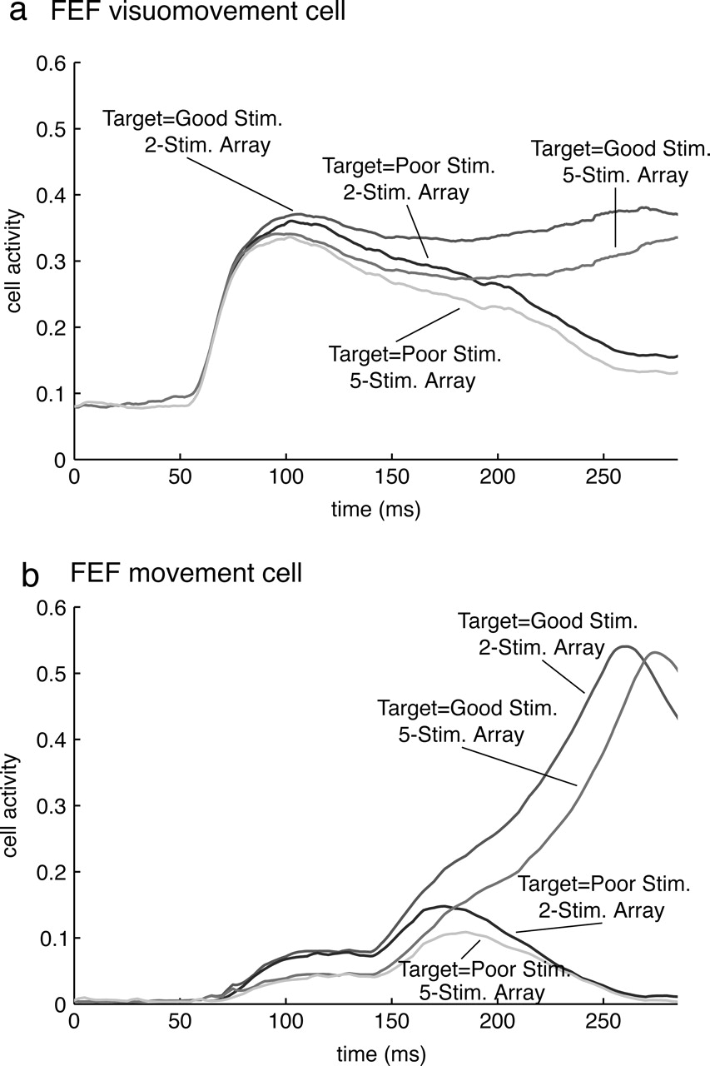
Figure 8. Target discrimination in the frontal eye field depending on the set size, which has been also observed in ...
Notes:
Figure 8. Target discrimination in the frontal eye field depending on the set size, which has been also observed in experimental data (Bichot et al., 2001a). (a) FEF visuomovement cells. (b) FEF movement cells. The initial activity of the cells within the five-stimulus array is lower. As a result they need more time to reach the threshold for eye movements in the FEF movement cells. However, this delay is partly compensated by lower overall inhibition when the distractor is suppressed.
Unless provided in the caption above, the following copyright applies to the content of this slide: Cerebral Cortex V 15 N 4 © Oxford University Press 2004; all rights reserved

Slide 9
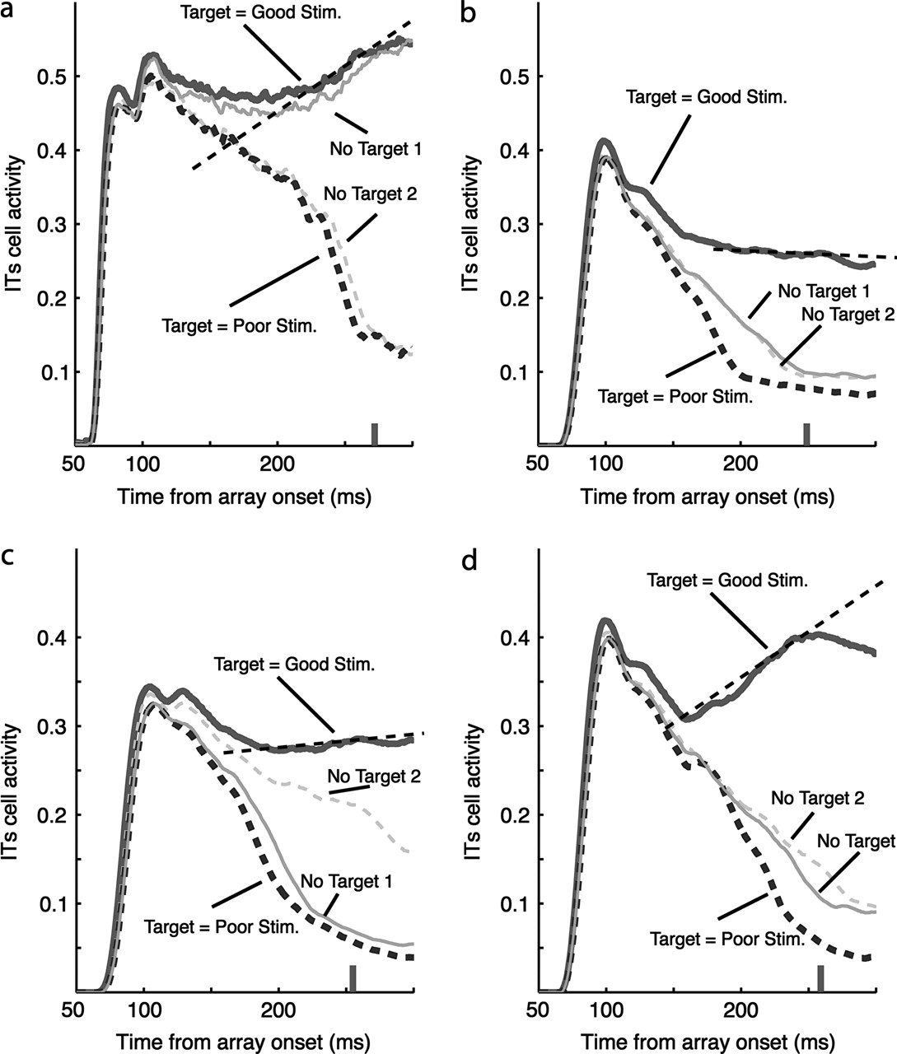
Figure 9. Comparison of alternative models for target selection in IT in the target presence and target absence ...
Notes:
Figure 9. Comparison of alternative models for target selection in IT in the target presence and target absence condition using a model with only a feature-specific bias (a, b), a visual selection model with feedback from FEF visuomovement cells (c) and a movement plan model with feedback from FEF movement cells (d). In all cases the response to the distractor (Target = Poor Stim.) is suppressed. The parameters of each model are fitted to meet two objectives. First, if the target is the good stimulus, a transient response after stimulus onset followed by an increase of activity prior to the eye movement is required. The slope of the increase is indicated by a dashed line. Second, in the no-target condition, none of the stimuli should be selected by noise in the system. The model with only a feature-specific bias using a strong self-enhancement (a) meets the first objective, since the response to the target shows an increase prior to the eye movement, but it fails to meet the second one, since stimulus ‘1’ is selected. The model with only a feature-specific bias using an intermediate self-enhancement (b) does not meet the first objective. The visual selection model (c) also fails to meet the first objective, although the spatial bias is already quite strong such that noise effects result in a slight target selection of stimulus ‘2’. The movement plan model (d) meets both objectives.
Unless provided in the caption above, the following copyright applies to the content of this slide: Cerebral Cortex V 15 N 4 © Oxford University Press 2004; all rights reserved

Slide 10
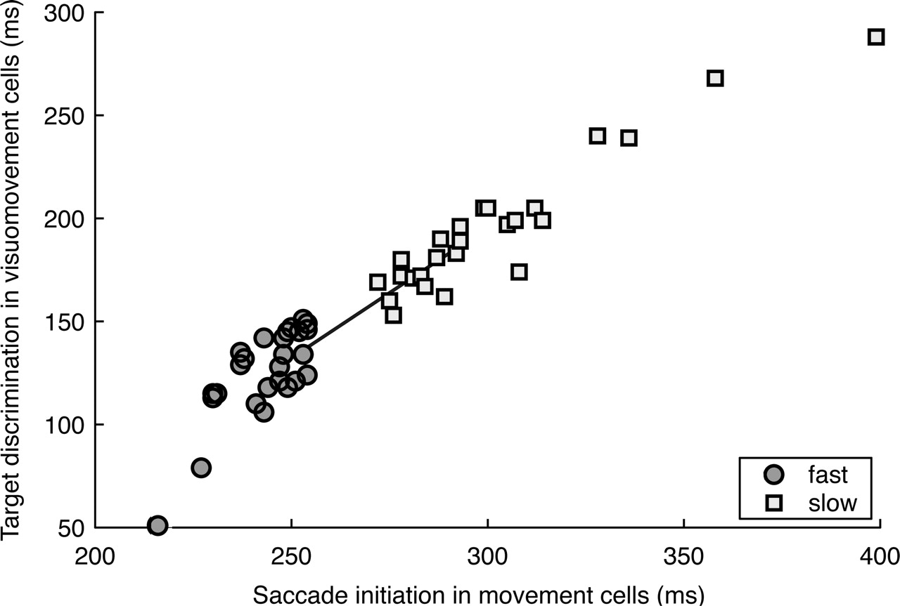
Figure 10. Fast and slow correct trials of visual search with varying discrimination of the target in V4 and IT ...
Notes:
Figure 10. Fast and slow correct trials of visual search with varying discrimination of the target in V4 and IT (depending on the target template strength). An increase in saccade initiation time in FEF movement cells shows a correlation with the target disrimination time in FEF visuomovement cells (Wilcoxon rank sum test; significance level 0.0001). The line connects the medians of each group and shows a slope of 1.3. Thus, the model predicts that a better target discrimination in FEF visuomovement cells leads to faster eye movements. For the target discrimination, refer to Appendix III.
Unless provided in the caption above, the following copyright applies to the content of this slide: Cerebral Cortex V 15 N 4 © Oxford University Press 2004; all rights reserved

Slide 11
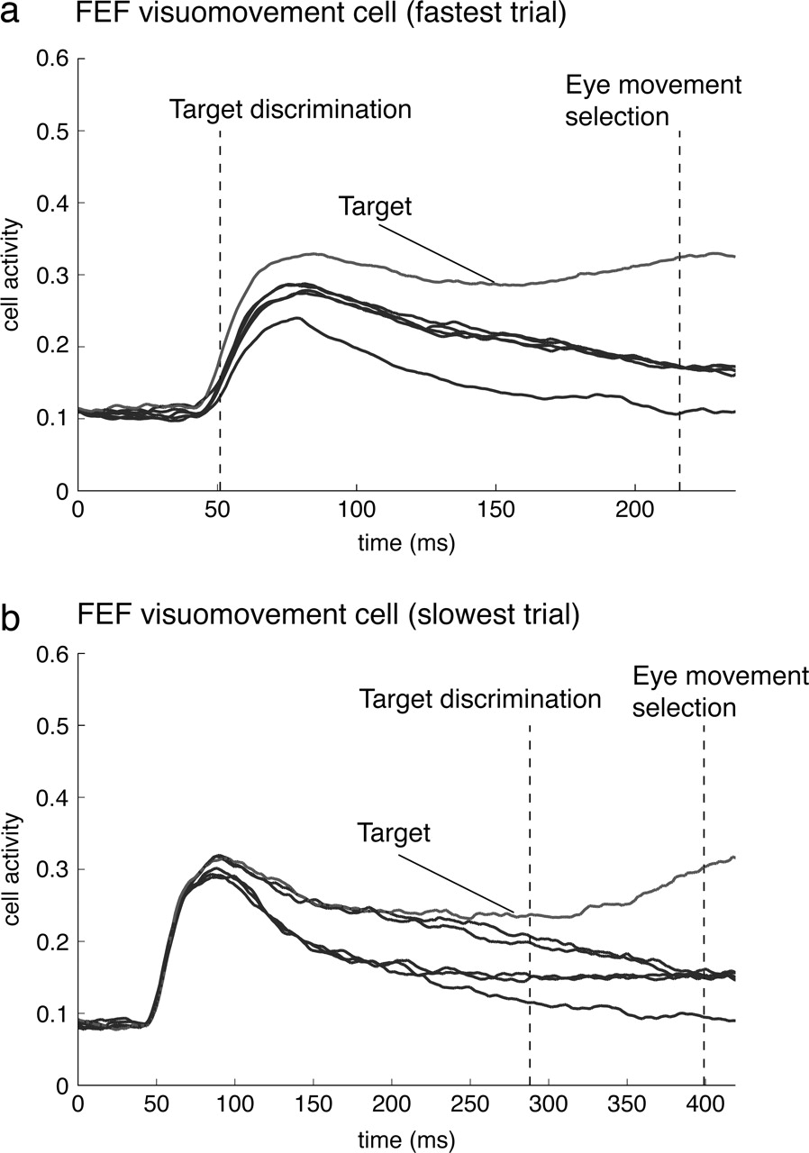
Figure 11. Discrimination of the target among five distractors in efficient and less efficient parallel search. The ...
Notes:
Figure 11. Discrimination of the target among five distractors in efficient and less efficient parallel search. The plots show the activity of the FEF visuomovement cells during the fastest trial (a) and the slowest trial (b) over time. The first dashed line indicates the discrimination in FEF visuomovement cells (Appendix III) and the second one the eye movement initiation in the FEF movement cells. In less efficient trials the target discrimination occurs late in time. The figure also indicates that the target discrimination in the input of the FEF is essential for a fast eye-movement selection. The initial differences after 50 ms correlate with the target–distractor similarity and depend on the randomized strength of the target template.
Unless provided in the caption above, the following copyright applies to the content of this slide: Cerebral Cortex V 15 N 4 © Oxford University Press 2004; all rights reserved

Slide 12
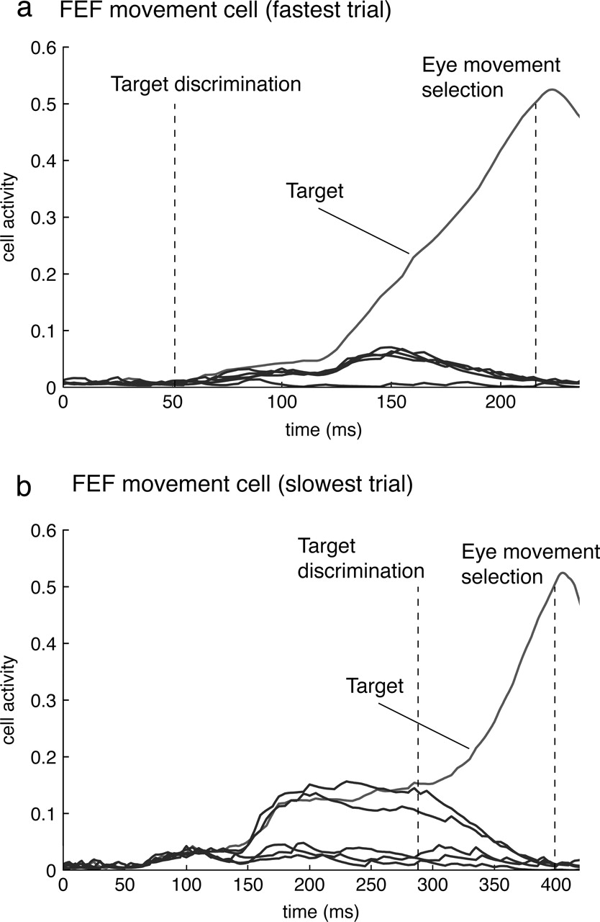
Figure 12. Activity of the FEF movement cells in efficient and less efficient parallel search over time. The figures ...
Notes:
Figure 12. Activity of the FEF movement cells in efficient and less efficient parallel search over time. The figures show the fastest trial (a) and the slowest trial (b). The first dashed line indicates the discrimination in FEF visuomovement cells and the second one the eye movement initiation in the FEF movement cells. The non-target movement cell activity reaches higher values in non-efficient trials. Typically the items at these positions have one feature in common with the target.
Unless provided in the caption above, the following copyright applies to the content of this slide: Cerebral Cortex V 15 N 4 © Oxford University Press 2004; all rights reserved

Slide 13
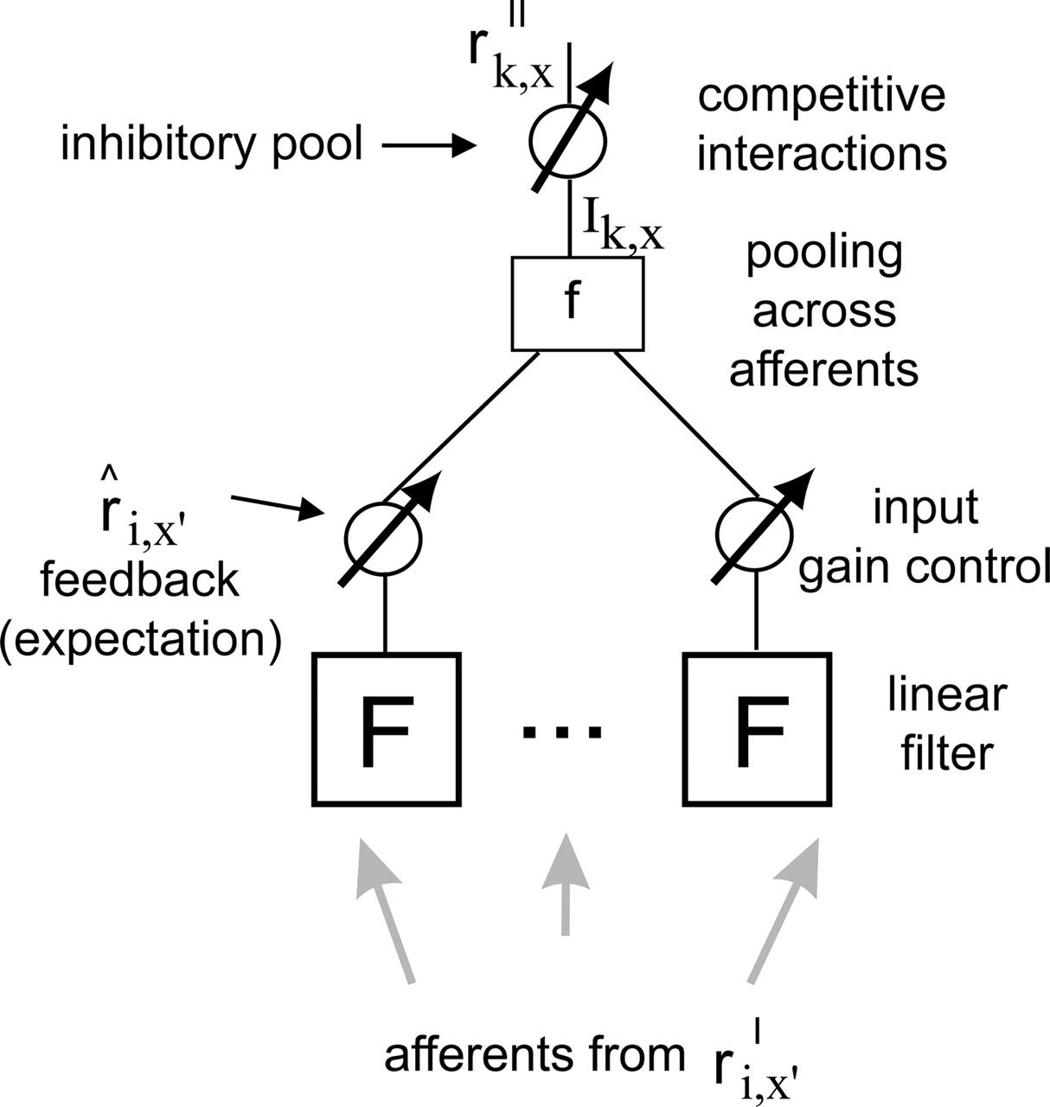
Figure 13. Sketch of the V4 and IT model to explain how afferents determine the output of a cell. Each cell in a higher ...
Notes:
Figure 13. Sketch of the V4 and IT model to explain how afferents determine the output of a cell. Each cell in a higher area II \batchmode \documentclass[fleqn,10pt,legalpaper]{article} \usepackage{amssymb} \usepackage{amsfonts} \usepackage{amsmath} \pagestyle{empty} \begin{document} \(r_{k,x}^{II}\) \end{document} (e.g. in ITs) receives a weighted input from each cell in a lower area I \batchmode \documentclass[fleqn,10pt,legalpaper]{article} \usepackage{amssymb} \usepackage{amsfonts} \usepackage{amsmath} \pagestyle{empty} \begin{document} \(r_{i,x{^\prime}}^{I}\) \end{document} (e.g. from V4) at different locations x′ within its receptive field. Feedback connections \batchmode \documentclass[fleqn,10pt,legalpaper]{article} \usepackage{amssymb} \usepackage{amsfonts} \usepackage{amsmath} \pagestyle{empty} \begin{document} \({\hat{r}}_{i,x{^\prime}}\) \end{document} increase the input gain. For example, ITs receives feedback from PF working memory and FEF movement cells (Fig. 2). After the gain control stage, a spatial pooling function f is applied. Inhibition among target cells is modeled by an inhibitory pooling among all cells in the population. The final response is then determined by a differential equation, which describes the change through time of a model cell's activity.
Unless provided in the caption above, the following copyright applies to the content of this slide: Cerebral Cortex V 15 N 4 © Oxford University Press 2004; all rights reserved

