Slide 1
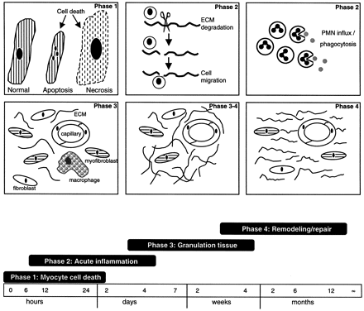
Fig. 1 Phases of cardiac wound healing in humans. (Numbers refer to the different phases of wound healing). ...
Notes:
Fig. 1 Phases of cardiac wound healing in humans. (Numbers refer to the different phases of wound healing). Abbreviations: ECM: extracellular matrix; PMN: neutrophilic granulocytes.
Unless provided in the caption above, the following copyright applies to the content of this slide: Copyright © 1999, European Society of Cardiology

Slide 2
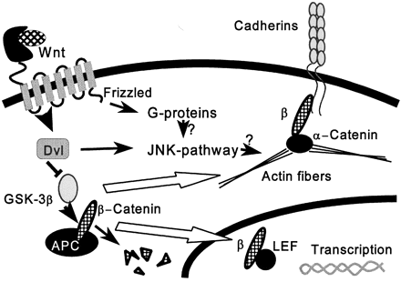
Fig. 2 Signal transduction pathways of frizzled receptors.
Notes:
Fig. 2 Signal transduction pathways of frizzled receptors.
Unless provided in the caption above, the following copyright applies to the content of this slide: Copyright © 1999, European Society of Cardiology

Slide 3
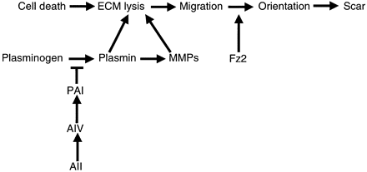
Fig. 3 Factors in cardiac structure that determine cardiac function after infarction.
Notes:
Fig. 3 Factors in cardiac structure that determine cardiac function after infarction.
Unless provided in the caption above, the following copyright applies to the content of this slide: Copyright © 1999, European Society of Cardiology

