Slide 1
Figure 1. Striving for the most complete coverage with acceptable accuracy, OrthoDB provides tentative associations of ...
Notes:
Figure 1. Striving for the most complete coverage with acceptable accuracy, OrthoDB provides tentative associations of the vast majority of classified genes with Gene Ontology (GO) and InterPro functional attributes.
Unless provided in the caption above, the following copyright applies to the content of this slide: © The Author(s) 2010. Published by Oxford University Press.This is an Open Access article distributed under the terms of the Creative Commons Attribution Non-Commercial License (http://creativecommons.org/licenses/by-nc/2.5), which permits unrestricted non-commercial use, distribution, and reproduction in any medium, provided the original work is properly cited.

Slide 2
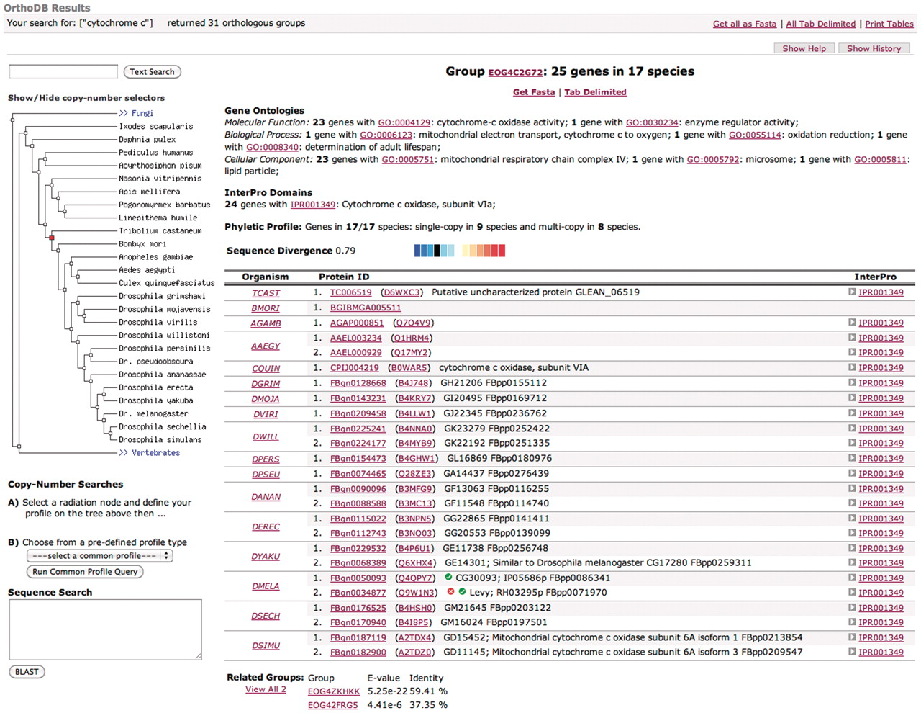
Figure 2. Screenshot of a sample result page, featuring functional Gene Ontology (GO), InterPro and phenotype ...
Notes:
Figure 2. Screenshot of a sample result page, featuring functional Gene Ontology (GO), InterPro and phenotype annotations, as well as evolutionary related groups, phyletic profile and relative divergence among orthologs.
Unless provided in the caption above, the following copyright applies to the content of this slide: © The Author(s) 2010. Published by Oxford University Press.This is an Open Access article distributed under the terms of the Creative Commons Attribution Non-Commercial License (http://creativecommons.org/licenses/by-nc/2.5), which permits unrestricted non-commercial use, distribution, and reproduction in any medium, provided the original work is properly cited.

