Slide 1
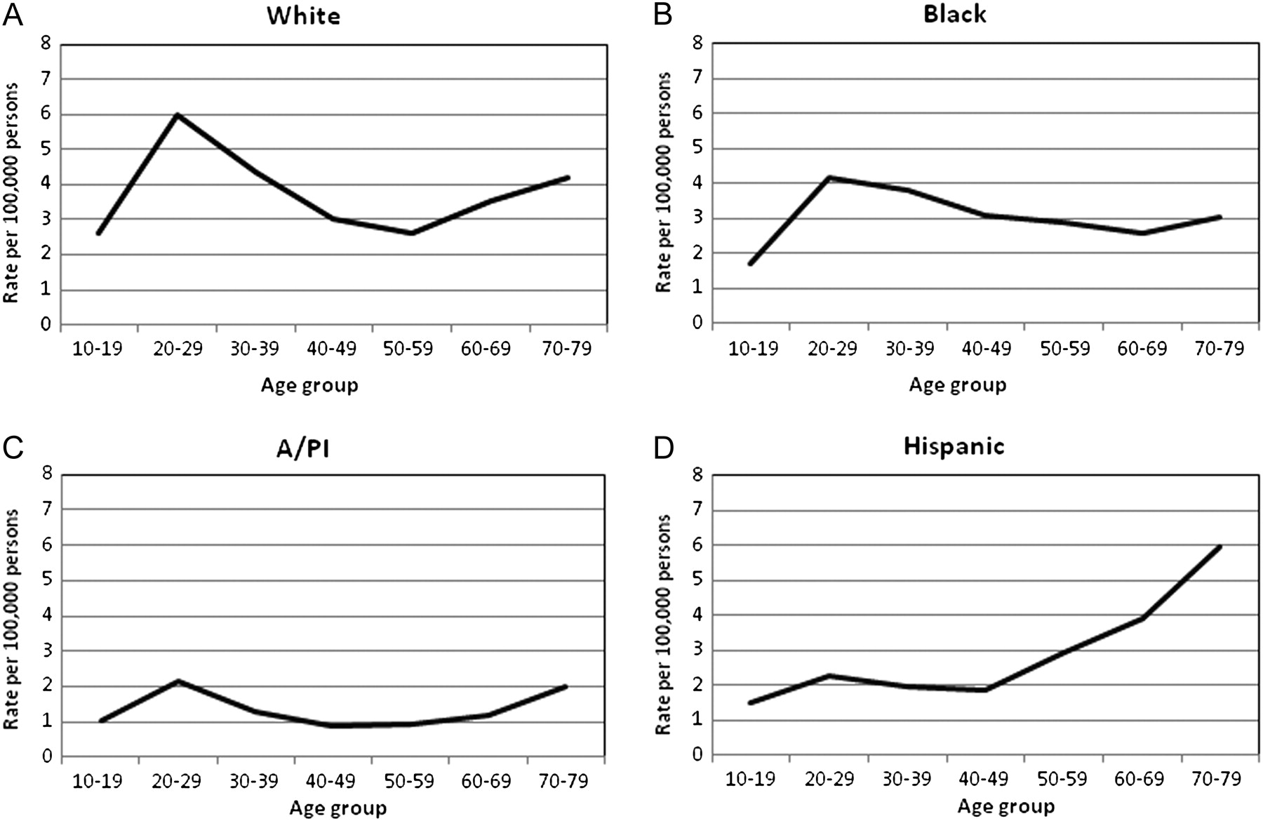
Figure 1 Age-specific incidence of Hodgkin's lymphoma by race. Data shown are age-specific incidence rates for 10-year ...
Notes:
Figure 1 Age-specific incidence of Hodgkin's lymphoma by race. Data shown are age-specific incidence rates for 10-year age groups ranging from age 10 to 79 years for each race (non-Hispanics whites (referred to as: whites), Hispanic whites (referred to as: Hispanics), blacks, and A/PIs). Rates are presented in terms of cases per 100 000 population. (A) Whites showed a continued bimodal age-incidence pattern, while (B) blacks had a much less clear bimodal distribution. (C) A/PIs exhibited a bimodal pattern and have the lowest incidence rates of any race/ethnic group. (D) Age-specific incidence in Hispanics was distinctly not bimodal with a small increase at age 20–29 followed by an exponential-like rise in incidence. A/PI, Asian/Pacific Islander.
Unless provided in the caption above, the following copyright applies to the content of this slide: © The Author 2012. Published by Oxford University Press on behalf of the European Society for Medical Oncology. All rights reserved. For permissions, please email: journals.permissions@oup.com.

Slide 2
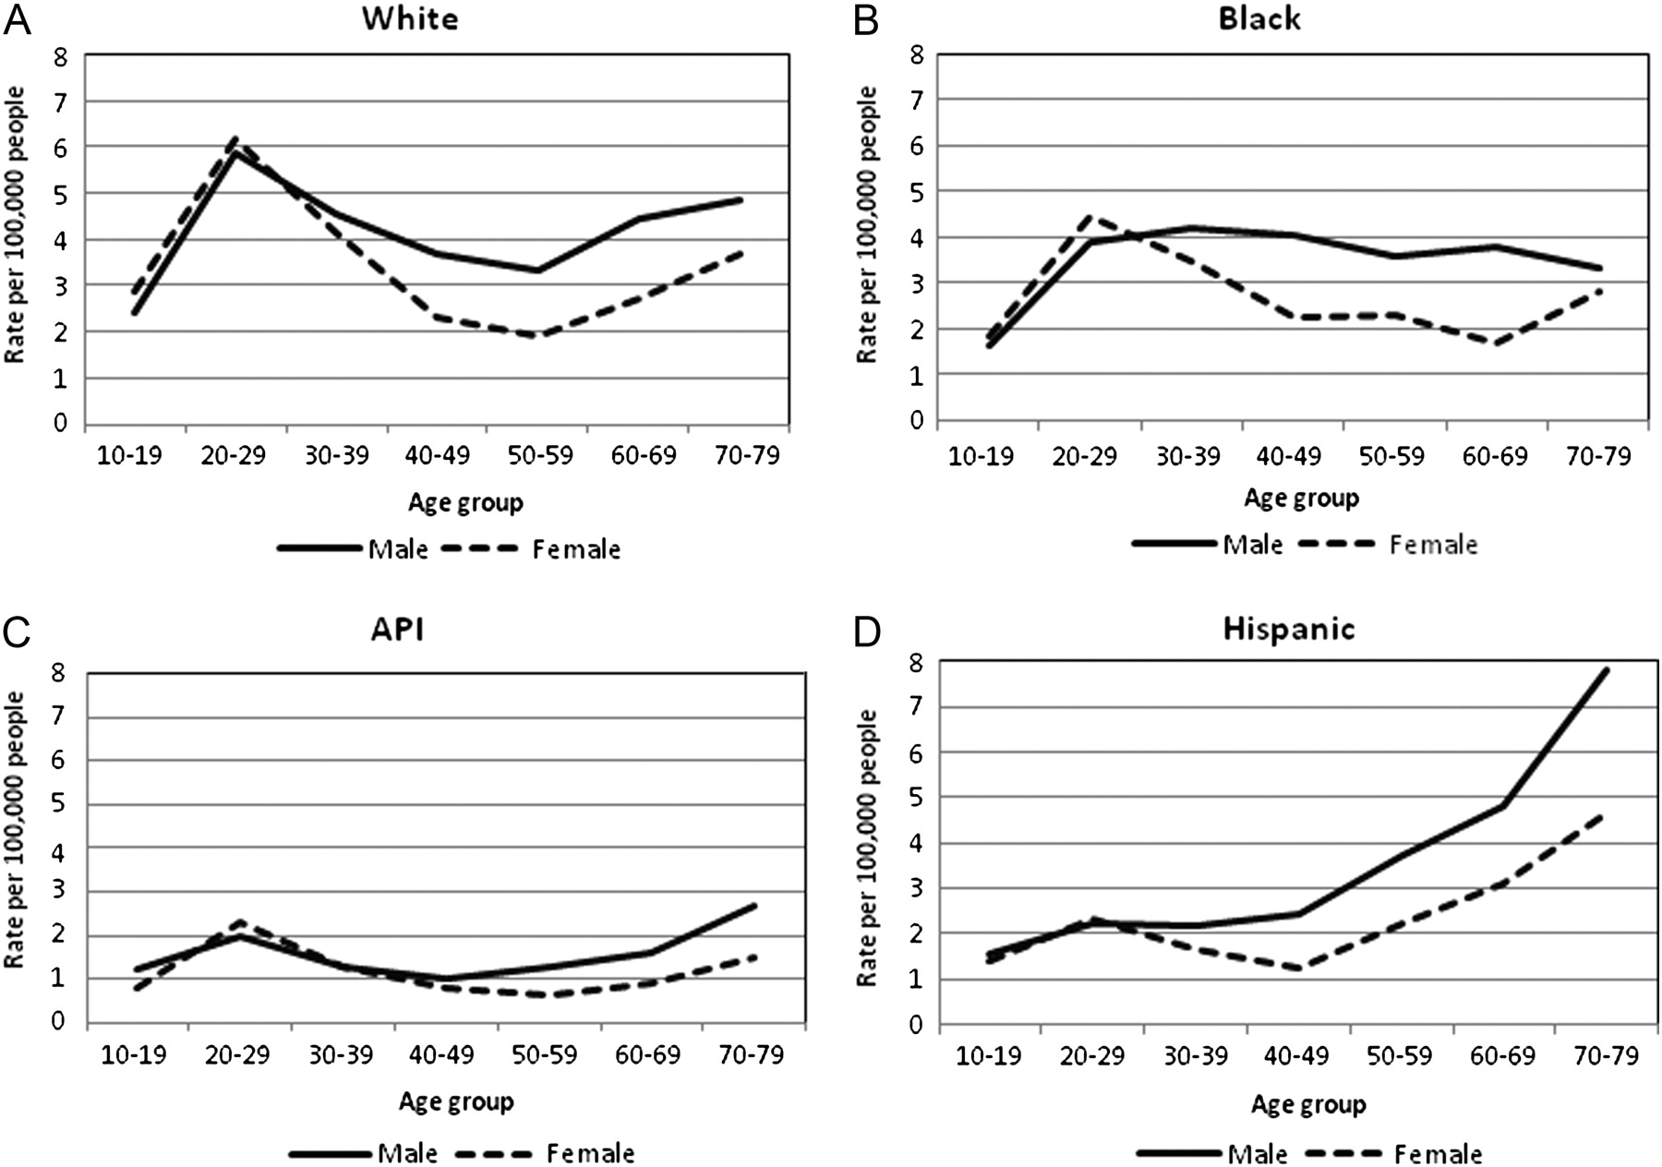
Figure 2 Age-specific incidence of HL by race and gender. (A) HL in whites was more common in males versus females, ...
Notes:
Figure 2 Age-specific incidence of HL by race and gender. (A) HL in whites was more common in males versus females, while both genders exhibited a bimodal incidence pattern. (B) Black men had a rise in incidence at age 20--29 years followed by a relatively flat rate through age 70--79 years. (C) A/PIs had similar male to female ratios as whites as well as an apparent bimodal age distribution, while among (D) Hispanics, incidence rates rose exponentially; after the age of 40 years, the incidence of HL was significantly higher in Hispanic males versus females (P <0.05). A/PI, Asian/Pacific Islander; HL, Hodgkin's lymphoma.
Unless provided in the caption above, the following copyright applies to the content of this slide: © The Author 2012. Published by Oxford University Press on behalf of the European Society for Medical Oncology. All rights reserved. For permissions, please email: journals.permissions@oup.com.

Slide 3
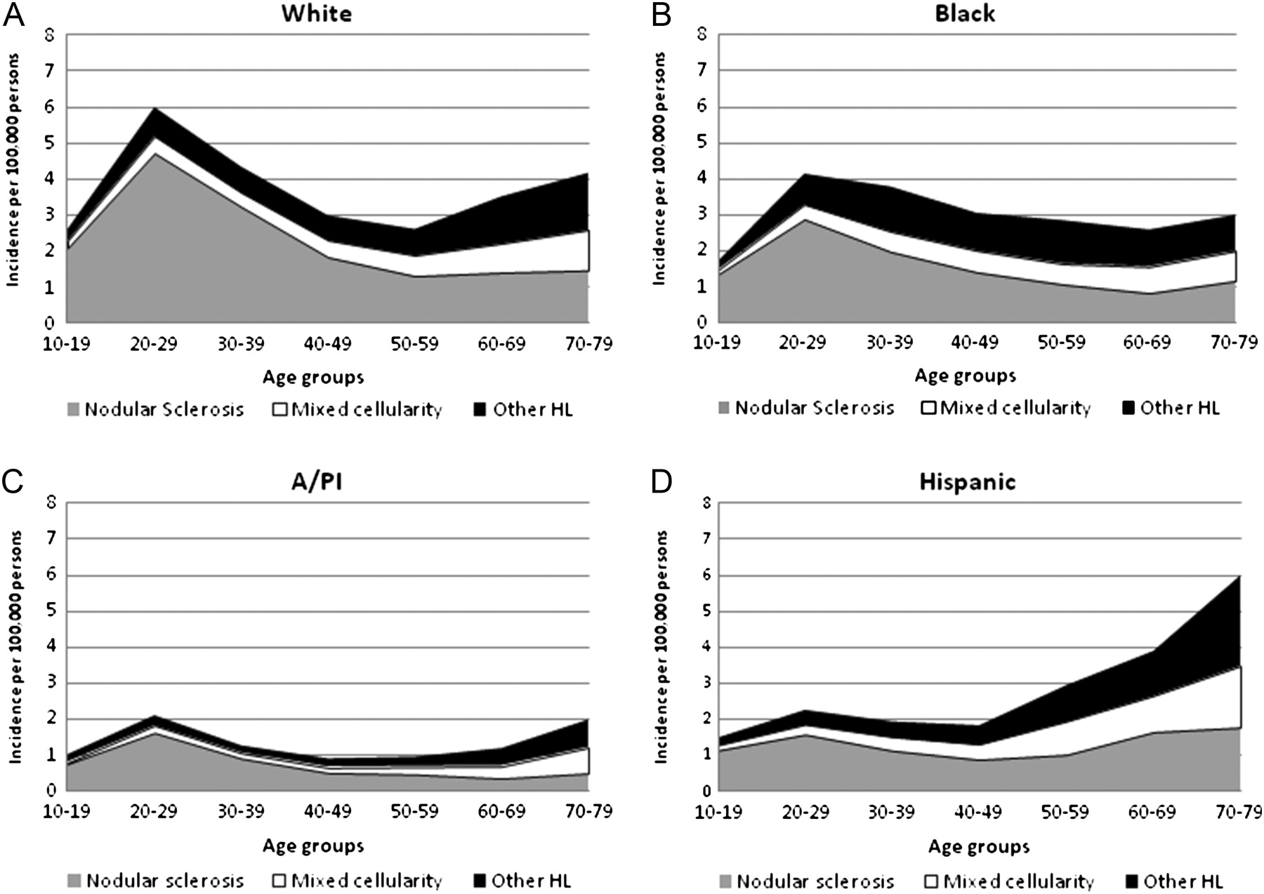
Figure 3 Age-specific incidence of HL by histology and race. Within the (A) white HL cohort, the young adult rise was ...
Notes:
Figure 3 Age-specific incidence of HL by histology and race. Within the (A) white HL cohort, the young adult rise was mostly due to NS subtype, while the decreased incidence of NS in older whites was accompanied by an increased incidence of MC. Similar to whites, the young adult rise in incidence of (B) black and (C) A/PI populations were predominantly due to NS HL; the incidence of NS fell steadily after age 30 years. (D) Hispanics (and blacks) presented significantly less frequently with NS HL compared with whites, both presenting more commonly with MC subtype. A/PI, Asian/Pacific Islander; HL, Hodgkin's lymphoma; MC, mixed cellularity; NS, nodular sclerosis.
Unless provided in the caption above, the following copyright applies to the content of this slide: © The Author 2012. Published by Oxford University Press on behalf of the European Society for Medical Oncology. All rights reserved. For permissions, please email: journals.permissions@oup.com.

Slide 4
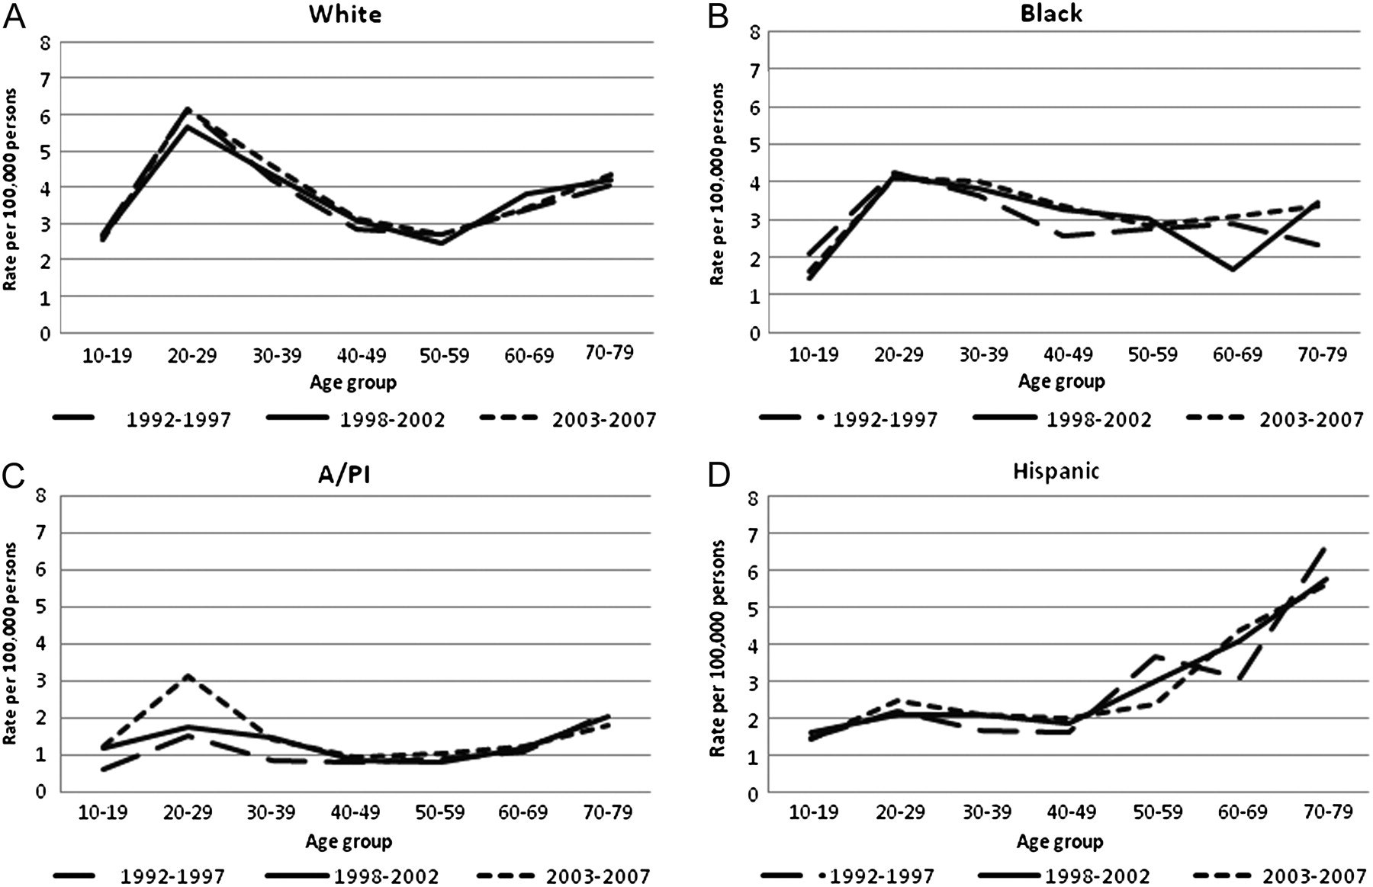
Figure 4 Period changes in age-specific incidence of HL by race. (A–D) During the 16-year period from 1992 through ...
Notes:
Figure 4 Period changes in age-specific incidence of HL by race. (A–D) During the 16-year period from 1992 through 2007, age-specific incidence patterns did not vary within races except for A/PI. Within the A/PI HL population, incidence rates successively increased within each period. A/PI, Asian/Pacific Islander; HL, Hodgkin's lymphoma.
Unless provided in the caption above, the following copyright applies to the content of this slide: © The Author 2012. Published by Oxford University Press on behalf of the European Society for Medical Oncology. All rights reserved. For permissions, please email: journals.permissions@oup.com.

Slide 5
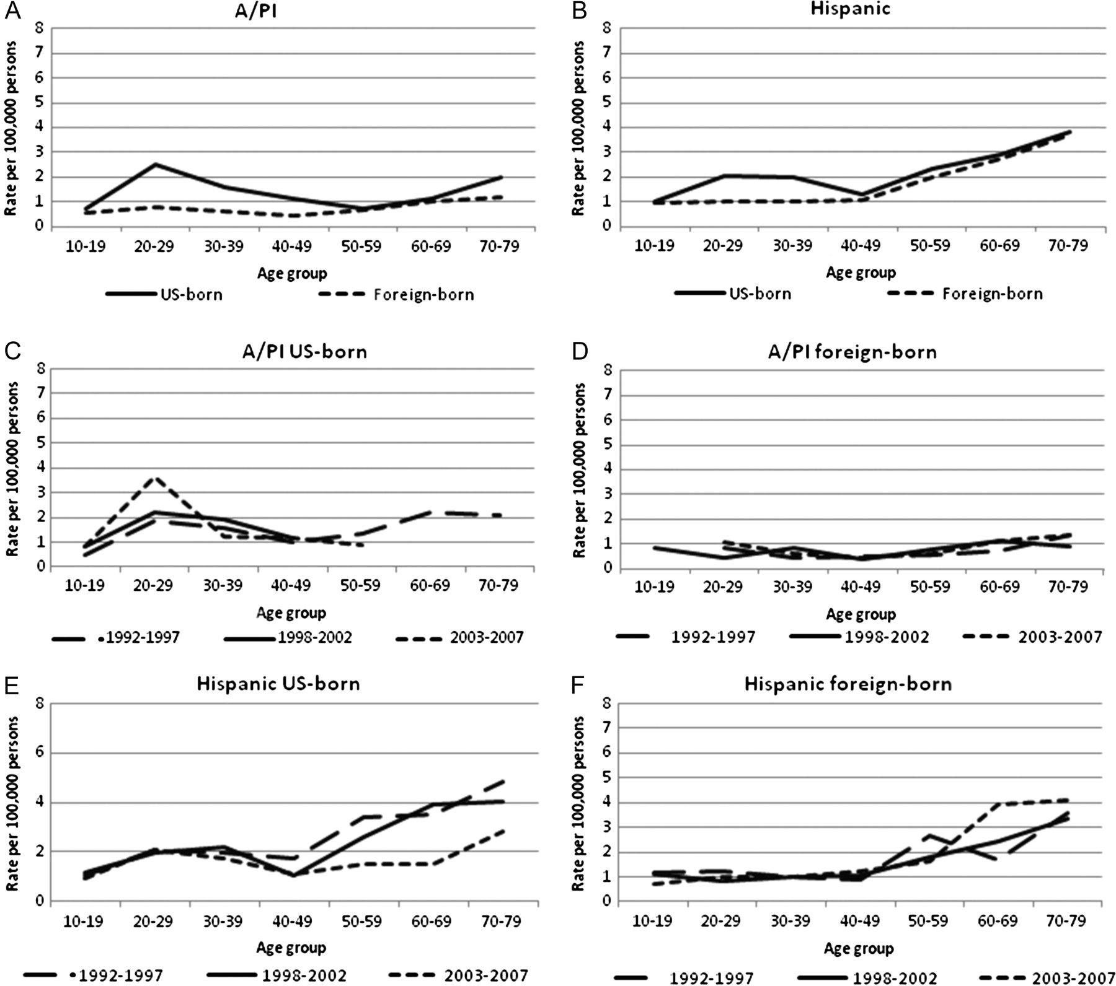
Figure 5 Age-specific incidence and period changes by race and birthplace. (A) US-born A/PIs age 20–49 years had a ...
Notes:
Figure 5 Age-specific incidence and period changes by race and birthplace. (A) US-born A/PIs age 20–49 years had a higher incidence of HL than foreign-born A/PI of the same age (P <0.05) with incidence converging after age 50 years. (B) US-born Hispanics age 20–39 years also had a significantly higher incidence of HL than foreign-born Hispanics of the same age (P <0.05). (C–D) In terms of period-specific HL incidence patterns, there was a trend toward increased incidence of US-born A/PI age 20–29 years, while there were no differences among other age groups. (E–F) Among Hispanics, there were no differences in HL incidence for either US- and foreign-born populations. A/PI, Asian/Pacific Islander; HL, Hodgkin's lymphoma.
Unless provided in the caption above, the following copyright applies to the content of this slide: © The Author 2012. Published by Oxford University Press on behalf of the European Society for Medical Oncology. All rights reserved. For permissions, please email: journals.permissions@oup.com.

Slide 6
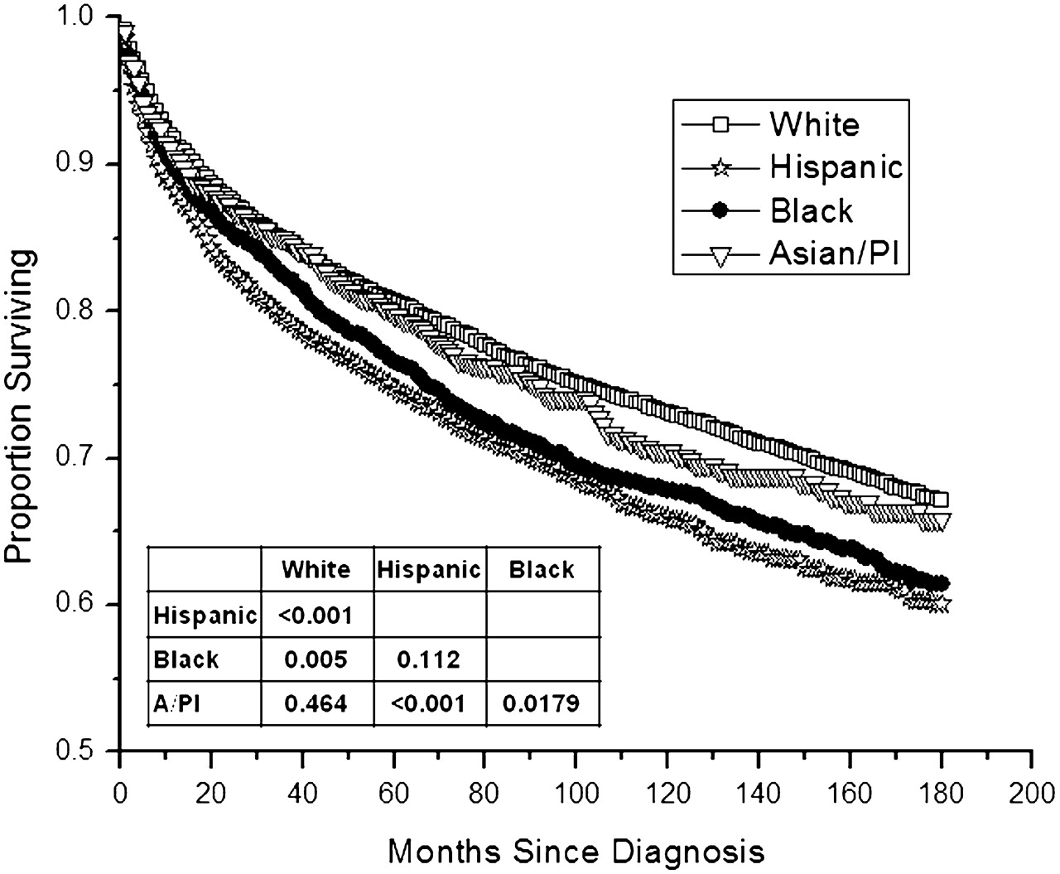
Figure 6 Survival of Hodgkin's lymphoma according to race. Overall survival (OS) by Kaplan–Meier analysis for whites, ...
Notes:
Figure 6 Survival of Hodgkin's lymphoma according to race. Overall survival (OS) by Kaplan–Meier analysis for whites, Hispanics, A/PI's, and Hispanics. Associated inlet compares OS across races.
Unless provided in the caption above, the following copyright applies to the content of this slide: © The Author 2012. Published by Oxford University Press on behalf of the European Society for Medical Oncology. All rights reserved. For permissions, please email: journals.permissions@oup.com.

