Slide 1
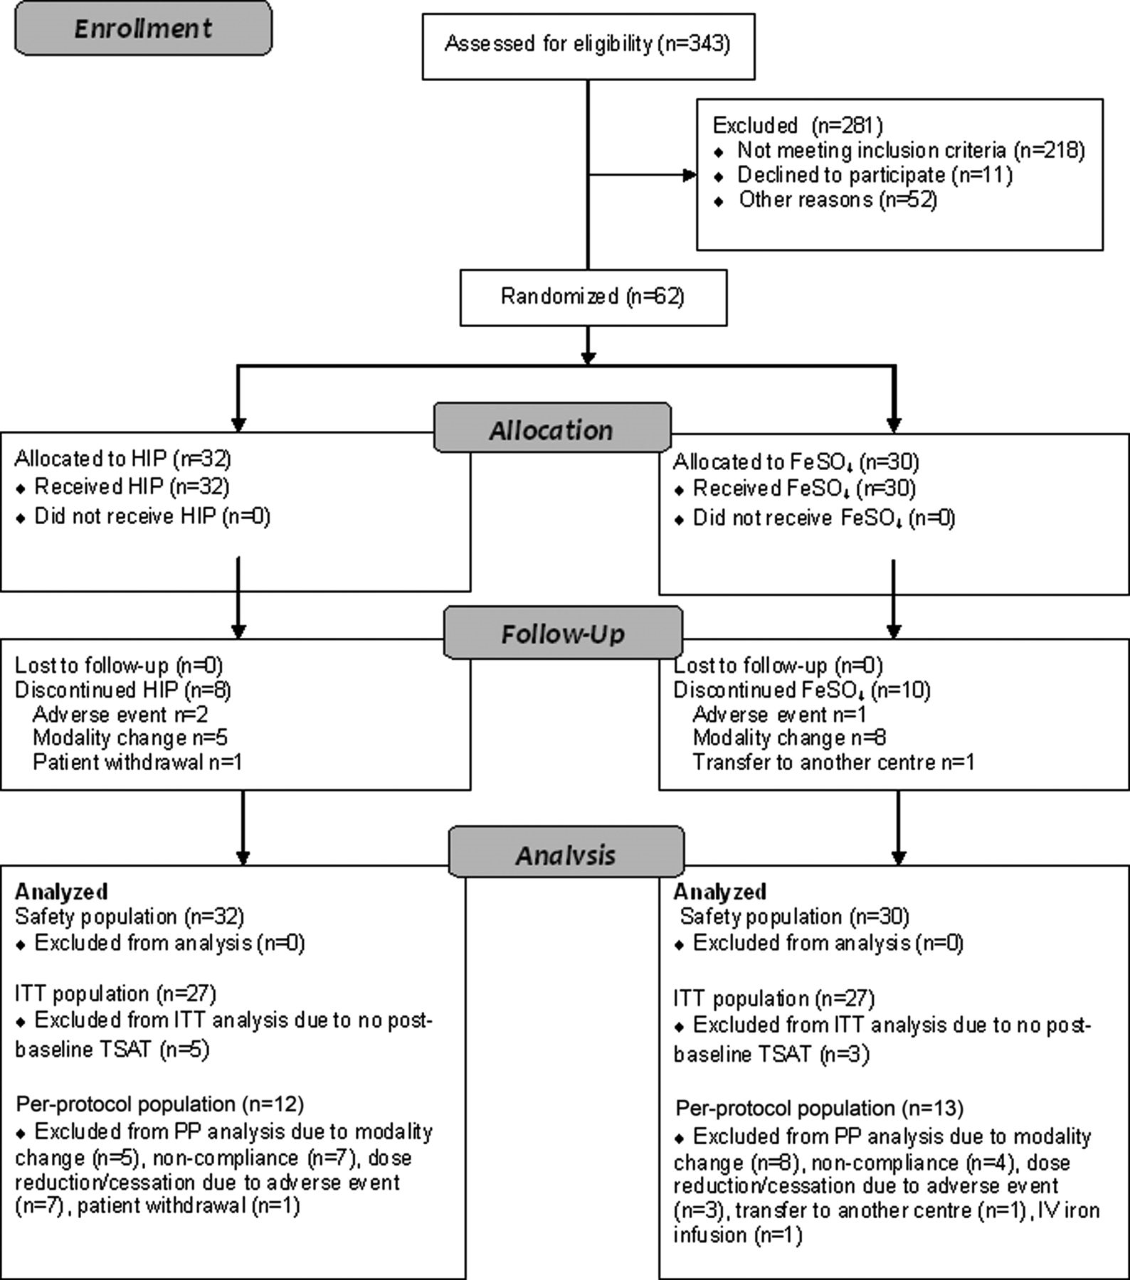
Fig. 1. CONSORT diagram showing the number of patients recruited into the HEMATOCRIT study, randomized, followed and ...
Notes:
Fig. 1. CONSORT diagram showing the number of patients recruited into the HEMATOCRIT study, randomized, followed and analysed.
Unless provided in the caption above, the following copyright applies to the content of this slide: © The Author 2012. Published by Oxford University Press on behalf of ERA-EDTA. All rights reserved. For Permissions, please e-mail: journals.permissions@oup.com

Slide 2
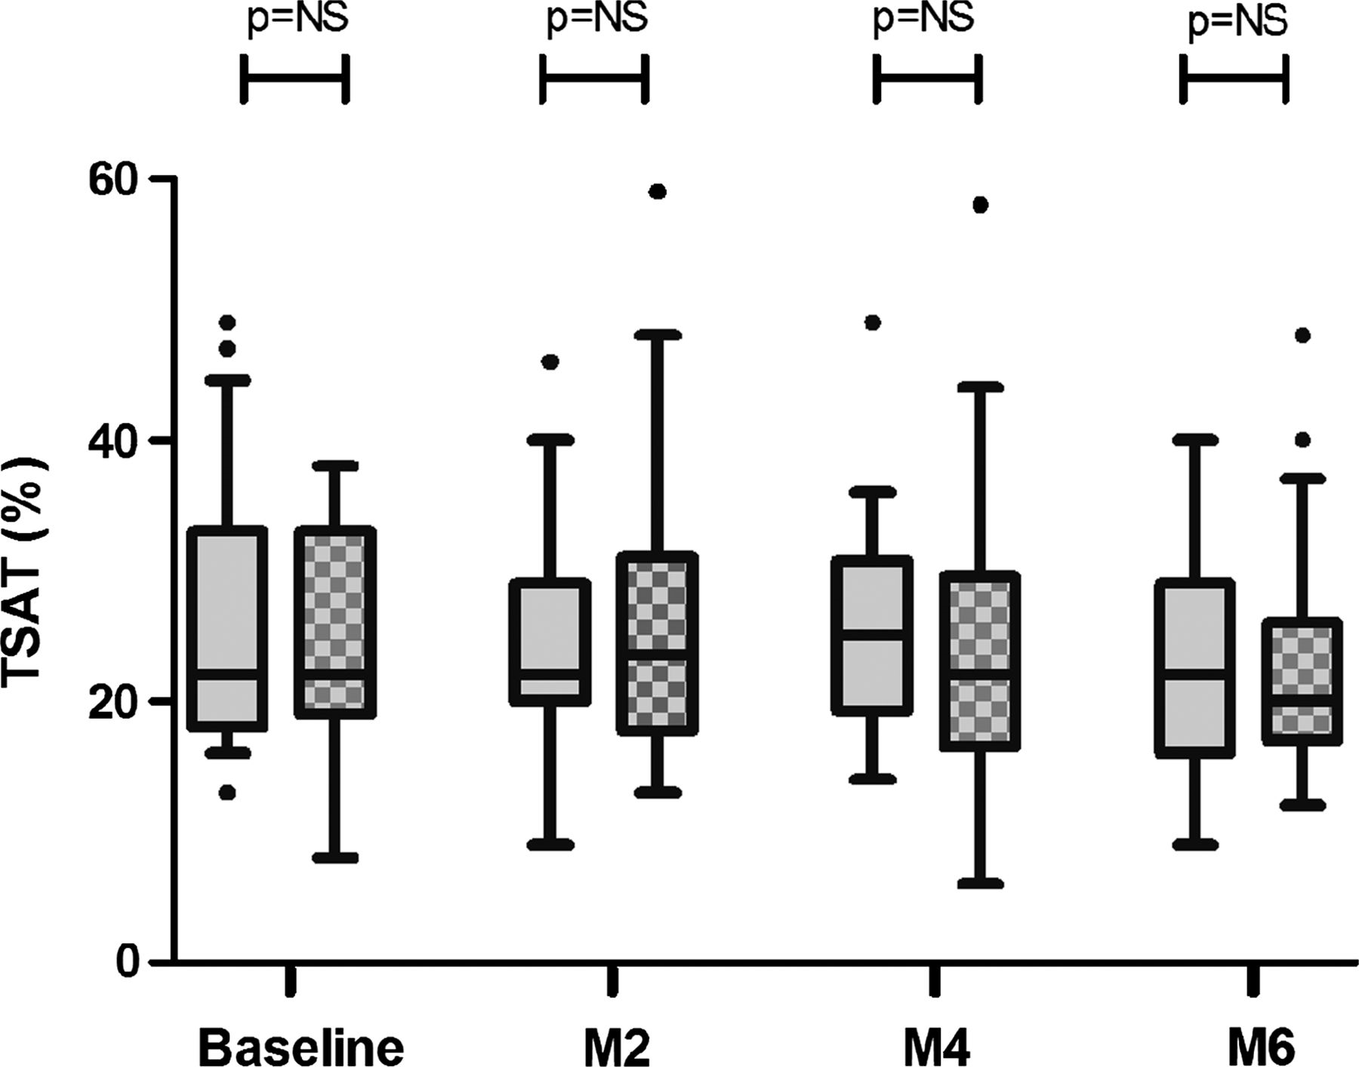
Fig. 2. Box and whisker plots of percentage TSAT with HIP (grey bars) compared with ferrous sulphate (checked bars) ...
Notes:
Fig. 2. Box and whisker plots of percentage TSAT with HIP (grey bars) compared with ferrous sulphate (checked bars) treatment at Months 0 (Baseline), 2 (M2), 4 (M4) and 6 (M6) post-commencement of study medication. The horizontal lines within the boxes represent median values. The upper and lower limits of each box represent the upper and lower quartiles, respectively. The upper and lower error bars represent the 90th and 10th percentiles, respectively. The solid dots represent outliers.
Unless provided in the caption above, the following copyright applies to the content of this slide: © The Author 2012. Published by Oxford University Press on behalf of ERA-EDTA. All rights reserved. For Permissions, please e-mail: journals.permissions@oup.com

