Slide 1
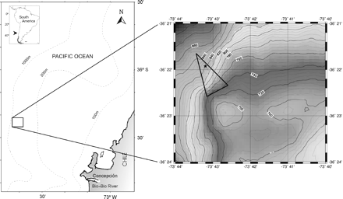
Figure 1. Study area off Concepción Bay, Central Chile. The triangle indicates trawls where evidence of active methane ...
Notes:
Figure 1. Study area off Concepción Bay, Central Chile. The triangle indicates trawls where evidence of active methane seepage was collected (carbonate blocks, live chemosymbiotic clams, and shell fragments). The star indicates the position in which shallow subsurface gas hydrates have been observed.
Unless provided in the caption above, the following copyright applies to the content of this slide: © 2008 International Council for the Exploration of the Sea. Published by Oxford Journals. All rights reserved. For Permissions, please email: journals.permissions@oxfordjournals.org

Slide 2
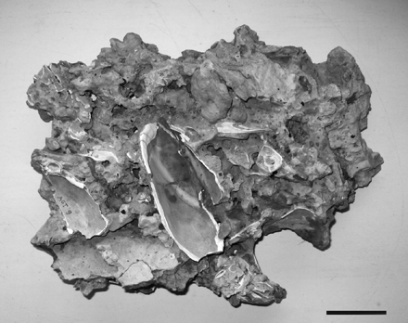
Figure 2. Typical carbonate block collected at the study area. Cemented valves of vesicomyids are also visible. Scale ...
Notes:
Figure 2. Typical carbonate block collected at the study area. Cemented valves of vesicomyids are also visible. Scale bar = 5 cm.
Unless provided in the caption above, the following copyright applies to the content of this slide: © 2008 International Council for the Exploration of the Sea. Published by Oxford Journals. All rights reserved. For Permissions, please email: journals.permissions@oxfordjournals.org

Slide 3
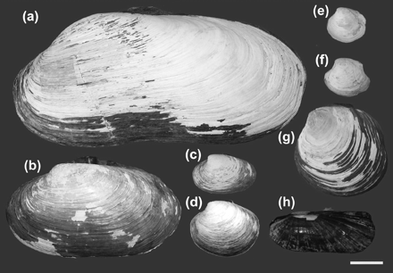
Figure 3. Chemosymbiotic bivalve assemblage of the CMSA: (a) vesicomyid gen. sp. 1, (b) vesicomyid gen. sp. 2, (c) ...
Notes:
Figure 3. Chemosymbiotic bivalve assemblage of the CMSA: (a) vesicomyid gen. sp. 1, (b) vesicomyid gen. sp. 2, (c) Calyptogena gallardoi, (d) Calyptogena sp., (e) Thyasira methanophila, (f) Conchocele sp., (g) Lucinoma anemiophila, and (h) Acharax sp. Scale bar = 2 cm.
Unless provided in the caption above, the following copyright applies to the content of this slide: © 2008 International Council for the Exploration of the Sea. Published by Oxford Journals. All rights reserved. For Permissions, please email: journals.permissions@oxfordjournals.org

Slide 4
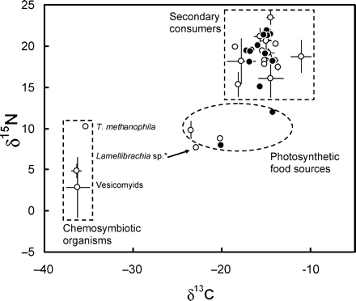
Figure 4. Dual isotope plot of δ¹³C and δ¹⁵N (mean ± s.d.) of chemosynthetic invertebrates, ...
Notes:
Figure 4. Dual isotope plot of δ13C and δ15N (mean ± s.d.) of chemosynthetic invertebrates, non-chemosynthetic food sources, and secondary consumers (invertebrates and fish) at the CMSA (white dots) and control non-seep sites (black dots). *See the text for explanation on the comparatively heavy 13C values of Lamellibrachia sp.
Unless provided in the caption above, the following copyright applies to the content of this slide: © 2008 International Council for the Exploration of the Sea. Published by Oxford Journals. All rights reserved. For Permissions, please email: journals.permissions@oxfordjournals.org

