Slide 1
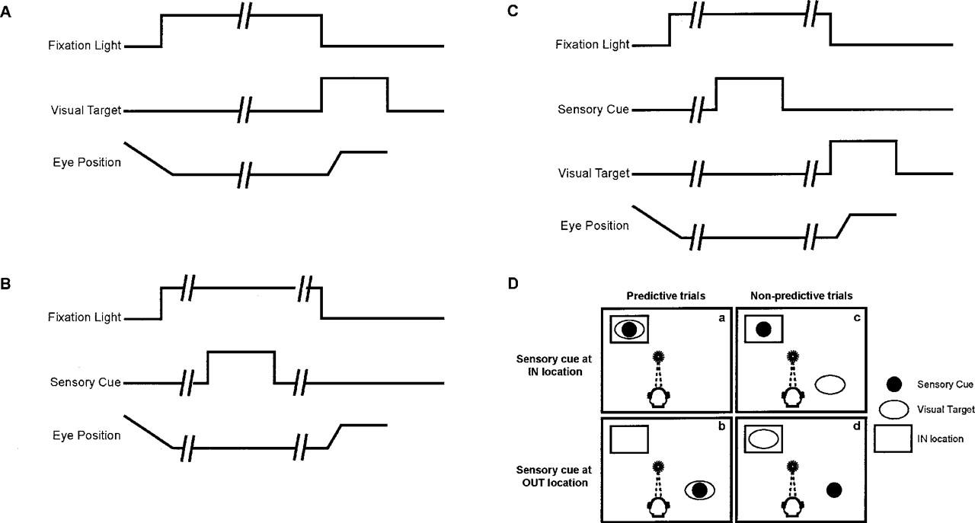
Figure 1. Behavioral tasks. (A) Visually guided saccade task. The monkey first fixated a central light. ...
Notes:
Figure 1. Behavioral tasks. (A) Visually guided saccade task. The monkey first fixated a central light. Following a random delay (as indicated by the broken line) of 400–700 ms, a visual target was presented and the monkey saccaded to its location. (B) Memory-guided saccade task. The monkey first fixated a central light. Following a random delay of 400–700 ms, a sensory cue was presented for 300 ms; 400–700 ms after offset of this sensory cue, the central light was extinguished signaling the monkey to saccade to the location of the remembered cue. (C) Predictive-cueing task. The monkey first fixated a central light. Next, after a random delay, a 300 ms sensory cue, either an auditory stimulus or a visual stimulus, was presented. After a random delay of 200–250 ms, the visual target was introduced and the monkey saccaded to the visual-target location. (D) Schematics of different configurations of the predictive-cueing task. The locations of the sensory cues and the visual targets are schematized relative to the IN location of a neuron’s response field. The location of the response field that elicited the maximal response was designated as the IN location. The location that was 180° contralateral to the IN location was designated as the OUT location. During predictive trials (LEFT column), a sensory cue and the visual target are at the same location. They are either (a) at the IN location or (b) at the OUT location. During non-predictive trials (RIGHT column), a sensory cue and the visual target are at different locations: (c) a sensory cue at the IN location and the visual target at the OUT location or (d) a sensory cue at the OUT location and the visual target at the IN location.
Unless provided in the caption above, the following copyright applies to the content of this slide:

Slide 2
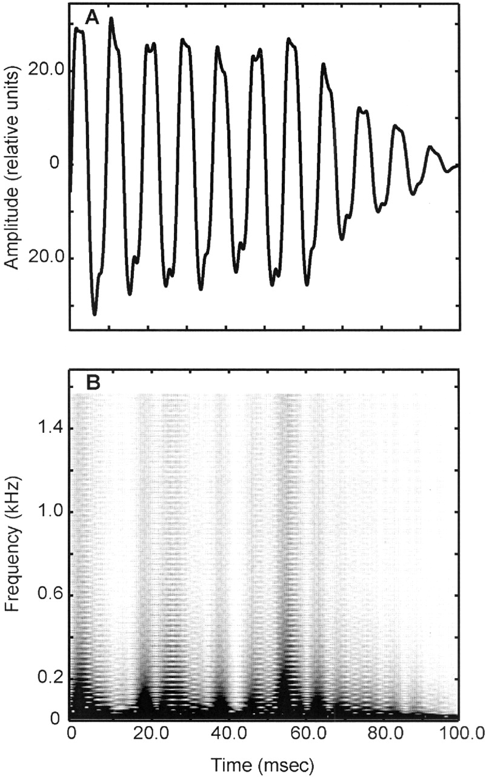
Figure 2. Auditory stimulus. The amplitude waveform (A) and the spectrogram (B) of one of the sound bursts ...
Notes:
Figure 2. Auditory stimulus. The amplitude waveform (A) and the spectrogram (B) of one of the sound bursts used to create the auditory stimulus.
Unless provided in the caption above, the following copyright applies to the content of this slide:

Slide 3
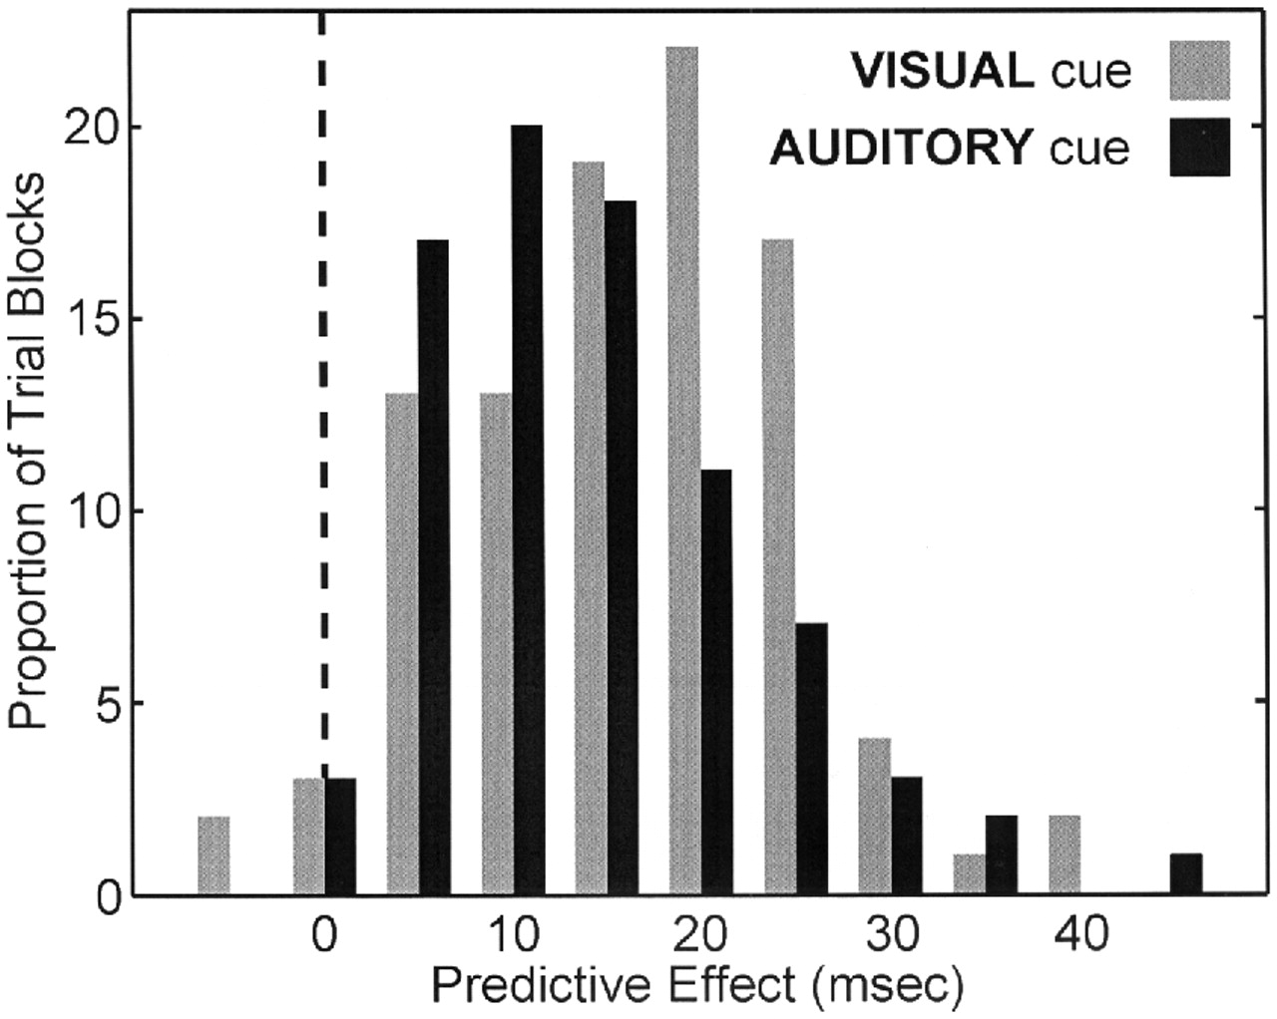
Figure 3. The effect of the sensory cue on mean saccadic latency. The difference between mean saccadic ...
Notes:
Figure 3. The effect of the sensory cue on mean saccadic latency. The difference between mean saccadic latency during non-predictive trials and predictive trials (the ‘predictive effect’) is plotted in grey for the visual predictive-cueing task and in black for the auditory predictive-cueing task. The distributions in this figure are based on the behavioral data that was collected while recording from 96 LIP neurons during the visual predictive-cueing task and 82 LIP neurons during the auditory predictive-cueing task. The dotted line indicates zero predictive effect.
Unless provided in the caption above, the following copyright applies to the content of this slide:

Slide 4
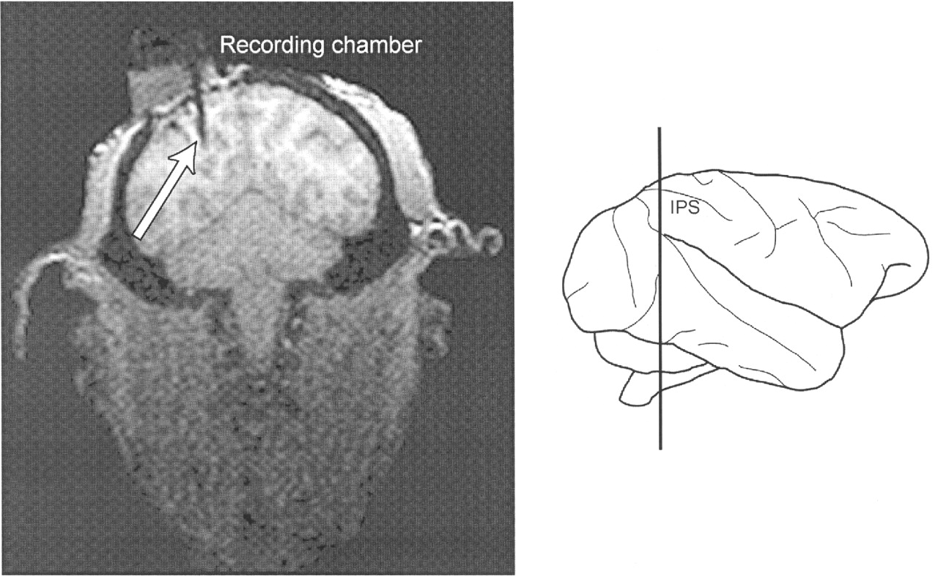
Figure 4. Verification of recording area. A magnetic resonance image shows the recording cylinder from monkey ...
Notes:
Figure 4. Verification of recording area. A magnetic resonance image shows the recording cylinder from monkey Z above the intraparietal sulcus. The arrow also indicates the tip of a recording electrode that is along the lateral bank of the intraparietal sulcus (IPS). Inset shows the coronal plane of the MRI image.
Unless provided in the caption above, the following copyright applies to the content of this slide:

Slide 5
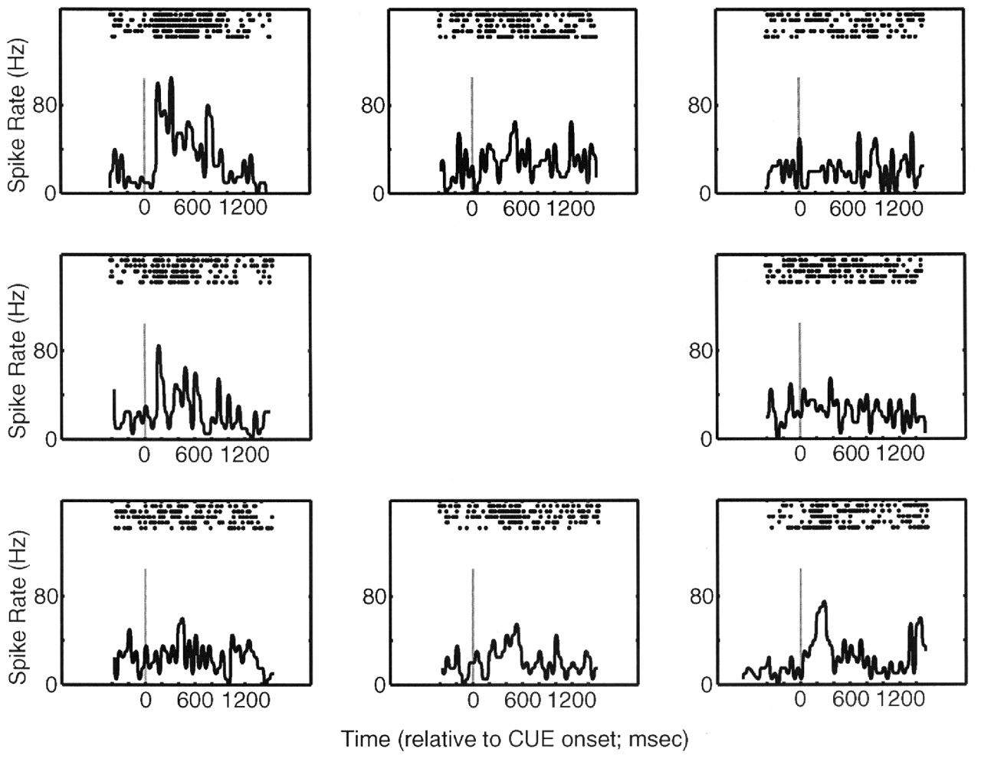
Figure 5. Responses of a LIP neuron during the memory-guided saccade task. Rasters and spike-density time ...
Notes:
Figure 5. Responses of a LIP neuron during the memory-guided saccade task. Rasters and spike-density time histograms are arranged as a function of cue location. The histograms and rasters are aligned relative to the onset of the 300 ms visual cue; the solid grey line in each panel indicates stimulus onset. The histograms were generated by binning spike times into 40 ms bins.
Unless provided in the caption above, the following copyright applies to the content of this slide:

Slide 6
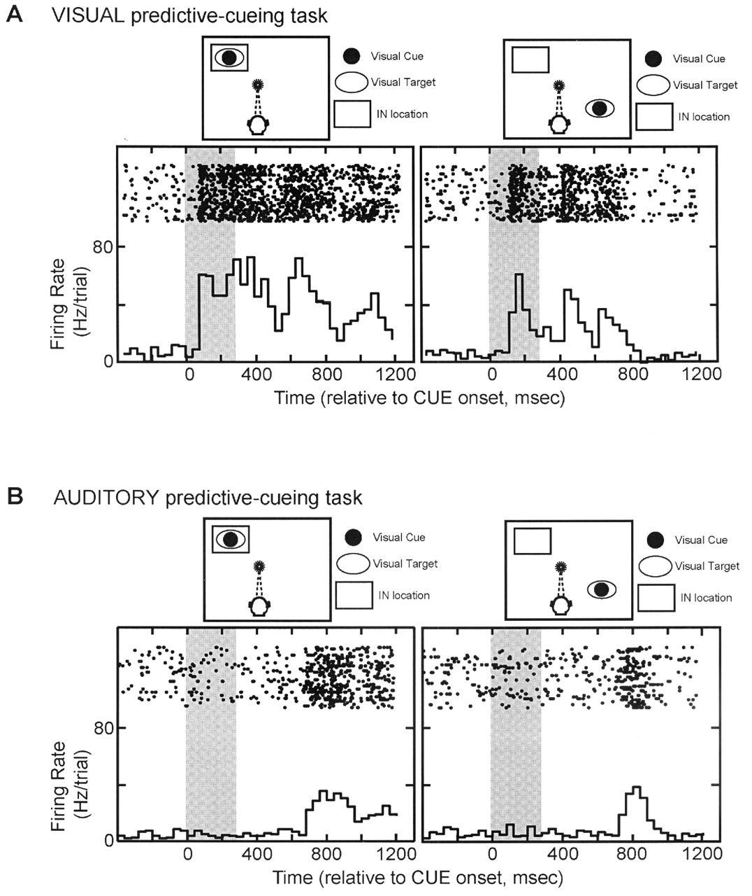
Figure 6. Response of a LIP neuron during (A) the visual predictive-cueing task and (B) the auditory ...
Notes:
Figure 6. Response of a LIP neuron during (A) the visual predictive-cueing task and (B) the auditory predictive-cueing tasks. In each panel, the two schematics above the neural data show the locations of the sensory cue and the visual target relative to the IN location of the response field. In both A and B, the neural activity in the LEFT column was generated during predictive trials when both the sensory cue and the visual target were located at the IN location of the response field. The neural activity in the RIGHT column was generated during predictive trials when both the sensory cue and the visual target were located at the OUT location. In each panel, the rasters and spike-density histograms are aligned relative to the onset of the sensory cue. The grey rectangle in each panel spans the duration of the sensory cue.
Unless provided in the caption above, the following copyright applies to the content of this slide:

Slide 7
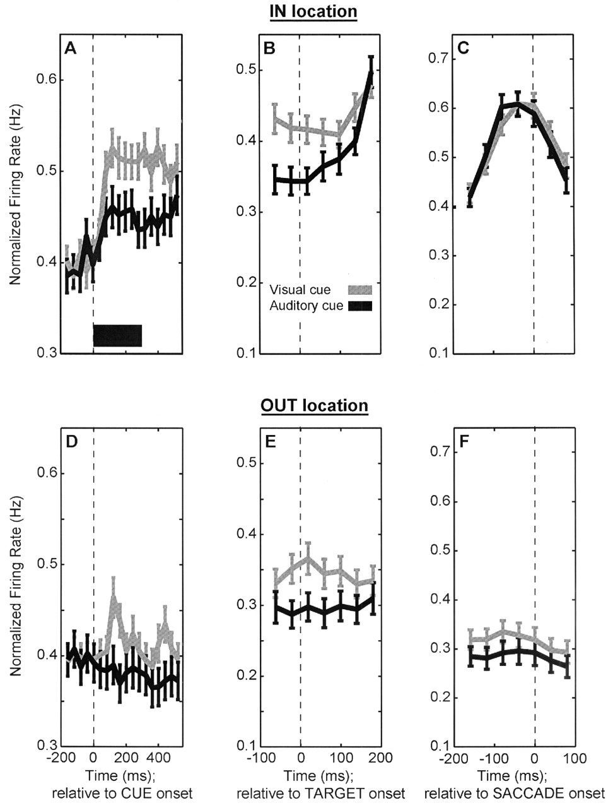
Figure 7. Population response profiles of LIP activity during the predictive-cueing task. The data in the TOP ...
Notes:
Figure 7. Population response profiles of LIP activity during the predictive-cueing task. The data in the TOP row were generated during predictive trials when both the cue and the target were at the IN location. The data in the BOTTOM row were generated during predictive trials when both the cue and the target were at the OUT location. Data are aligned relative to different epochs of the task: (A, D) cue onset, (B, E) target onset, and (C, F) saccade onset. In each panel, each of these alignment points is indicated by a dotted line. As indicated by the legend in B, the response profiles and error bars in grey were generated from LIP activity recorded during the visual predictive-cueing task, and the response profiles and error bars in black were generated from LIP activity recorded during the auditory predictive-cueing task. Error bars are standard errors of the mean. The black rectangle in A indicates cue duration. Data are normalized within each panel.
Unless provided in the caption above, the following copyright applies to the content of this slide:

Slide 8
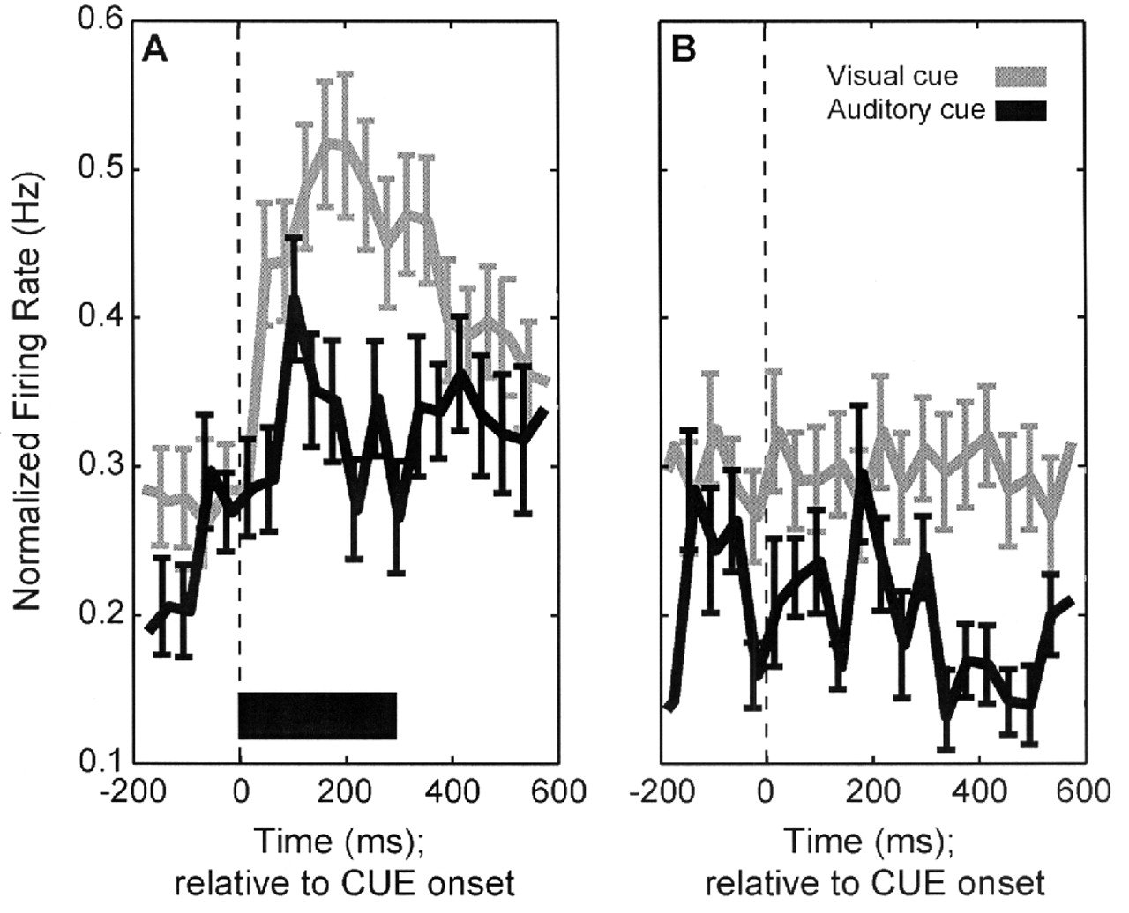
Figure 8. Population response profiles of LIP activity during memory-guided saccades. The two panels ...
Notes:
Figure 8. Population response profiles of LIP activity during memory-guided saccades. The two panels illustrate data collected when the cue was (A) at the IN location and (B) the OUT location. Data are aligned relative to cue onset; in each panel, each of these alignment points is indicated by a dotted line. As indicated by the legend in B, the response profiles and error bars in grey were generated from LIP activity recorded during the visual memory-guided saccade task and the response profiles and error bars in black were generated from LIP activity recorded during the auditory memory-guided saccade task. Error bars are standard errors of the mean. The black rectangle in A indicates cue duration.
Unless provided in the caption above, the following copyright applies to the content of this slide:

Slide 9
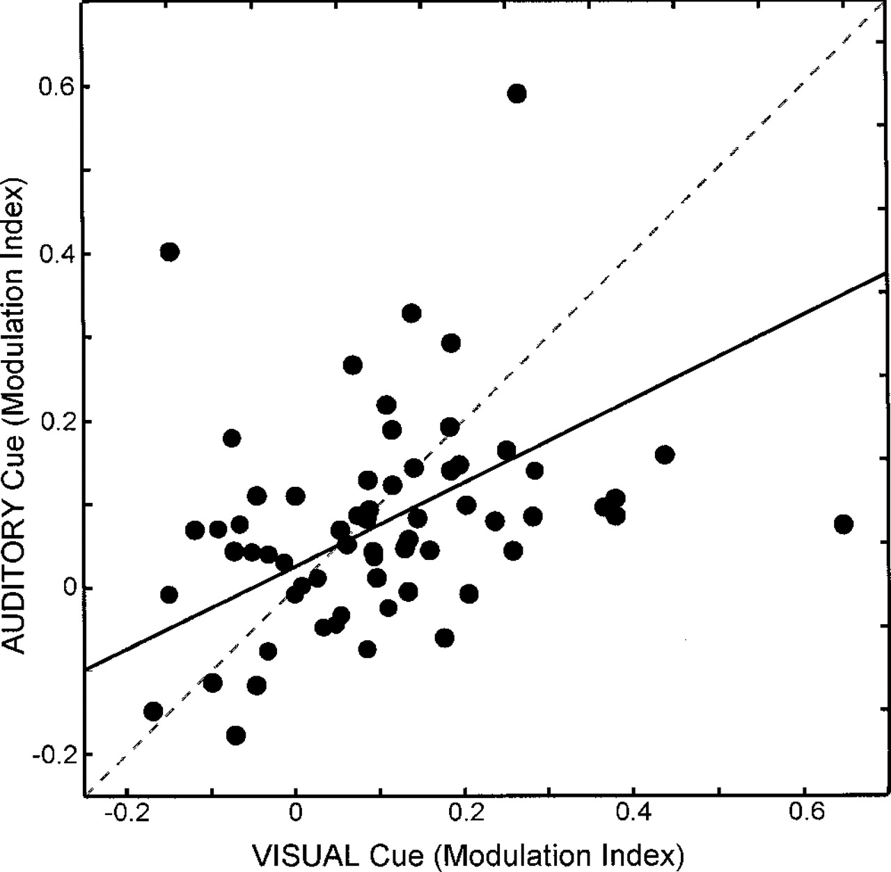
Figure 9. Correlation analysis of LIP neurons during the cue period of the visual and auditory ...
Notes:
Figure 9. Correlation analysis of LIP neurons during the cue period of the visual and auditory predictive-cueing task for 65 LIP neurons. On a neuron-by-neuron basis, the modulation-index value from the visual predictive-cueing task is plotted on the abscissa and the modulation-index value from the auditory predictive-cueing task is plotted on the ordinate. The dotted grey line represents the expected relationship if the neurons had the same modulation-index values from the visual and auditory predictive-cueing tasks. The solid black line represents the slope of the two-dimensional least-mean-squares line that relates the modulation-index values from the visual predictive-cueing task with the modulation-index values from the auditory predictive-cueing task.
Unless provided in the caption above, the following copyright applies to the content of this slide:

Slide 10
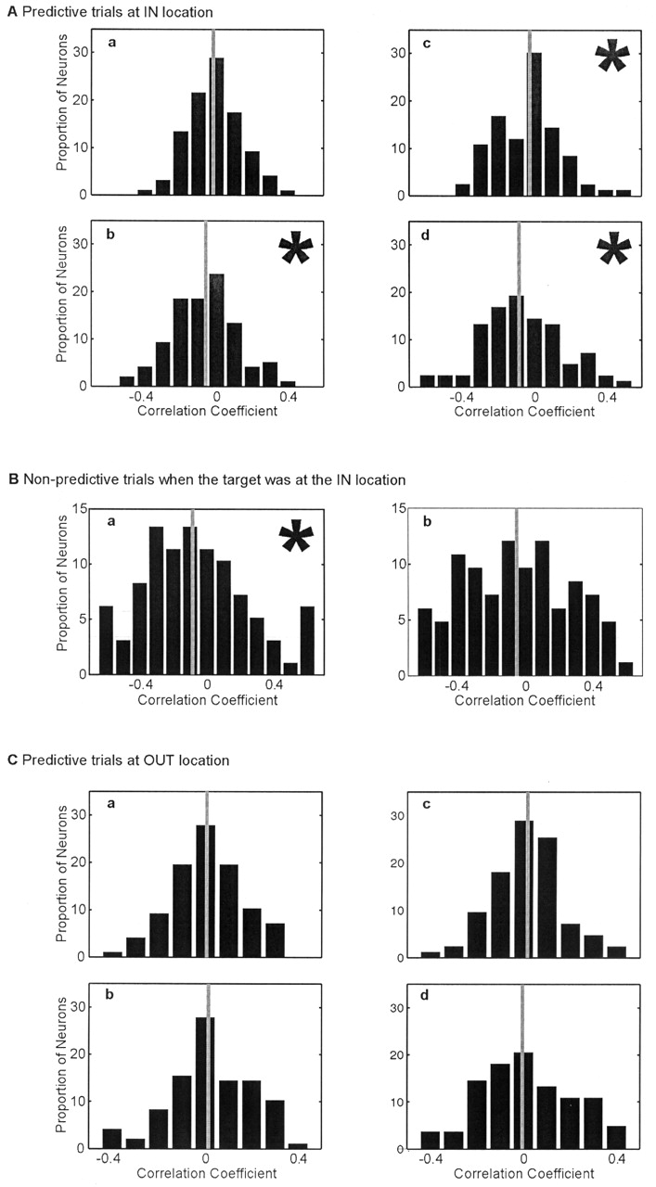
Figure 10. Population histograms of the correlation between firing rate and saccadic latency during the ...
Notes:
Figure 10. Population histograms of the correlation between firing rate and saccadic latency during the visual and auditory predictive-cueing tasks. (A) Distributions of correlation coefficients during predictive trials when the cue and the target were at the IN location. The distribution relating visual cue-period activity and saccadic latency is shown in a, the distribution relating auditory cue-period activity and saccadic latency is shown in b, the distribution relating response-period activity during the visual predictive-cueing task is shown in c and the distribution relating response-period activity during the auditory predictive-cueing task is shown in d. (B) Distributions of correlation coefficients during non-predictive trials when the target was at the IN location. The distribution relating response-period activity during the visual predictive-cueing task is shown in a and the distribution relating response-period activity during the auditory predictive-cueing task is shown in b. (C) Distributions of correlation coefficients during predictive trials when the cue and the target were at the OUT location. The distribution relating visual cue-period activity and saccadic latency is shown in a, the distribution relating auditory cue-period activity and saccadic latency is shown in b, the distribution relating response-period activity during the visual predictive-cueing task is shown in c and the distribution relating response-period activity during the auditory predictive-cueing task is shown in d. Each of the distributions in this figure is based on the behavioral and neural data collected while recording from 96 LIP neurons during the visual predictive-cueing task and 82 LIP neurons during the auditory predictive-cueing task. The grey line in each panel indicates the mean of each distribution. Panels with asterisks indicate distributions with mean values that are significantly (P < 0.05) less than zero.
Unless provided in the caption above, the following copyright applies to the content of this slide:

Slide 11
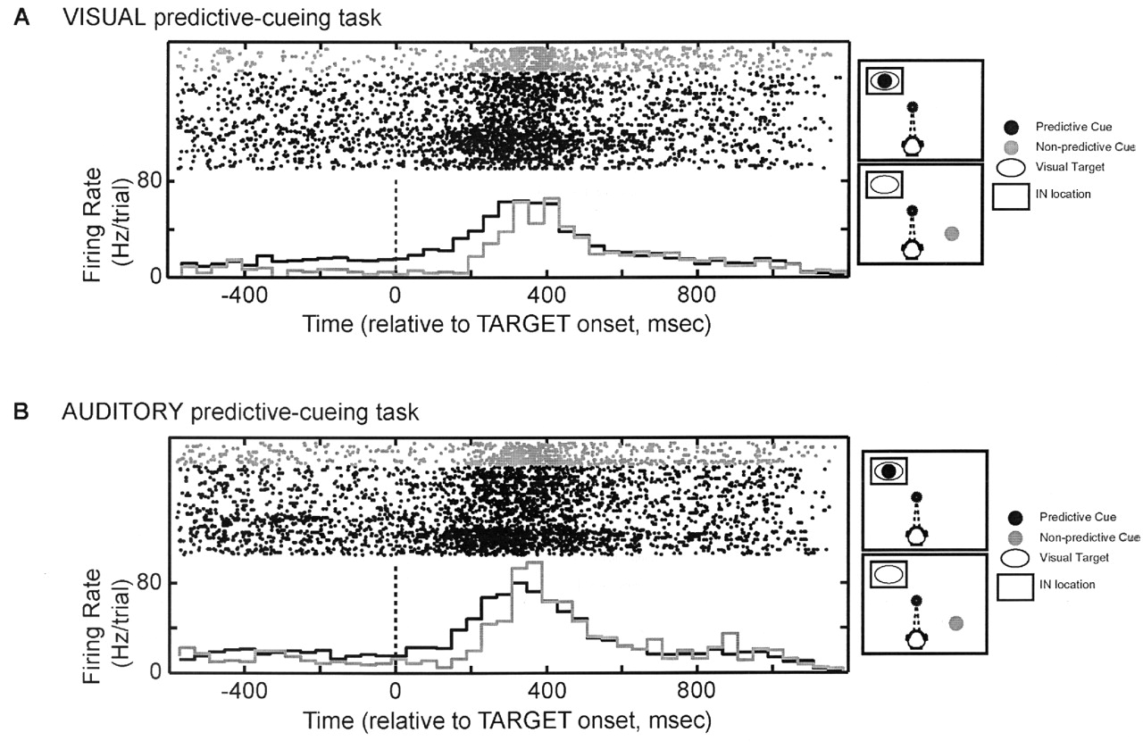
Figure 11. Response of a LIP neuron during (A) the visual predictive-cueing task and (B) the auditory ...
Notes:
Figure 11. Response of a LIP neuron during (A) the visual predictive-cueing task and (B) the auditory predictive-cueing task. In both A and B, the two schematics to the right of the neural data show the locations of a sensory cue and the visual target relative to the IN location of the response field during predictive (top) and non-predictive trials (bottom); the data in this figure represent only those trials in which the visual target was located at the IN location. In each panel, the rasters and spike-density histograms in black were data collected during predictive trials, whereas those in grey were data collected during non-predictive trials. The rasters and spike-density histograms in each panel are aligned relative to the onset of the visual target; the dashed line indicates visual-target onset.
Unless provided in the caption above, the following copyright applies to the content of this slide:

Slide 12
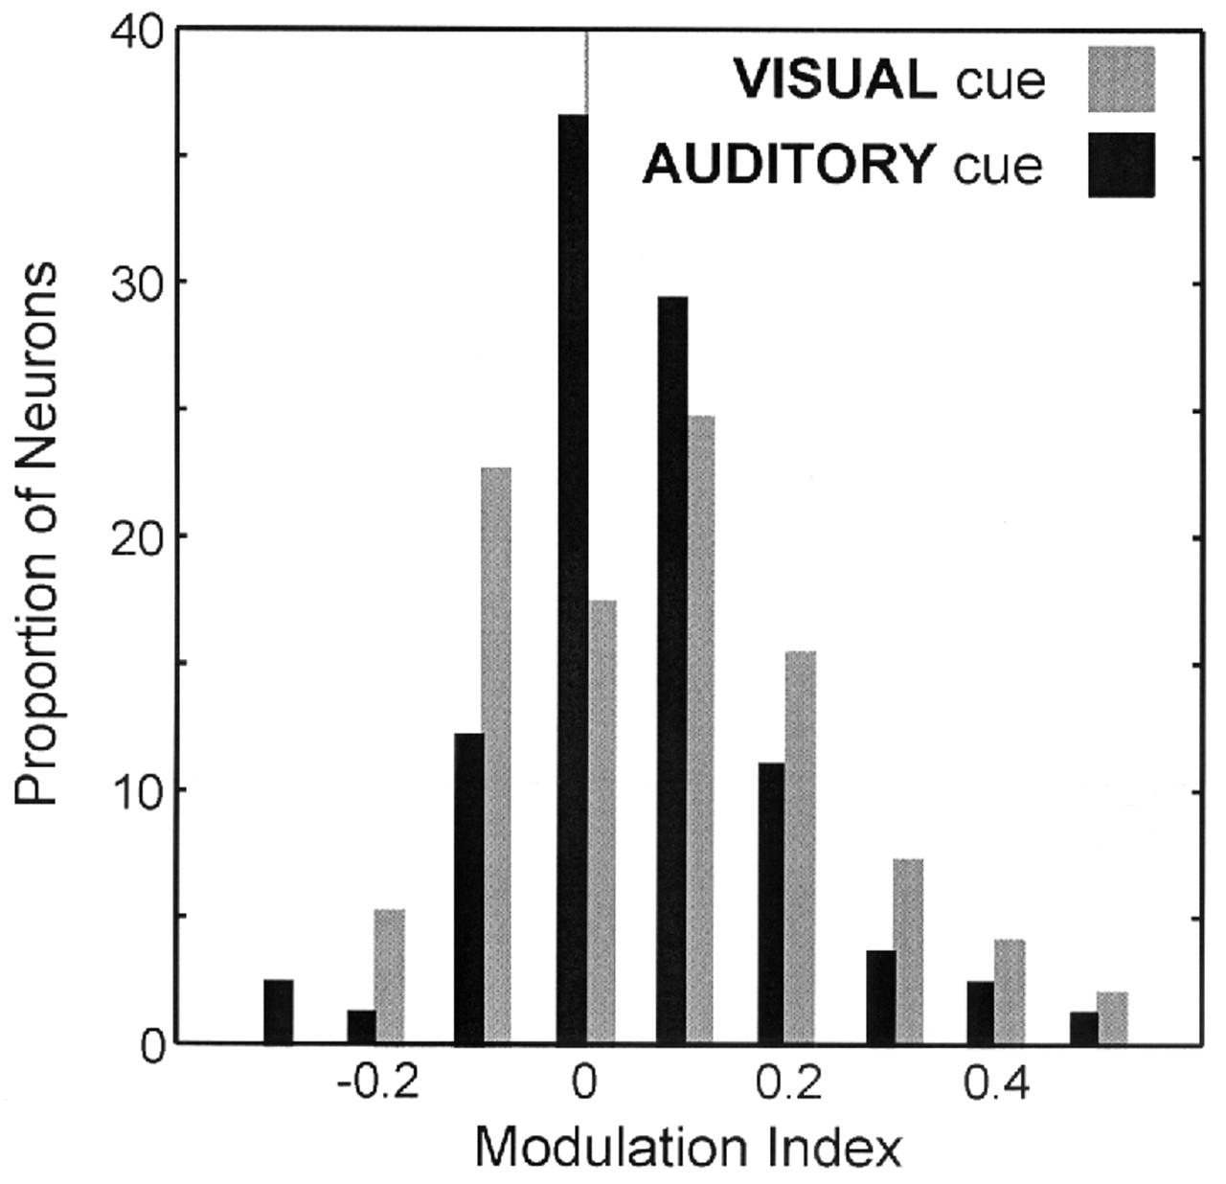
Figure 12. Frequency histogram for the modulation index during the response period. Data from neurons ...
Notes:
Figure 12. Frequency histogram for the modulation index during the response period. Data from neurons recorded during the visual predictive-cueing task (n = 96) are shown in A and data from neurons recorded during the auditory predictive-cueing task (n = 82) are shown in B. The grey line in each panel indicates an index value = 0.
Unless provided in the caption above, the following copyright applies to the content of this slide:

