Slide 1
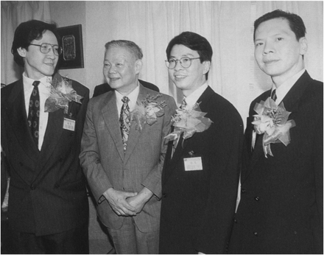
FIG. 1 A Chinese leader officiating in Sun Yee On investment in 1993. Source: Next Magazine 27 August 1993.
Notes:
FIG. 1 A Chinese leader officiating in Sun Yee On investment in 1993. Source: Next Magazine 27 August 1993.
Unless provided in the caption above, the following copyright applies to the content of this slide: © The Author 2010. Published by Oxford University Press on behalf of the Centre for Crime and Justice Studies (ISTD). All rights reserved. For permissions, please e-mail: journals.permissions@oxfordjournals.org

Slide 2
FIG. 2 Share price movement of CPH in 1999.
Notes:
FIG. 2 Share price movement of CPH in 1999.
Unless provided in the caption above, the following copyright applies to the content of this slide: © The Author 2010. Published by Oxford University Press on behalf of the Centre for Crime and Justice Studies (ISTD). All rights reserved. For permissions, please e-mail: journals.permissions@oxfordjournals.org

Slide 3
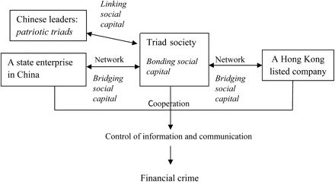
FIG. 3 Dimensions of social capital in triad organized crime.
Notes:
FIG. 3 Dimensions of social capital in triad organized crime.
Unless provided in the caption above, the following copyright applies to the content of this slide: © The Author 2010. Published by Oxford University Press on behalf of the Centre for Crime and Justice Studies (ISTD). All rights reserved. For permissions, please e-mail: journals.permissions@oxfordjournals.org

