Slide 1
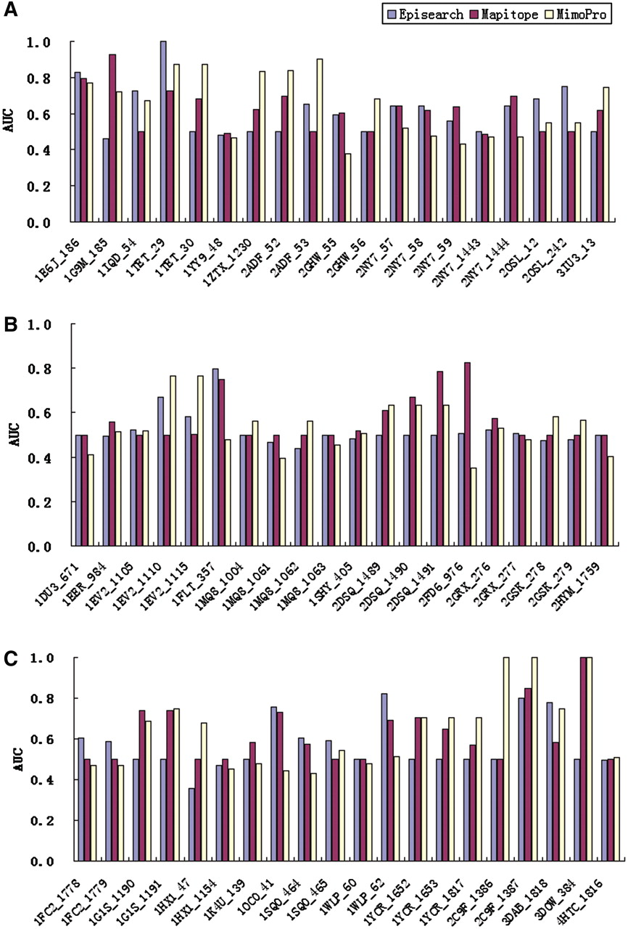
Figure 1. Benchmark Mapitope, Episearch and MimoPro with MimoBench. The string under the X-axis is the case tested. ...
Notes:
Figure 1. Benchmark Mapitope, Episearch and MimoPro with MimoBench. The string under the X-axis is the case tested. Each case has the format: PDB ID_Mimotope Set ID, where the left part is the PDB code of corresponding target–template structure, the right part is entry ID of the mimotope set. (A) Antibody–antigen group, (B) receptor–ligand group and (C) other protein–protein interaction group.
Unless provided in the caption above, the following copyright applies to the content of this slide: © The Author(s) 2011. Published by Oxford University Press.This is an Open Access article distributed under the terms of the Creative Commons Attribution Non-Commercial License (http://creativecommons.org/licenses/by-nc/3.0), which permits unrestricted non-commercial use, distribution, and reproduction in any medium, provided the original work is properly cited.

Slide 2
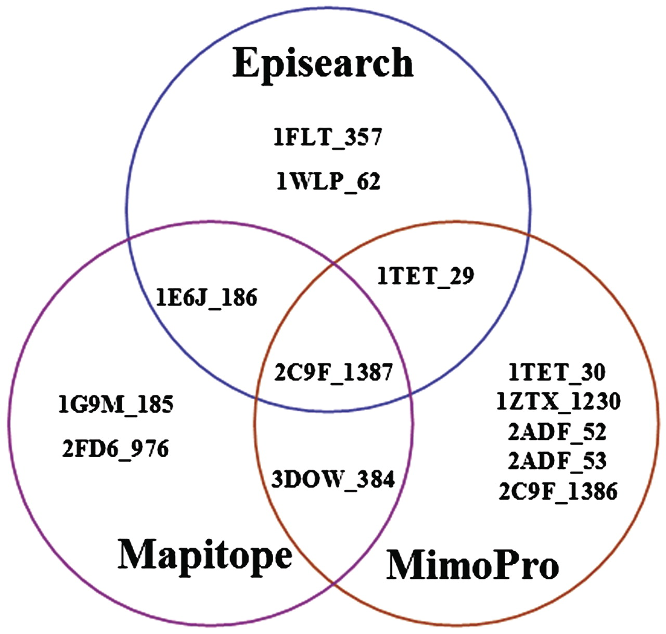
Figure 2. Success cases of Mapitope, Episearch and MimoPro with AUC above 0.8. The cases are written in the same format ...
Notes:
Figure 2. Success cases of Mapitope, Episearch and MimoPro with AUC above 0.8. The cases are written in the same format described in Figure 1.
Unless provided in the caption above, the following copyright applies to the content of this slide: © The Author(s) 2011. Published by Oxford University Press.This is an Open Access article distributed under the terms of the Creative Commons Attribution Non-Commercial License (http://creativecommons.org/licenses/by-nc/3.0), which permits unrestricted non-commercial use, distribution, and reproduction in any medium, provided the original work is properly cited.

