Slide 1
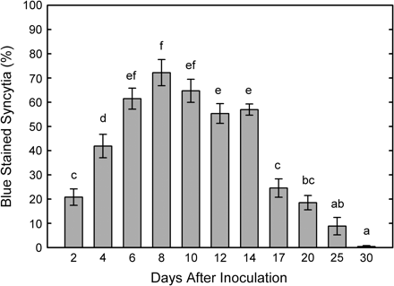
Fig. 1. GUS expression in syncytia of pAtSUC4–gus Arabidopsis plants. Columns show the percentage of GUS-stained ...
Notes:
Fig. 1. GUS expression in syncytia of pAtSUC4–gus Arabidopsis plants. Columns show the percentage of GUS-stained syncytia at different time points after nematode inoculation. At every time point 63 single plants, each inoculated with 50 freshly hatched J2 of H. schachtii, were analysed. Letters show significant differences at P <0.05 (one-way ANOVA, LSD). Values are means ±SE.
Unless provided in the caption above, the following copyright applies to the content of this slide: © The Author [2007]. Published by Oxford University Press [on behalf of the Society for Experimental Biology]. All rights reserved. For Permissions, please e-mail: journals.permissions@oxfordjournals.org

Slide 2
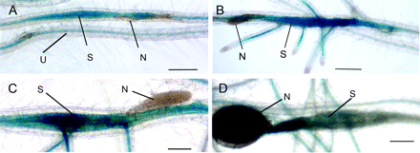
Fig. 2. Histochemical GUS-assay of pAtSUC4–gus lines infected with J2 of H. schachtii: (A) local GUS activity in a ...
Notes:
Fig. 2. Histochemical GUS-assay of pAtSUC4–gus lines infected with J2 of H. schachtii: (A) local GUS activity in a nematode-induced syncytium and in the phloem of non-infected roots at 4 dai; (B) syncytia and roots arising from the syncytia are stained blue at 6 dai; (C) at 14 dai there is still a strong GUS signal in a syncytium of a female juvenile; (D) an adult female is feeding on a syncytium where GUS expression is restricted to the area close to the nematode's head (20 dai). dai, Days after inoculation, S, syncytium, N, nematode, U, non-infected root. Scale bars=400 μm.
Unless provided in the caption above, the following copyright applies to the content of this slide: © The Author [2007]. Published by Oxford University Press [on behalf of the Society for Experimental Biology]. All rights reserved. For Permissions, please e-mail: journals.permissions@oxfordjournals.org

Slide 3
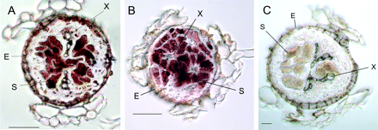
Fig. 3. In situ RT-PCR on cross-sections of syncytia (25 μm) 10 d after inoculation for (A) AtSUC2, (B) AtSUC4, and ...
Notes:
Fig. 3. In situ RT-PCR on cross-sections of syncytia (25 μm) 10 d after inoculation for (A) AtSUC2, (B) AtSUC4, and (C) negative control without polymerase. In (A) and (B) the staining is restricted to syncytia, whereas in (C) no staining is visible. S, Syncytium, X, xylem, E, endodermis. Scale bars=20 μm.
Unless provided in the caption above, the following copyright applies to the content of this slide: © The Author [2007]. Published by Oxford University Press [on behalf of the Society for Experimental Biology]. All rights reserved. For Permissions, please e-mail: journals.permissions@oxfordjournals.org

Slide 4
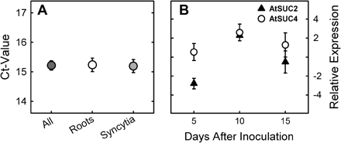
Fig. 4. (A) Real time RT-PCR of 18S RNA control. Gene expression was analysed in three independent root and syncytium ...
Notes:
Fig. 4. (A) Real time RT-PCR of 18S RNA control. Gene expression was analysed in three independent root and syncytium samples. Ct-values of root tissues, syncytia tissues, and both tissues tested combined are shown. Values are means ±SE (n=3). (B) Relative real-time RT-PCR of AtSUC2 and AtSUC4 in syncytia. Values are given in fold change in syncytium-enriched root tissues compared with control roots. Values are means ±SE (n=3)
Unless provided in the caption above, the following copyright applies to the content of this slide: © The Author [2007]. Published by Oxford University Press [on behalf of the Society for Experimental Biology]. All rights reserved. For Permissions, please e-mail: journals.permissions@oxfordjournals.org

Slide 5
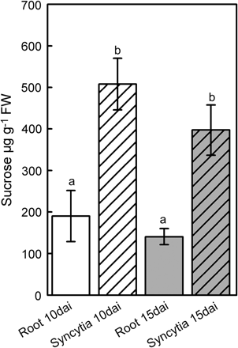
Fig. 5. Levels of sucrose in non-infected roots and syncytia at 10 dai and 15 dai. Syncytial samples show highly ...
Notes:
Fig. 5. Levels of sucrose in non-infected roots and syncytia at 10 dai and 15 dai. Syncytial samples show highly elevated values. Values are means ±SE (n=3).
Unless provided in the caption above, the following copyright applies to the content of this slide: © The Author [2007]. Published by Oxford University Press [on behalf of the Society for Experimental Biology]. All rights reserved. For Permissions, please e-mail: journals.permissions@oxfordjournals.org

Slide 6
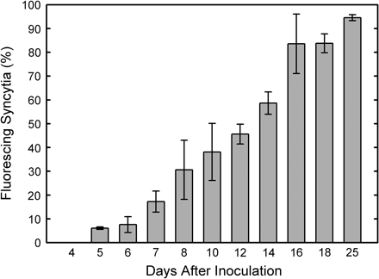
Fig. 6. Percentage of fluorescing syncytia after loading with CF on different days after inoculation (dai). At 4 dai ...
Notes:
Fig. 6. Percentage of fluorescing syncytia after loading with CF on different days after inoculation (dai). At 4 dai no syncytia showed fluorescence whereas at later stages the percentage increased to >90%. Values are means ±SE (n=3).
Unless provided in the caption above, the following copyright applies to the content of this slide: © The Author [2007]. Published by Oxford University Press [on behalf of the Society for Experimental Biology]. All rights reserved. For Permissions, please e-mail: journals.permissions@oxfordjournals.org

Slide 7
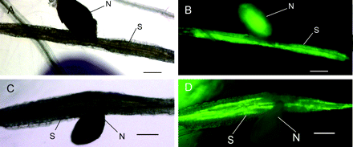
Fig. 7. Loading experiments with CF. (A) Transmission light image of a female nematode and its syncytium. (B) ...
Notes:
Fig. 7. Loading experiments with CF. (A) Transmission light image of a female nematode and its syncytium. (B) Fluorescence microscopic view of the same specimen. CF has been unloaded from the phloem to the syncytium and taken up by the nematode. (C) Transmission light image of a female stage-4 juvenile and its syncytium. (D) Fluorescence microscopic view of the same specimen as shown in (C). CF is retained in the phloem and not translocated into the syncytium. N, Nematode, S, syncytium. Scale bars=200 μm.
Unless provided in the caption above, the following copyright applies to the content of this slide: © The Author [2007]. Published by Oxford University Press [on behalf of the Society for Experimental Biology]. All rights reserved. For Permissions, please e-mail: journals.permissions@oxfordjournals.org

Slide 8
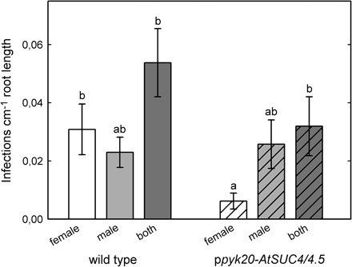
Fig. 8. Nematode infection test comparing wild type (Col) with ppyk20-AtSUC4/4.5 RNAi line. Plants were grown on ...
Notes:
Fig. 8. Nematode infection test comparing wild type (Col) with ppyk20-AtSUC4/4.5 RNAi line. Plants were grown on media without sucrose in order to ensure that nematode juveniles are completely dependent on the plant's sugar supply. Letters indicate significant differences at P <0.05 (one-way ANOVA, LSD) values are means ±SE (n=12).
Unless provided in the caption above, the following copyright applies to the content of this slide: © The Author [2007]. Published by Oxford University Press [on behalf of the Society for Experimental Biology]. All rights reserved. For Permissions, please e-mail: journals.permissions@oxfordjournals.org

