Slide 1
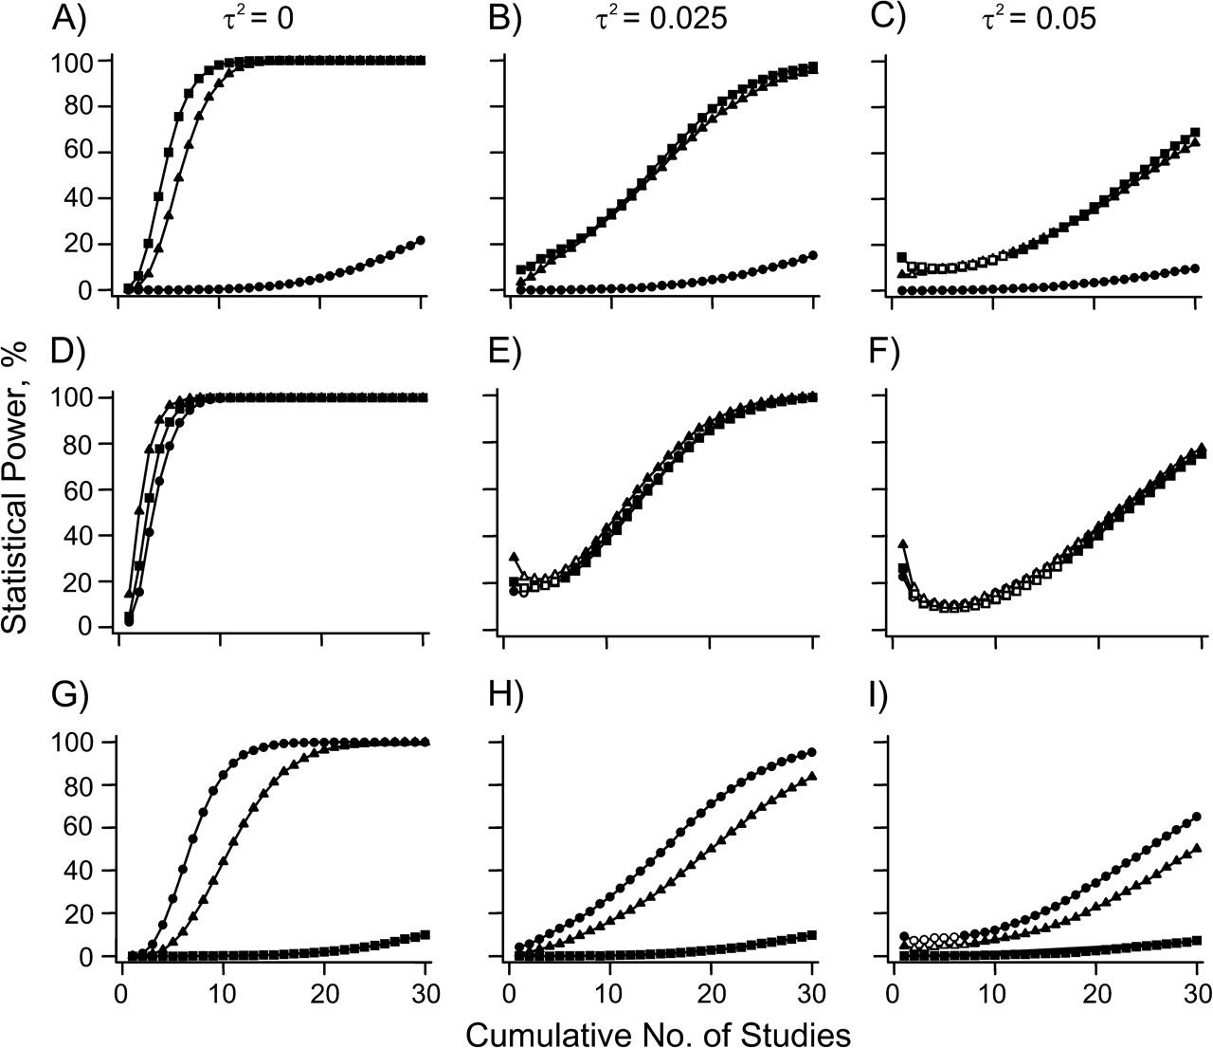
Figure 1. Cumulative power comparison among 3 main true genetic models by random-effects calculations (dominant in A, ...
Notes:
Figure 1. Cumulative power comparison among 3 main true genetic models by random-effects calculations (dominant in A, B, and C; log additive in D, E, and F; and recessive in G, H, and I) in meta-analyses of up to 30 data sets (with an average of 2,000 participants, a range of 1,000–3,000 in each, and a case-control ratio of 1.0), combining data from common gene variants (minor allele frequency, f = 0.4) with modest effect sizes (odds ratio = 1.3). In each panel, power is given under the correct and under misspecified genetic models. Models of analysis: dominant = squares; log additive (per allele risk) = triangles; and recessive = circles. Power is calculated by the proportion of simulated meta-analyses that exceed the threshold of P < 10−7. The region of power desert is illustrated by open symbols in panels C, E, F, and I. τ2, between-study variance.
Unless provided in the caption above, the following copyright applies to the content of this slide: American Journal of Epidemiology © The Author 2009. Published by Oxford University Press on behalf of the Johns Hopkins Bloomberg School of Public Health. All rights reserved. For permissions, please e-mail: journals.permissions@oxfordjournals.org.

Slide 2
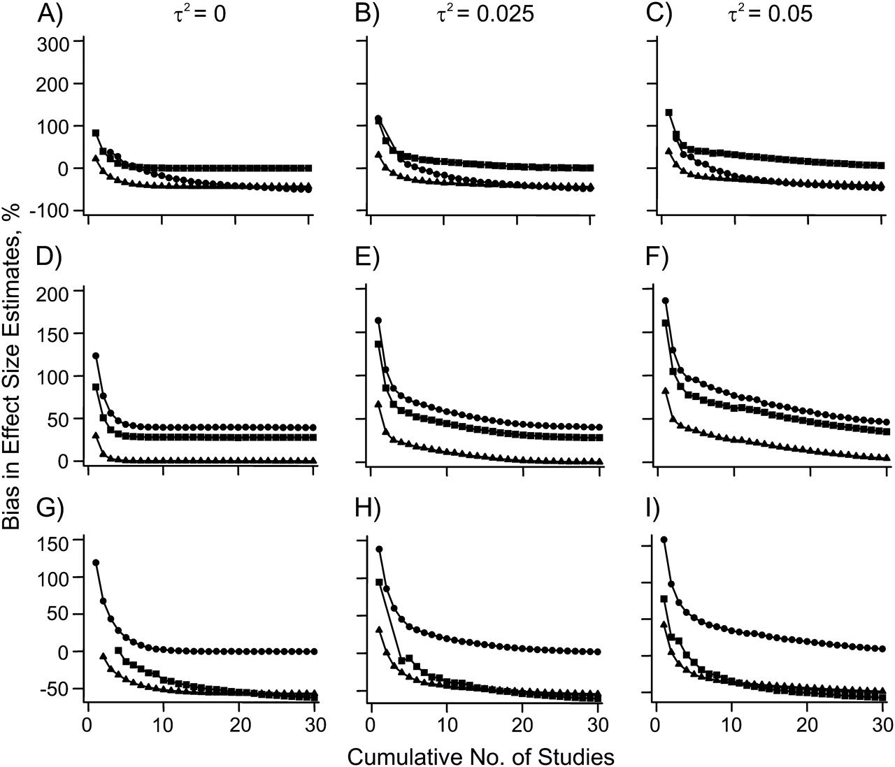
Figure 2. Median bias in summary effect sizes (logarithm of the odds ratio) for different true underlying modes of ...
Notes:
Figure 2. Median bias in summary effect sizes (logarithm of the odds ratio) for different true underlying modes of inheritance (dominant in A, B, and C; log additive in D, E, and F; and recessive in G, H, and I) and misspecified genetic models under random-effects calculations. Models of analysis: dominant = squares; log additive (per allele risk) = triangles; and recessive = circles. Bias was calculated as the median ratio of the detected effect size and the true effect size computed from the set of meta-analyses showing statistically significant signals at P < 10−7. τ2, between-study variance.
Unless provided in the caption above, the following copyright applies to the content of this slide: American Journal of Epidemiology © The Author 2009. Published by Oxford University Press on behalf of the Johns Hopkins Bloomberg School of Public Health. All rights reserved. For permissions, please e-mail: journals.permissions@oxfordjournals.org.

Slide 3
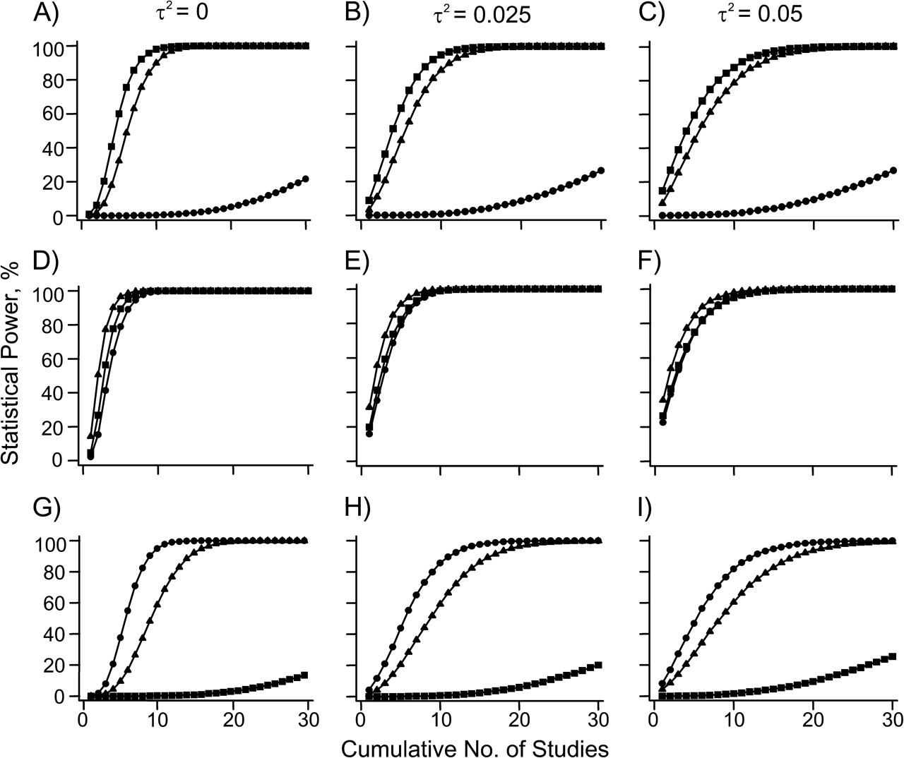
Figure 3. Cumulative power comparison among 3 main true genetic models by fixed-effects calculations (dominant in A, B, ...
Notes:
Figure 3. Cumulative power comparison among 3 main true genetic models by fixed-effects calculations (dominant in A, B, and C; log additive in D, E, and F; and recessive in G, H, and I) in meta-analyses of up to 30 data sets (with an average of 2,000 participants, a range of 1,000–3,000 in each, and a case-control ratio of 1.0), combining data from common gene variants (minor allele frequency, f = 0.4) with modest effect sizes (odds ratio = 1.3). In each panel, power is given under the correct and under misspecified genetic models. Models of analysis: dominant = squares; log additive (per allele risk) = triangles; and recessive = circles. Power is calculated by the proportion of simulated meta-analyses that exceed the threshold of P < 10−7. τ2, between-study variance.
Unless provided in the caption above, the following copyright applies to the content of this slide: American Journal of Epidemiology © The Author 2009. Published by Oxford University Press on behalf of the Johns Hopkins Bloomberg School of Public Health. All rights reserved. For permissions, please e-mail: journals.permissions@oxfordjournals.org.

Slide 4
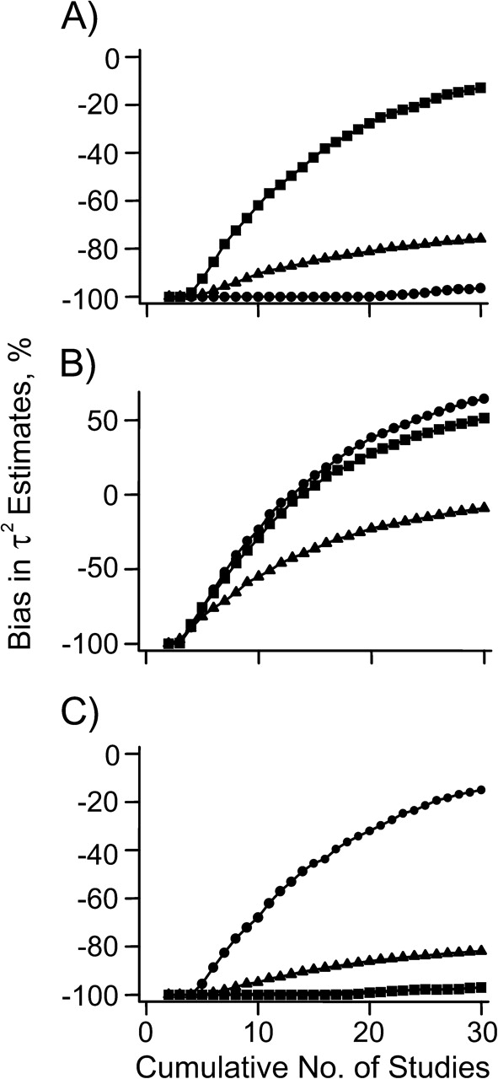
Figure 4. Bias in between-study variance (τ²) estimates for the set of meta-analyses that showed ...
Notes:
Figure 4. Bias in between-study variance (τ2) estimates for the set of meta-analyses that showed statistically significant results (P < 10−7) under different true underlying genetic models (dominant in A; log additive in B; and recessive in C) with heterogeneity (τ2 = 0.05). Models of analysis: dominant = squares; log additive (per allele risk) = triangles; and recessive = circles.
Unless provided in the caption above, the following copyright applies to the content of this slide: American Journal of Epidemiology © The Author 2009. Published by Oxford University Press on behalf of the Johns Hopkins Bloomberg School of Public Health. All rights reserved. For permissions, please e-mail: journals.permissions@oxfordjournals.org.

