Slide 1
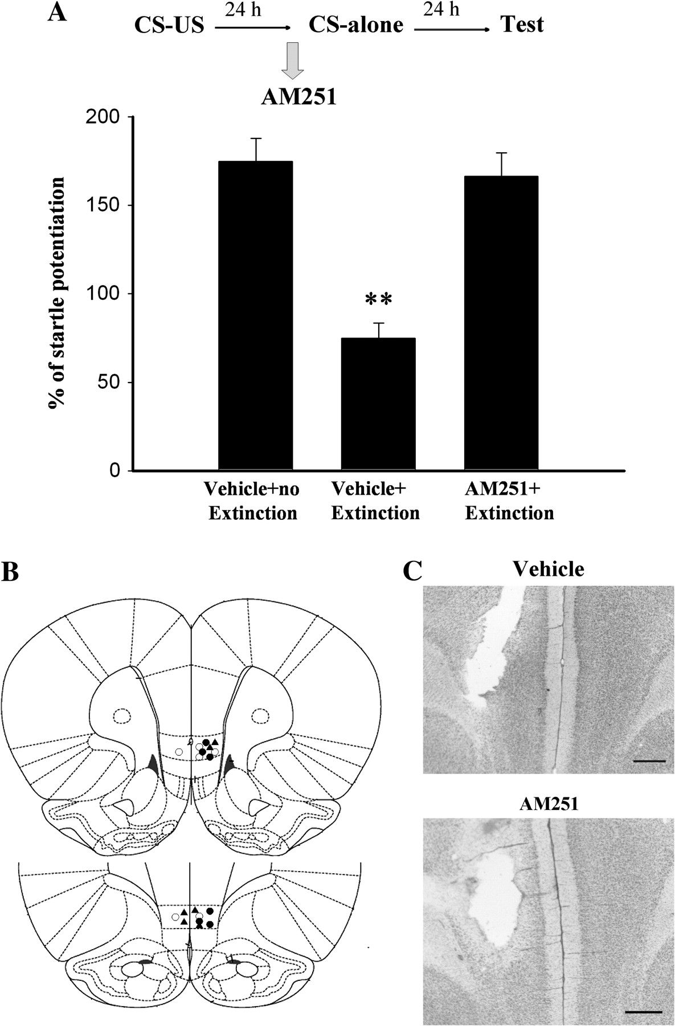
Figure 1. Intra-IL infusion of CB1 receptor antagonist blocks extinction of fear memory. (A) Rats were administered 10 ...
Notes:
Figure 1. Intra-IL infusion of CB1 receptor antagonist blocks extinction of fear memory. (A) Rats were administered 10 light–shock pairings, and 24 h later, vehicle (n = 6) or CB1 receptor antagonist AM251 (2 μg, n = 6) was infused into the IL 30 min before CS-alone trials. The percentage of fear-potentiated startle was measured 24 h after CS-alone trials. **P < 0.01 versus AM251. Rats that had received vehicle but no extinction served as controls (n = 6). (B) Cannula tip placements for rats infused with vehicle but no extinction training (○), vehicle + extinction (•), and AM251 + extinction (▴) in experiment A. (C) Representative photomicrograph that illustrates the placement of the infusion needle tip in the IL in DMSO-treated (20%) or AM251-treated (2 μg) rats. Scale bar: 0.5 mm.
Unless provided in the caption above, the following copyright applies to the content of this slide: © The Author 2008. Published by Oxford University Press. All rights reserved. For permissions, please e-mail: journals.permissions@oxfordjournals.org

Slide 2
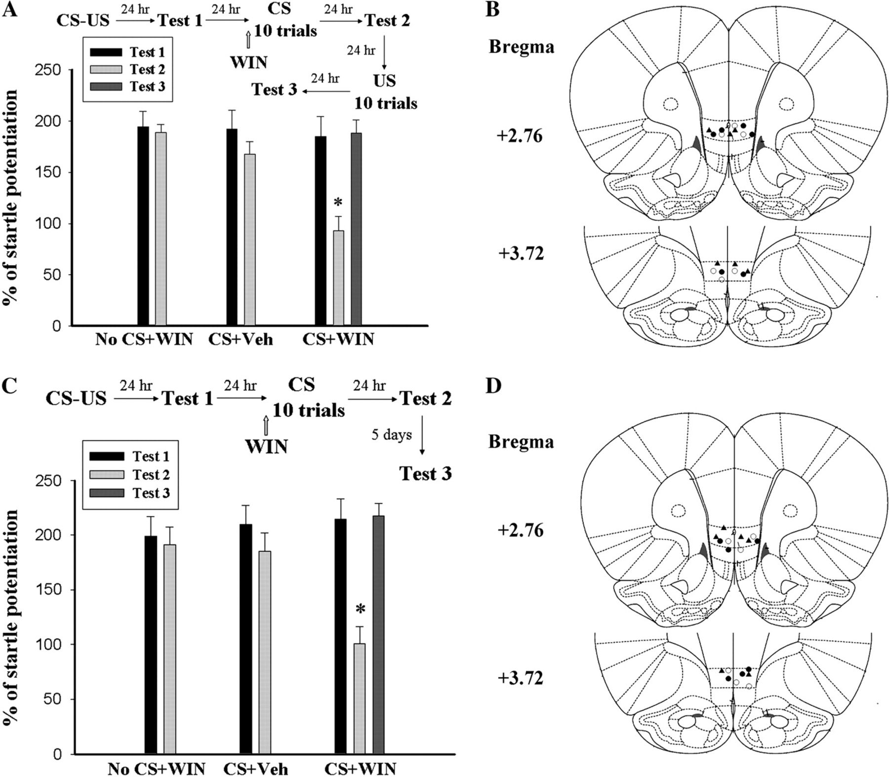
Figure 2. Intra-IL infusion of cannabinoid agonist facilitates extinction of fear memory. (A) Rats were administered 10 ...
Notes:
Figure 2. Intra-IL infusion of cannabinoid agonist facilitates extinction of fear memory. (A) Rats were administered 10 light–shock pairings, and retention of memory was assessed 24 h later (Test 1). On day 3, WIN (0.05 μg, n = 6) or vehicle (n = 6) was infused into the IL 30 min before CS-alone trials (1 block of 10 presentations of light-alone trials). A separate group of rats that received WIN infusion but no extinction training served as No-CS controls (n = 6). The rats were tested for fear-potentiated startle 24 h after extinction training (Test 2). The WIN-treated rats were given 10 footshocks on day 5, and retention of memory was tested 24 h later (day 6, Test 3). *P < 0.05 versus Test 1. (B) Cannula tip placements for rats infused with No-CS vehicle (•), CS vehicle (○), and CS WIN (▴) in experiment A. (C) Rats were trained and received WIN + extinction training as in experiment A (n = 5 in each group). Recovery of memory was assessed 5 days after extinction training (day 9). *P < 0.05 versus Test 1. (D) Cannula tip placements for rats infused with No-CS WIN (•), CS vehicle (○), and CS WIN (▴) in experiment C.
Unless provided in the caption above, the following copyright applies to the content of this slide: © The Author 2008. Published by Oxford University Press. All rights reserved. For permissions, please e-mail: journals.permissions@oxfordjournals.org

Slide 3
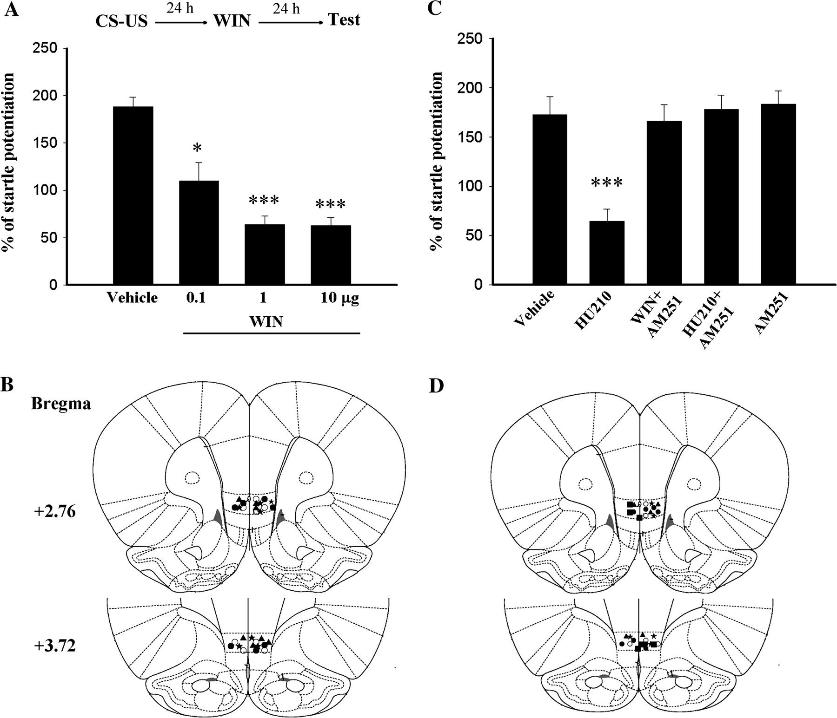
Figure 3. Intra-IL infusion of cannabinoid agonists without light-alone trials reduces fear-potentiated startle. (A) ...
Notes:
Figure 3. Intra-IL infusion of cannabinoid agonists without light-alone trials reduces fear-potentiated startle. (A) Rats were conditioned and 24 h later received vehicle (n = 8) or different doses of cannabinoid agonist WIN (0.1, 1, and 10 μg, n = 7 in each group). Retention of memory was measured 24 h after drug application. *P < 0.05, ***P < 0.001 versus vehicle group. (B) Cannula tip placements for rats infused with vehicle (○), 0.1 μg WIN (•), 1 μg WIN (▴), and 10 μg WIN (★) in experiment A. (C) Twenty-four hours after conditioning, the rats received vehicle, cannabinoid agonist HU210 (1 μg, n = 5), AM251 (2 μg) + WIN (n = 5), AM251 + HU210 (n = 5), or AM251 only (n = 6). AM251 was administered 20–25 min before WIN (1 μg) or HU210. Retention of memory was measured 24 h after drug application. ***P < 0.001 versus vehicle group. (D) Cannula tip placements for rats infused with vehicle (○), HU210 (•), WIN + AM251 (▴), HU210 + AM251 (★), and AM251 only (▪) in experiment C.
Unless provided in the caption above, the following copyright applies to the content of this slide: © The Author 2008. Published by Oxford University Press. All rights reserved. For permissions, please e-mail: journals.permissions@oxfordjournals.org

Slide 4
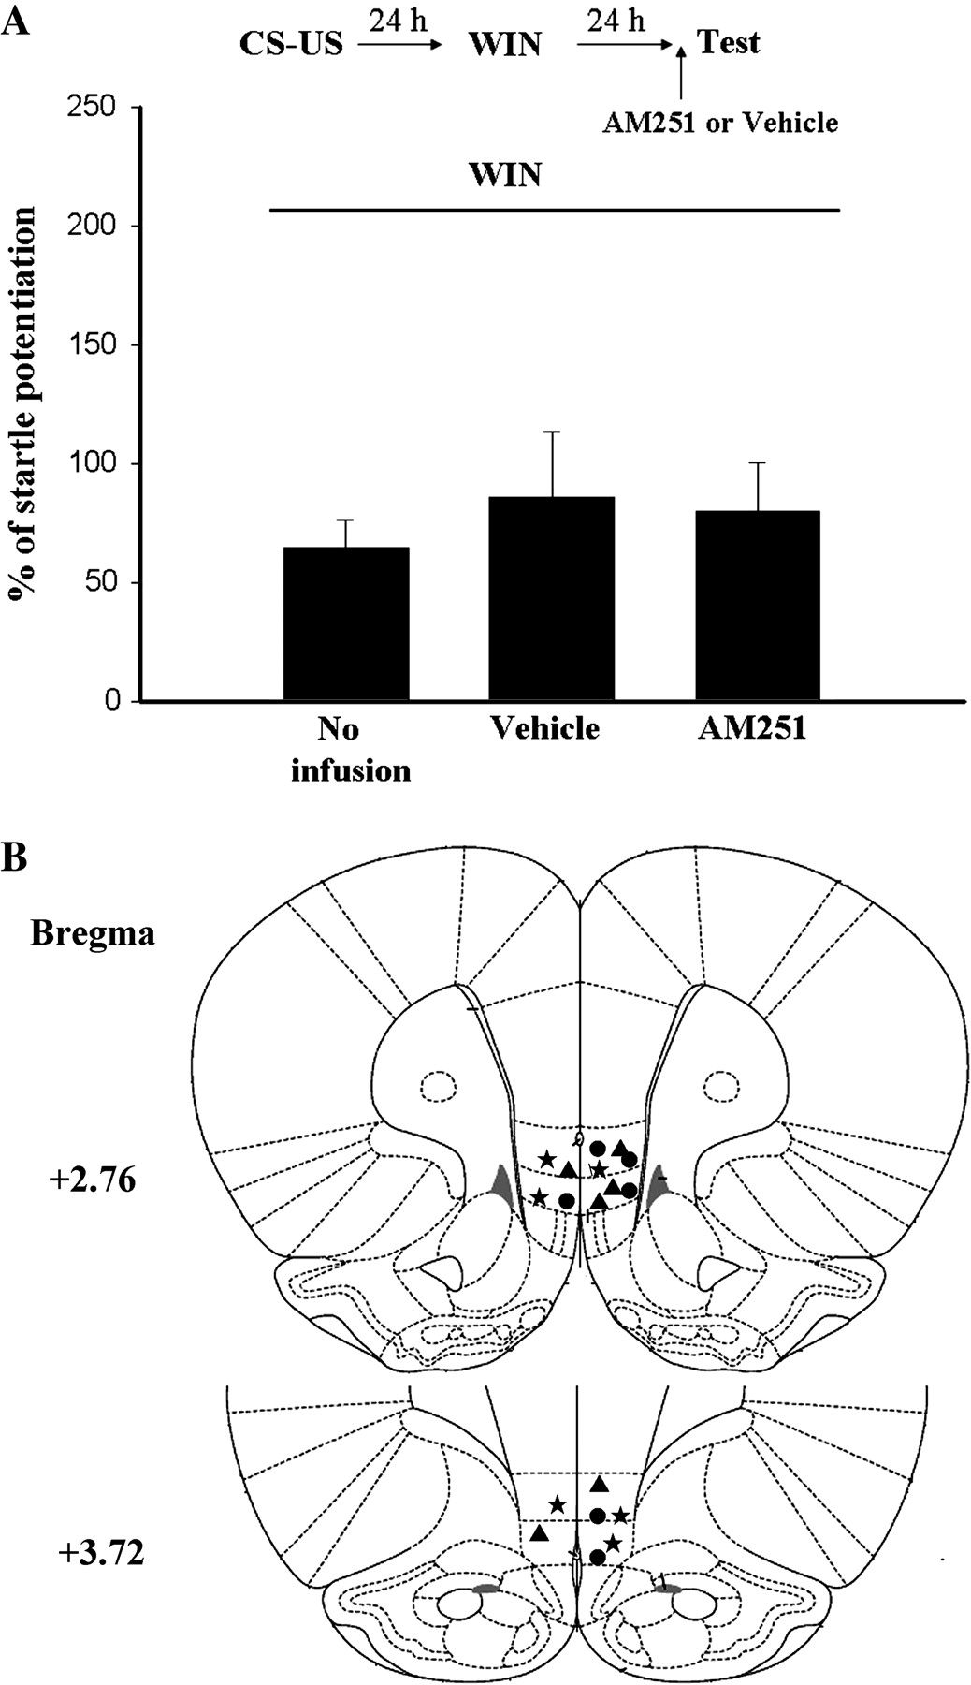
Figure 4. WIN-induced reduction of fear-potentiated startle is not affected by pretest infusion of CB1 antagonist. (A) ...
Notes:
Figure 4. WIN-induced reduction of fear-potentiated startle is not affected by pretest infusion of CB1 antagonist. (A) Rats were conditioned and 24 h later were administered IL infusion of WIN (1 μg). Retention of memory was measured 24 h after WIN application. AM251 (2 μg) or vehicle was infused 30 min before testing. (B) Cannula tip placements for rats infused with WIN but no pretest infusion (•), pretest infusion of vehicle (▴), and pretest infusion of AM251 (★) in experiment A (n = 6 in each group).
Unless provided in the caption above, the following copyright applies to the content of this slide: © The Author 2008. Published by Oxford University Press. All rights reserved. For permissions, please e-mail: journals.permissions@oxfordjournals.org

Slide 5
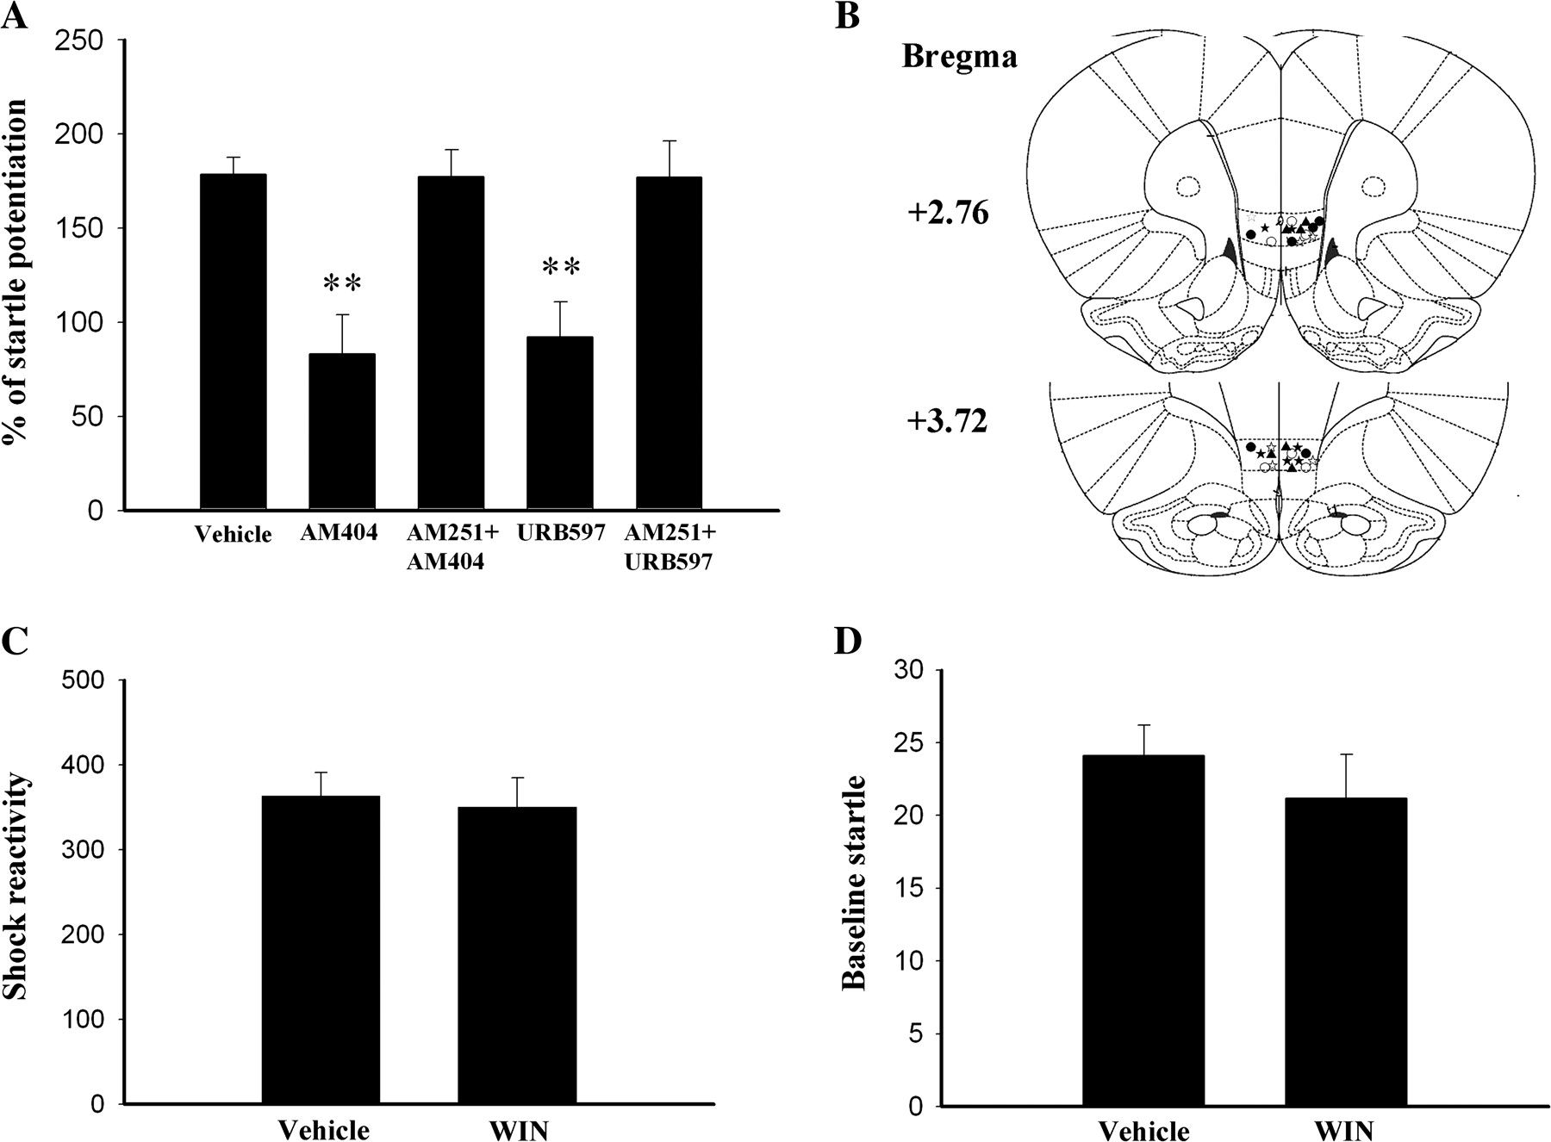
Figure 5. Mimicry of the effect of cannabinoid agonists by eCB uptake and AEA hydrolysis inhibitors. (A) Twenty-four ...
Notes:
Figure 5. Mimicry of the effect of cannabinoid agonists by eCB uptake and AEA hydrolysis inhibitors. (A) Twenty-four hours after conditioning, rats received vehicle, eCB uptake inhibitor AM404 (0.2 μg), AM251 (2 μg) + AM404, URB597 (0.3 μg), or AM251 + URB597 (n = 6 in each group). AM251 was administered 20–25 min before AM404 or AEA hydrolysis inhibitor URB597. Retention of memory was measured 24 h after drug application. **P < 0.01 versus vehicle group. (B) Cannula tip placements for rats infused with vehicle (○), AM404 (•), AM251 + AM404 (▴), URB597 (), or AM251 + URB597 (□) in experiment A. (C and D) Effect of WIN on shock reactivity and baseline anxiety. Conditioned rats received intra-mPFC infusion of WIN (1 μg) and 30 min later were administered 3 shocks and 42 startle stimuli (0.6 mA, 0.5-s shocks, 95-dB noise-burst startle) (n = 6). Three days later, the same rats were returned to the startle box, injected with vehicle, and similarly tested. (C) Average shock reactivity shown in arbitrary units represents average response to 3 footshocks. (D) Average baseline startle amplitude shown in arbitrary units represents average response to 42 startle stimuli.
Unless provided in the caption above, the following copyright applies to the content of this slide: © The Author 2008. Published by Oxford University Press. All rights reserved. For permissions, please e-mail: journals.permissions@oxfordjournals.org

Slide 6
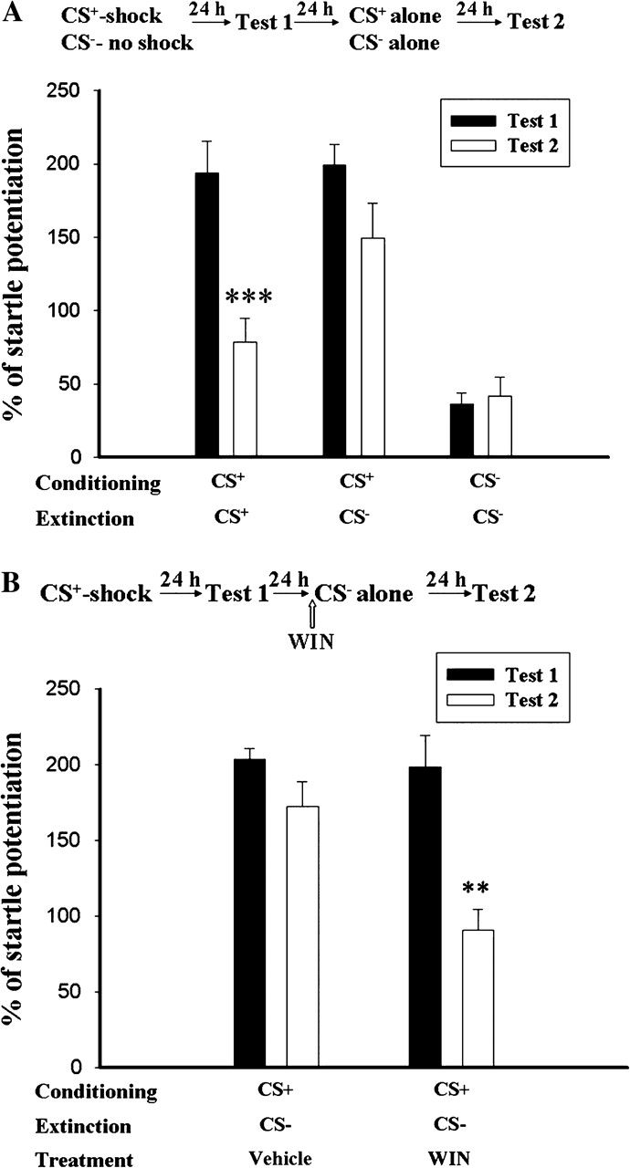
Figure 6. General reduction of conditioned fear by cannabinoid receptor agonist. (A) Rats were conditioned with 10 ...
Notes:
Figure 6. General reduction of conditioned fear by cannabinoid receptor agonist. (A) Rats were conditioned with 10 CS+ (yellow light)–shock pairings, and retention of memory was assessed 24 h later (Test 1). On day 3, the rats received CS+-alone (n = 6) or CS−-alone (blue light, n = 8) trials (3 sessions of 10 presentations) and were tested 24 h later (Test 2). Rats were able to discriminate between CS+ and CS− as evidenced by the fact that the levels of startle potentiation in Test 2 were significantly lower than those in Test 1 in response to the CS+-alone trials but not to the CS−-alone trials. The rats that received CS−–no shock pairing and CS− extinction training served as controls (n = 6). ***P < 0.001 versus Test 1. (B) Rats were conditioned and tested as in experiment A. On day 3, the rats were given WIN (1 μg, n = 6) or vehicle (n = 6) 30 min before CS−-alone (blue light) trials (3 sessions of 10 presentations). Retention of memory was assessed 24 h later (Test 2). WIN produced a general decrease in conditioned fear as evidenced by the fact that the levels of startle potentiation in Test 2 were significantly lower than those in Test 1 in the WIN-treated rats but not in the vehicle-treated rats in response to CS−-alone trials. **P < 0.01 versus Test 1.
Unless provided in the caption above, the following copyright applies to the content of this slide: © The Author 2008. Published by Oxford University Press. All rights reserved. For permissions, please e-mail: journals.permissions@oxfordjournals.org

Slide 7
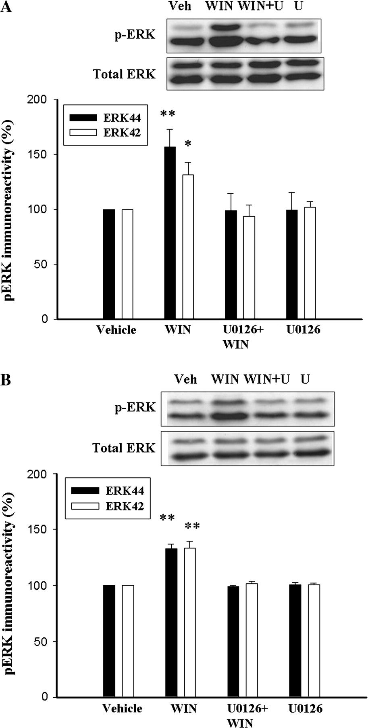
Figure 7. Involvement of ERKs in the action of CB1 agonists. (A) Representative western blots and densitometric ...
Notes:
Figure 7. Involvement of ERKs in the action of CB1 agonists. (A) Representative western blots and densitometric analysis of ERKs phosphorylation induced by WIN. The mPFC slices were incubated with WIN (2 μM) for 15 min and then washed to remove WIN. One hour later, homogenate from the IL was prepared and blotted with antibodies directly against the active form of ERKs. When MEK inhibitor U0126 (10 μM) was present, ERK phosphorylation induced by WIN was abolished. U0126 alone had no effect on ERK phosphorylation. *P < 0.05, **P < 0.01 versus vehicle group. (B) Rats were conditioned and 24 h later received intra-IL infusion of WIN (1 μg), vehicle, U0126 (2 μg) plus WIN, or U0126 alone (n = 6 in each group). One hour after drug application, the tissues of the IL subregion were dissected out and ERK phosphorylation was measured. **P < 0.01 versus vehicle group. The levels of pERK in the WIN-treated rats were expressed as a percentage of the level in the vehicle controls.
Unless provided in the caption above, the following copyright applies to the content of this slide: © The Author 2008. Published by Oxford University Press. All rights reserved. For permissions, please e-mail: journals.permissions@oxfordjournals.org

Slide 8
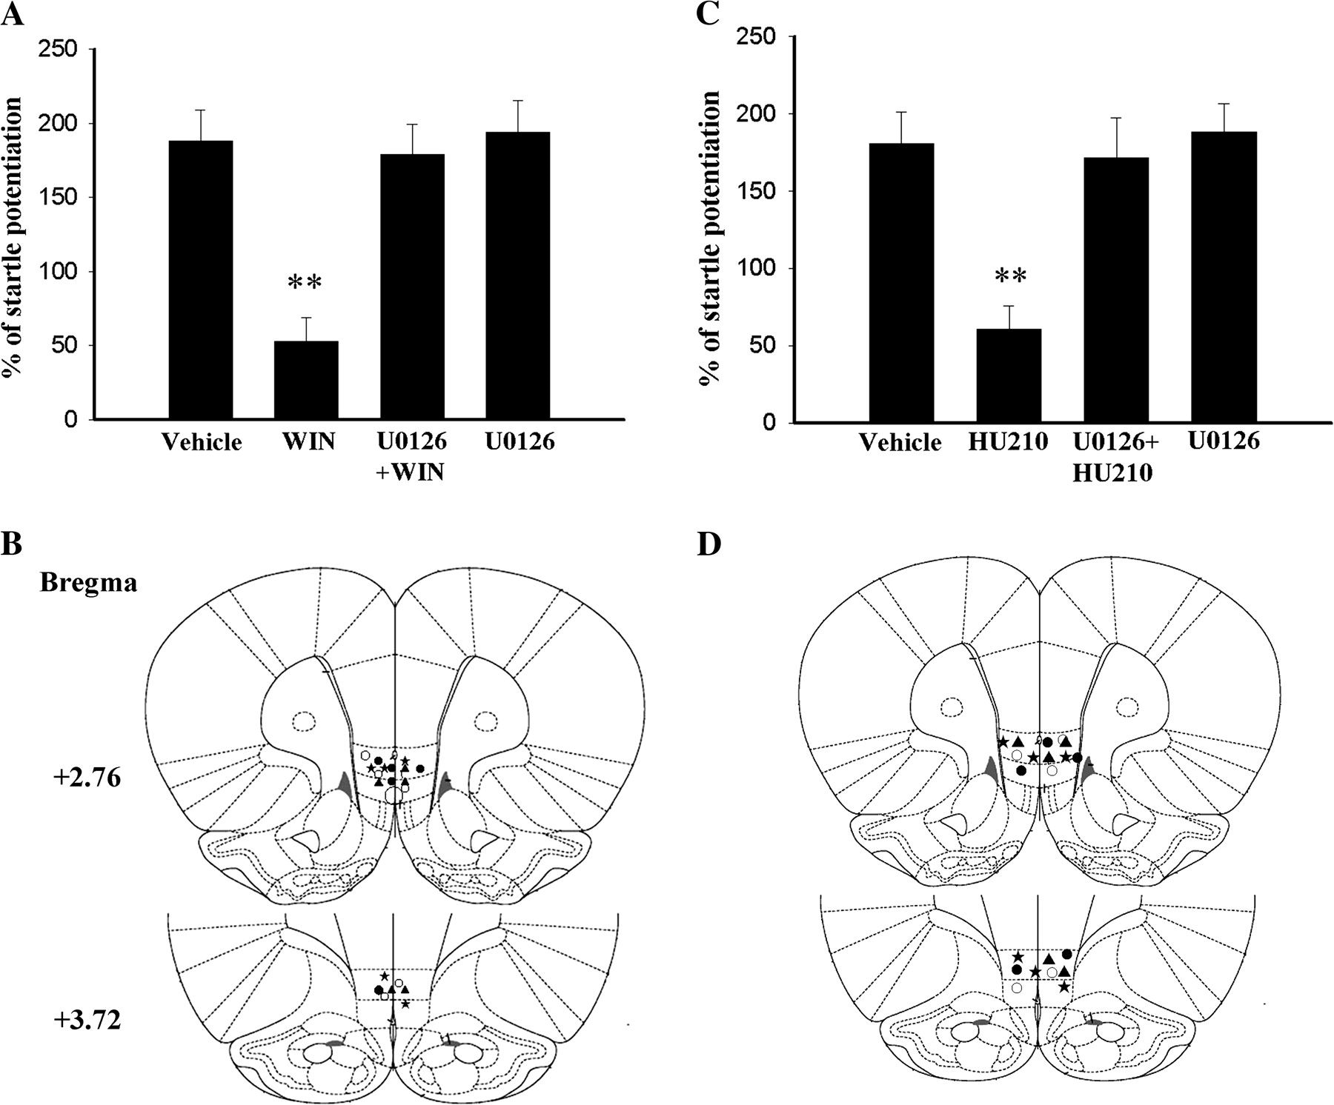
Figure 8. Block of WIN-induced reduction of startle potentiation by MEK inhibitor. (A) Rats were conditioned and 24 h ...
Notes:
Figure 8. Block of WIN-induced reduction of startle potentiation by MEK inhibitor. (A) Rats were conditioned and 24 h later were given WIN (1 μg), U0126 (2 μg) + WIN, or vehicle (n = 5 in each group). The percentage of fear-potentiated startle was measured 24 h after WIN treatment. U0126 (2 μg) was administered 20–25 min before HU210. **P < 0.01 versus vehicle group. (B) Cannula tip placements for rats infused with vehicle (○), WIN (•), U0126 + WIN (★), and U0126 (▴) in experiment A. (C) Rats were conditioned and 24 h later were given HU210 (1 μg, n = 5), U0126 (2 μg) + HU210 (n = 6), or vehicle (n = 5). The percentage of fear-potentiated startle was measured 24 h after HU210 treatment. U0126 (2 μg) was administered 20–25 min before HU210. **P < 0.01 versus vehicle group. Cannula tip placements for rats infused with vehicle (○), HU210 (•), U0126 + HU210 (★), and U0126 (▴) in experiment C.
Unless provided in the caption above, the following copyright applies to the content of this slide: © The Author 2008. Published by Oxford University Press. All rights reserved. For permissions, please e-mail: journals.permissions@oxfordjournals.org

