Slide 1
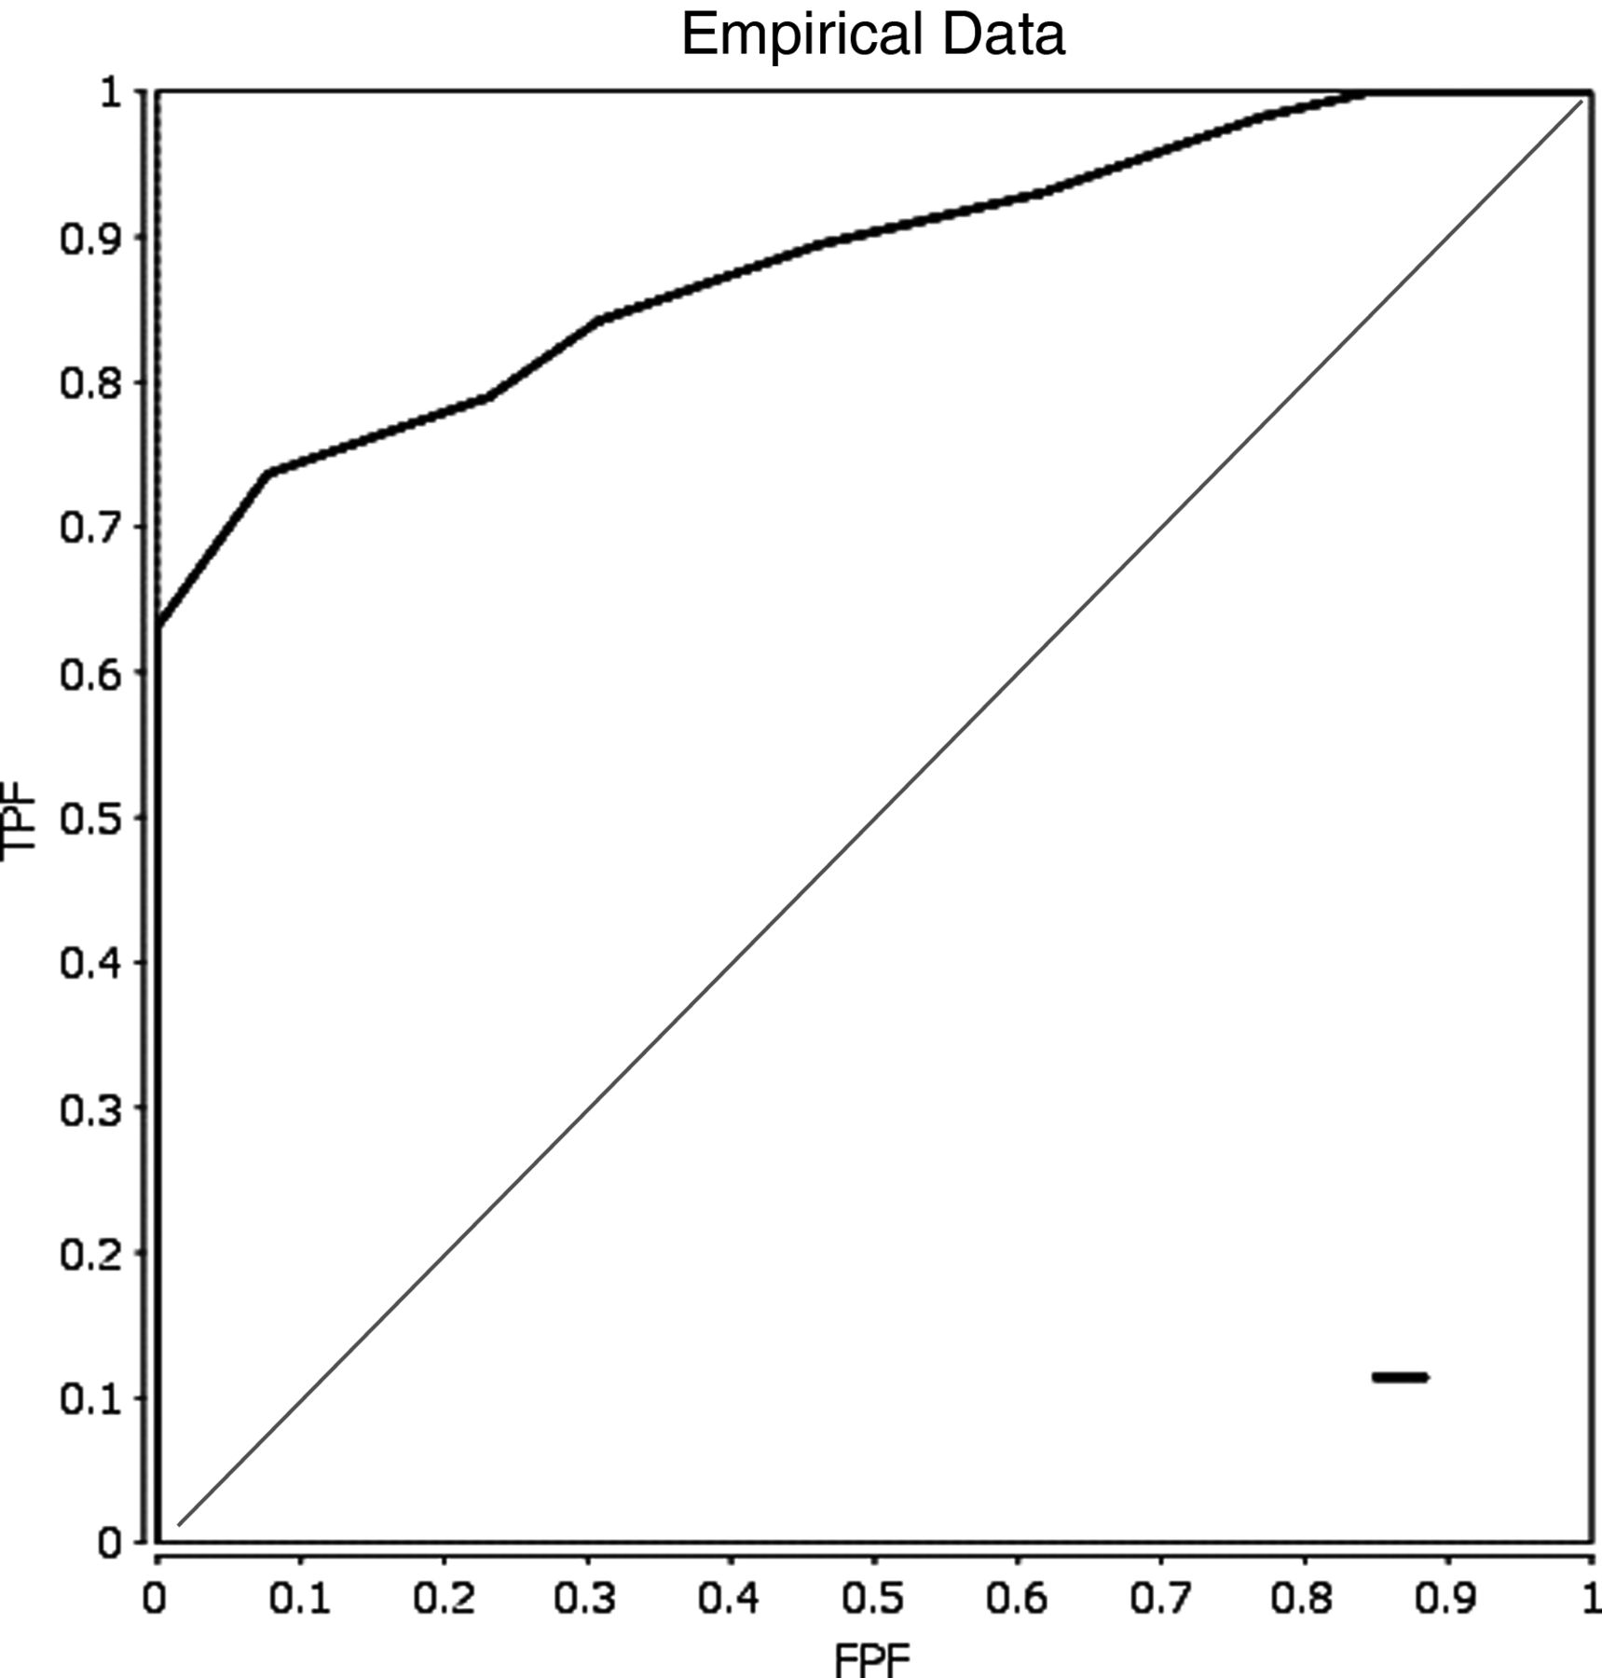
Fig. 1. ROC curve calculated for the screening battery (n = 70, cut-off = 9, AUC = 0.884). The diagonal line on the ...
Notes:
Fig. 1. ROC curve calculated for the screening battery (n = 70, cut-off = 9, AUC = 0.884). The diagonal line on the graph shows random classification, the ROC curve shows the correct classification (y-axis = sensitivity, x-axis = (1 − specificity)
Unless provided in the caption above, the following copyright applies to the content of this slide: © The Author 2013. Published by Oxford University Press. All rights reserved. For permissions, please e-mail: journals.permissions@oup.com.

