Slide 1
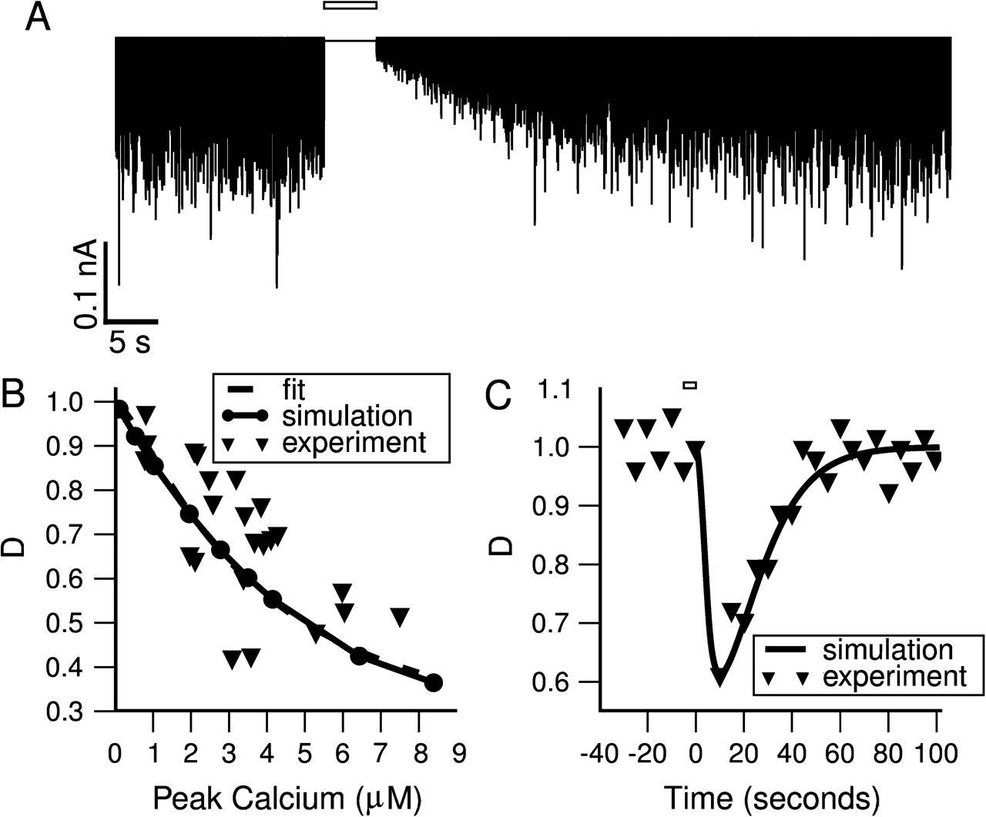
Figure 1. A phenomenological model of depolarization-induced suppression of inhibition. (A) Model simulated IPSCs from ...
Notes:
Figure 1. A phenomenological model of depolarization-induced suppression of inhibition. (A) Model simulated IPSCs from a 100-Hz Poisson spike train before and after DSI induction by a 5 s depolarization (open bar). Note the reduction in IPSC amplitude and slow recovery. (B) Dependence of minimum D (maximum DSI) on peak calcium concentration. Calcium influx was triggered by depolarization to 0 mV. Experimentally, DSI was measured by comparing the amplitudes of evoked IPSCs before and after depolarization. Triangles: experimental data from (Wang and Zucker 2001) Figure 4 (converted to D). Dashed line: data fitting to a Hill equation; filled circles: model simulations; solid line: the Hill equation from our model. (C) Sample time course of DSI after a 5-s depolarization (open bar). Triangles: experimental data from Figure 3 of Wang and Zucker (2001), after conversion to D; solid line: model simulation results.
Unless provided in the caption above, the following copyright applies to the content of this slide: © The Author 2007. Published by Oxford University Press. All rights reserved. For permissions, please e-mail: journals.permissions@oxfordjournals.org

Slide 2
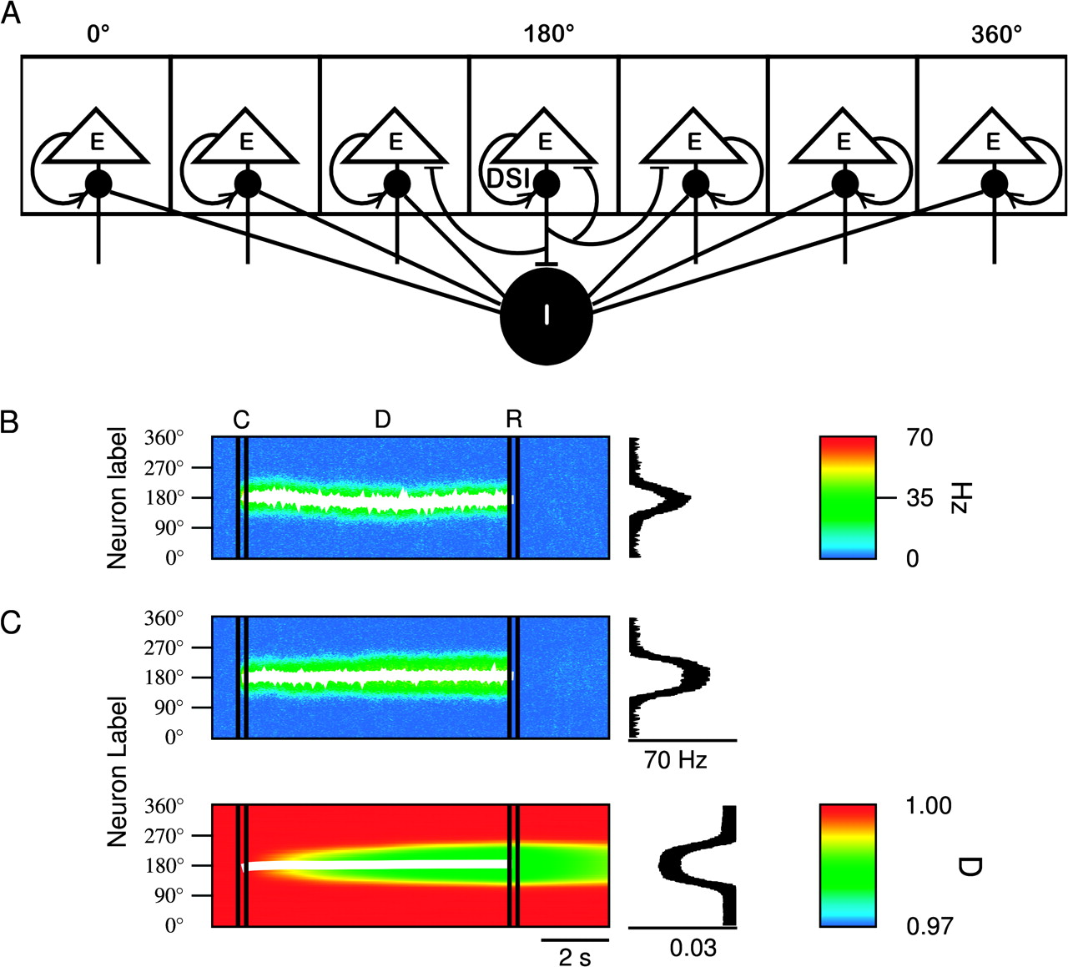
Figure 2. Network model of spatial working memory endowed with DSI. (A) Schematic network architecture. Excitatory ...
Notes:
Figure 2. Network model of spatial working memory endowed with DSI. (A) Schematic network architecture. Excitatory cells are labeled and arranged by their preferred cues (0–360 degrees). Excitatory-to-excitatory connections are structured such that pyramidal cells with similar preference are more strongly connected to each other. The connections from the inhibitory population to itself as well as to the excitatory population are unstructured. DSI is implemented as a cell-specific reduction in inhibitory input conductance. (B) Model simulation of the ODR task without DSI. The spatiotemporal network activity pattern is shown with a color-coded firing rate map (see color bar); the abscissa is time and the ordinate is neuron label. The white line represents the stored cue location as the peak location of a bell-shaped persistent activity pattern, measured by the population vector. The network activity profile averaged over the last half second of the delay period is shown on the right. (C) Spatiotemporal network activity with DSI. Top: firing rate activity; Bottom: DSI activity (Dmin = 0.97). The white line represents the dip location of the D population pattern. The D profile (on right) was calculated by averaging D over the last half-second of the delay period. Note the slow buildup and decay of the DSI effect at the same location as the neural spiking activity.
Unless provided in the caption above, the following copyright applies to the content of this slide: © The Author 2007. Published by Oxford University Press. All rights reserved. For permissions, please e-mail: journals.permissions@oxfordjournals.org

Slide 3
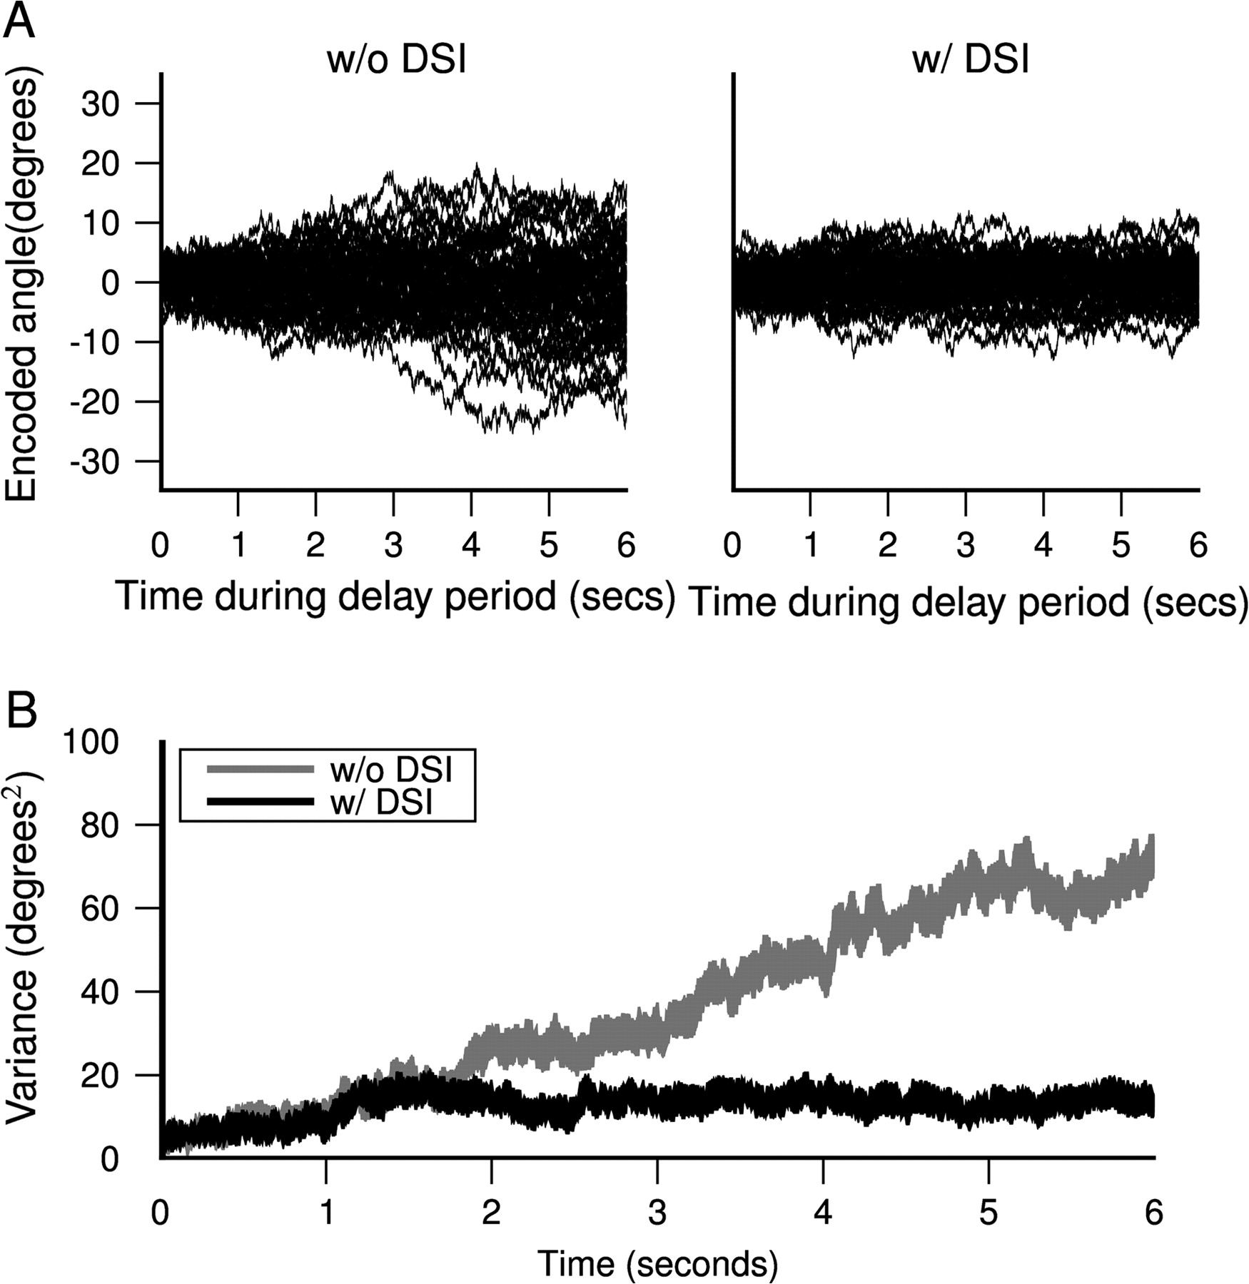
Figure 3. DSI enhances the accuracy of memory-guided responses by reducing random drifts of persistent activity. (A) ...
Notes:
Figure 3. DSI enhances the accuracy of memory-guided responses by reducing random drifts of persistent activity. (A) Time course of remembered cue location (determined by the population vector) throughout a delay period of 6 s, for 50 trials. Left: without DSI. Right: with DSI (Dmin = 0.97). (B) Variability of remembered cue location as a function of time, calculated as the variance of the population vector across 50 trials in (A). Without DSI the variance of the population vector grows in time (gray line). DSI creates a privileged locus to stabilize a mnemonic activity pattern, so that after an initial increase in the first 2 s, the variance plateaus and remains constant (black line).
Unless provided in the caption above, the following copyright applies to the content of this slide: © The Author 2007. Published by Oxford University Press. All rights reserved. For permissions, please e-mail: journals.permissions@oxfordjournals.org

Slide 4
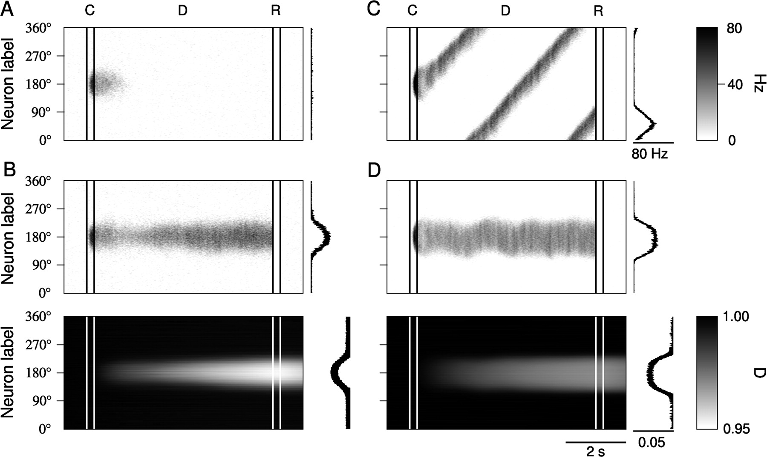
Figure 4. SRA destabilizes working memory function, which is restored by DSI. (A) Spatiotemporal activity pattern ...
Notes:
Figure 4. SRA destabilizes working memory function, which is restored by DSI. (A) Spatiotemporal activity pattern without DSI. The addition of a small amount of SRA (gAHP = 0.0006) causes a cue-triggered activity pattern to decay within 1 s so the memory is lost. (B) Disinhibition by DSI (Dmin = 0.96) counteracts SRA and rescues the self-sustained persistent activity. Spatiotemporal activity pattern (top) and spatiotemporal DSI (bottom) are shown in gray scales. (C) Spatiotemporal network activity without DSI and with a high signal to noise ratio. A significant amount of SRA (gAHP = 0.005 that yields Fadapt = 50%) causes the delay activity to move as a propagating wave, so the memory can no longer be retrieved. (D) Spatiotemporal activity (top) and spatiotemporal DSI (bottom) with the same parameters as (C), but with the addition of DSI (Dmin = 0.95). Activity-induced well of disinhibition compensates for SRA and prevents the activity pattern from traveling away from the initial cue location.
Unless provided in the caption above, the following copyright applies to the content of this slide: © The Author 2007. Published by Oxford University Press. All rights reserved. For permissions, please e-mail: journals.permissions@oxfordjournals.org

Slide 5
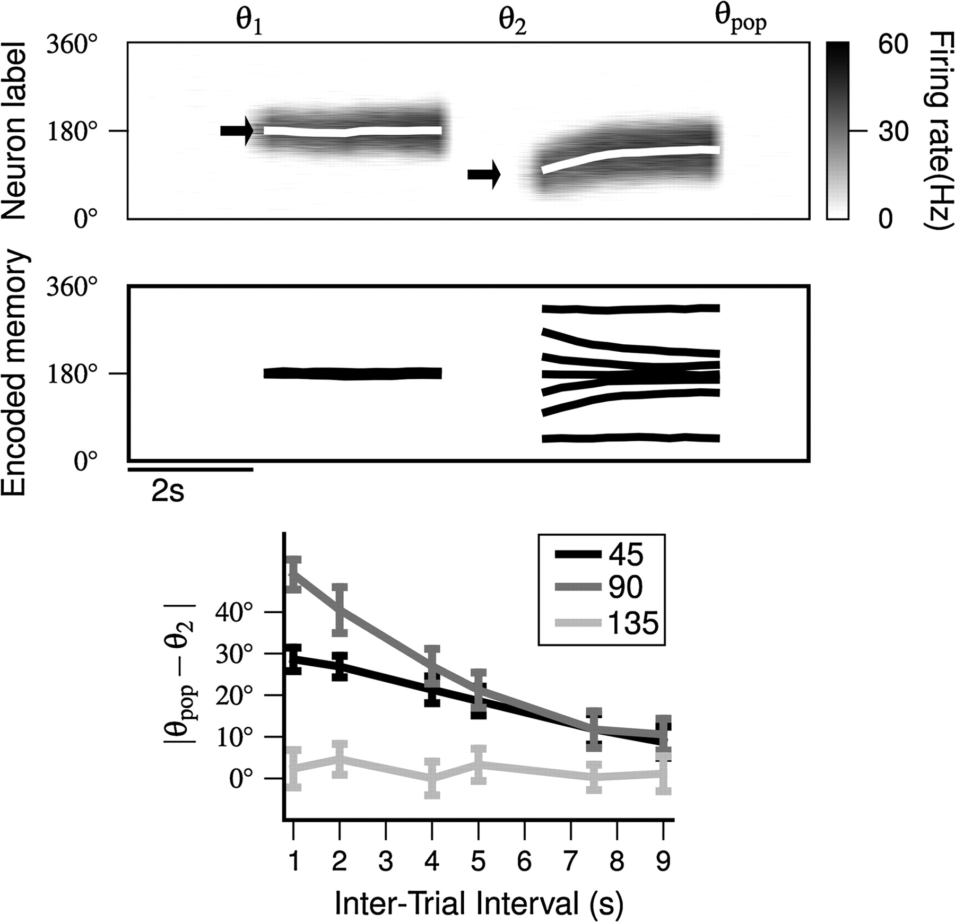
Figure 5. Trial-to-trial effects by stimulus-specific and long-lasting DSI. Top panel: spatiotemporal activity pattern ...
Notes:
Figure 5. Trial-to-trial effects by stimulus-specific and long-lasting DSI. Top panel: spatiotemporal activity pattern illustrating the simulation protocol. Two cues were presented; the first (θ1) cue was presented for 0.25 s, followed by a 3 s delay period, and then a 0.25 s termination period. After a 1-s intertrial interval, another cue (θ2) was presented. Arrows indicate cue locations. The white lines are the remembered locations measured by population vector. The θpop denotes the remembered location at the end of the second delay. Middle panel: population vector over time for various values of θ2. Bottom panel: systematic drift of population vector versus intertrial interval, for 3 different values of θ2 so that |θ1 − θ2| = 45, 90, and 135 degrees, respectively. Note larger drifts when the 2 cues in the consecutive trials are separated by 90 degrees than when they are 45 degrees apart because in the latter case there is less space for the activity pattern in the second trial to travel toward the cue location in the first trial. When 135 degrees or more separates the cues, there is no interaction between consecutive cues. In all simulations Dmin is 0.97.
Unless provided in the caption above, the following copyright applies to the content of this slide: © The Author 2007. Published by Oxford University Press. All rights reserved. For permissions, please e-mail: journals.permissions@oxfordjournals.org

Slide 6
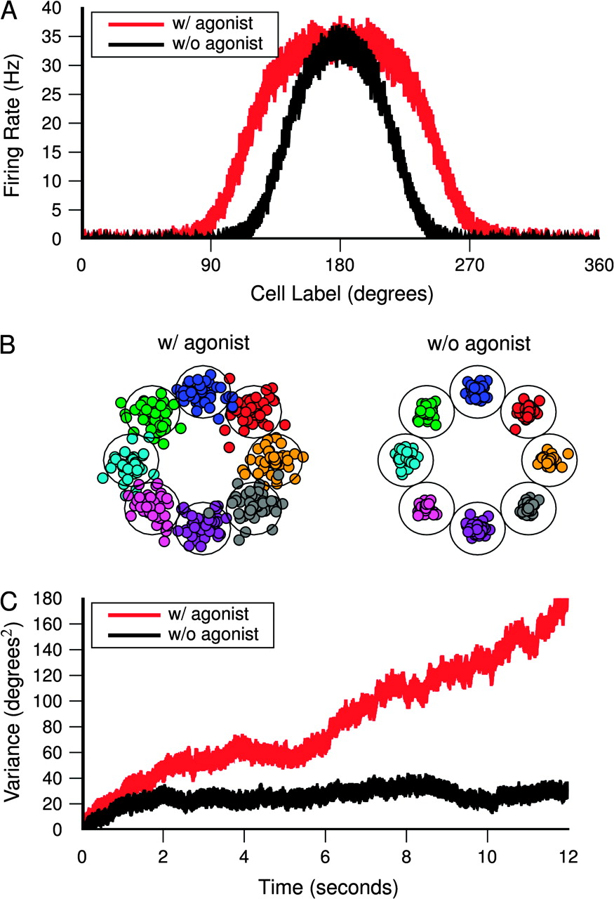
Figure 6. Application of an exogenous global agonist impairs working memory function. (A) Network profile of persistent ...
Notes:
Figure 6. Application of an exogenous global agonist impairs working memory function. (A) Network profile of persistent activity averaged over 150 trials, 6 s into the delay period. A global agonist broadens the mnemonic activity pattern (red) compared with control (black). (B) Endpoints of memory-guided saccades, at the end of a 12-s delay period (see Methods). Saccades that fall outside of the large circles surrounding the sensory cue locations are considered as erroneous responses. Saccade endpoints are color coded by the cue location. (C) Variance of the remembered location during delay period, calculated from 50 trials, with (red) and without (black) a global agonist. In the presence of an exogenous activity-independent agonist, there is no DSI effect to stabilize random drifts, so the accuracy of memory-guided saccades deteriorates.
Unless provided in the caption above, the following copyright applies to the content of this slide: © The Author 2007. Published by Oxford University Press. All rights reserved. For permissions, please e-mail: journals.permissions@oxfordjournals.org

