Slide 1
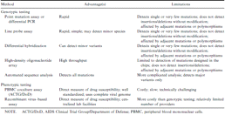
Table 1 Drug-resistance testing methods.
Notes:
Table 1 Drug-resistance testing methods.
Unless provided in the caption above, the following copyright applies to the content of this slide: © 2000 by the Infectious Diseases Society of America

