Slide 1
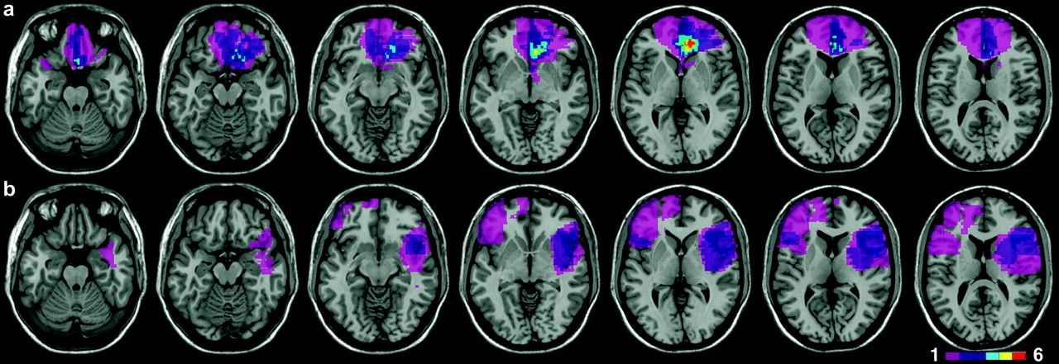
Figure 1. Location and overlap of brain lesions. Panel (a) shows the lesions of the 10 subjects with ventromedial ...
Notes:
Figure 1. Location and overlap of brain lesions. Panel (a) shows the lesions of the 10 subjects with ventromedial frontal damage, and panel (b) those of the 11 D/LF subjects. Lesions are projected on the same 7 axial slices of the standard Montreal Neurological Institute brain, oriented according to radiological convention (i.e., left is right). Areas damaged in one subject are shown in pink; brighter shades denote the degree to which lesions involve the same structures in 2 or more individuals, as indicated in the legend.
Unless provided in the caption above, the following copyright applies to the content of this slide: © The Author 2007. Published by Oxford University Press. All rights reserved. For permissions, please e-mail: journals.permissions@oxfordjournals.org

Slide 2
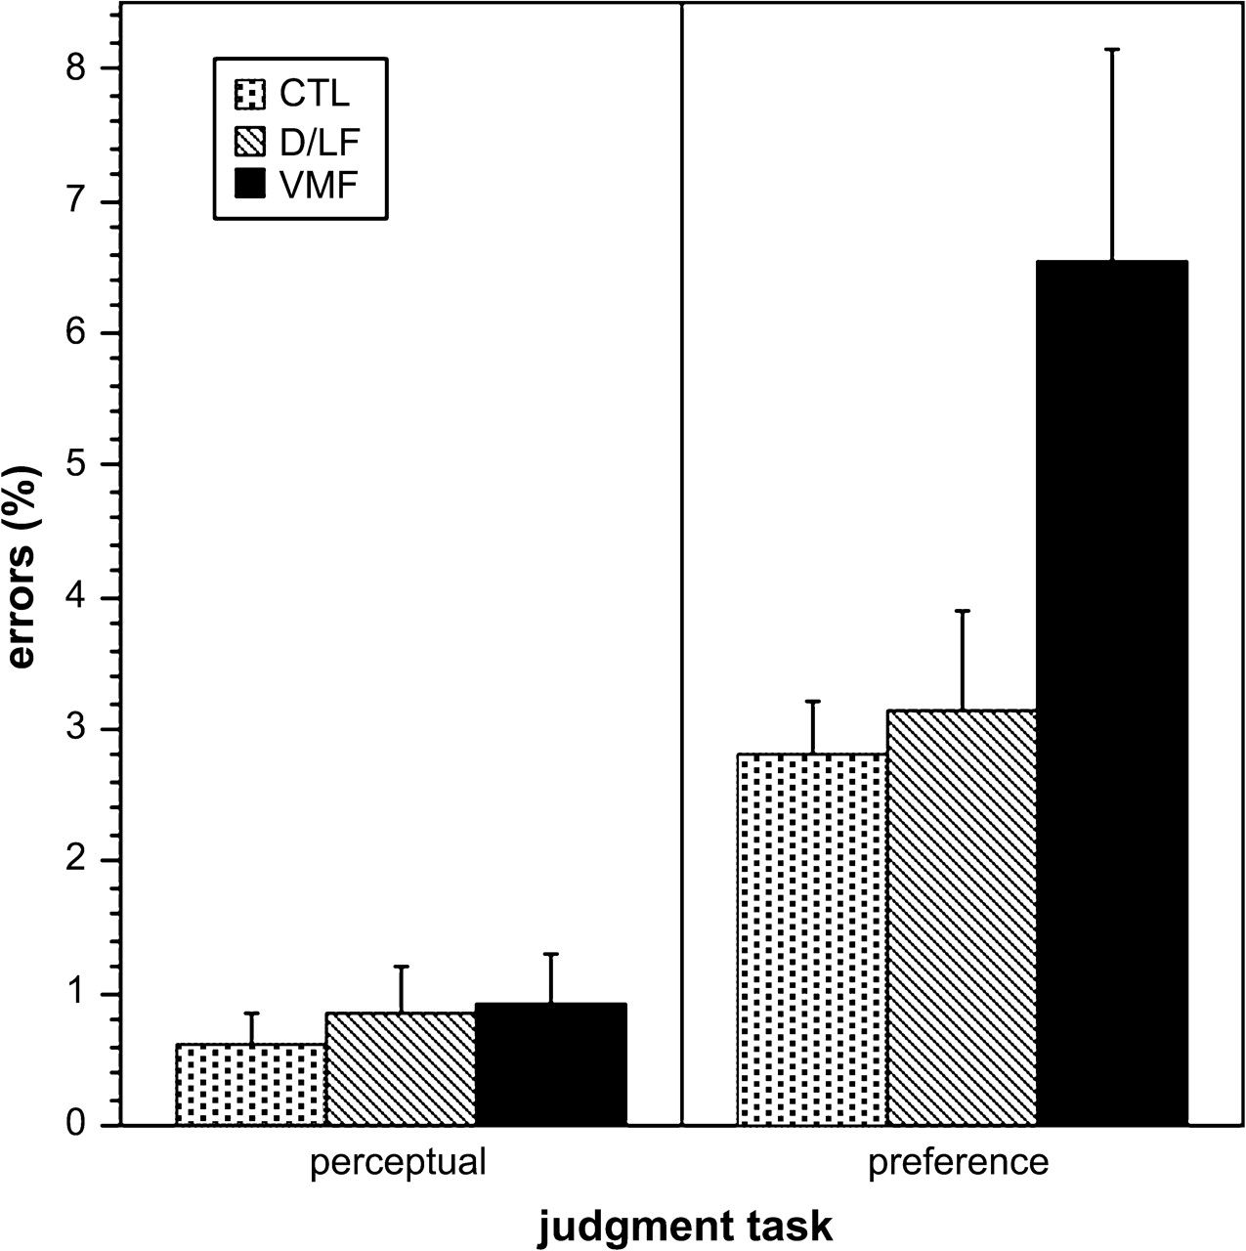
Figure 2. The mean percentage of errors in the perceptual judgment task (left panel) and of erratic choices in the ...
Notes:
Figure 2. The mean percentage of errors in the perceptual judgment task (left panel) and of erratic choices in the preference judgment task (right panel) for all 3 groups of subjects. Error bars indicate standard errors of the mean.
Unless provided in the caption above, the following copyright applies to the content of this slide: © The Author 2007. Published by Oxford University Press. All rights reserved. For permissions, please e-mail: journals.permissions@oxfordjournals.org

