Slide 1
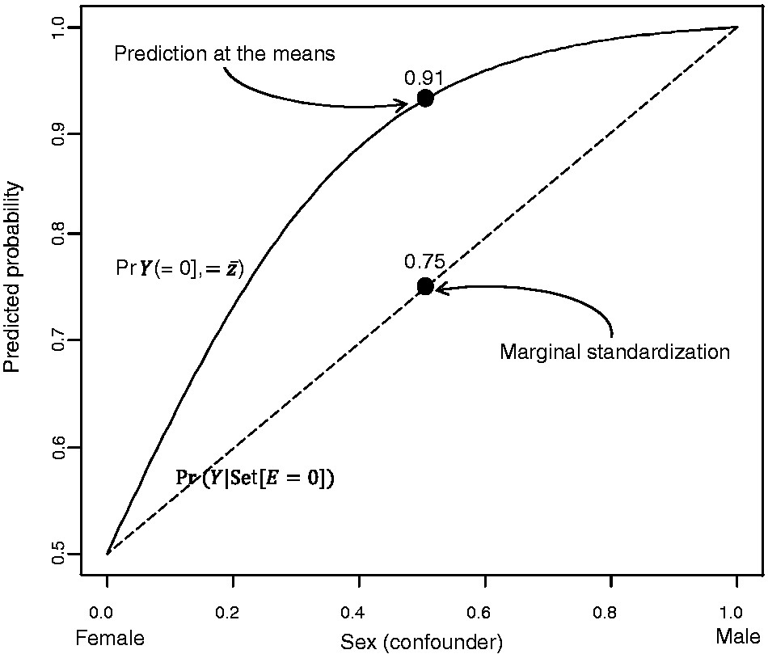
Figure 1. Half of a sigmoid curve depicting calculation of predicted probabilities following logistic regression using ...
Notes:
Figure 1. Half of a sigmoid curve depicting calculation of predicted probabilities following logistic regression using marginal standardization (dashed straight line) and prediction at the means (solid curved line) in unexposed people from a hypothetical population
Unless provided in the caption above, the following copyright applies to the content of this slide: © The Author 2014; all rights reserved. Published by Oxford University Press on behalf of the International Epidemiological Association

