Slide 1
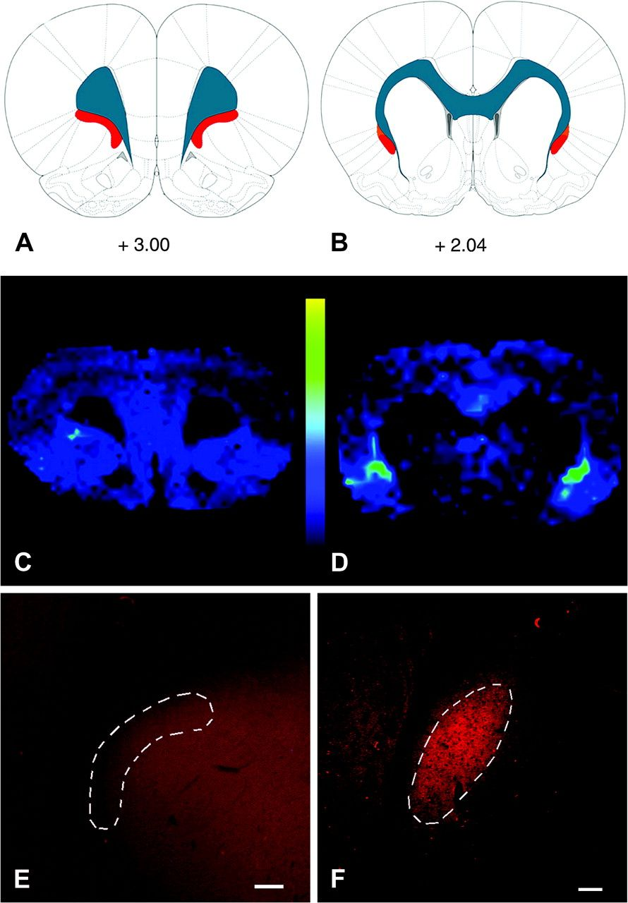
Figure 1. MALDI IMS reveals a protein enriched in the claustrum. (A, B) Images acquired at 2 different rostrocaudal ...
Notes:
Figure 1. MALDI IMS reveals a protein enriched in the claustrum. (A, B) Images acquired at 2 different rostrocaudal levels are depicted on the rat brain atlas plates from Paxinos and Watson (2007); values represent distance in millimeters relative to bregma. Blue represents white matter tracts, whereas red depicts the claustrum. (D) At striatal levels, a m/z 7725 protein peak can be seen to be enriched in the claustrum relative to surrounding structures. This peak is not seen at frontal levels (panel C). (E, F) Immunohistochemical localization of Gng2 validates the MALDI IMS data: Gng2-ir is enriched in the neuropil of the claustrum only at striatal levels (F) and is not seen at frontal (E) levels. The outlined areas depict the current definitions of claustral structural boundaries. Scale bars: (E), 200 μm; (F), 100 μm.
Unless provided in the caption above, the following copyright applies to the content of this slide: © The Author 2009. Published by Oxford University Press. All rights reserved. For permissions, please e-mail: journals.permissions@oxfordjournals.org

Slide 2
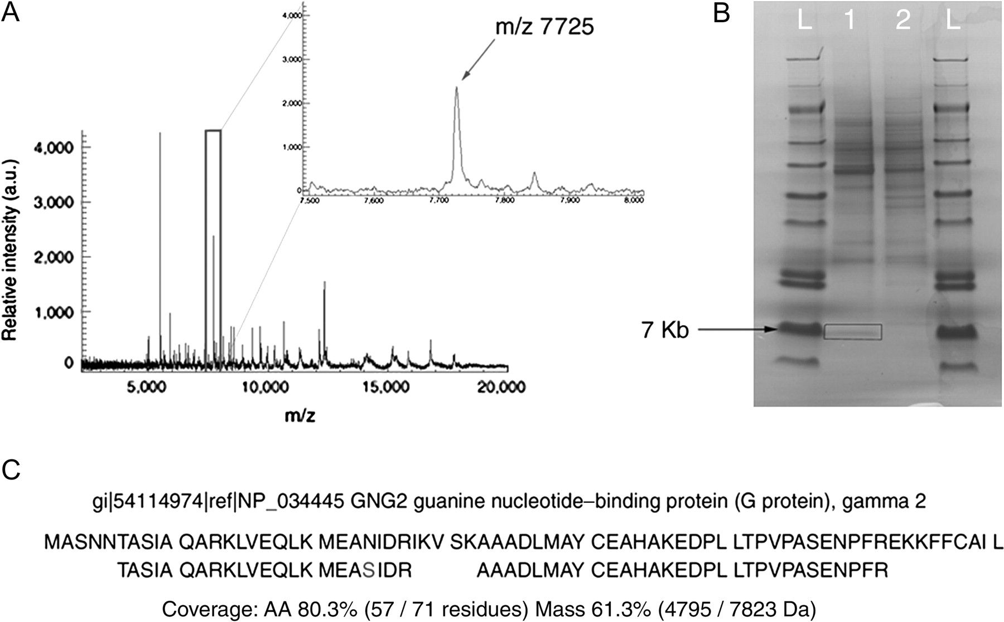
Figure 2. Mass spectrum of proteins and peptides in the rat claustrum as revealed by MALDI IMS. (A) A representative ...
Notes:
Figure 2. Mass spectrum of proteins and peptides in the rat claustrum as revealed by MALDI IMS. (A) A representative spectrum obtained from IMS analysis of the claustrum is shown, with an expanded view of the spectrum outline in the box shown at the upper right. The peak corresponding to m/z 7725 was enriched in the claustrum. (B) SDS-PAGE isolation of the m/z 7725 protein species. Following fractionation of the claustral homogenate by HPLC, 2 fractions containing the m/z 7725 species were identified by MALDI MS. These fractions were separated by gel electrophoresis. A single band of ∼7 kDA was seen in the first fraction (lane 1) but was not present in the next fraction (lane 2); the lanes marked L refers are molecular weight ladders. The band from lane 1 was excised (box) for subsequent in-gel trypsinization. (C) Alignment of peptides derived from trypsinization of the m/z 7725 protein with the predicted trypsinized mouse full-length Gng2. The full-length rat Gng2 protein was not available in the following searchable databases: NCBI, ExPASy, EBI, PIR, MIPs, and SGD. In total, peptides of the m/z 7725 protein had a mass coverage of 61.3%, matching 57 of 72 amino acid residues. The rat protein contains a serine (S) at residue 24.
Unless provided in the caption above, the following copyright applies to the content of this slide: © The Author 2009. Published by Oxford University Press. All rights reserved. For permissions, please e-mail: journals.permissions@oxfordjournals.org

Slide 3
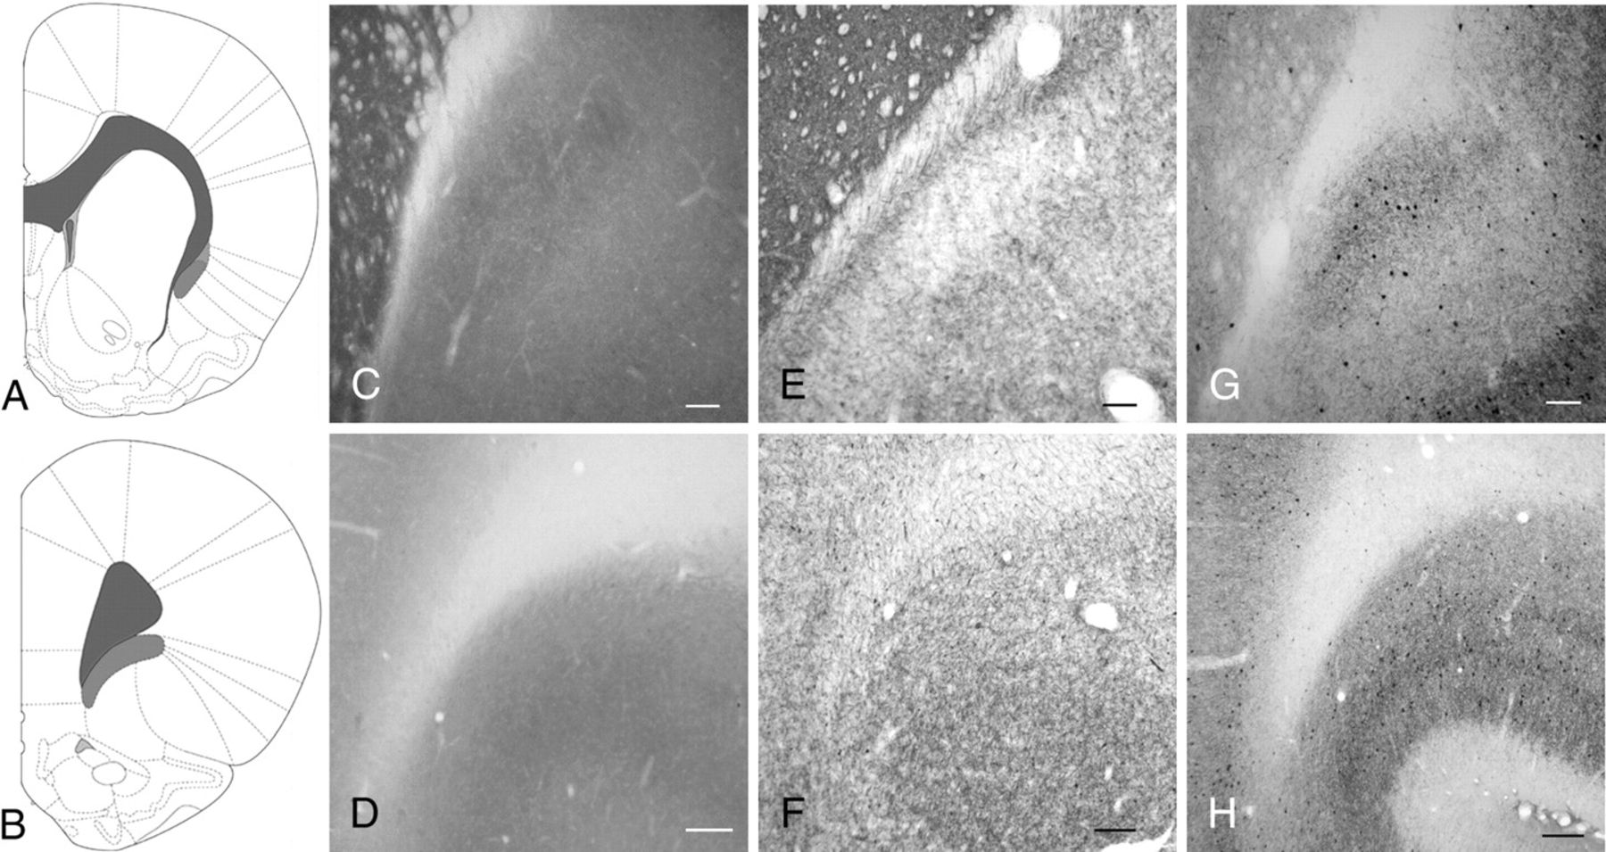
Figure 3. The claustrum is present at striatal but not at more anterior levels. The atlas depiction seen in panel (A) ...
Notes:
Figure 3. The claustrum is present at striatal but not at more anterior levels. The atlas depiction seen in panel (A) represents the rostrocaudal level for panels (C, E, and G); panel (B) represents the rostrocaudal level for panels (D, F, and H). (C, D) CO histochemistry reveals the structural boundaries of the claustrum only at striatal levels (panel C), where a distinct body of relatively dense staining can be seen that is rotated slightly lateral to the EC. In contrast, there is not a zone of dense CO staining that marks the inferior concavity of the forceps minor at frontal levels (D). (E, F) AChE histochemistry and (G, H) PV-ir reveal relatively dense staining in the claustrum at striatal (panels E and G) but not frontal levels (panels F and H). Scale bars: (C, E, and G), 200 μm; (D, F, and H), 100 μm.
Unless provided in the caption above, the following copyright applies to the content of this slide: © The Author 2009. Published by Oxford University Press. All rights reserved. For permissions, please e-mail: journals.permissions@oxfordjournals.org

Slide 4
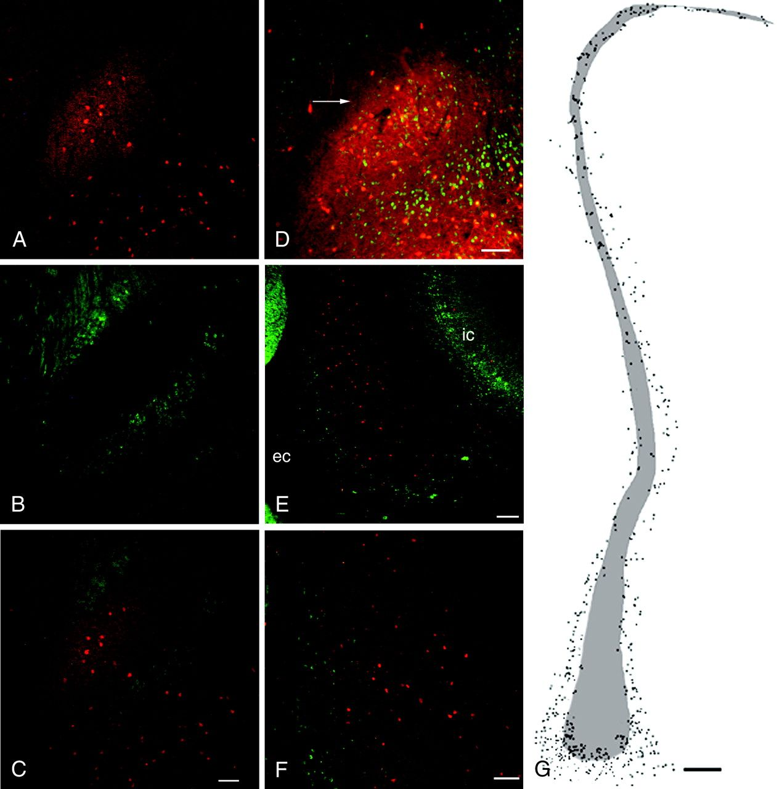
Figure 4. The claustrum of the rat and primate is embedded in layer VI of IC. (A) A dense PV-ir neuropil (red) marks ...
Notes:
Figure 4. The claustrum of the rat and primate is embedded in layer VI of IC. (A) A dense PV-ir neuropil (red) marks the claustrum. (B) In contrast, immunohistochemical staining for Crym (green), a protein whose expression is restricted to deep layers of cortex, avoids the claustrum and instead surrounds it (see merged image in panel C). (D) In the rat claustrum, NeuN-ir neurons (green) can be seen to surround the dense PV-ir plexus marking the claustrum (red), including in the zone between the EC and the claustrum (arrow). (E) The primate claustrum, marked by PV-ir (red), is also surrounded by Crym-ir (IC) cells (green). (F) In the middorsal aspect of the primate claustrum many Crym-ir cortical neurons (green) are seen at the border of the claustrum (red). (G) A charting of the distribution of Crym-ir cells (dots) surrounding and admixed with the PV-ir claustrum (shaded area) in the primate. Scale bar shown in (C) (100 μm) applies to panels (A, B, and C). (D), 100 μm; (E), 200 μm; (F), 100 μm; and (G), 500 μm.
Unless provided in the caption above, the following copyright applies to the content of this slide: © The Author 2009. Published by Oxford University Press. All rights reserved. For permissions, please e-mail: journals.permissions@oxfordjournals.org

Slide 5
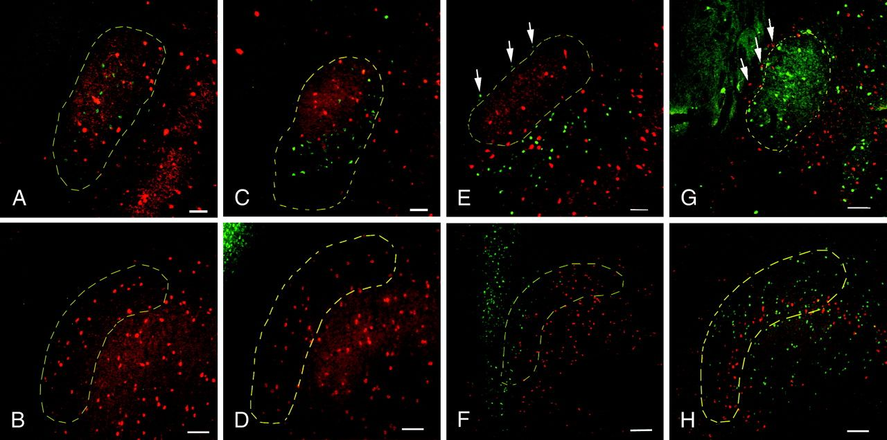
Figure 5. Retrograde labeling of claustrum from cortical and subcortical sites. Injections of retrograde tracers into ...
Notes:
Figure 5. Retrograde labeling of claustrum from cortical and subcortical sites. Injections of retrograde tracers into various cortical sites revealed retrograde labeling in the claustrum at striatal but not frontal levels. Conversely, tracer deposits into subcortical sites did not label cells in the claustrum at striatal levels but did label cells interposed between the claustrum and EC. (A) FG deposits of the anterior cingulate cortex retrogradely labeled cells (green) in the PV-rich claustrum (red) at striatal levels but not at frontal levels (B). (C, D) Injections of FG into the medial prefrontal cortex show a similar picture, with labeled cells in the claustrum at caudal (panel C) but not rostral (panel D) levels. (E) Following FG injections into the mediodorsal thalamus, FG-positive cell bodies (green) at striatal levels surround the claustrum (red), including in the zone between the claustrum and EC (arrows), but are not present in the claustrum. (F) What was previously designated anterior claustrum contains retrogradely labeled cells (green) from the thalamus. (G, H) Following injection of cholera toxin B into the lateral hypothalamus, retrogradely labeled cells (shown in red in panels G and H) are seen only at frontal levels (panel H) but are not seen in the claustrum at striatal levels (G). At the level of the striatum, retrogradely labeled cells from the hypothalamus instead surround the claustrum, including the territory between the claustrum and EC (arrows) Scale bars: (A, C, E, and G), 100 μm; (B, D, F, and H), 200 μm.
Unless provided in the caption above, the following copyright applies to the content of this slide: © The Author 2009. Published by Oxford University Press. All rights reserved. For permissions, please e-mail: journals.permissions@oxfordjournals.org

Slide 6
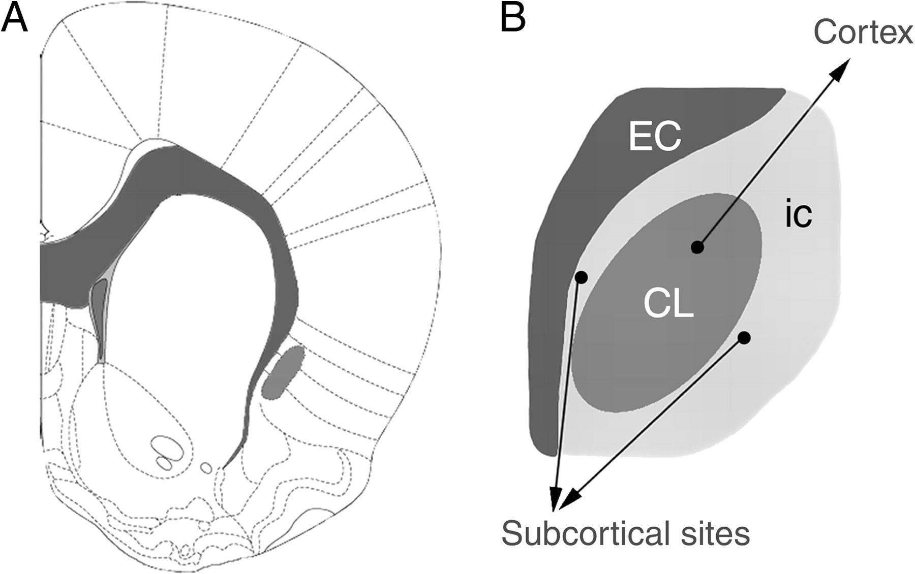
Figure 6. Organization of the claustrum. A revised view of the structural boundaries and organization of efferent ...
Notes:
Figure 6. Organization of the claustrum. A revised view of the structural boundaries and organization of efferent projections of the rat claustrum. White matter structures are shaded dark gray and the claustrum is depicted in a lighter shade of gray. Current data do not support the presence of an anterior claustrum, ventrolateral to the forceps minor at frontal cortical levels; this region appears to be deep layers of IC. However, at striatal levels (panel A) the claustrum is present, where it is surrounded on all sides by deep layer IC cells (light gray in panel B). These insular cells project to subcortical but not cortical targets. In contrast, the claustrum (CL, darker gray) projects solely to cortical regions. Image in panel (A) is modified from Paxinos and Watson (2007).
Unless provided in the caption above, the following copyright applies to the content of this slide: © The Author 2009. Published by Oxford University Press. All rights reserved. For permissions, please e-mail: journals.permissions@oxfordjournals.org

