Slide 1
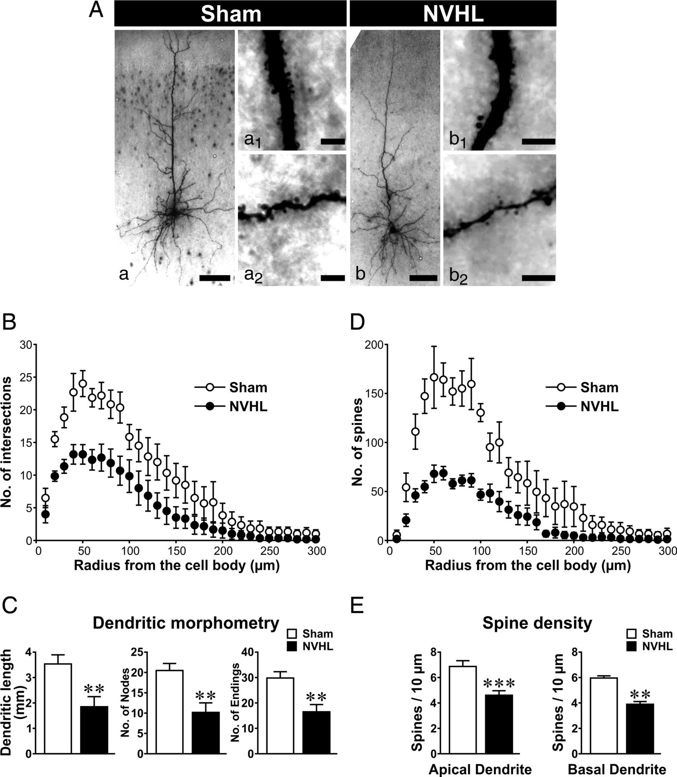
Figure 1. Loss of dendrites and spines in layer 5 mPFC pyramidal neurons of NVHL rats. (A) Low power micrographs (scale ...
Notes:
Figure 1. Loss of dendrites and spines in layer 5 mPFC pyramidal neurons of NVHL rats. (A) Low power micrographs (scale bar = 100 μm) of labeled layer 5 mPFC pyramidal neurons from sham (a) and NVHL rats (b). Micrographs on the right of these low power pictures are magnified images of apical dendrites (a1 and b1) and basal dendrites (a2 and b2). Scale bars on these magnified images represent 5 μm. Note the lower spine density on dendrites from NVHL specimens (b1 and b2). (B) Sholl analysis of basal dendritic trees (within concentric circles of 10–300 μm from the soma) of layer 5 mPFC pyramidal neurons from sham and NVHL rats. Basal dendrites of neurons from NVHL rats (n = 6) make fewer contacts (number of intersections) with concentric Sholl circles than basal dendrites of neurons from sham rats (n = 6). (C) Morphometric comparison of basal dendrites of layer 5 mPFC pyramidal neurons from sham and NVHL rats. Compared with neurons from sham rats (n = 6, white bars), neurons from NVHL rats (n = 6, black bars) displayed shorter dendritic length (left) and lower dendritic complexity that are represented by fewer branching points (number of nodes, center) and endings (termination of dendrites, right). **P < 0.01, Student's t-test. (D) Sholl analysis of the total number of spines on dendrites (within concentric circles of 10–300 μm from the soma) of layer 5 mPFC pyramidal neurons from sham and NVHL rats. Note the fewer dendritic spines in neurons from NVHL rats. (E) Spine density of apical and basal dendrites of layer 5 mPFC pyramidal neurons from sham and NVHL rats. The spine density was estimated by dividing the total number of spines by dendritic length within the Sholl circles in (B) and (D). Note that the averaged spine densities on both apical and distal dendrites in neurons from NVHL rats are significantly lower than those in neurons from sham rats. **P< 0.01 and ***P< 0.001, Student's t-test.
Unless provided in the caption above, the following copyright applies to the content of this slide: © The Author 2012. Published by Oxford University Press. All rights reserved. For Permissions, please e-mail: journals.permissions@oup.com

Slide 2
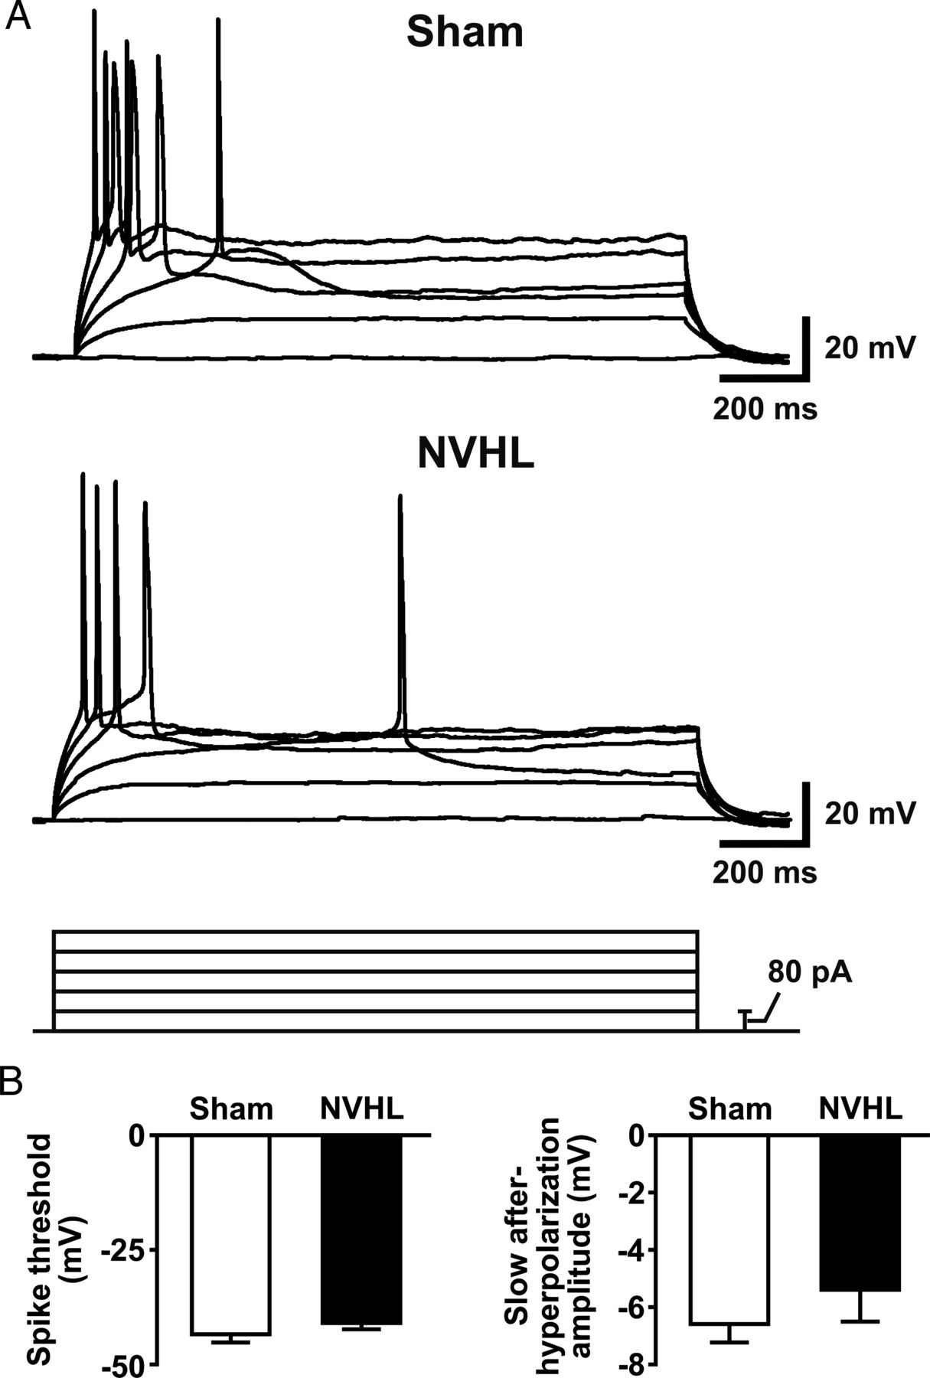
Figure 2. Characterization of the excitability of layer 5 mPFC pyramidal neurons in sham and NVHL rats. (A) ...
Notes:
Figure 2. Characterization of the excitability of layer 5 mPFC pyramidal neurons in sham and NVHL rats. (A) Representative membrane potential traces recorded from layer 5 mPFC pyramidal neurons of sham and NVHL rats. Depolarizing current steps (80 pA) were injected into neurons to trigger action potential. (B) Histograms illustrate averaged action potential threshold (left) and slow after-hyperpolarization amplitude (right) from sham (n = 14, white bars) and NVHL recordings (n = 17, black bars).
Unless provided in the caption above, the following copyright applies to the content of this slide: © The Author 2012. Published by Oxford University Press. All rights reserved. For Permissions, please e-mail: journals.permissions@oup.com

Slide 3
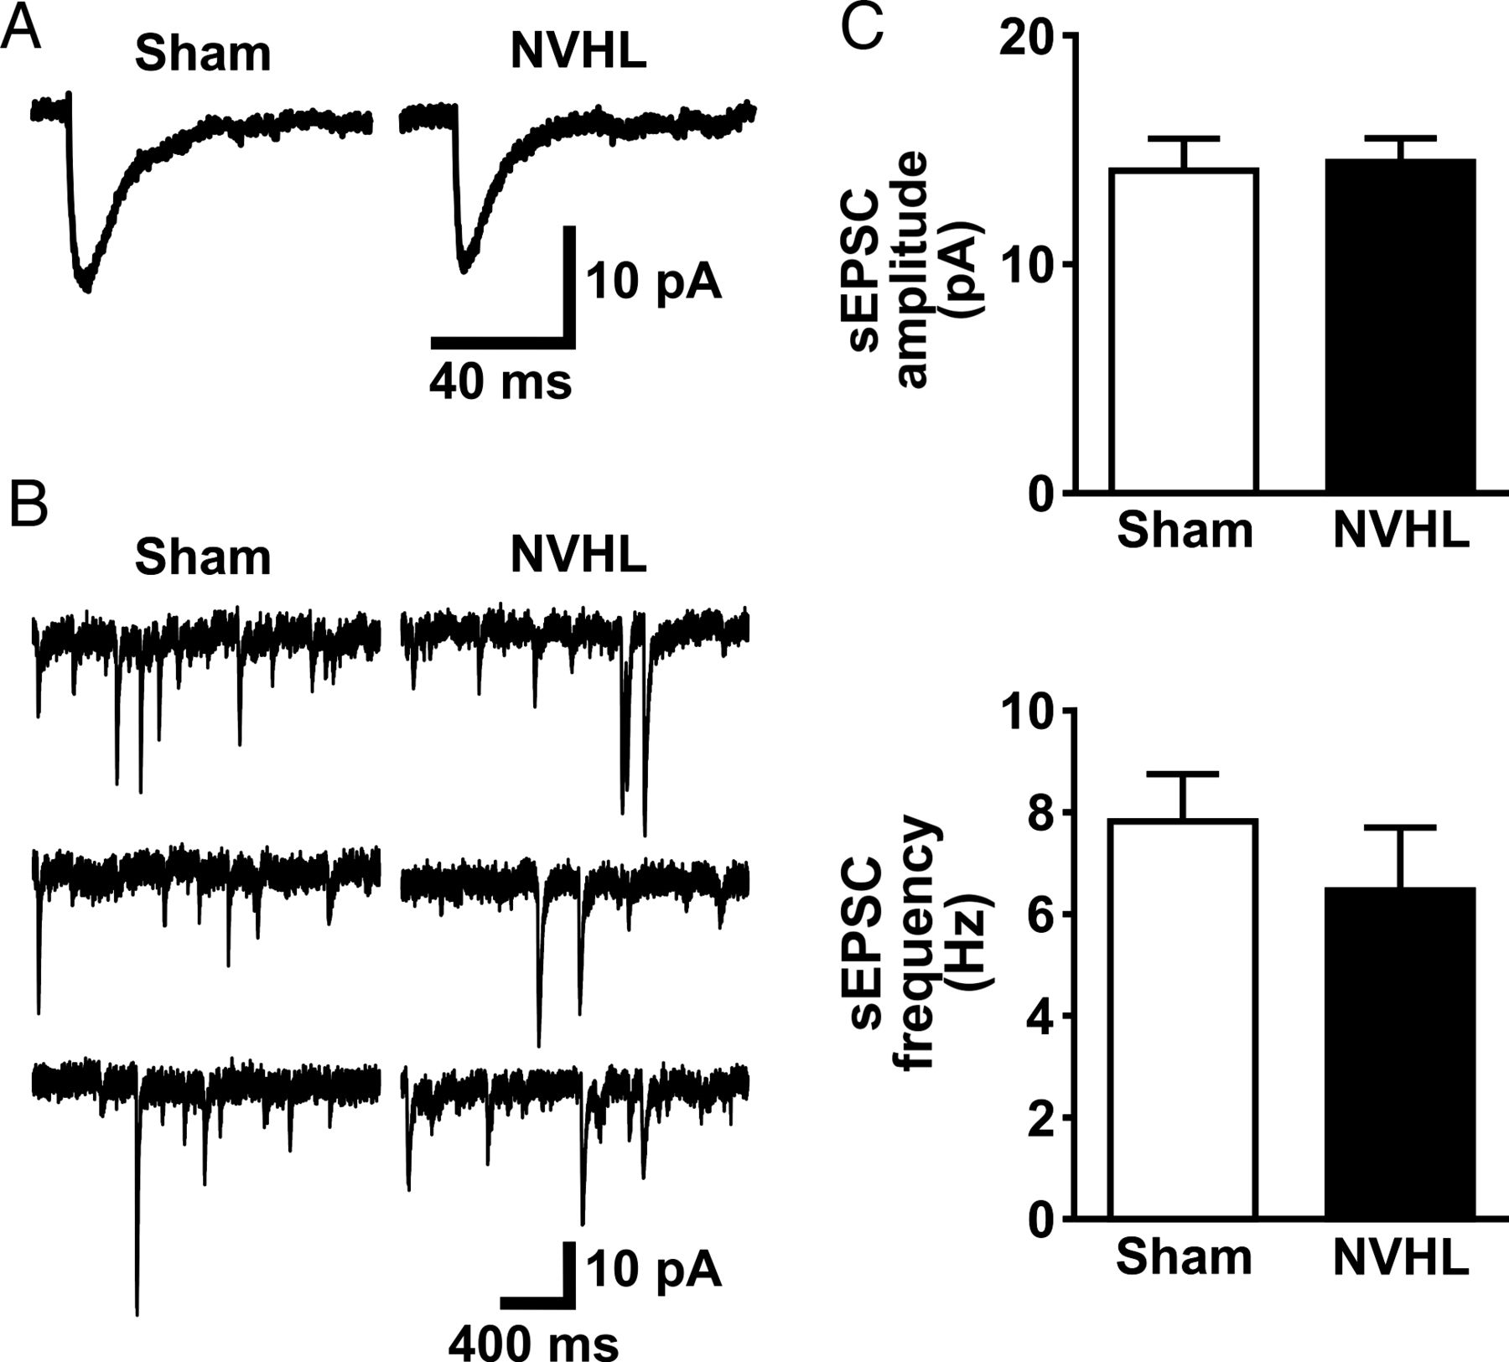
Figure 3. Characterization of action potential-dependent sEPSCs in layer 5 mPFC pyramidal neurons of sham and NVHL ...
Notes:
Figure 3. Characterization of action potential-dependent sEPSCs in layer 5 mPFC pyramidal neurons of sham and NVHL rats. (A) Representative averaged traces of sEPSCs recorded from layer 5 mPFC pyramidal neurons of sham and NVHL rats. (B) Representative consecutive traces of sEPSCs recorded from layer 5 mPFC pyramidal neurons of sham and NVHL rats. (C) Histograms illustrate averaged amplitude and frequency of sEPSCs from sham (n = 13, white bars) and NVHL recordings (n = 11, black bars).
Unless provided in the caption above, the following copyright applies to the content of this slide: © The Author 2012. Published by Oxford University Press. All rights reserved. For Permissions, please e-mail: journals.permissions@oup.com

Slide 4
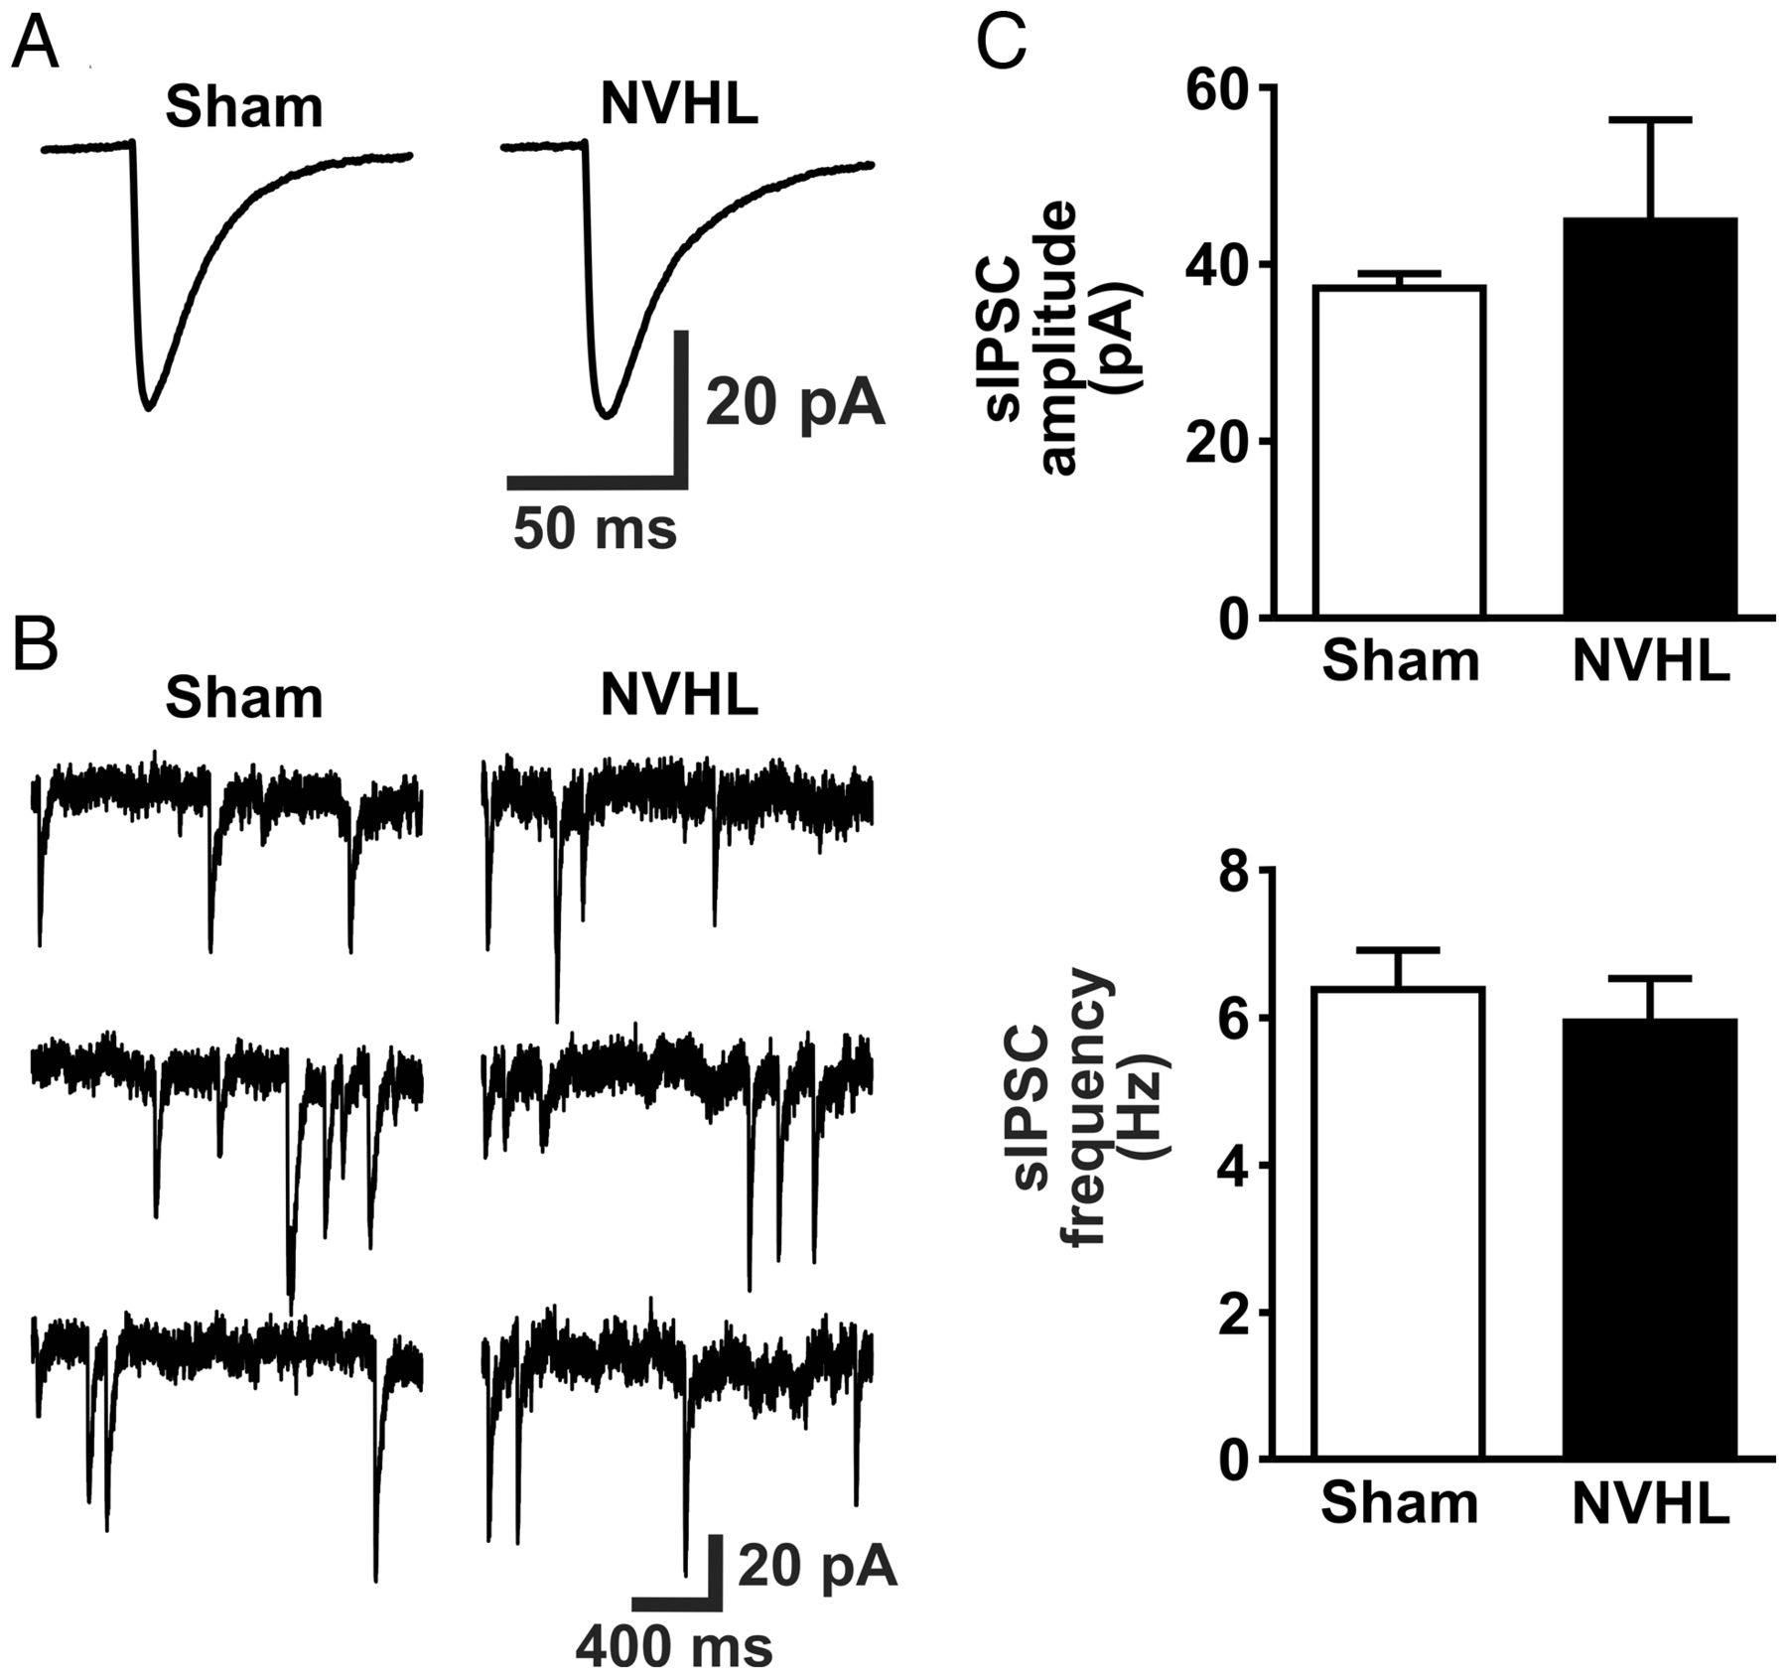
Figure 4. Characterization of action potential-dependent sIPSCs in layer 5 mPFC pyramidal neurons of sham and NVHL ...
Notes:
Figure 4. Characterization of action potential-dependent sIPSCs in layer 5 mPFC pyramidal neurons of sham and NVHL rats. (A) Representative averaged traces of sIPSCs recorded from layer 5 mPFC pyramidal neurons of sham and NVHL rats. (B) Representative consecutive traces of sIPSCs recorded from layer 5 mPFC pyramidal neurons of sham and NVHL rats. (C) Histograms illustrate averaged amplitude and frequency of sIPSCs from sham (n = 8, white bars) and NVHL recordings (n = 8, black bars).
Unless provided in the caption above, the following copyright applies to the content of this slide: © The Author 2012. Published by Oxford University Press. All rights reserved. For Permissions, please e-mail: journals.permissions@oup.com

Slide 5
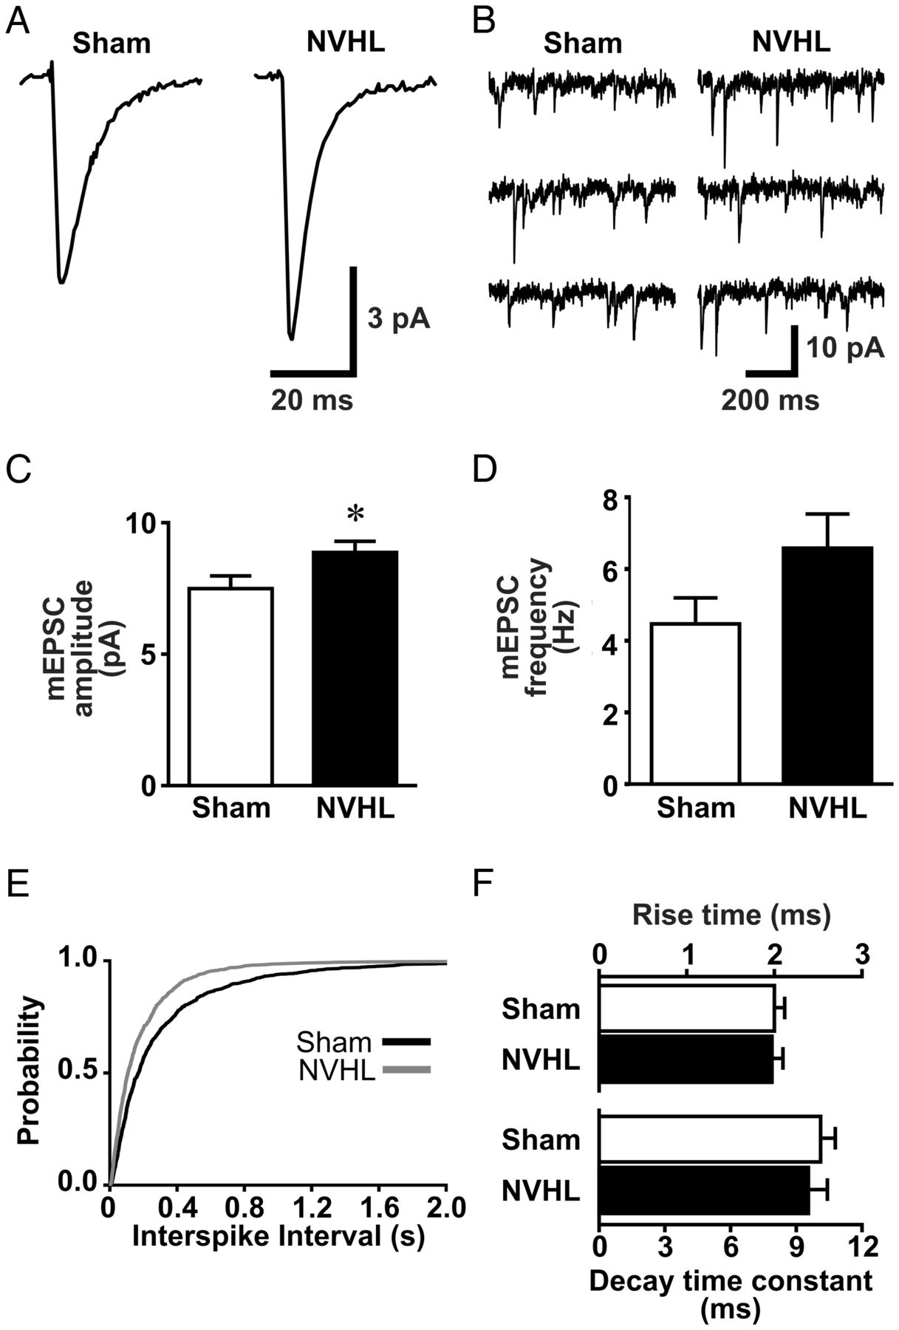
Figure 5. Increase in the amplitude of action potential-independent mEPSCs in layer 5 mPFC pyramidal neurons of NVHL ...
Notes:
Figure 5. Increase in the amplitude of action potential-independent mEPSCs in layer 5 mPFC pyramidal neurons of NVHL rats. (A) Representative averaged traces of mEPSCs recorded from layer 5 mPFC pyramidal neurons of sham and NVHL rats. Note the significant increase in the mEPSC amplitude in the NVHL group. (B) Representative consecutive traces of mEPSCs recorded from layer 5 mPFC pyramidal neurons of sham and NVHL rats. (C) Histogram illustrates the averaged amplitude of mEPSCs from sham (n = 10, white bars) and NVHL recordings (n = 10, black bars). Note the significant increase in the mEPSC amplitude in the NVHL group. *P< 0.05, Student's t-test. (D) Histogram illustrates the averaged frequency of mEPSCs from sham (n = 10, white bars) and NVHL recordings (n = 10, black bars). (E) Cumulative probability plots of interspike intervals of mEPSCs recorded from sham (n = 10, black line) and NVHL rats (n = 10, gray line). (F) Histograms illustrate averaged rise time and decay time constant of mEPSCs from sham (n = 10, white bars) and NVHL recordings (n = 10, black bars).
Unless provided in the caption above, the following copyright applies to the content of this slide: © The Author 2012. Published by Oxford University Press. All rights reserved. For Permissions, please e-mail: journals.permissions@oup.com

Slide 6
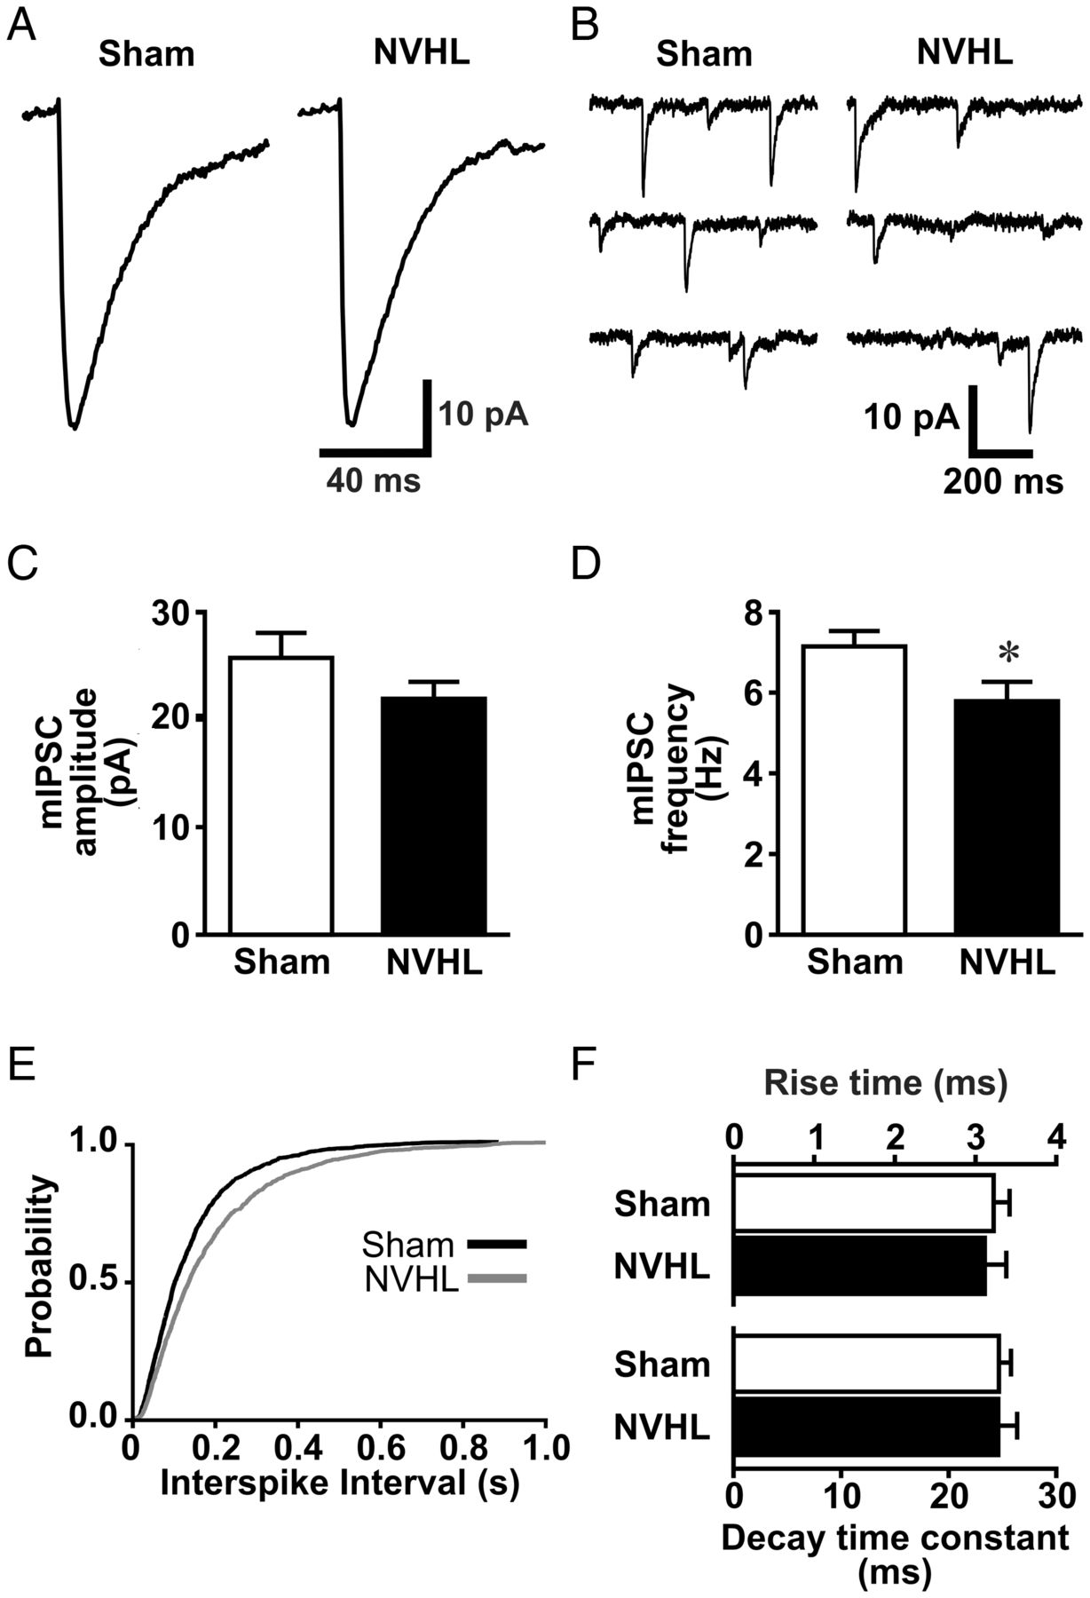
Figure 6. Decrease in the frequency of action potential-independent mIPSCs in layer 5 mPFC pyramidal neurons of NVHL ...
Notes:
Figure 6. Decrease in the frequency of action potential-independent mIPSCs in layer 5 mPFC pyramidal neurons of NVHL rats. (A) Representative averaged traces of mIPSCs recorded from layer 5 mPFC pyramidal neurons of sham and NVHL rats. (B) Representative consecutive mIPSC traces recorded from layer 5 mPFC pyramidal neurons of sham and NVHL rats. Note the decrease in the mIPSC frequency in the NVHL group. (C) Histogram illustrates averaged amplitude of mIPSCs from sham (n = 9, white bars) and NVHL recordings (n = 8, black bars). (D) Histogram illustrates averaged frequency of mIPSCs from sham (n = 9, white bars) and NVHL recordings (n = 8, black bars). Note the significant decrease in the mIPSC frequency in the NVHL group. *P< 0.05, Student's t-test. (E) Cumulative probability plots of interspike intervals of mIPSCs from sham (n = 9, black line) and NVHL recordings (n = 8, gray line). (F) Histograms illustrate averaged rise time and decay time constant of mIPSCs from sham (n = 9, white bars) and NVHL recordings (n = 8, black bars).
Unless provided in the caption above, the following copyright applies to the content of this slide: © The Author 2012. Published by Oxford University Press. All rights reserved. For Permissions, please e-mail: journals.permissions@oup.com

Slide 7
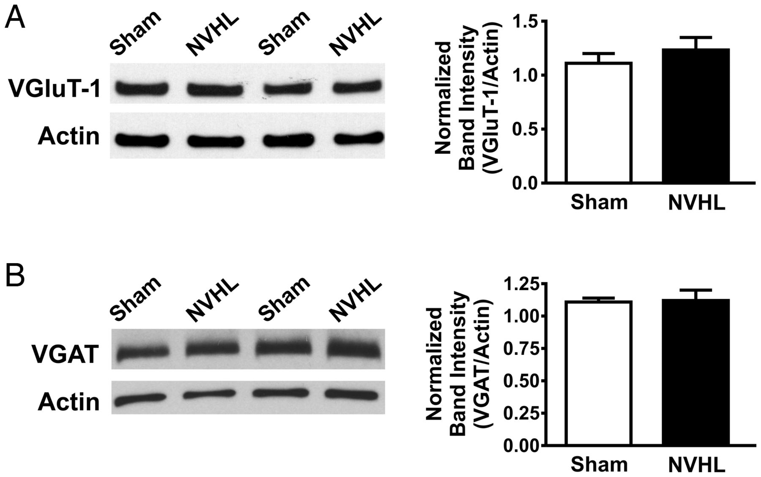
Figure 7. Western blot analysis of mPFC presynaptic proteins. (A) Representative western blots of VGluT-1 in the mPFC ...
Notes:
Figure 7. Western blot analysis of mPFC presynaptic proteins. (A) Representative western blots of VGluT-1 in the mPFC lysate of sham and NVHL rats (left). Expression was normalized to actin. Histogram on the right illustrates the averaged normalized intensity of VGluT-1 from sham (n = 12, white bars) and NVHL rats (n = 11, black bars). (B) Representative western blots of VGAT in the mPFC lysate of sham and NVHL rats (left). Histogram on the right illustrates the averaged normalized intensity of VGAT from sham (n = 6, white bars) and NVHL rats (n = 5, black bars).
Unless provided in the caption above, the following copyright applies to the content of this slide: © The Author 2012. Published by Oxford University Press. All rights reserved. For Permissions, please e-mail: journals.permissions@oup.com

