Slide 1
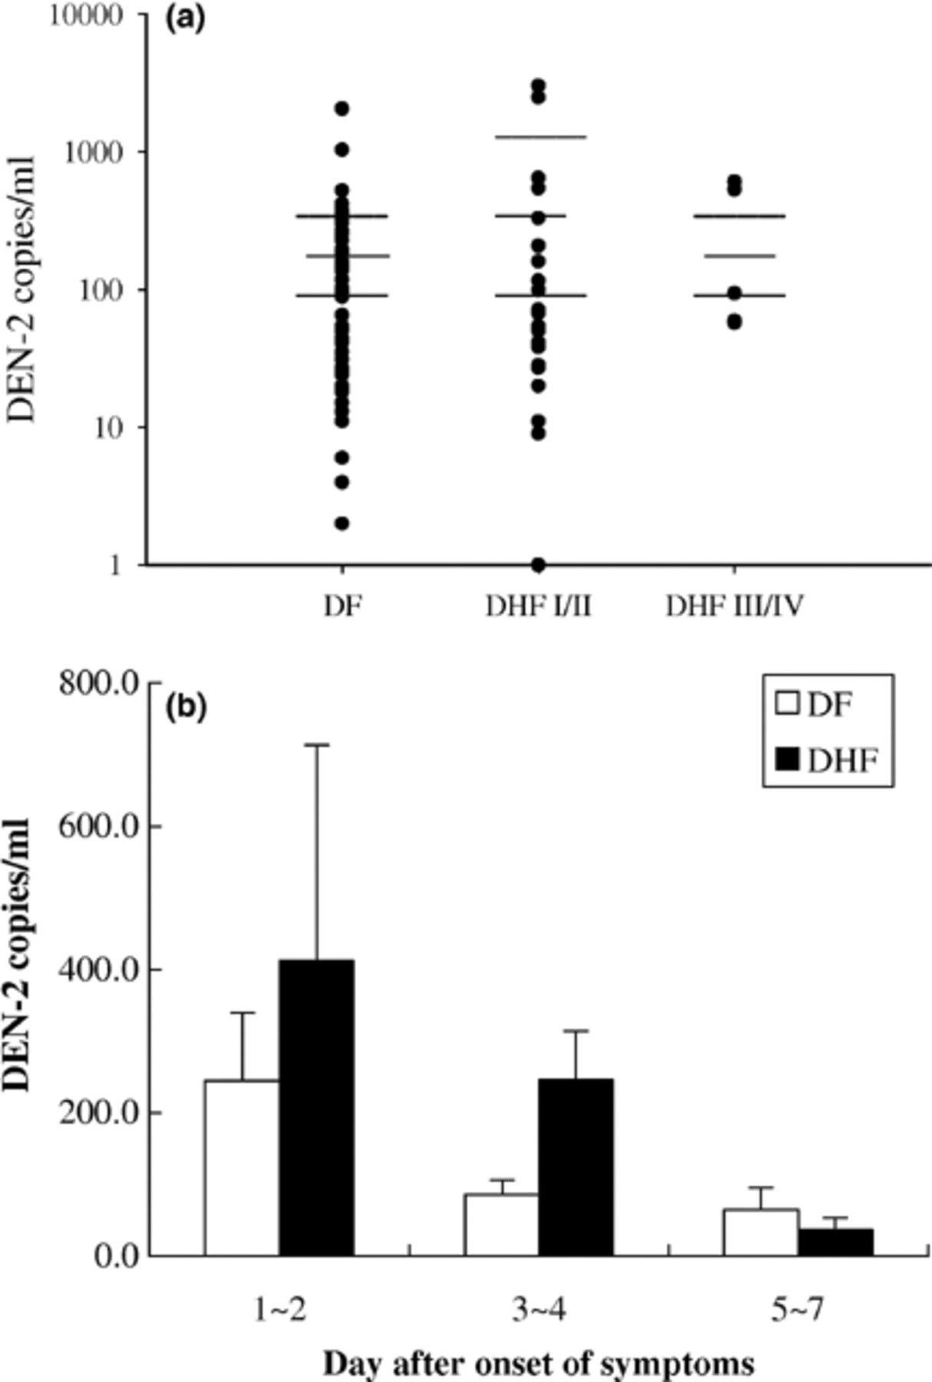
Figure 1 A real-time fluorogenic RT-PCR detection of the DEN-2 genome copies in blood. Blood samples collected upon ...
Notes:
Figure 1 A real-time fluorogenic RT-PCR detection of the DEN-2 genome copies in blood. Blood samples collected upon admission (2–7 days after onset of symptoms) were subjected to RNA extraction for real time RT-PCR analysis of virus load. (a) The virus titers in blood determined by the TaqMan fluorogenic RT-PCR were 173.8 ± 37.4; 358.0 ± 154.8; and 269.0 ± 112.0 copies/ml, respectively, in patients with DF (n= 66), DHF I/II (n= 24), and DHF III/IV (n= 9). There was no significant difference among three groups. (b) Kinetic changes of the virus load detected by real-time fluorogenic RT-PCR in patients with DF (open bar) and DHF (solid bar).
Unless provided in the caption above, the following copyright applies to the content of this slide: © 2005 Federation of European Microbiological Societies

Slide 2
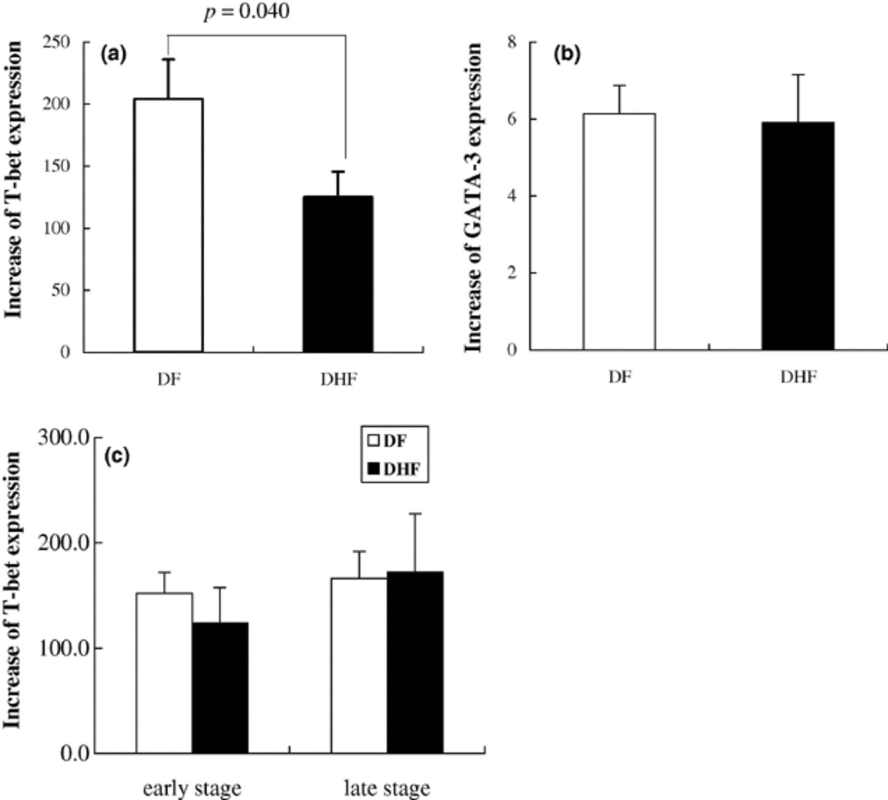
Figure 2 Real-time quantitative RT-PCR analysis of T-bet/GATA-3 mRNA expression in PBLs from patients with and without ...
Notes:
Figure 2 Real-time quantitative RT-PCR analysis of T-bet/GATA-3 mRNA expression in PBLs from patients with and without DHF. The increase of T-bet mRNA expression was calculated as normalization by β-actin mRNA expression and comparison to normal control. (a) A summary of the T-bet mRNA expression in PBLs from patients with DF and DHF. The increase fold of T-bet mRNA expression in patients with DHF was significantly lower than those with DF (increase fold: 125.4 ± 20.3 vs. 204.1 ± 31.9; p= 0.040). (b) A summary of the GATA-3 mRNA expression in PBLs from patients with DF and DHF. The GATA-3 mRNA expression in patients with DF and DHF was not significantly different as compared to the normal control in each independent experiment (increase fold: 6.1 ± 0.7 vs. 5.9 ± 1.2, respectively). (c) Kinetic changes of T-bet mRNA expression in patients with DF (open bar) and DHF (solid bar).
Unless provided in the caption above, the following copyright applies to the content of this slide: © 2005 Federation of European Microbiological Societies

