Slide 1
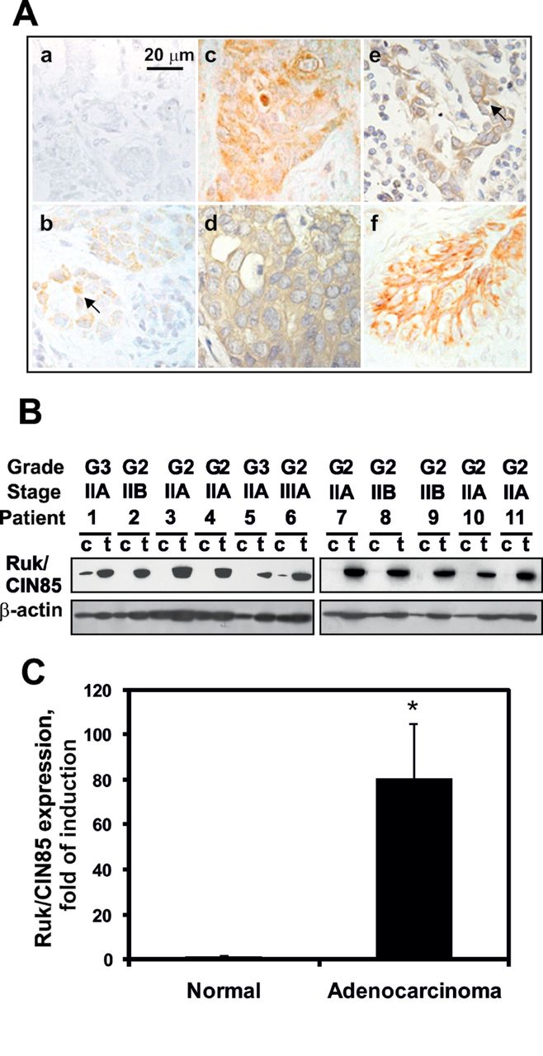
Fig. 1. Ruk _{l} /CIN85 is overexpressed in human breast adenocarcinoma and lymph node metastases. ( A ) ...
Notes:
Fig. 1. Ruk l /CIN85 is overexpressed in human breast adenocarcinoma and lymph node metastases. ( A ) Expression of Ruk/CIN85 in non-cancerous breast epithelium (b), breast adenocarcinoma (c and d), lymph node metastases (e) and intravascular tumor embols (f), detected by immunohistochemistry using the monoclonal anti-Ruk/CIN85 antibody MISh-A1. A negative control stain is shown (a). ( B ) Western blot analysis of Ruk l /CIN85 expression in adenocarcinoma samples in comparison with non-cancerous breast tissue from the same patients. β-Actin was used as a loading control. c—non-cancerous (control) tissue sample, t—adenocarcinoma tumor sample from the same patient. ( C ) Results of western blotting were quantified by densitometry. The level of Ruk l /CIN85 expression detected with MISh-A1 in non-cancerous tissue was set to 1. Data represent mean ± SEM of 31 samples, * P ≤ 0.01.
Unless provided in the caption above, the following copyright applies to the content of this slide: © The Author 2012. Published by Oxford University Press. All rights reserved. For Permissions, please email: journals.permissions@oup.com

Slide 2
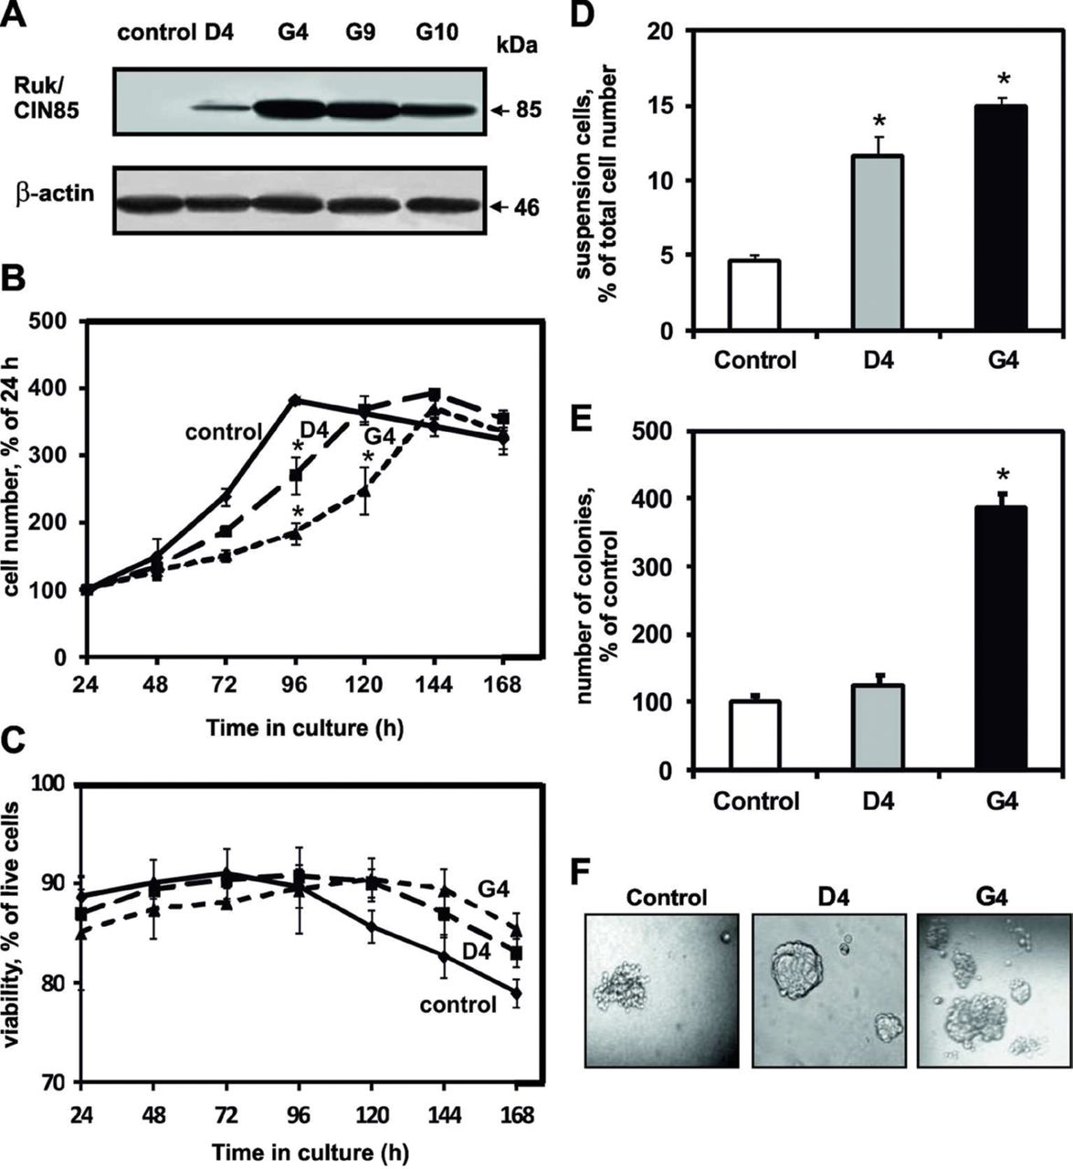
Fig. 2. Ruk _{l} /CIN85 changes dynamics of cell growth and alters cell adhesion properties. ( A ) Western ...
Notes:
Fig. 2. Ruk l /CIN85 changes dynamics of cell growth and alters cell adhesion properties. ( A ) Western blot analysis of four independent MCF-7 clones that stably express untagged Ruk l /CIN85 (D4, G4, G9 and G10) with MISh-A1 antibody. β-Actin was used as a loading control. Control—cells transfected with empty vector. ( B ) Ruk l /CIN85-mediated changes in cell growth dynamics. In each subline the number of cells was set equal to 100% at 24h. Data represent mean ± SEM of four independent experiments, * P ≤ 0.05 compared with control MCF-7 cells. ( C ) Ruk l /CIN85 does not affect cell viability. Cell viability was calculated as percent of live cells to the total cells number. Data represent mean ± SEM of four independent experiments. ( D ) The total number of cells (attached and floating) was counted in each subline and set equal to 100%; percent of cells in suspension was then calculated to the total cell number. Data represent mean ± SEM of four independent experiments, * P ≤ 0.05 compared with control. ( E ) The anchorage-independent growth of cells was determined by soft agar colony formation assay. The number of colonies formed by control cells 2 weeks after plating was set equal to 100%. Data represent mean ± SEM of three independent experiments, * P ≤ 0.05 compared with control. ( F ) Representative photographs of colonies in agar.
Unless provided in the caption above, the following copyright applies to the content of this slide: © The Author 2012. Published by Oxford University Press. All rights reserved. For Permissions, please email: journals.permissions@oup.com

Slide 3
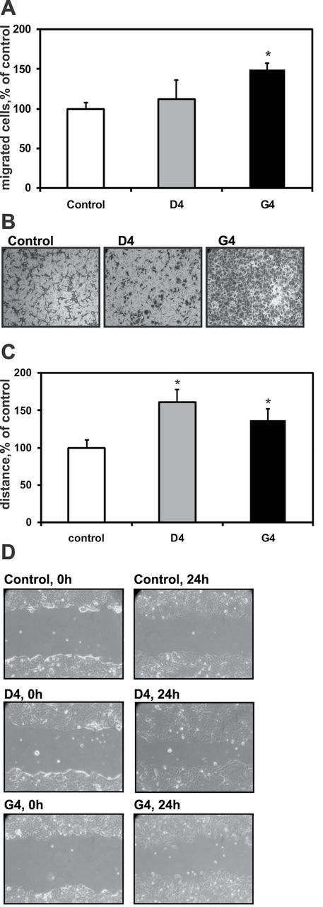
Fig. 3. Ruk _{l} /CIN85 affects cell motility. ( A ) Control MCF-7 and Ruk _{l} /CIN85-expressing ...
Notes:
Fig. 3. Ruk l /CIN85 affects cell motility. ( A ) Control MCF-7 and Ruk l /CIN85-expressing sublines D4 and G4 cells were seeded onto cell culture inserts in medium containing 0.1% FCS and allowed to migrate towards medium containing 5% FCS. The number of migrated control cells was set equal to 100%. Data are mean ± SEM of four independent experiments. * P ≤ 0.05 compared with control. ( B ) Representative photographs of migrated cells; original magnification is 400. ( C ) Confluent cell monolayers were scratched with a pipette tip. Wound closure was monitored microscopically 24h later. The average distance moved by control cells was set equal to 100%. Data are expressed as mean ± SEM of four independent experiments. * P ≤ 0.05 compared with control. ( D ) Representative photographs of wound areas either immediately or 24h after scratching are shown; original magnification is 200.
Unless provided in the caption above, the following copyright applies to the content of this slide: © The Author 2012. Published by Oxford University Press. All rights reserved. For Permissions, please email: journals.permissions@oup.com

Slide 4
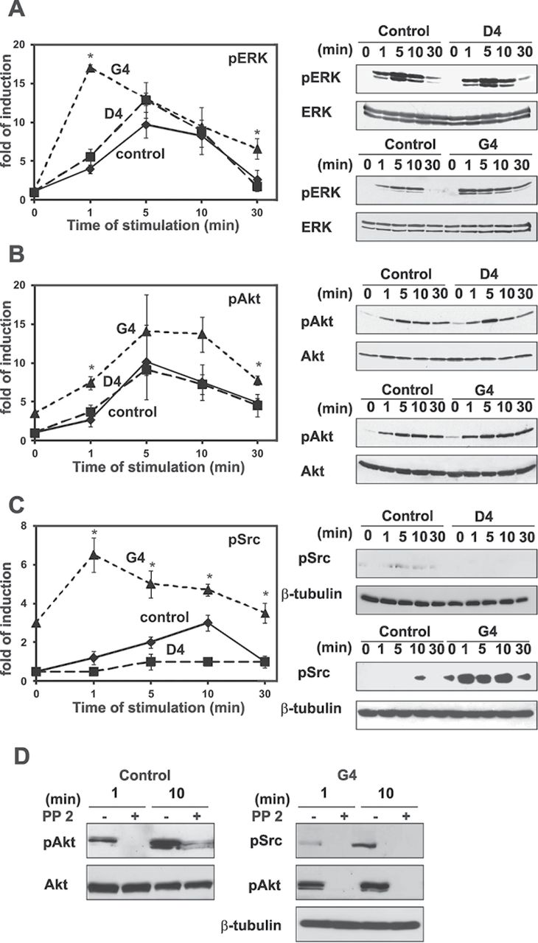
Fig. 4. Ruk _{l} /CIN85 enhances ERK1/2, Akt and Src activation. Control MCF-7 and Ruk _{l} ...
Notes:
Fig. 4. Ruk l /CIN85 enhances ERK1/2, Akt and Src activation. Control MCF-7 and Ruk l /CIN85-expressing D4 and G4 subline cells were treated with EGF (100ng/ml) for the indicated periods of time. The phosphorylation of Akt, ERK and Src was measured by western blot analysis with phosphospecific antibodies. ( A ) The ratio of phosphorylated ERK1/2 (pERK) to total ERK1/2 in untreated control cells was set equal to 1. Representative blots are shown in the right panels. Data are expressed as mean ± SEM of four independent experiments, * P ≤ 0.05 as compared with control. ( B ) The ratio of phosphorylated Akt (pAkt) to total Akt in untreated control cells was set equal to 1. Representative blots are shown in the right panels. Data are expressed as mean ± SEM of five independent experiments, * P ≤ 0.05 as compared with control.( C ) The ratio of phosphorylated Src (pSrc) to β-tubulin as loading control in untreated control cells was set equal to 1. Representative blots are shown in the right panels. Data are expressed as mean ± SEM of three independent experiments, * P ≤ 0.05 as compared with control. ( D ) The cells were treated with EGF as before either in the presence or absence of Src inhibitor PP2 (1 µM). Src and Akt phosphorylation was detected by western blot analysis.
Unless provided in the caption above, the following copyright applies to the content of this slide: © The Author 2012. Published by Oxford University Press. All rights reserved. For Permissions, please email: journals.permissions@oup.com

Slide 5
Fig. 5. Ruk _{l} /CIN85-expressing cells display no sensitivity to EGF-induced motility. ( A ) Control MCF-7 ...
Notes:
Fig. 5. Ruk l /CIN85-expressing cells display no sensitivity to EGF-induced motility. ( A ) Control MCF-7 and Ruk l /CIN85-expressing D4 and G4 subline cells were plated in 24-well dishes and treated either with EGF (100ng/ml) or vehicle for 72h. Then, metabolic activity was assayed by a MTT test. Values are percent of corresponding untreated controls. Data are expressed as mean ± SEM of four independent experiments. ( B ) Control MCF-7 and Ruk l /CIN85-expressing D4 and G4 subline cells were treated either with EGF (100ng/ml) or vehicle for 3 days and analyzed in a transwell migration assay. The number of migrated untreated cells was set equal to 100% for each subline. Data are expressed as mean ± SEM of four independent experiments. * P ≤ 0.05 Ruk l /CIN85-expressing cells compared with control cells. ( C ) Representative photographs of the filters are shown; original magnification is 400. ( D ) Control MCF-7 and Ruk l /CIN85-expressing D4 and G4 subline cells were treated either with EGF (100ng/ml) or vehicle for 72h and then a wound healing assay was performed. The average distance moved by untreated cells was set equal to 100% for each subline. Data are expressed as mean ± SEM of four independent experiments. * P ≤ 0.05 Ruk l /CIN85-expressing cells compared with control cells. ( E ) Representative photographs of wound areas either immediately or 24h after scratching are shown; original magnification is 200, untr.—EGF-untreated cells.
Unless provided in the caption above, the following copyright applies to the content of this slide: © The Author 2012. Published by Oxford University Press. All rights reserved. For Permissions, please email: journals.permissions@oup.com

Slide 6
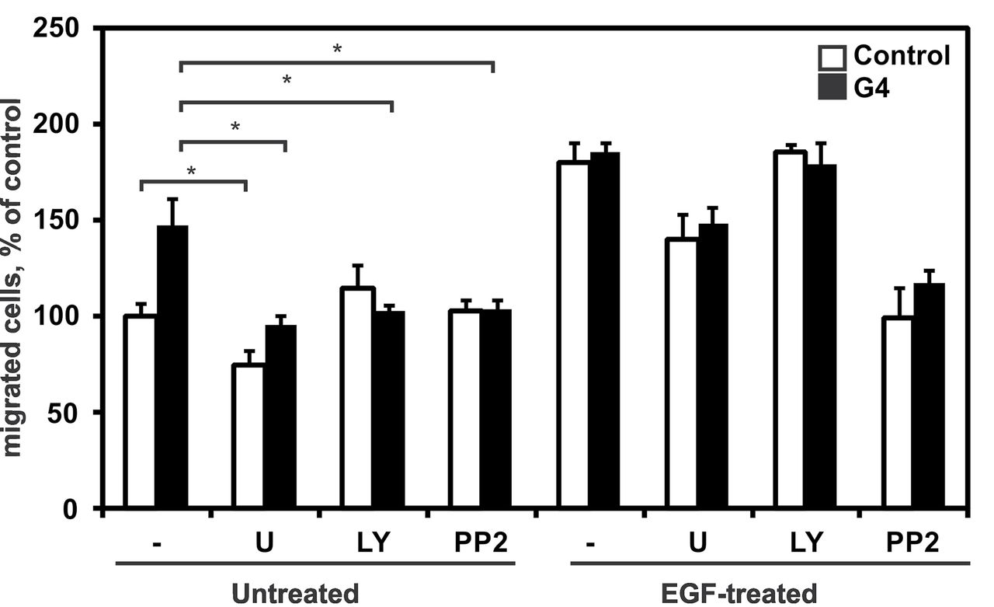
Fig. 6. Basal but not EGF-dependent changes in cell motility are caused by Src/Akt pathway activation in Ruk ...
Notes:
Fig. 6. Basal but not EGF-dependent changes in cell motility are caused by Src/Akt pathway activation in Ruk l /CIN85-expressing cells. Transwell migration assays were performed as in Figure 5 . Either the PI3K inhibitor LY294002 (10 µM), the Src inhibitor PP2 (1 µM), the MEK inhibitor U0126 (10 µM) or vehicle were added to the cells 20min before EGF treatment. The number of migrated untreated control cells was set equal to 100%. Data are expressed as mean ± SEM of three independent experiments. * P ≤ 0.05 untreated G4 compared with untreated control cells.
Unless provided in the caption above, the following copyright applies to the content of this slide: © The Author 2012. Published by Oxford University Press. All rights reserved. For Permissions, please email: journals.permissions@oup.com

