Slide 1
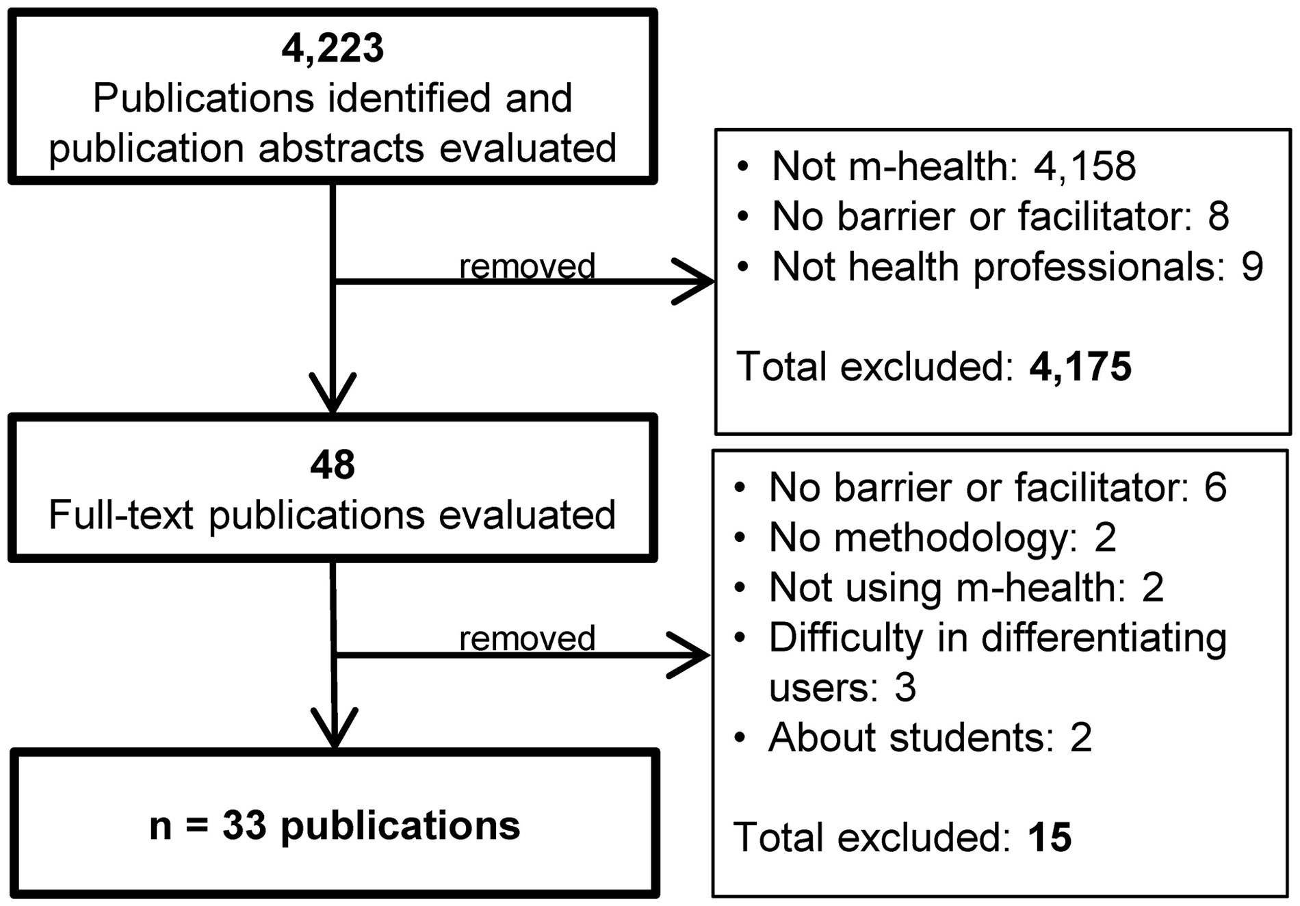
Figure 1: – Study selection flow diagram.
Notes:
Figure 1: – Study selection flow diagram.
Unless provided in the caption above, the following copyright applies to the content of this slide: © The Author 2015. Published by Oxford University Press on behalf of the American Medical Informatics Association. All rights reserved. For Permissions, please email: journals.permissions@oup.com

