Slide 1
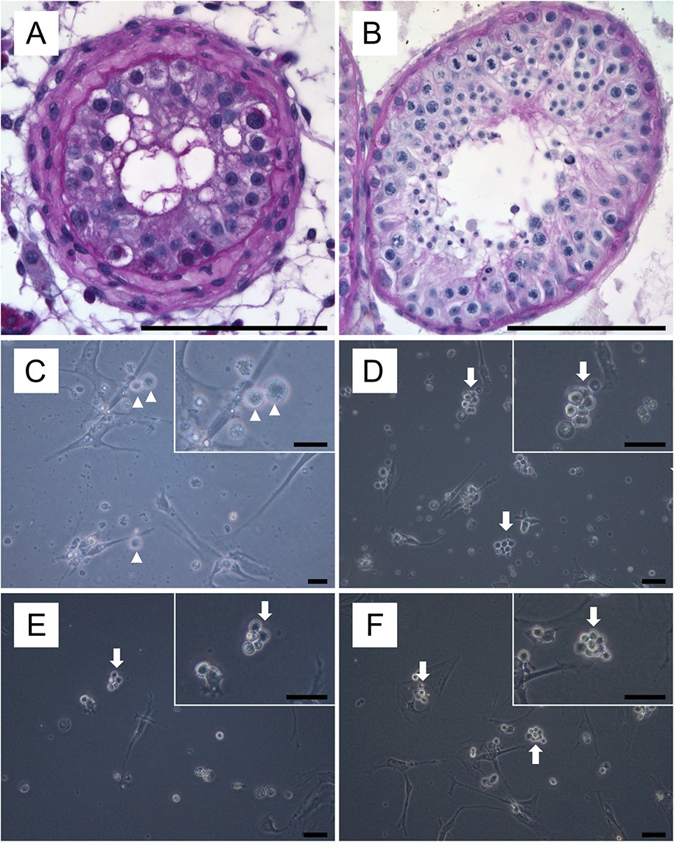
Figure 1 Micrographs showing testicular histology and phase-contrast micrographic images of germ cell cultures. A. ...
Notes:
Figure 1 Micrographs showing testicular histology and phase-contrast micrographic images of germ cell cultures. A. Periodic acid Schiff-stained sections of testicular tissue with germ cell arrest at the stage of spermatogonia (SPG-arrest) and B. Representative image of testicular biopsy with qualitatively intact spermatogenesis. C. Phase-contrast micrographic image of germ cell cultures from a patient with SPG-arrest and D–F with qualitatively normal spermatogenesis. Note that cultures of the SPG-arrest patient mostly consist of single cells, whereas cultures from a patient group with normal spermatogenesis show characteristic germ cell clusters. Arrow heads indicate individual germ cells and arrows germ cell clusters. Scale bars represent 100 µm in A, B, 20 µm in image C and 50 µm in remaining micrographs (D, E, F). Hormonal and histological parameters of patients who were selected for germ cell cultures and expression analysis, including single-cell PCR. Patient groupsHormonal parameters (normal range)Histological parameters of seminiferous tubulesLH (2–10 U/l)T ( >12 nmol/l)FSH (1–7 U/l)% ES% SPC% SPG% SCO% TSSPG-Arrest (n = 1)n.d.n.d.n.d.0078157Normal (n = 7)4.73 ( ± 3.65)18.5 ( ± 6.26)6.19 ( ± 2.40)65.14 ( ± 6.84)20.0 ( ± 2.83)2.86 ( ± 1.57)1 ( ± 1)8.57 ( ± 7.25)Data are presented as mean ± SD. ES, elongated spermatids; SPC, spermatocyte; SPG, spermatogonia; SCO, Sertoli cell only; T, testosterone; TS, tubular shadow.
Unless provided in the caption above, the following copyright applies to the content of this slide: © The Author 2017. Published by Oxford University Press on behalf of the European Society of Human Reproduction and Embryology. All rights reserved. For Permissions, please email: journals.permissions@oup.com

Slide 2
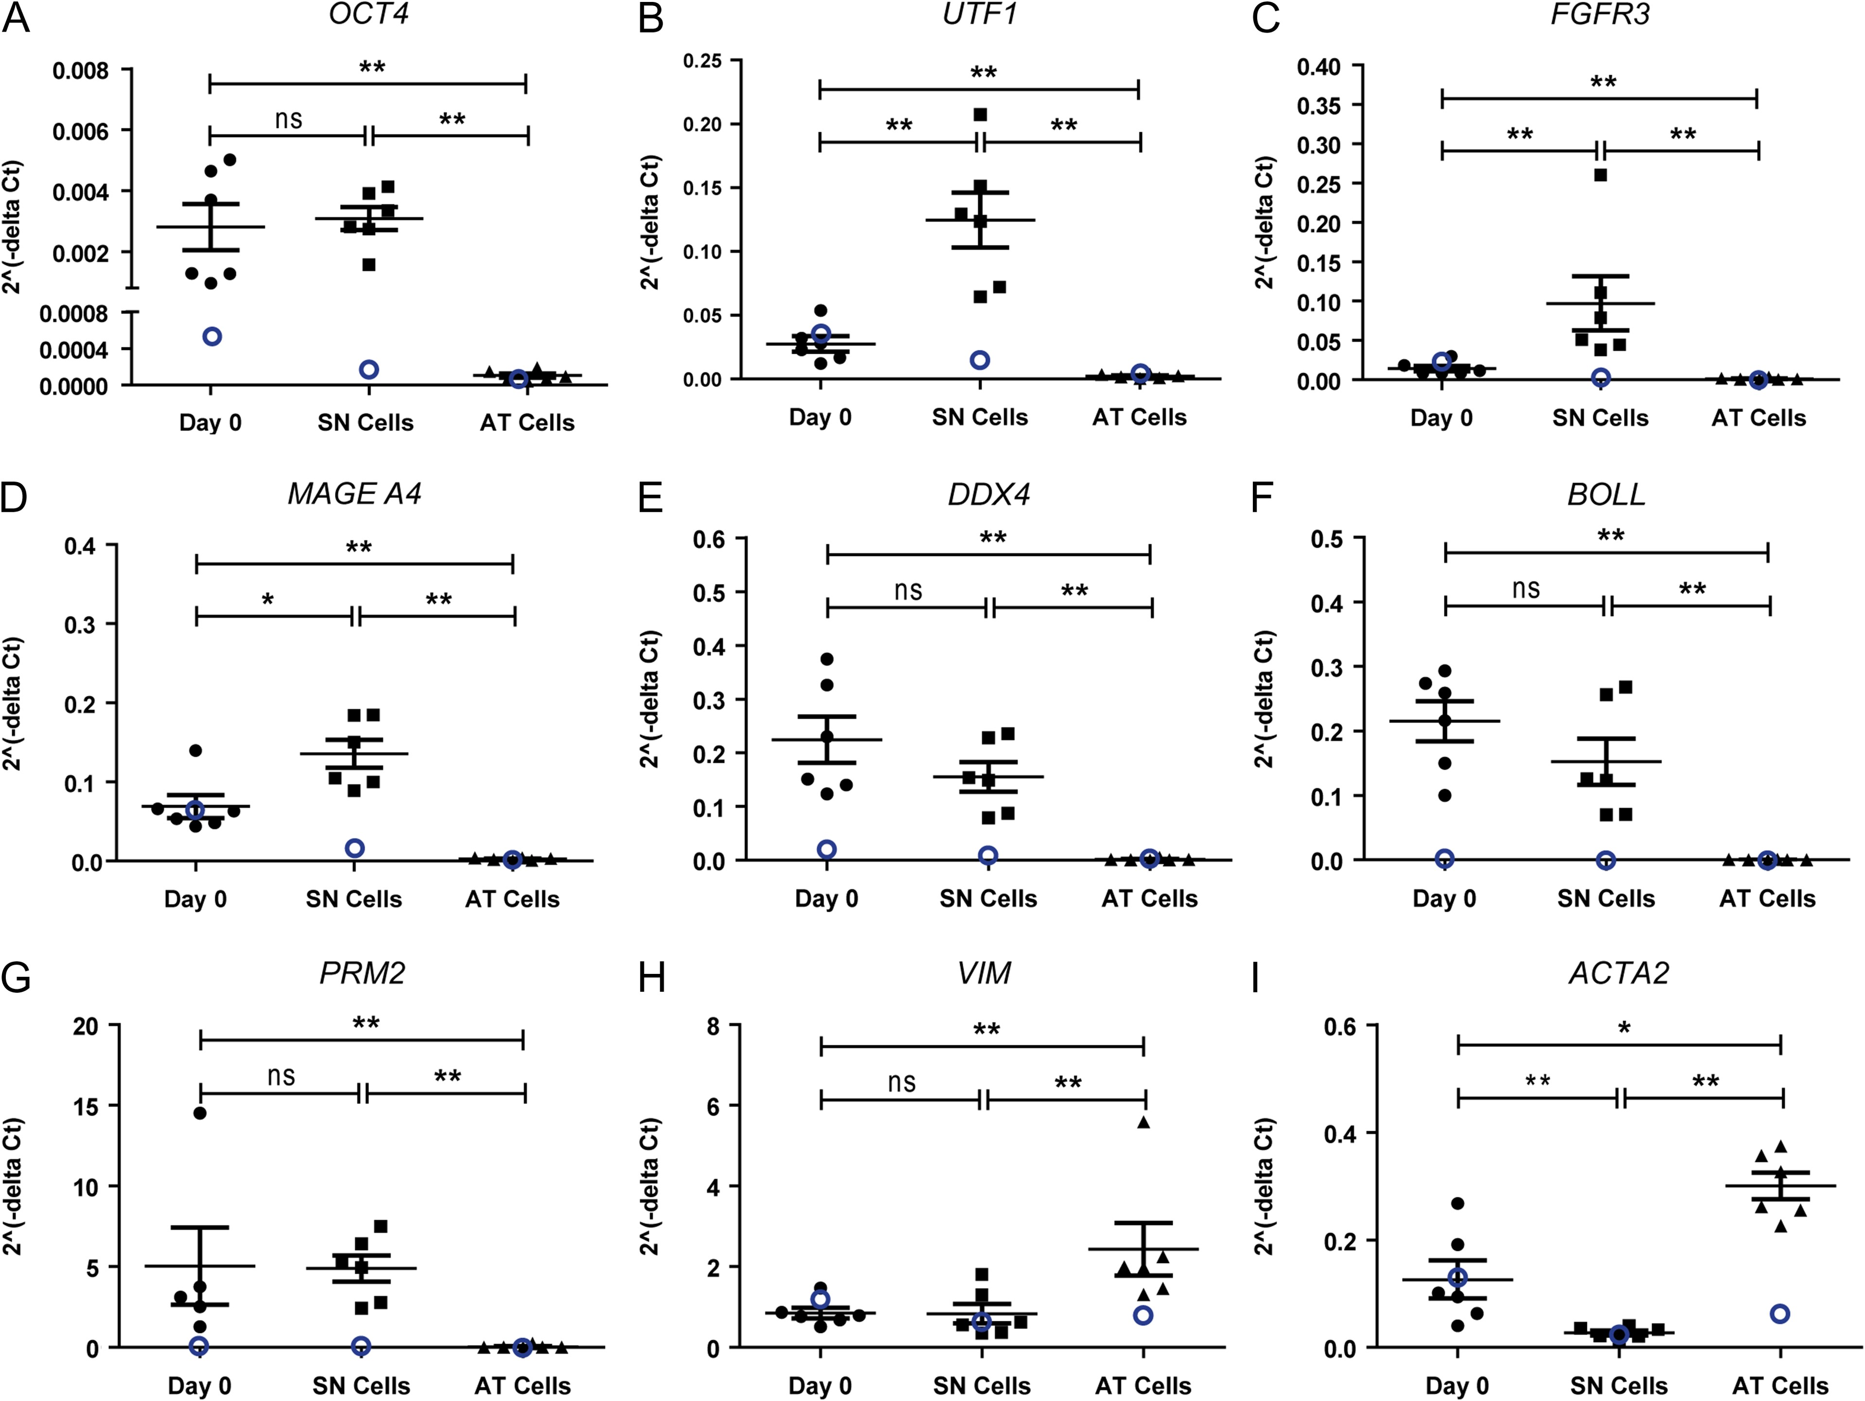
Figure 2 Relative quantification of marker genes on Day 0 of culture and following short-term culture in the ...
Notes:
Figure 2 Relative quantification of marker genes on Day 0 of culture and following short-term culture in the supernatant (SN) and the attached (AT) cell fractions. Results from a patient with SPG-arrest are shown as open circles, whereas results obtained using testicular tissues with complete spermatogenesis (n = 6) are shown as solid shapes. Data are shown as means with SEM, with individual data points for each culture fraction obtained from an individual patient. Statistical differences are marked with *P < 0.05 and **P < 0.01.
Unless provided in the caption above, the following copyright applies to the content of this slide: © The Author 2017. Published by Oxford University Press on behalf of the European Society of Human Reproduction and Embryology. All rights reserved. For Permissions, please email: journals.permissions@oup.com

Slide 3
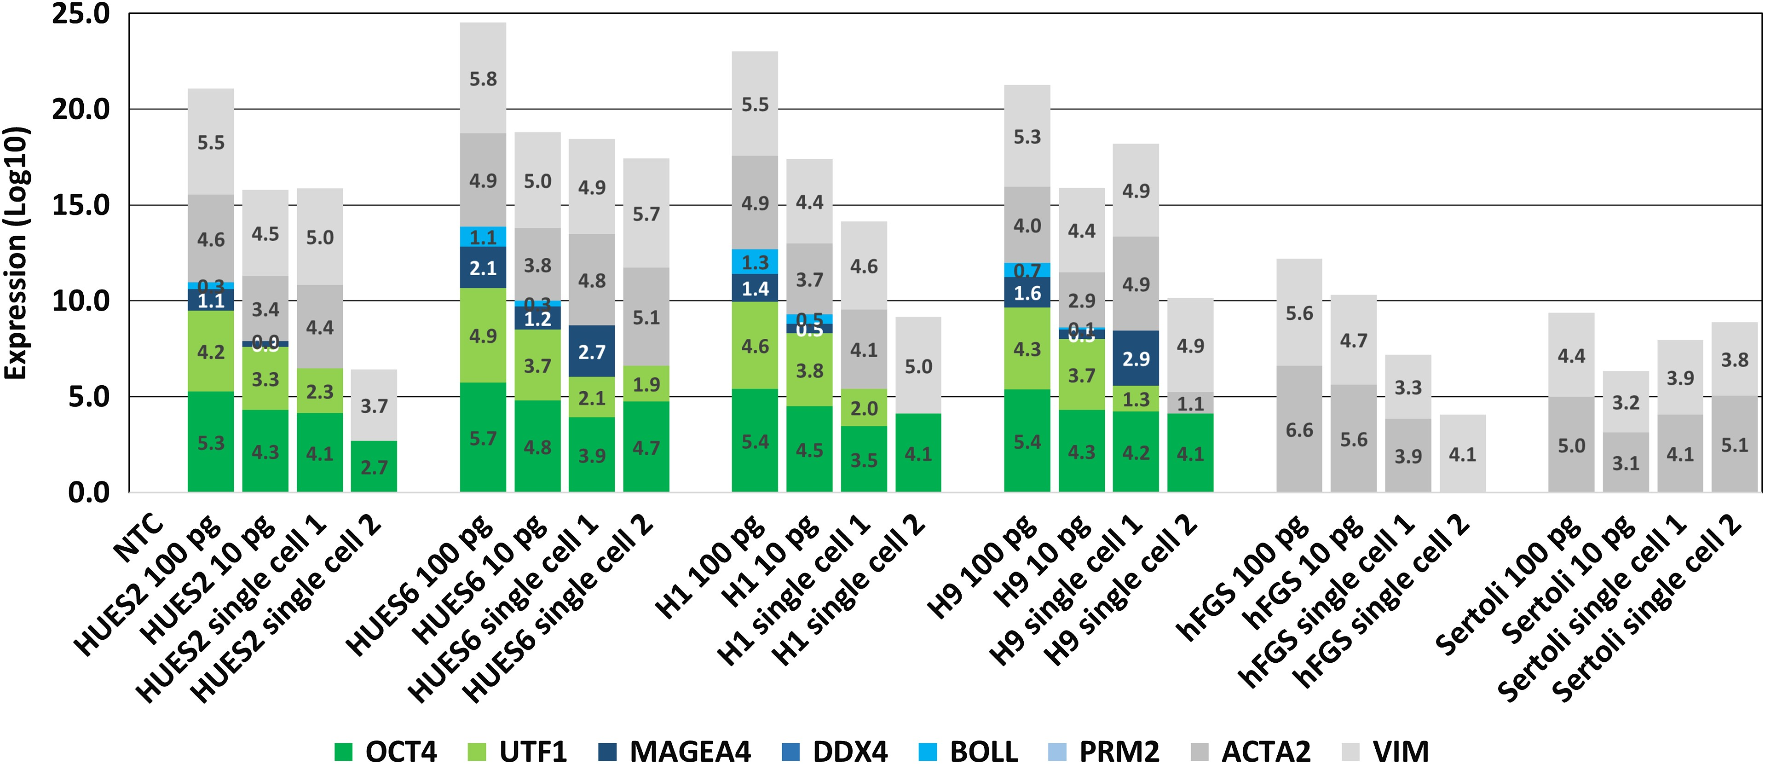
Figure 3 mRNA levels of undifferentiated, germ cell, and somatic marker genes in human embryonic stem cell (ESCs) (H1, ...
Notes:
Figure 3 mRNA levels of undifferentiated, germ cell, and somatic marker genes in human embryonic stem cell (ESCs) (H1, H9, HUES2 and HUES6), human foetal gonadal stromal (hFGS) and Sertoli cells. Results were obtained using 100 pg, 10 pg, or single cells as the starting template amount. NTC, no template control.
Unless provided in the caption above, the following copyright applies to the content of this slide: © The Author 2017. Published by Oxford University Press on behalf of the European Society of Human Reproduction and Embryology. All rights reserved. For Permissions, please email: journals.permissions@oup.com

Slide 4
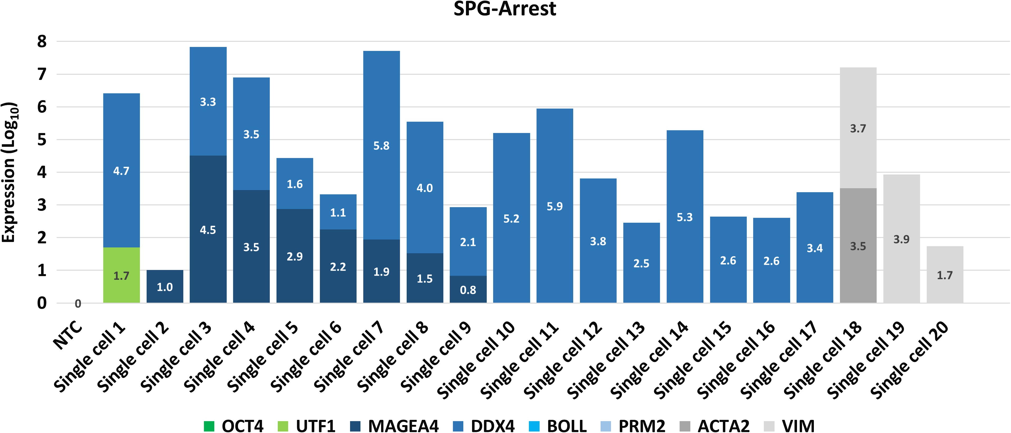
Figure 4 Single-cell expression results from a patient with SPG-arrest. Results were obtained from 20 individual cells ...
Notes:
Figure 4 Single-cell expression results from a patient with SPG-arrest. Results were obtained from 20 individual cells and are shown as relative expression levels on a log10 scale.
Unless provided in the caption above, the following copyright applies to the content of this slide: © The Author 2017. Published by Oxford University Press on behalf of the European Society of Human Reproduction and Embryology. All rights reserved. For Permissions, please email: journals.permissions@oup.com

Slide 5
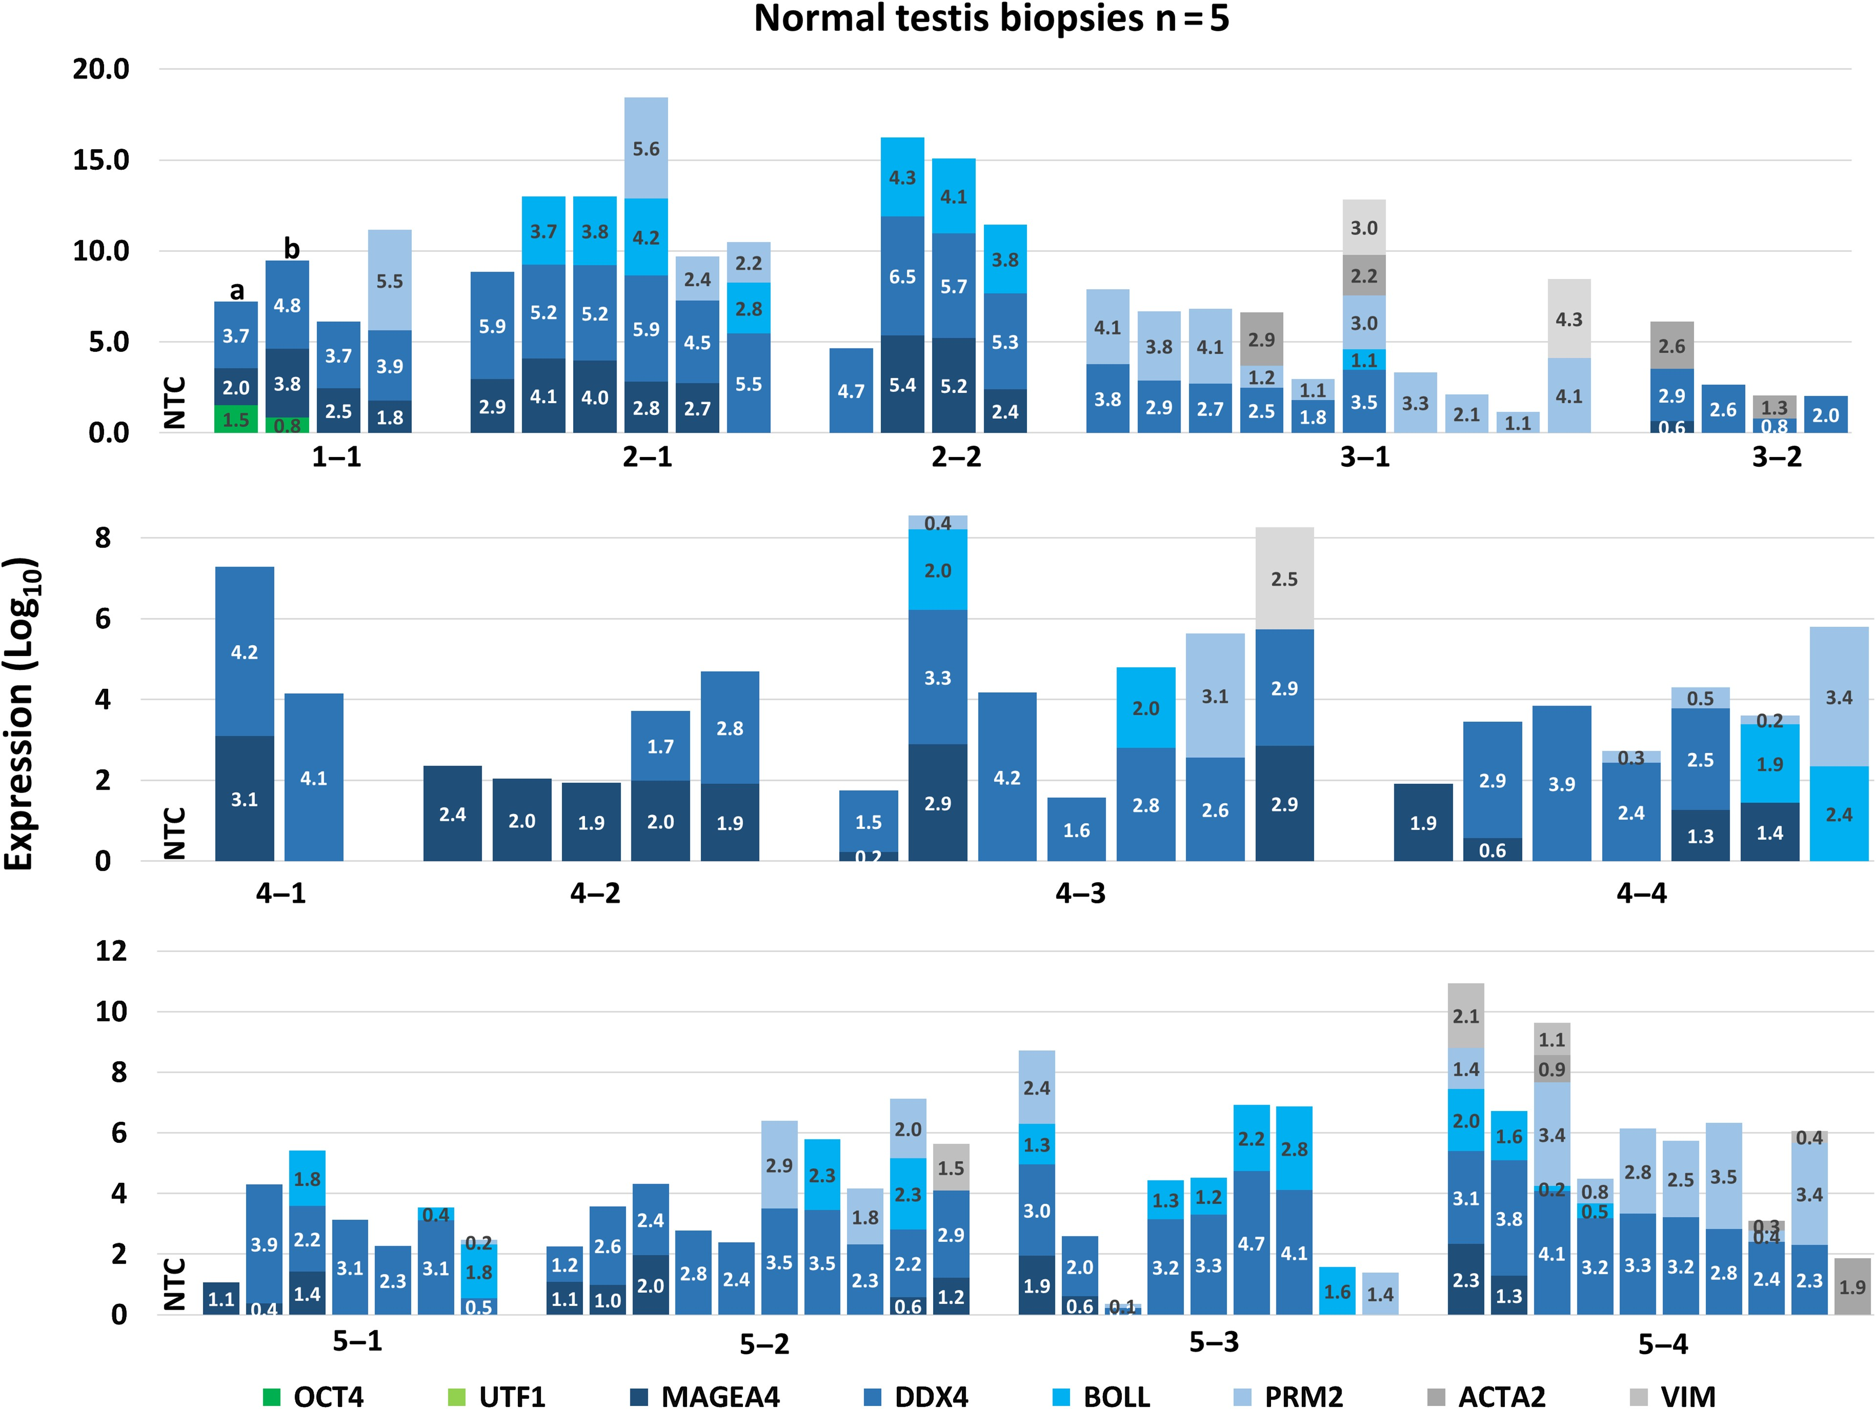
Figure 5 Single-cell expression of germ cell clusters obtained from patients with qualitatively complete ...
Notes:
Figure 5 Single-cell expression of germ cell clusters obtained from patients with qualitatively complete spermatogenesis (n = 5). On the x-axis the patient numbers and the number of respective clusters are indicated.
Unless provided in the caption above, the following copyright applies to the content of this slide: © The Author 2017. Published by Oxford University Press on behalf of the European Society of Human Reproduction and Embryology. All rights reserved. For Permissions, please email: journals.permissions@oup.com

Slide 6
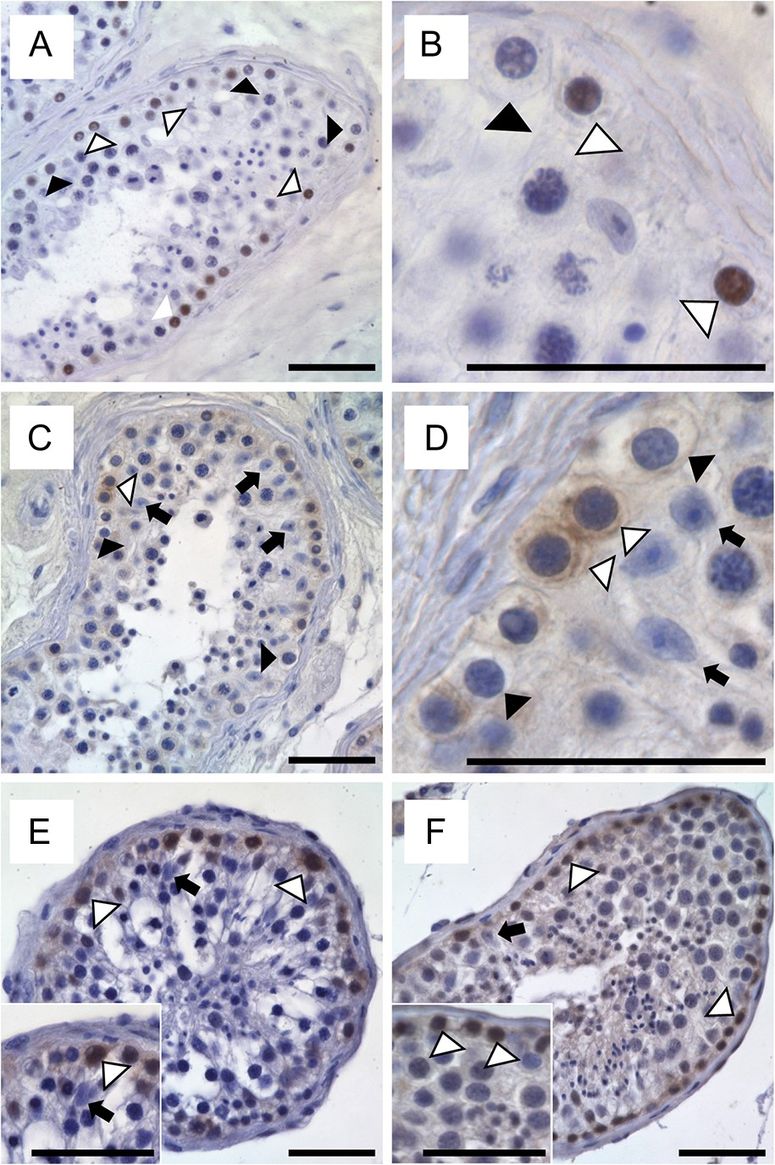
Figure 6 Spermatogonial-specific expression of candidate markers identified by RNA-seq in human testicular tissues ...
Notes:
Figure 6 Spermatogonial-specific expression of candidate markers identified by RNA-seq in human testicular tissues with qualitatively normal spermatogenesis. Immunohistochemistry stainings for DDX5 (A, B), EEF1A1 (C, D), TSPY1 (E) and NGN3 (F) on Bouin's fixed (A–D) and PFA fixed (E, F) tissues. Black arrows point to immunonegative Sertoli cells whereas black and white arrow heads indicate negative and positive germ cells, respectively. Scale bars represent 50 µm.
Unless provided in the caption above, the following copyright applies to the content of this slide: © The Author 2017. Published by Oxford University Press on behalf of the European Society of Human Reproduction and Embryology. All rights reserved. For Permissions, please email: journals.permissions@oup.com

