Slide 1
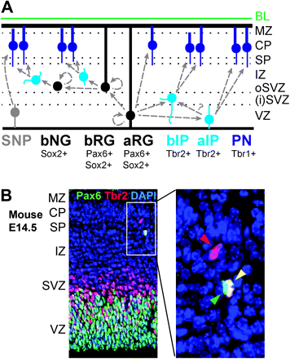
Figure 1. Neurogenic progenitors in developing neocortex. (A) Schematic illustration of cortical progenitor lineages, ...
Notes:
Figure 1. Neurogenic progenitors in developing neocortex. (A) Schematic illustration of cortical progenitor lineages, compartments, and characteristic transcription factor expression. aRG generate cortical projection neurons (PNs) directly and indirectly via bRG, apical intermediate progenitors (aIPs), and basal intermediate progenitors (bIPs). In addition, basal “nonradial” glia (bNG) have been described in human cortex (Hansen et al. 2010) and SNPs in rodent cortex. Colors indicate the capacity for proliferation and self-renewal: black, high; light blue, low; dark blue, postmitotic; gray, unknown. (B) Examples of progenitors identified by transcription factor expression in embryonic day (E) 14.5 mouse neocortex. Radial glia are identified by high Pax6 (green) expression and IPs by Tbr2 (red) expression. At this stage, most radial glia are aRG located in the VZ and most IPs are bIP in the SVZ and aIP in the VZ. The boxed area, enlarged at right, contains 3 progenitor cells interpreted as a bRG (green arrowhead), a newly generated bIP (yellow arrowhead), and a mature bIP (red arrowhead).
Unless provided in the caption above, the following copyright applies to the content of this slide: © The Author 2011. Published by Oxford University Press. All rights reserved. For permissions, please e-mail: journals.permissions@oup.com

Slide 2
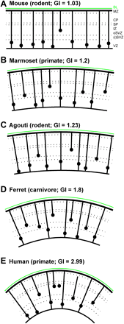
Figure 2. Distribution of aRG and bRG in developing cortex of 5 species. Mouse cortex (A) contains a low number of bRG ...
Notes:
Figure 2. Distribution of aRG and bRG in developing cortex of 5 species. Mouse cortex (A) contains a low number of bRG and has a lissencephalic cortex with very low gyrification index (GI) of 1.03. Marmoset cortex (B) has abundant bRG in iSVZ and oSVZ, despite a low GI of 1.2. Agouti (C) contains relatively abundant bRG in oSVZ and iSVZ. Ferret (D) and human (E) cortex contain abundant bRG, most of which are located in the oSVZ. Zones and progenitor types indicated as in Figure 1.
Unless provided in the caption above, the following copyright applies to the content of this slide: © The Author 2011. Published by Oxford University Press. All rights reserved. For permissions, please e-mail: journals.permissions@oup.com

