Slide 1
Table 1 Stimulus material Note: Table shows a description of conceptual-expectation and movement-prediction for the ...
Notes:
Table 1 Stimulus material Note: Table shows a description of conceptual-expectation and movement-prediction for the behavioral prime words and the action pictures that were used in the experiment. Figure 1.Stimuli and design. In both tasks, participants observed word-cues, which were followed by a picture of an object-related action. In the Movement task, they had to judge whether the perceived movement goal (e.g., an object that is moved to the nose) matched the cue (e.g., “to smell”). In the Conceptual task, participants observed the same stimuli, while they judged whether the expected conceptual goal (to purposefully use an object, for example, use a rose for smelling) matched the cue. See also Table 1 for the complete list of used stimulus material.
Unless provided in the caption above, the following copyright applies to the content of this slide: © The Author 2014. Published by Oxford University Press. All rights reserved. For Permissions, please e-mail: journals.permissions@oup.com

Slide 2
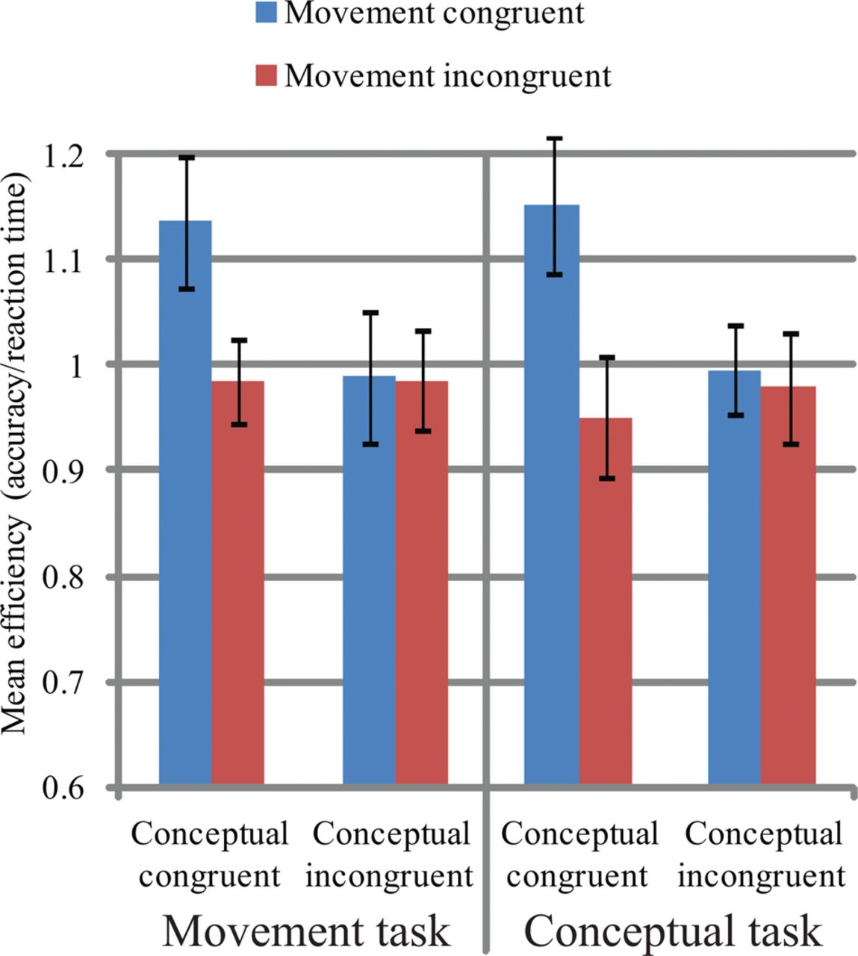
Figure 2. Behavioral performance. Participants' mean efficiency scores in the Movement task and Conceptual task as a ...
Notes:
Figure 2. Behavioral performance. Participants' mean efficiency scores in the Movement task and Conceptual task as a function of Conceptual-expectation and Movement-prediction. Error bars represent mean ± standard errors of the mean (SEM).
Unless provided in the caption above, the following copyright applies to the content of this slide: © The Author 2014. Published by Oxford University Press. All rights reserved. For Permissions, please e-mail: journals.permissions@oup.com

Slide 3
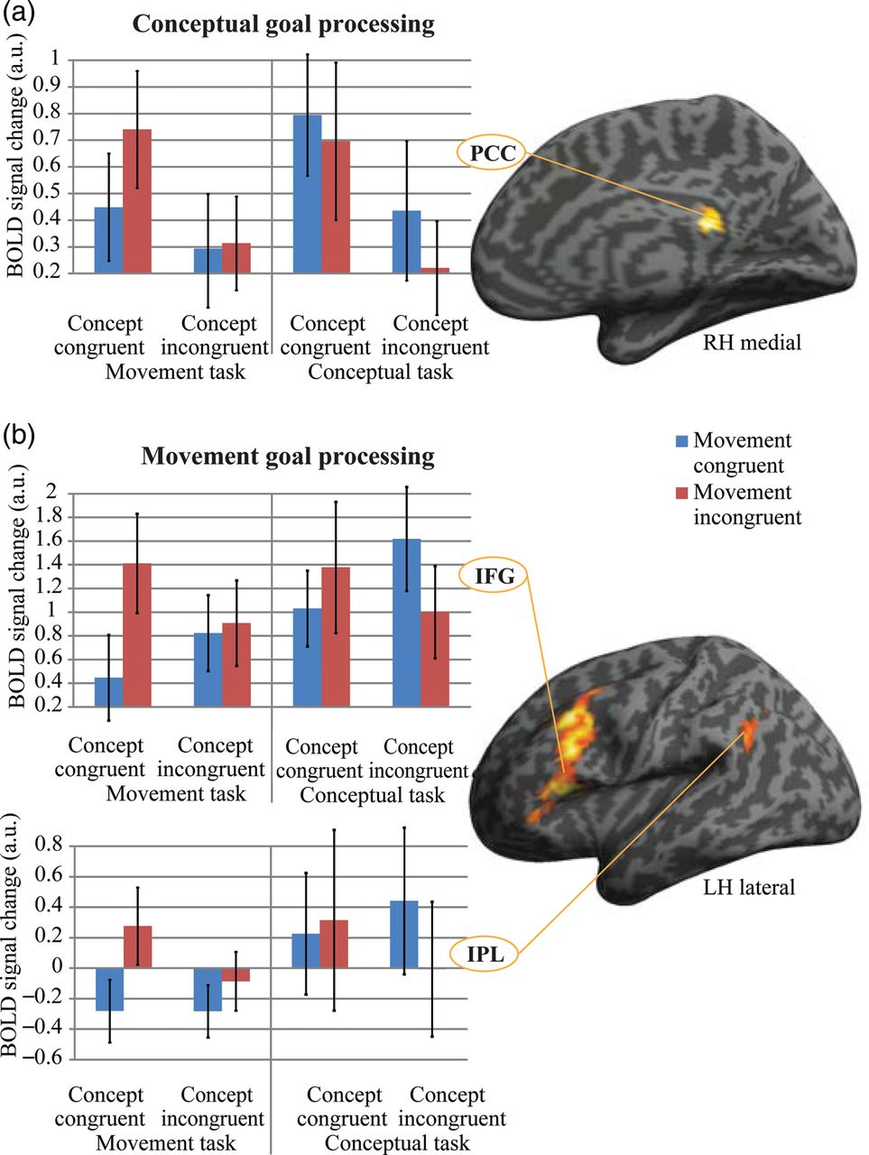
Table 2 Localization of neural activations Note: Spatial coordinates (x, y, z) of the cluster-peaks showing ...
Notes:
Table 2 Localization of neural activations Note: Spatial coordinates (x, y, z) of the cluster-peaks showing significant activations for conceptual and movement processing of observed goal-directed behavior. All significant clusters at P < 0.05 FWE-correction threshold are shown. Figure 3.Neural processing of conceptual goals and movement goals. (a) Conceptual goals that were expected given the cue-evoked greater activity than the unexpected ones bilaterally in the posterior cingulate cortex (PCC). Conceptual processing in the PCC was independent of the task and of movement-prediction (signal change plot). (b) Left lateralized parieto-frontal network, including IFG and IPL, was sensitive to the processing of unpredicted movement goals in the movement task only and solely when the conceptual goal was expected (signal change plots). Bars represent mean ± SEM. For exact localization of neural activations, see Table 2.
Unless provided in the caption above, the following copyright applies to the content of this slide: © The Author 2014. Published by Oxford University Press. All rights reserved. For Permissions, please e-mail: journals.permissions@oup.com

