Slide 1
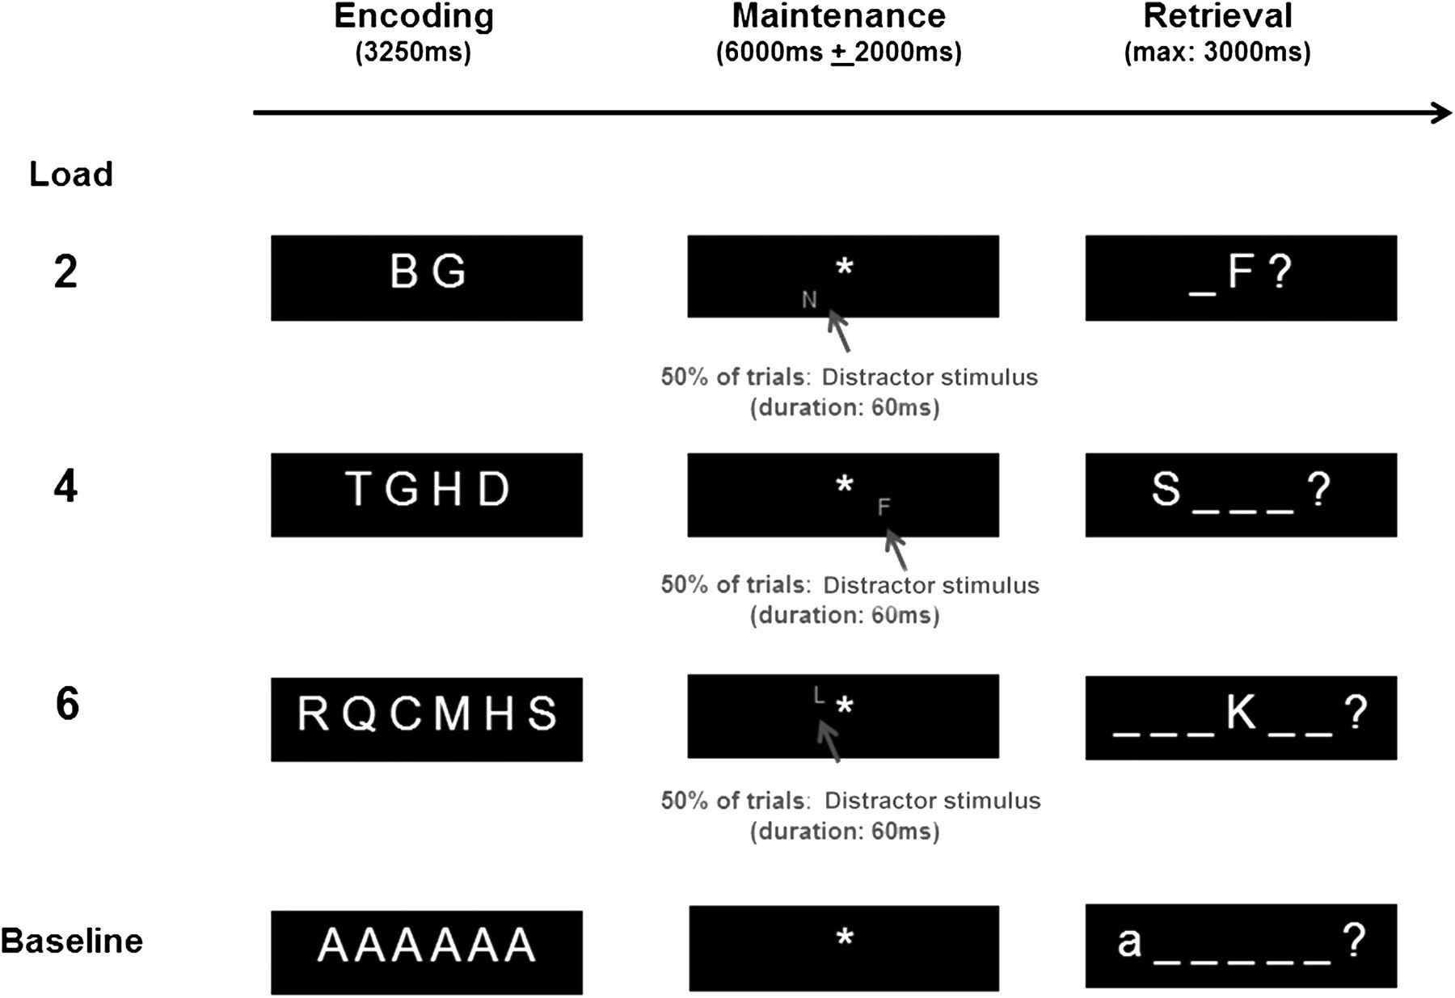
Figure 1. Schematic drawing of the task design and timing. For each condition, a negative probe trial is illustrated.
Notes:
Figure 1. Schematic drawing of the task design and timing. For each condition, a negative probe trial is illustrated.
Unless provided in the caption above, the following copyright applies to the content of this slide: © The Author 2011. Published by Oxford University Press. All rights reserved. For permissions, please e-mail: journals.permissions@oup.com

Slide 2
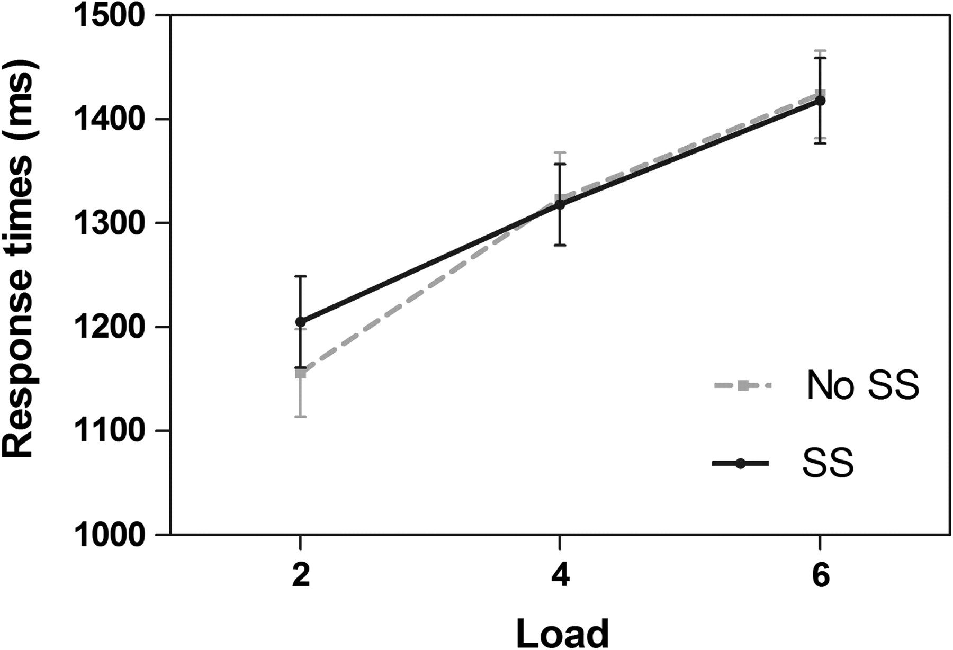
Figure 2. Response times for the experimental task as a function of STM load and DS.
Notes:
Figure 2. Response times for the experimental task as a function of STM load and DS.
Unless provided in the caption above, the following copyright applies to the content of this slide: © The Author 2011. Published by Oxford University Press. All rights reserved. For permissions, please e-mail: journals.permissions@oup.com

Slide 3
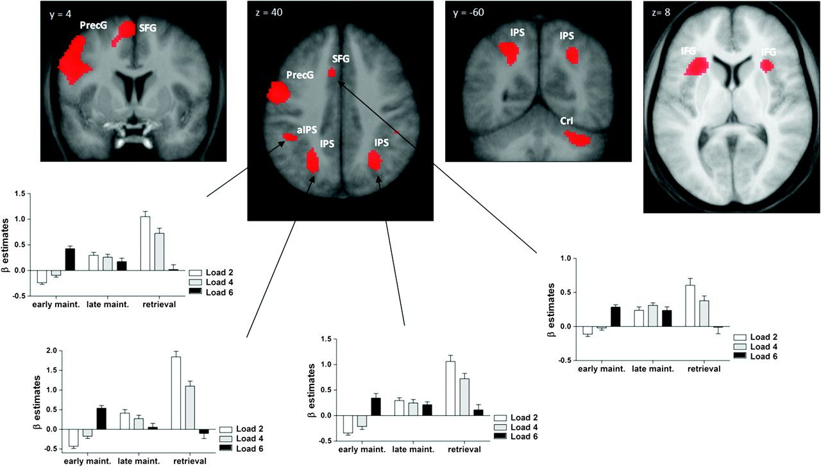
Figure 3. Regions showing a positive response to STM load (shown at a threshold of T > 3.50, P < 0.001, uncorrected, ...
Notes:
Figure 3. Regions showing a positive response to STM load (shown at a threshold of T > 3.50, P < 0.001, uncorrected, for display purpose; see Table 1 for corrected P values). Beta coefficient estimates as a function of STM phase and STM load are shown for target regions of the dorsal attention networks (see Table 1 for coordinates). PrecG, precentral gyrus; IFG, inferior frontal gyrus; CrI, cerebellum area CrI.
Unless provided in the caption above, the following copyright applies to the content of this slide: © The Author 2011. Published by Oxford University Press. All rights reserved. For permissions, please e-mail: journals.permissions@oup.com

Slide 4
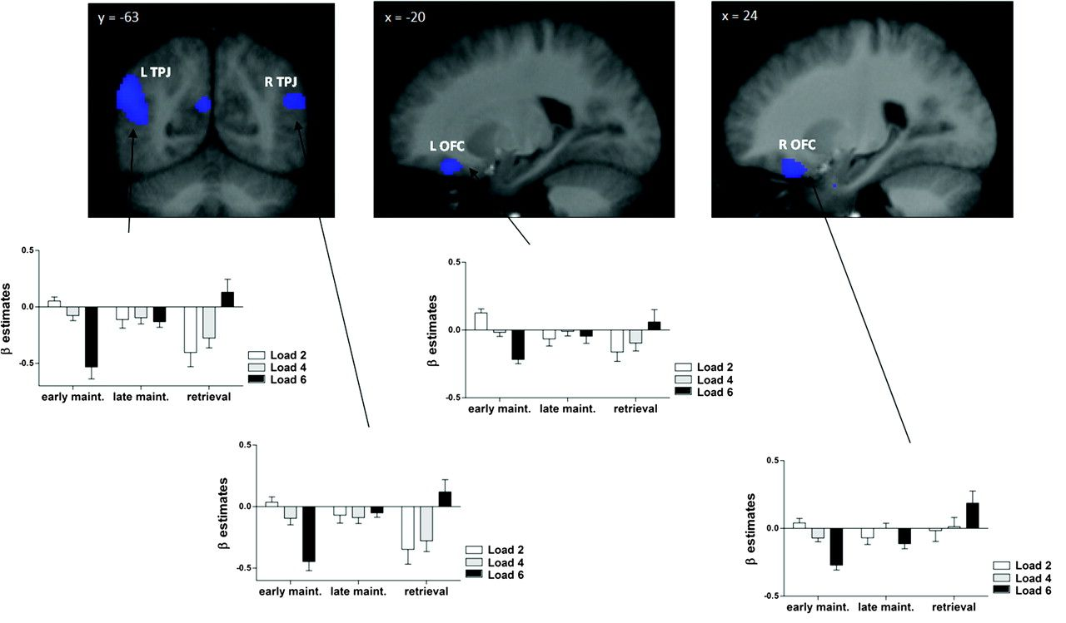
Figure 4. Regions showing a negative response to STM load (shown at a threshold of T > 3.50, P < 0.001, uncorrected, ...
Notes:
Figure 4. Regions showing a negative response to STM load (shown at a threshold of T > 3.50, P < 0.001, uncorrected, for display purpose; see Table 1 for corrected P values). Beta coefficient estimates as a function of STM phase and STM load are shown for target regions of the dorsal and ventral attention networks (see Table 1 for coordinates).
Unless provided in the caption above, the following copyright applies to the content of this slide: © The Author 2011. Published by Oxford University Press. All rights reserved. For permissions, please e-mail: journals.permissions@oup.com

Slide 5
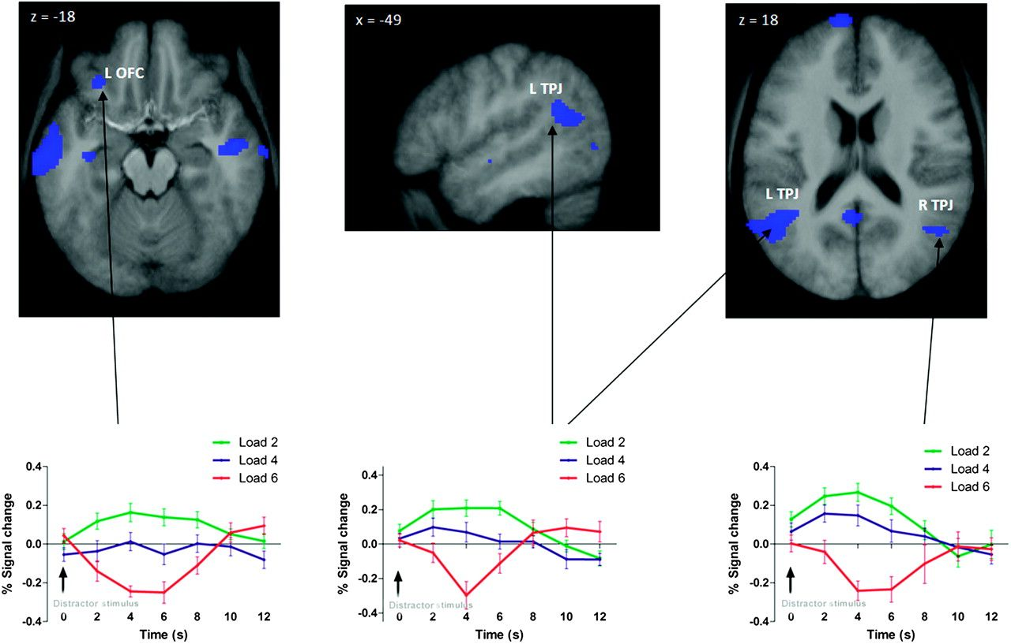
Figure 5. Regions showing a response to the DS as a function of STM load condition (shown at a threshold of T > 3.20, P ...
Notes:
Figure 5. Regions showing a response to the DS as a function of STM load condition (shown at a threshold of T > 3.20, P < 0.001, uncorrected, for display purpose; see Table 2 for corrected P values). Time course of activation is shown for target regions of the ventral attention networks (see Table 2 for coordinates).
Unless provided in the caption above, the following copyright applies to the content of this slide: © The Author 2011. Published by Oxford University Press. All rights reserved. For permissions, please e-mail: journals.permissions@oup.com

